Slide 1
Database Management System
Database management system is a software which is used to manage the database. For example: MySQL, Oracle, etc are a very popular commercial database which is used in different applications. DBMS provides an interface to perform various operations like database creation, storing data in it, updating data, creating a table in the database and a lot more. It provides protection and security to the database. In the case of multiple users, it also maintains data consistency.

Slide 2
What is Database The database is a collection of inter-related data which is used to retrieve, insert and delete the data efficiently. It is also used to organize the data in the form of a table, schema, views, and reports, etc. For example: The college Database organizes the data about the admin, staff, students and faculty etc. Using the database, you can easily retrieve, insert, and delete the information. Characteristics of DBMS It uses a digital repository established on a server to store and manage the information. It can provide a clear and logical view of the process that manipulates data. DBMS contains automatic backup and recovery procedures. It contains ACID properties which maintain data in a healthy state in case of failure. It can reduce the complex relationship between data. It is used to support manipulation and processing of data. It is used to provide security of data. It can view the database from different viewpoints according to the requirements of the user.

Slide 3
DBMS allows users the following tasks:
Data Definition: It is used for creation, modification, and removal of definition that defines the organization of data in the database. Data Updation: It is used for the insertion, modification, and deletion of the actual data in the database. Data Retrieval: It is used to retrieve the data from the database which can be used by applications for various purposes. User Administration: It is used for registering and monitoring users, maintain data integrity, enforcing data security, dealing with concurrency control, monitoring performance and recovering information corrupted by unexpected failure.

Slide 4
Advantages of DBMS
Controls database redundancy: It can control data redundancy because it stores all the data in one single database file and that recorded data is placed in the database. Data sharing: In DBMS, the authorized users of an organization can share the data among multiple users. Easily Maintenance: It can be easily maintainable due to the centralized nature of the database system. Reduce time: It reduces development time and maintenance need. Backup: It provides backup and recovery subsystems which create automatic backup of data from hardware and software failures and restores the data if required. multiple user interface: It provides different types of user interfaces like graphical user interfaces, application program interfaces

Slide 5
Disadvantages of DBMS
Cost of Hardware and Software: It requires a high speed of data processor and large memory size to run DBMS software. Size: It occupies a large space of disks and large memory to run them efficiently. Complexity: Database system creates additional complexity and requirements. Higher impact of failure: Failure is highly impacted the database because in most of the organization, all the data stored in a single database and if the database is damaged due to electric failure or database corruption then the data may be lost forever.

Slide 6
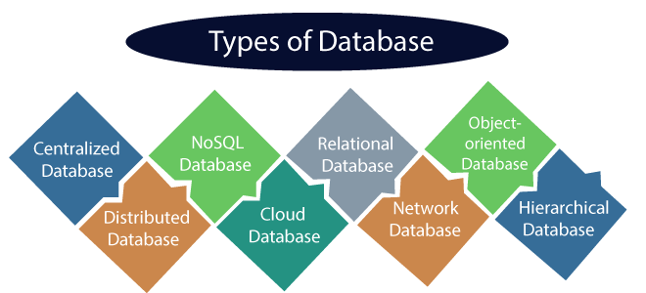
Types of Databases

Slide 7
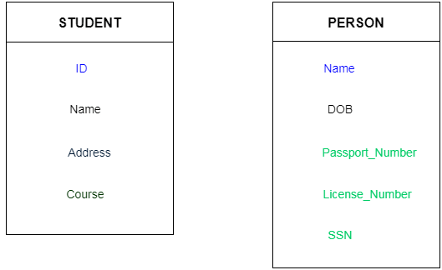
Keys
Keys play an important role in the relational database.
It is used to uniquely identify any record or row of data from the table. It is also used to establish and identify relationships between tables.

Slide 8
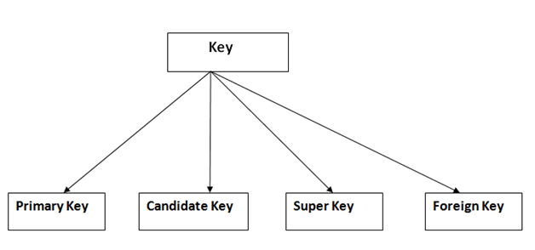
Types of key:

Slide 9
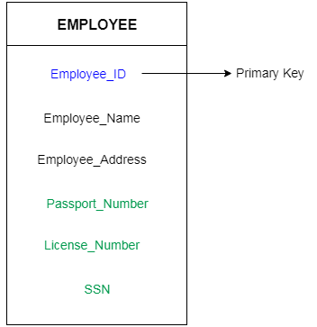
. Primary key
It is the first key which is used to identify one and only one instance of an entity uniquely. An entity can contain multiple keys as we saw in PERSON table. The key which is most suitable from those lists become a primary key.
In the EMPLOYEE table, ID can be primary key since it is unique for each employee. In the EMPLOYEE table, we can even select License_Number and Passport_Number as primary key since they are also unique.
For each entity, selection of the primary key is based on requirement and developers.

Slide 10
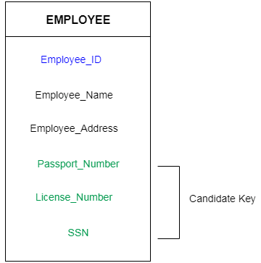
2. Candidate key
A candidate key is an attribute or set of an attribute which can uniquely identify a tuple.
The remaining attributes except for primary key are considered as a candidate key. The candidate keys are as strong as the primary key.
For example: In the EMPLOYEE table, id is best suited for the primary key. Rest of the attributes like SSN, Passport_Number, and License_Number, etc. are considered as a candidate key.

Slide 11
3. Super Key
Super key is a set of an attribute which can uniquely identify a tuple. Super key is a superset of a candidate key.
For example: In the above EMPLOYEE table, for(EMPLOEE_ID, EMPLOYEE_NAME) the name of two employees can be the same, but their EMPLYEE_ID can't be the same. Hence, this combination can also be a key.
The super key would be EMPLOYEE-ID, (EMPLOYEE_ID, EMPLOYEE-NAME), etc.

Slide 12
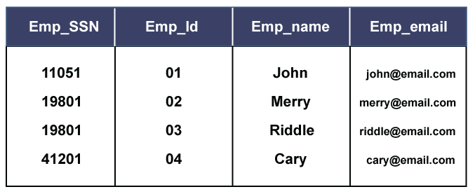
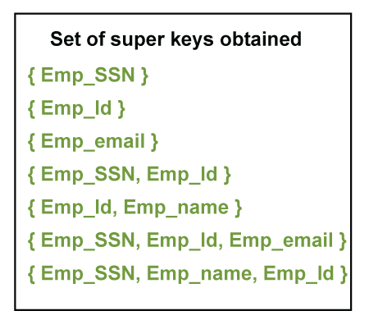

Slide 13
4. Foreign key
Foreign keys are the column of the table which is used to point to the primary key of another table.
In a company, every employee works in a specific department, and employee and department are two different entities. So we can't store the information of the department in the employee table. That's why we link these two tables through the primary key of one table.
We add the primary key of the DEPARTMENT table, Department_Id as a new attribute in the EMPLOYEE table.
Now in the EMPLOYEE table, Department_Id is the foreign key, and both the tables are related.

Slide 14
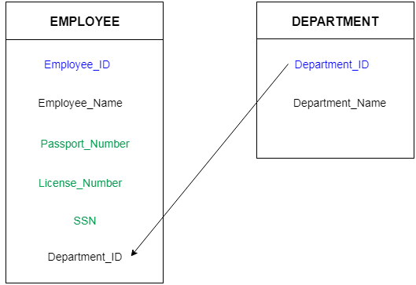

Slide 15
SQL Commands
SQL commands are instructions. It is used to communicate with the database. It is also used to perform specific tasks, functions, and queries of data.
SQL can perform various tasks like create a table, add data to tables, drop the table, modify the table, set permission for users.

Slide 16
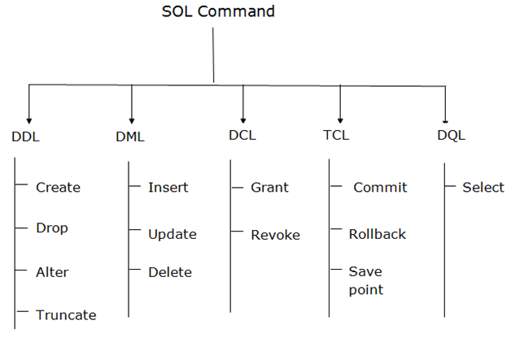
Types of SQL Commands There are five types of SQL commands: DDL, DML, DCL, TCL, and DQL.

Slide 17
1. Data Definition Language (DDL)
DDL changes the structure of the table like creating a table, deleting a table, altering a table, etc.
All the command of DDL are auto-committed that means it permanently save all the changes in the database.
Here are some commands that come under DDL:
CREATE…… CREATE TABLE TAB_NAME(COL_NAME DATATYPE())
ALTER ……ADD…ALTER TAB TAB_NAME ADD(ADDRESS VARCHAR(50));
ALTER TAB TAB_NAME AMODIFY (ADNAME VARCHAR(20));
DROP……….... DROP TABLE TAB_NAME
TRUNCATE…..TRUNCATE TABLE TAB_NAME

Slide 18
2. Data Manipulation Language
DML commands are used to modify the database. It is responsible for all form of changes in the database.
The command of DML is not auto-committed that means it can't permanently save all the changes in the database. They can be rollback.
Here are some commands that come under DML:
INSERT……INSERT INTO UNV (TEACHER,SUB) VALUES(“COMP”,”IT”):
UPDATE…. UPDATE EMPLOYEE SET Emp_name = 'Rock' WHERE Emp_Id = 01;
DELETE….. DELETE from Employee where Emp_name=‘’Riddle’’;

Slide 19
3. Data Control Language
DCL commands are used to grant and take back authority from any database user.
Here are some commands that come under DCL:
Grant…. GRANT SELECT, UPDATE ON TAB_NAME TO ONE_U,ANOTHER_U
Revoke….. Revoke SELECT, UPDATE ON TAB_NAME FROM ONE_U,ANOTHER_U

Slide 20
4. Transaction Control Language
TCL commands can only use with DML commands like INSERT, DELETE and UPDATE only.
These operations are automatically committed in the database that's why they cannot be used while creating tables or dropping them.
Here are some commands that come under TCL:
COMMIT…. DELETE from Employee WHERE Emp_id=3; COMMIT;
ROLLBACK…DELETE from Employee WHERE Emp_id=3; ROLLBACK;
SAVEPOINT…SAVEPOINT SAVEPOINT_NAME

Slide 21
5. Data Query Language
DQL is used to fetch the data from the database.
It uses only one command:
SELECT….. Select Emp_name from Employee WHERE Emp_id>1;

