Slide 1
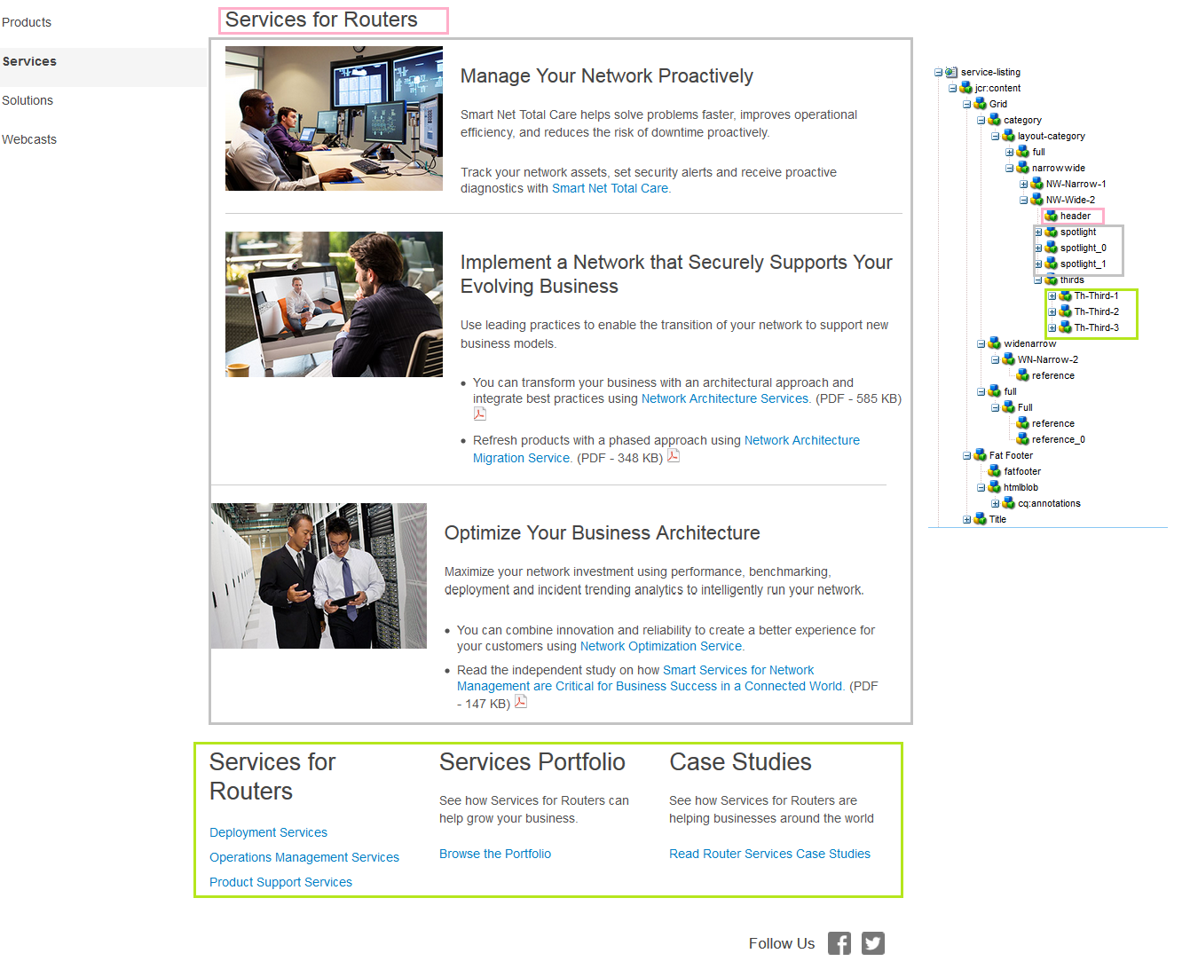
http://www.cisco.com/c/en/us/products/routers/service-listing.html
http://www.cisco.com/c/en/us/products/switches/service-listing.html
http://www.cisco.com/c/en/us/products/wireless/service-listing.html

