Slide 1
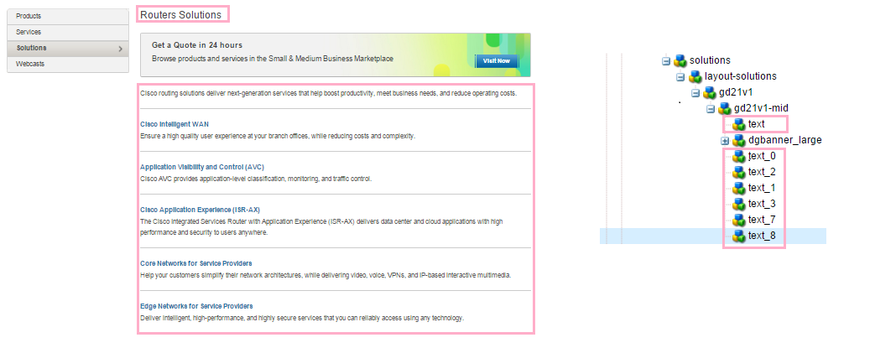
http://www.cisco.com/c/en/us/products/routers/solution-listing.html
http://www.cisco.com/c/en/us/products/switches/solution-listing.html
No HTML deviations in this template

Slide 2
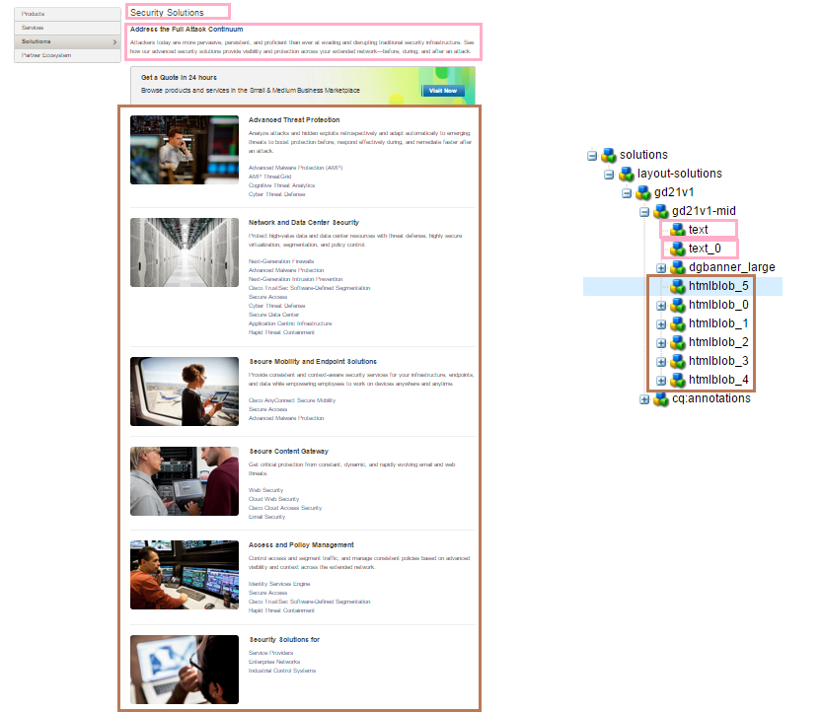
http://www.cisco.com/c/en/us/products/security/solution-listing.html

Slide 3
Deviations for Above Slide
The htmlblob is not available on the below locale page.
An additional component with class “clb c39 c39-tall” is available in the below locale page.
http://www.cisco.com/web/DE/products/unified_computing/solutions.html

Slide 4
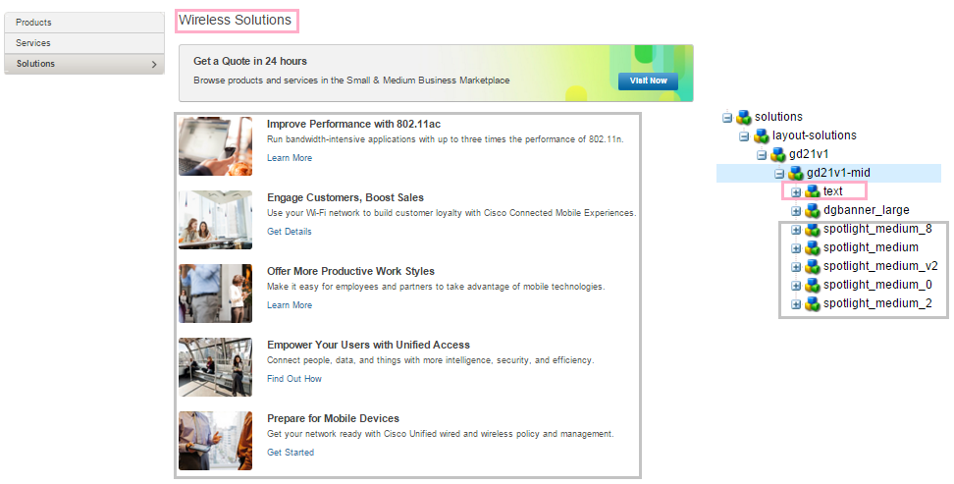
http://www.cisco.com/c/en/us/products/wireless/solution-listing.html

Slide 5
Deviations in above slide
Extra h2 in text component

Slide 6
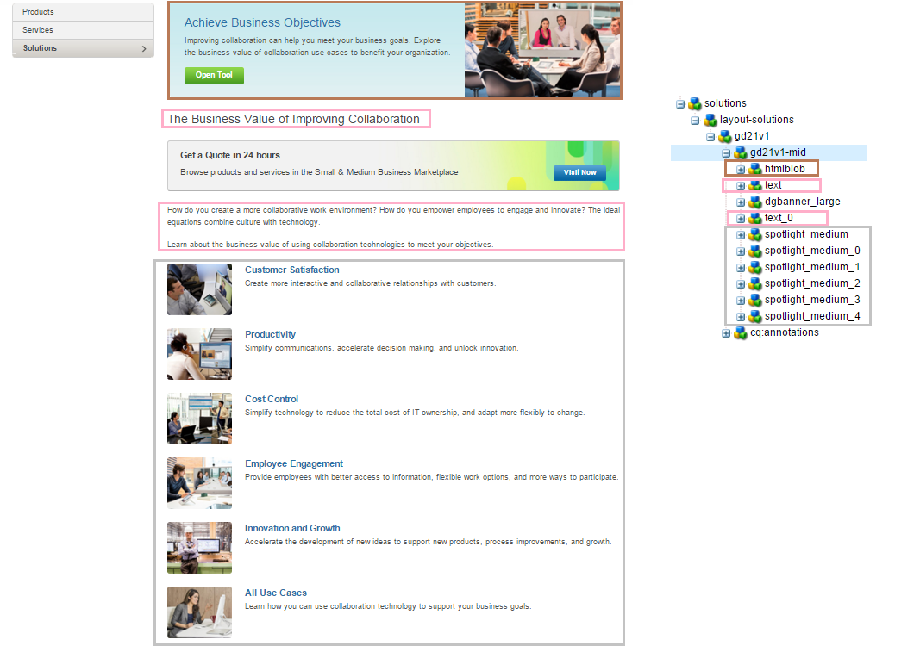
http://www.cisco.com/c/en/us/solutions/collaboration/solution-listing.html

Slide 7
Html deviation for template for slide 6
The spotlights are in tabular format in German locale page

Slide 8
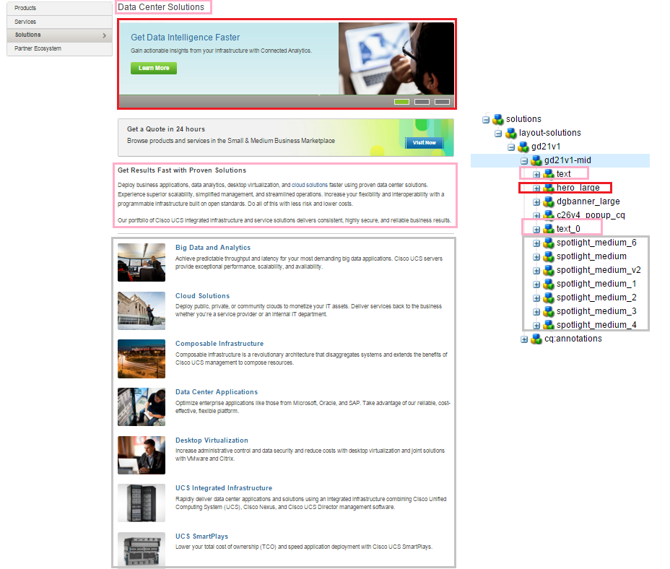
http://www.cisco.com/c/en/us/solutions/data-center-virtualization/solution-listing.html
No HTML deviations in this template

Slide 9

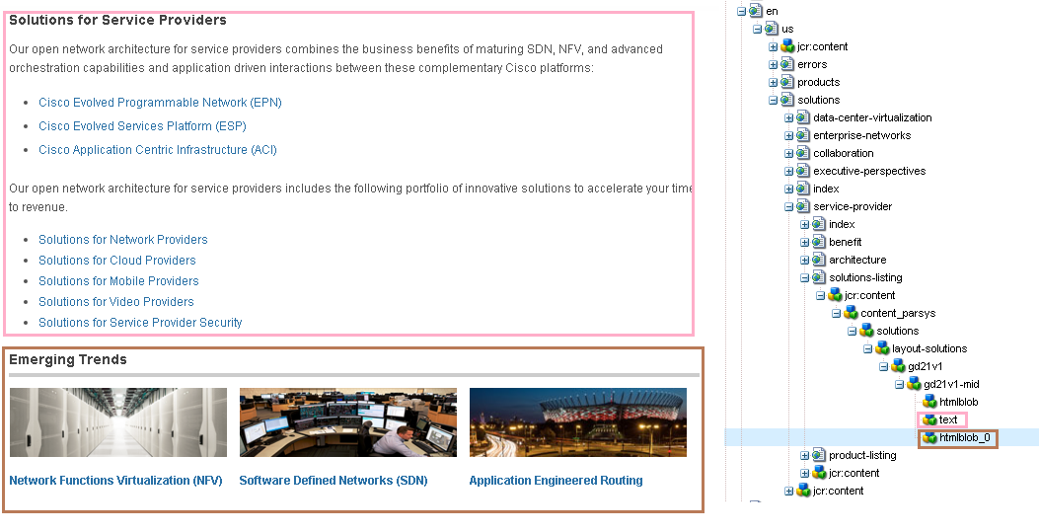
http://www.cisco.com/c/en/us/solutions/service-provider/solutions-listing.html

Slide 10
HTML Deviations for Template in Slide 9
There is no htmlblob component in below page.
http://www.cisco.com/web/DE/solutions/sp/solutions-listing.html

Slide 11
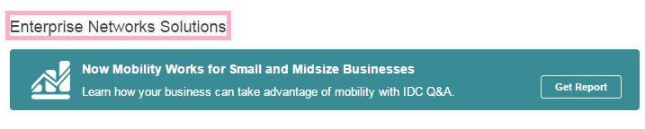
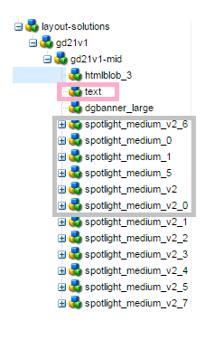
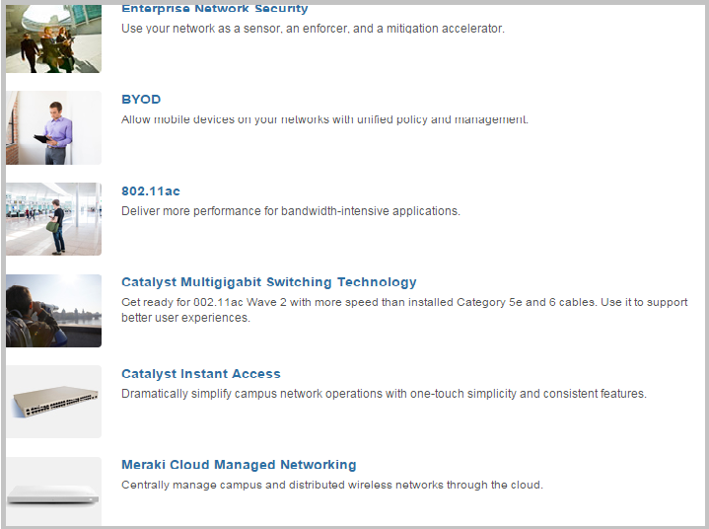
http://www.cisco.com/c/en/us/solutions/enterprise-networks/solution-listing.html

Slide 12
Html deviation for template in slide 11
There are 3 additional text components on below local page.
http://www.cisco.com/web/DE/solutions/borderless/solutions.html

Slide 13
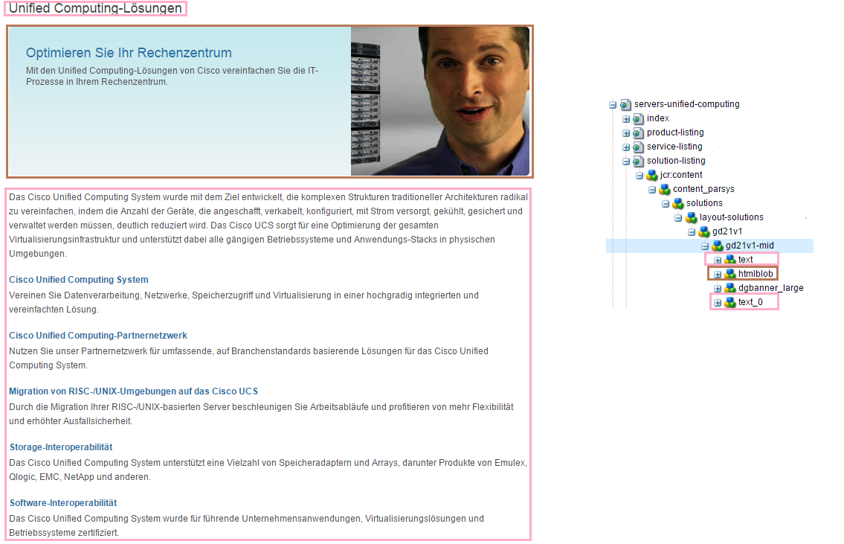
http://www.cisco.com/c/en/us/products/servers-unified-computing/solution-listing.html

