Slide 1
Index Responsive Pages

Slide 2
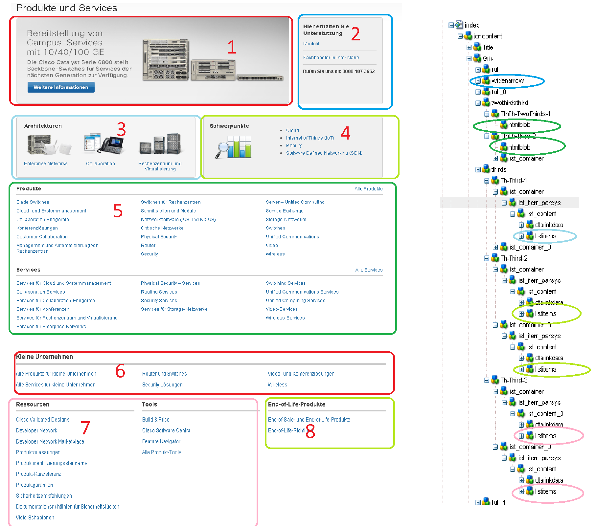
http://www.cisco.com/web/DE/products/index.html

Slide 3
End nodes to map content
2 :- widenarrow/WN-Narrow-2/htmlblob_0.
3,4,7,8 :- listitems/item_*/linkdata.

Slide 4
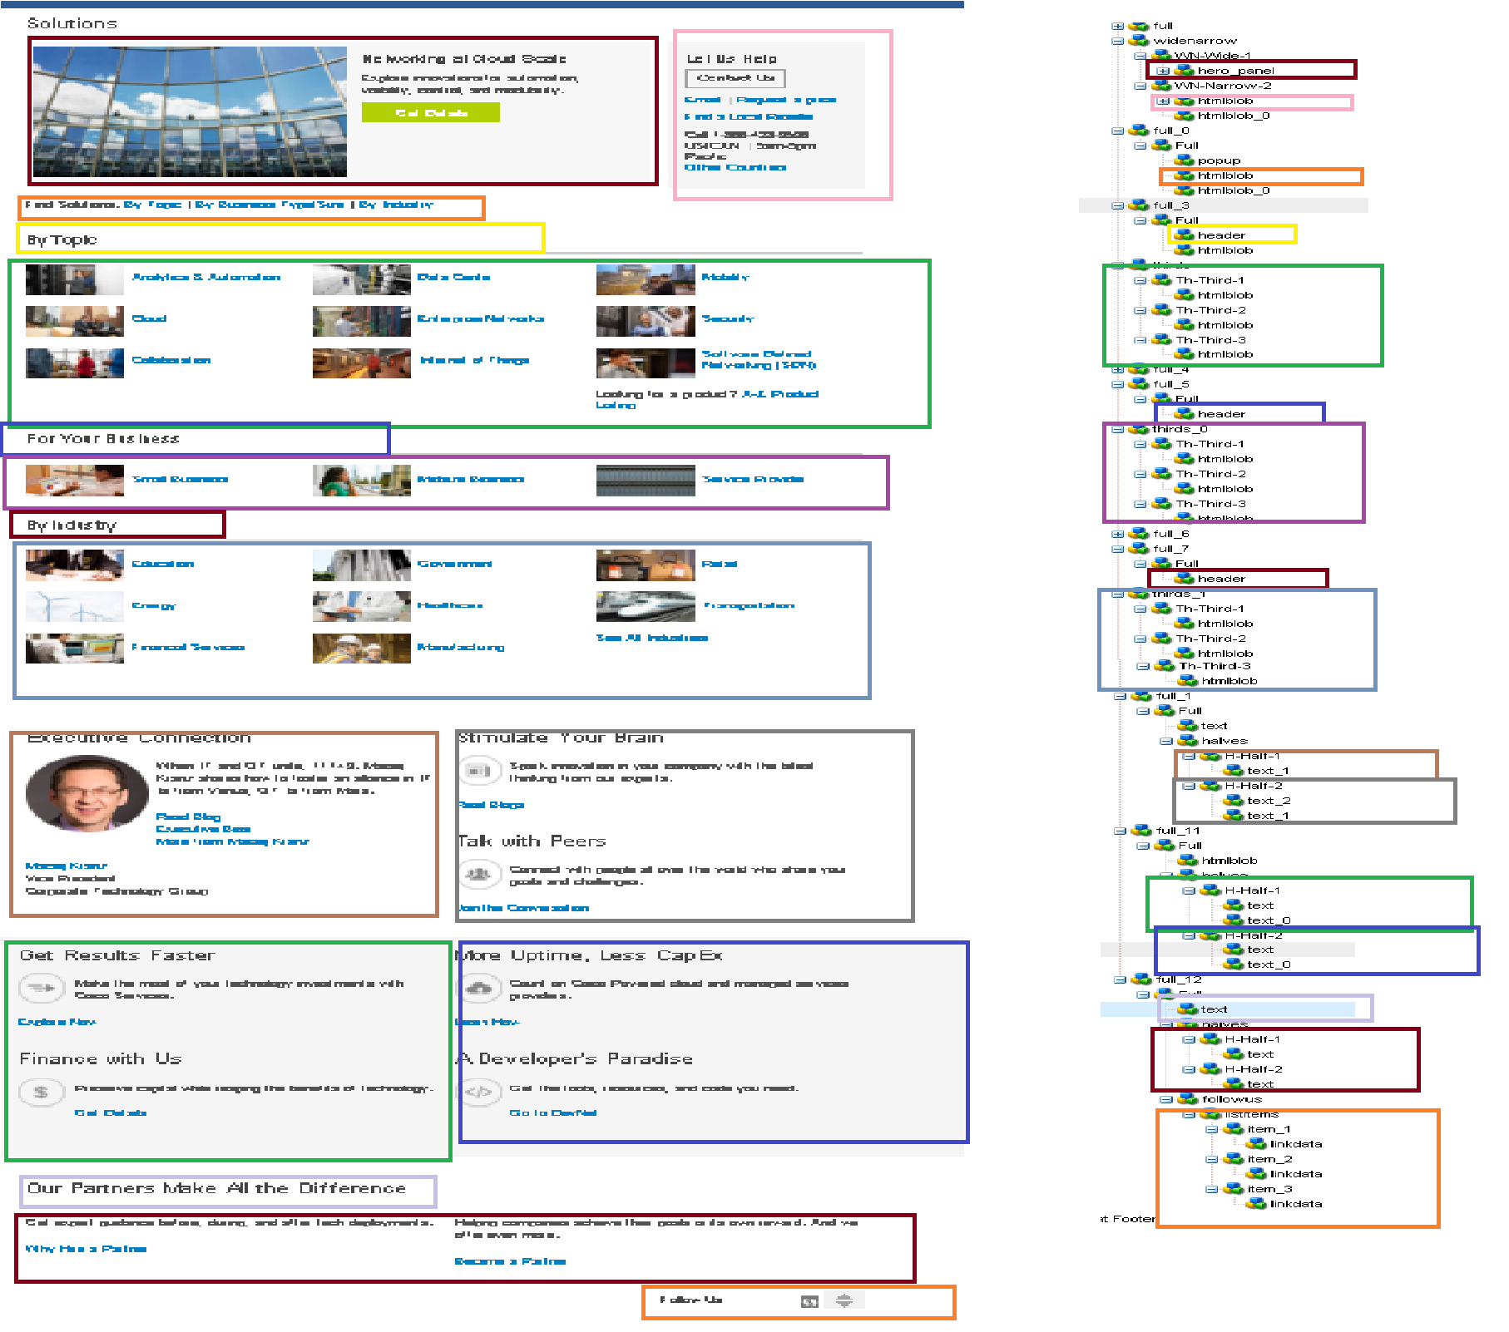
http://www.cisco.com/c/en/us/solutions/index.html

