Slide 1
Product Listing

Slide 2
Responsive Pages
http://www.cisco.com/c/en/us/products/cloud-systems-management/product-listing.html
http://www.cisco.com/c/en/us/products/physical-security/product-listing.html

Slide 3
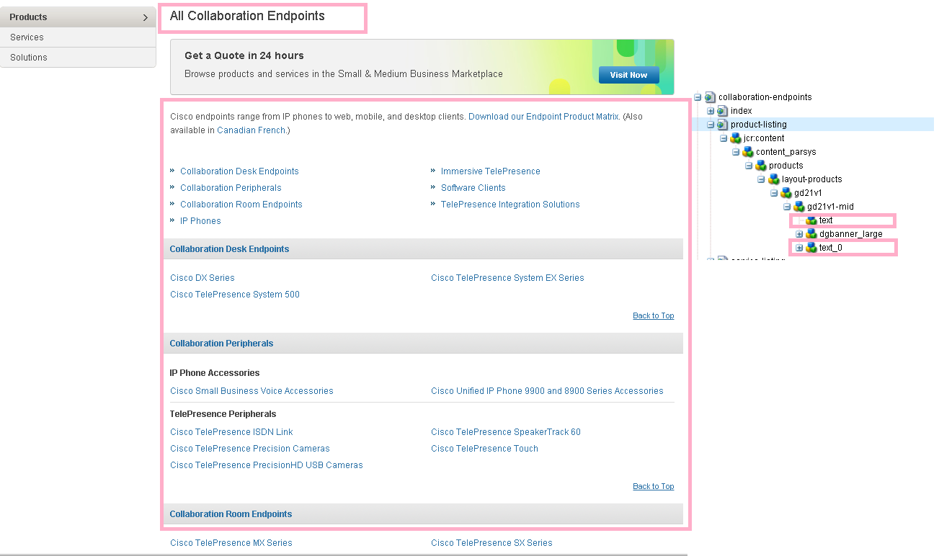
http://www.cisco.com/c/en/us/products/collaboration-endpoints/product-listing.html
http://www.cisco.com/c/en/us/products/conferencing/product-listing.html
http://www.cisco.com/c/en/us/products/customer-collaboration/product-listing.html
http://www.cisco.com/c/en/us/products/unified-communications/product-listing.html
http://www.cisco.com/c/en/us/solutions/service-provider/product-listing.html

Slide 4
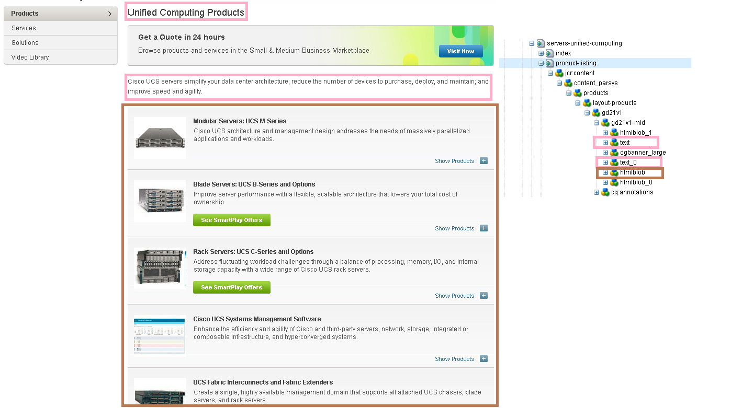
http://www.cisco.com/c/en/us/products/servers-unified-computing/product-listing.html

Slide 5
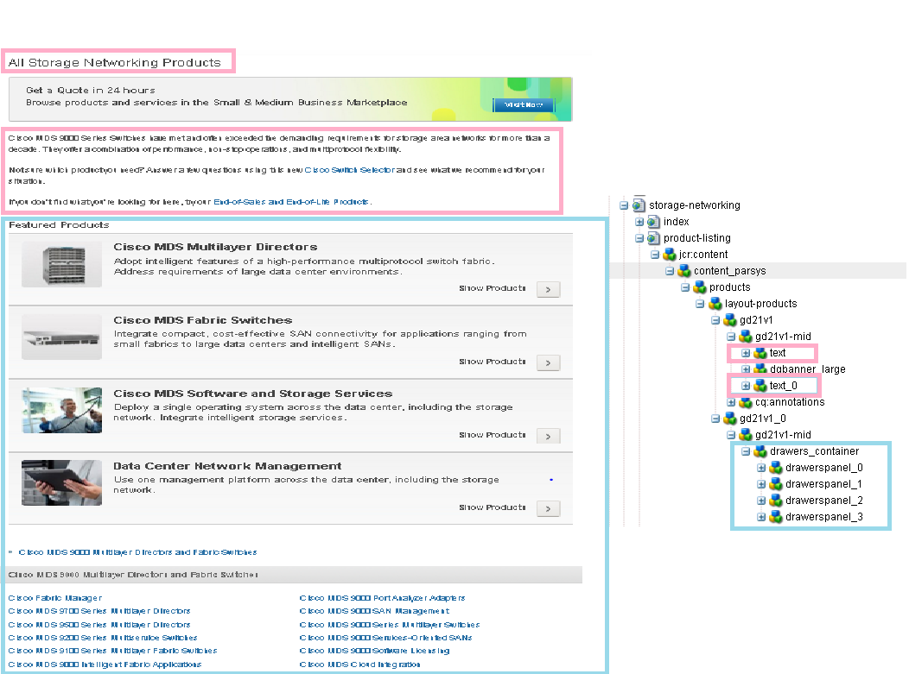
http://www.cisco.com/c/en/us/products/storage-networking/product-listing.html
http://www.cisco.com/c/en/us/solutions/collaboration/product-listing.html
http://www.cisco.com/c/en/us/solutions/data-center-virtualization/product-listing.html
http://www.cisco.com/c/en/us/solutions/enterprise-networks/product-listing.html

Slide 6
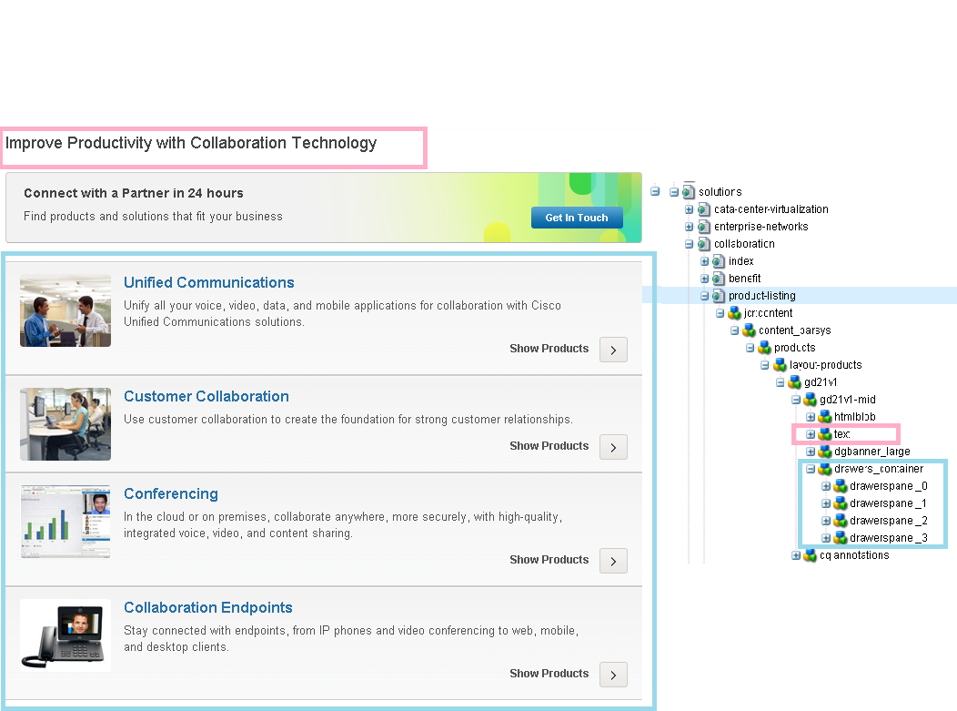
http://www.cisco.com/c/en/us/solutions/collaboration/product-listing.html
http://www.cisco.com/c/en/us/solutions/data-center-virtualization/product-listing.html
http://www.cisco.com/c/en/us/solutions/enterprise-networks/product-listing.html

Slide 7
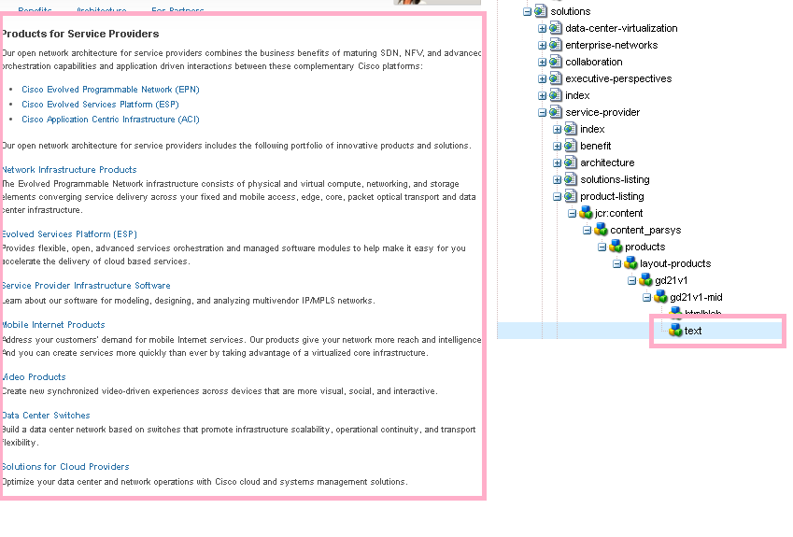
http://www.cisco.com/c/en/us/solutions/service-provider/product-listing.html

