Slide 1
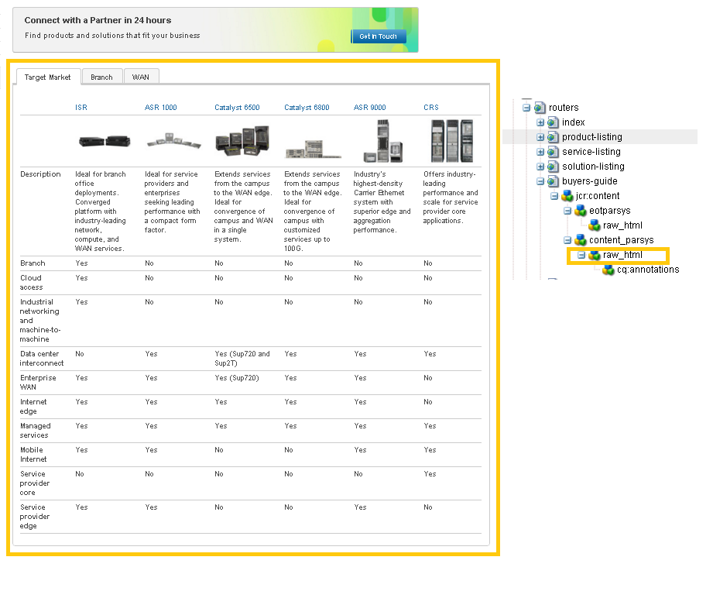
http://www.cisco.com/c/en/us/products/routers/buyers-guide.html

Slide 2
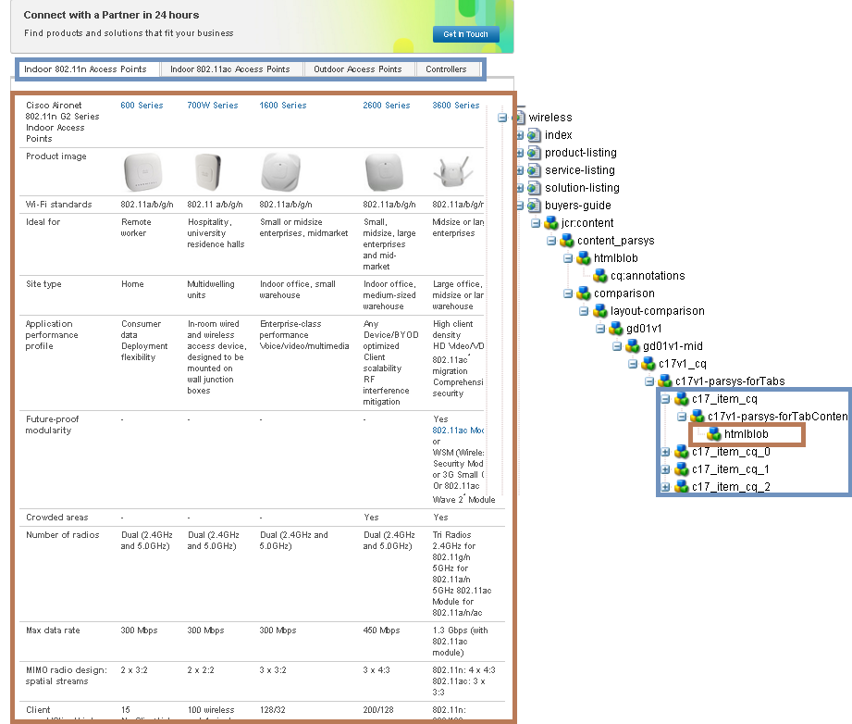
http://www.cisco.com/c/en/us/products/wireless/buyers-guide.html

Slide 3

http://www.cisco.com/c/en/us/solutions/executive-perspectives/index.html

