Slide 1
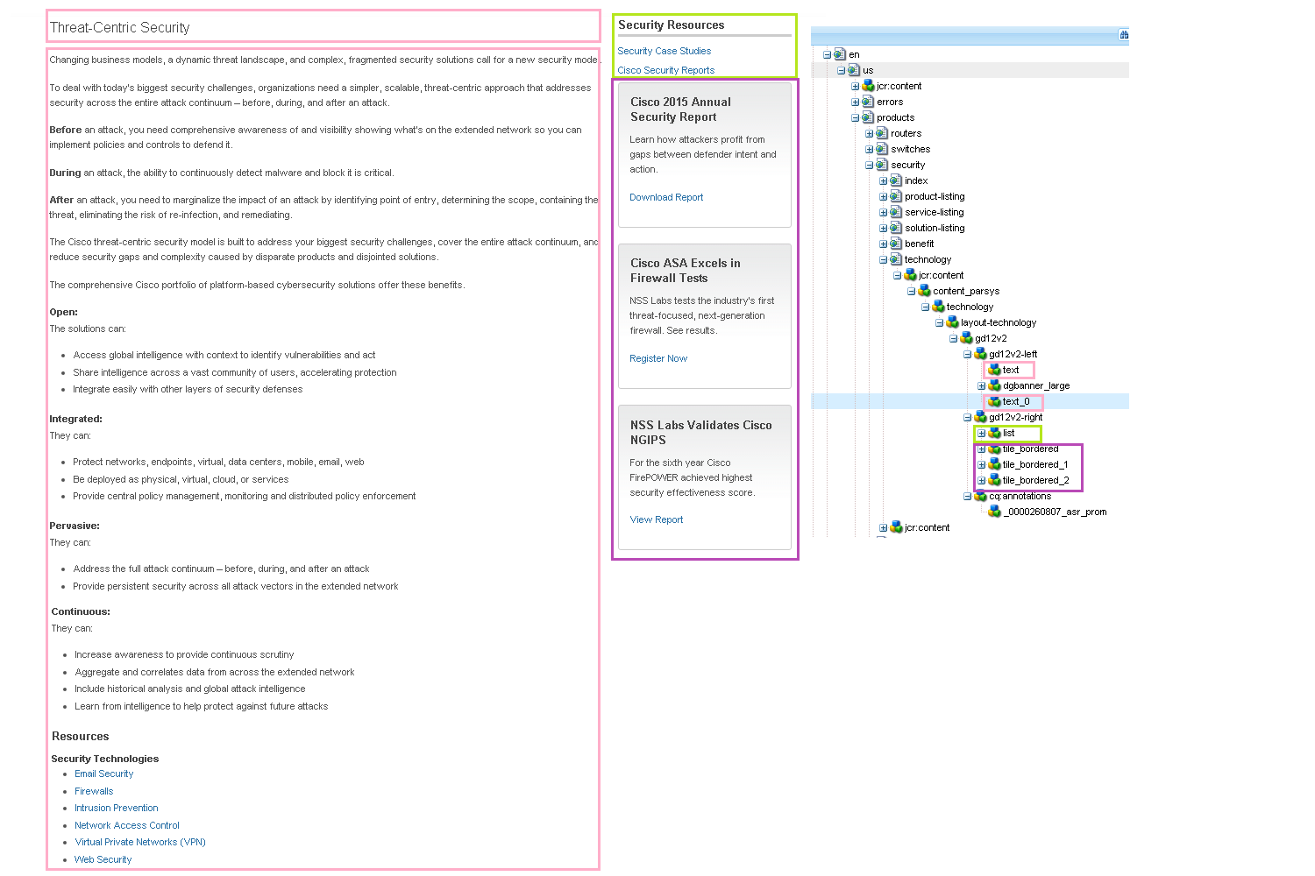
http://www.cisco.com/c/en/us/products/security/technology.html
No HTML deviations in this template

Slide 2
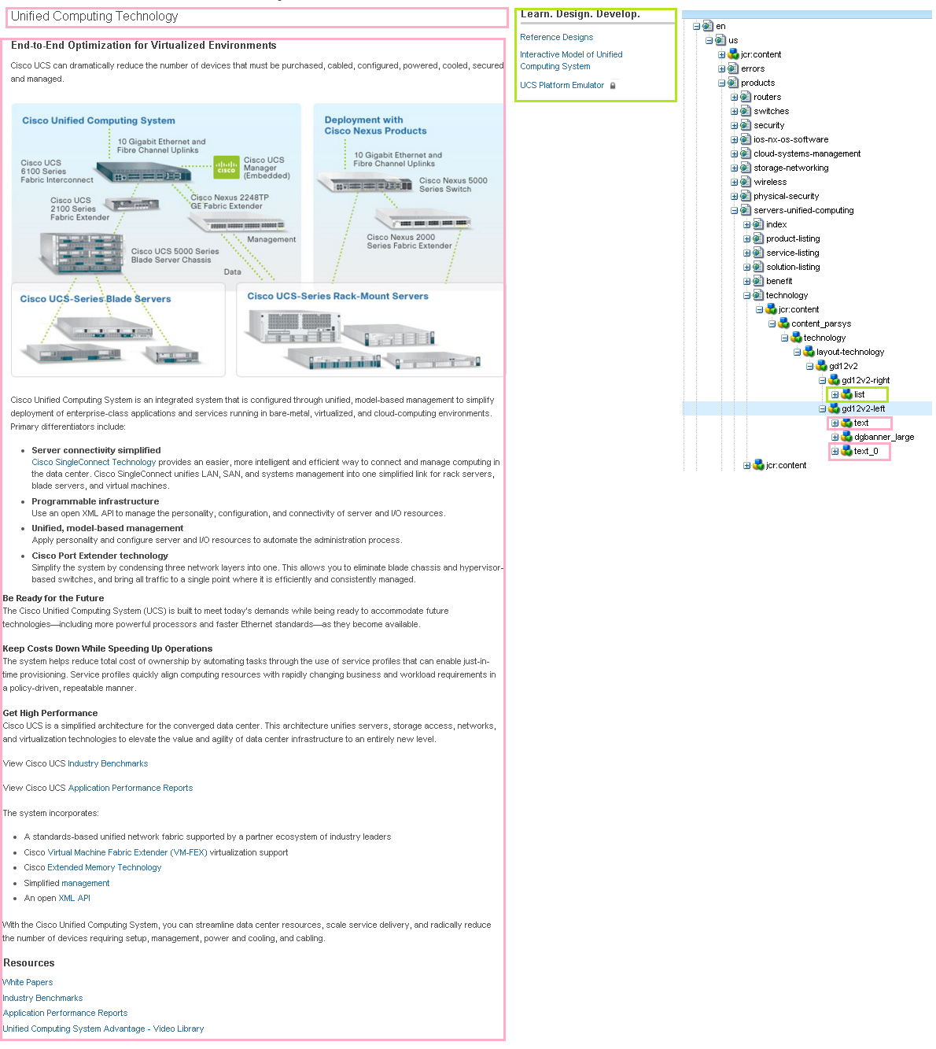
http://www.cisco.com/c/en/us/products/servers-unified-computing/technology.html

Slide 3
HTML Deviations for Template in Slide 2
There is no list component in below page.
http://www.cisco.com/web/DE/products/unified_computing/technology.html
There is a tail bordered component in right rail of below locale page, where english page doesn't have a tail bordered component.
http://www.cisco.com/web/DE/products/unified_computing/technology.html

Slide 4
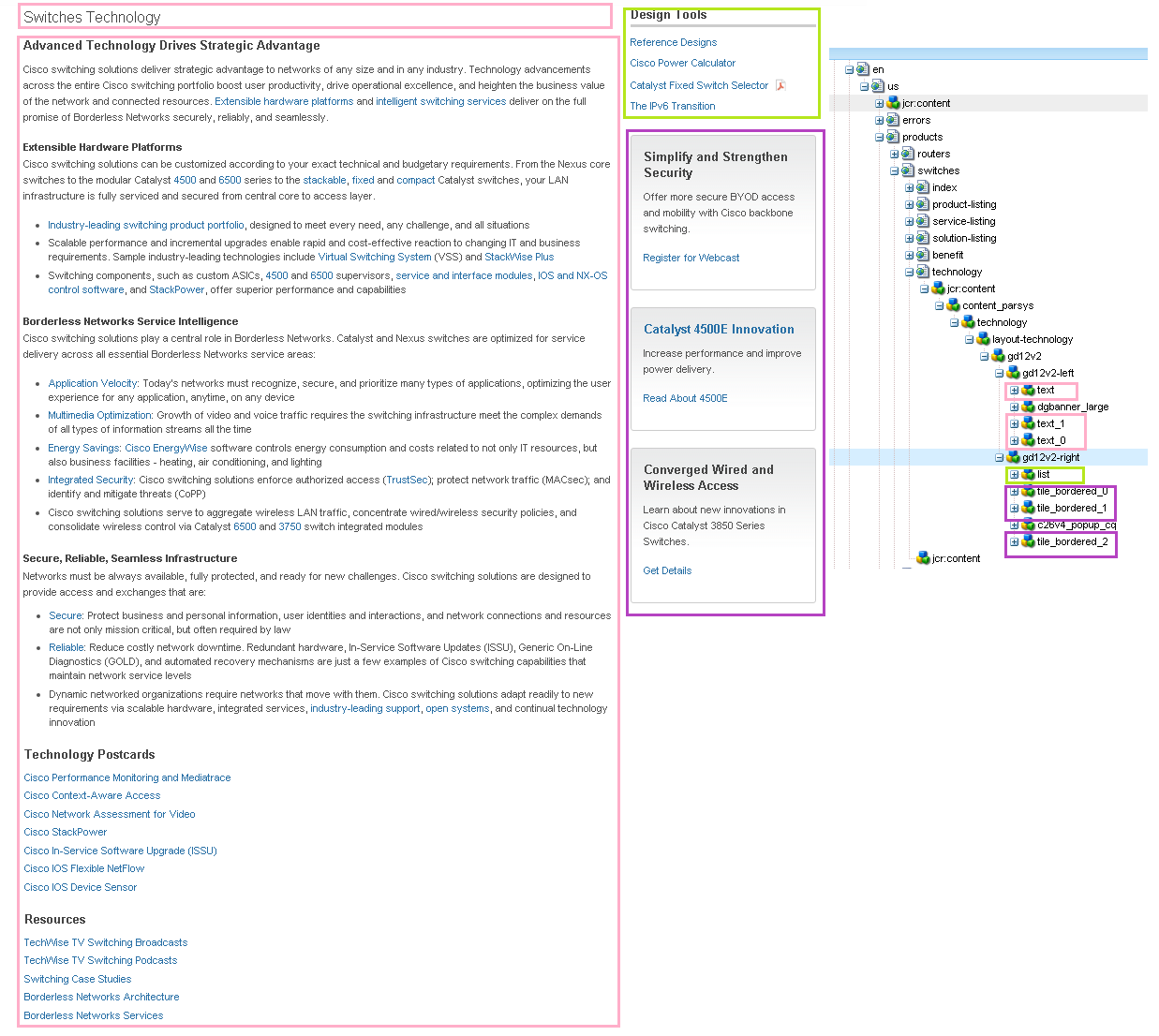
http://www.cisco.com/c/en/us/products/switches/technology.html

Slide 5
HTML Deviations for Template in Slide 4
Locale page: http://www.cisco.com/web/DE/products/switches/technology.html
There is no list component in locale page.
There is an additional tail component with list values in right side of locale page.
There is an extra component with class “flashvideo-M” aligned to the right of text component in locale page.

