Slide 1
Responsive pages

Slide 2
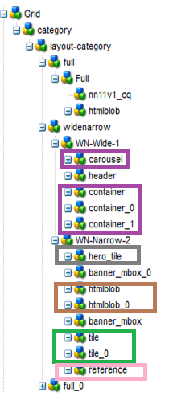



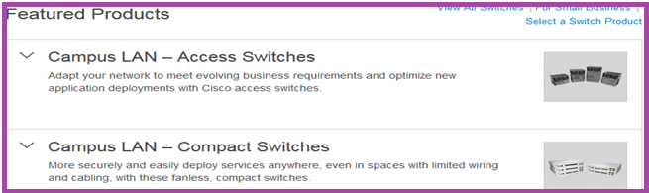

http://www.cisco.com/c/en/us/products/switches/index.html
http://www.cisco.com/c/en/us/products/routers/index.html
http://www.cisco.com/c/en/us/products/wireless/index.html
http://www.cisco.com/c/en/us/products/cloud-systems-management/index.html
http://www.cisco.com/c/en/us/products/physical-security/index.html

