Slide 1
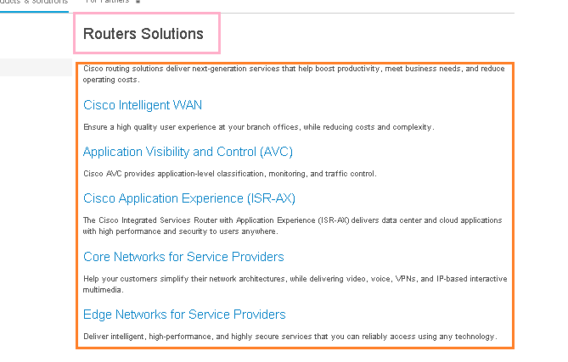
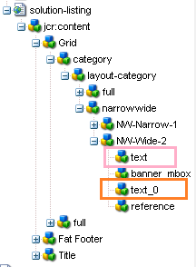
http://www.cisco.com/c/en/us/products/routers/solution-listing.html
http://www.cisco.com/c/en/us/products/switches/solution-listing.html

Slide 2
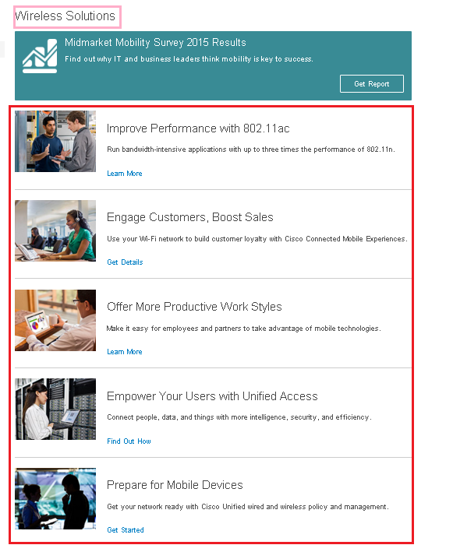
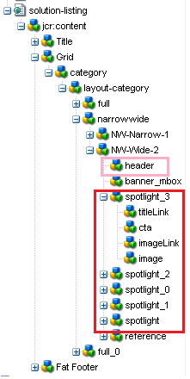
http://www.cisco.com/c/en/us/products/wireless/solution-listing.html

