Slide 1

Defect-Driven Adaptive Dual-Mode ROV for Tidal-Turbine Inspection
Supervisor
Student Name | Roll Number
Avanthika Binu | AM.EN.U4RAE23013
Neehara Parayil | AM.EN.U4RAE23031
Shreya Shibu | AM.EN.U4RAE23041
Mr. Amal Prakash

Slide 2
Introduction
Tidal and open-water turbines harness marine currents for renewable energy.
However, operating continuously underwater exposes their blades and structures to strong currents, turbulence, low visibility, biofouling, corrosion, erosion, cavitation, and structural damage.
Regular inspection is essential, but underwater inspection is challenging due to current disturbances, inspection stability, limited energy, and communication constraints.

Slide 3
LITERATURE REVIEW
Ref.No. | Author Name &Year | Publication Name | Article Title | Observation | Limitations
1 | Ioannou et al., 2024 | IEEE Aerospace and Electronic Systems Magazine | Underwater Inspection and Monitoring: Technologies for Autonomous Operations | Reviews UUVs, AUVs, ROVs, sensors, navigation and autonomous inspection methods. | Conventional AUVs have limited ability to hover and maintain position for close-range inspection of underwater structures.
2 | Ruba M. et al., 2025 | IEEE – ISACC | Enhancing Underwater Tunnel Safety through Smart Inspection | Uses an ROV camera and AI-based image processing for crack detection. | Camera-based detection is affected by underwater visibility, lighting and image quality.
3 | Yoo et al., 2025 | IEEE OCEANS 2025 Brest | Mechanical Design and Hydrodynamic Analysis of Underwater Walking Robot for Efficient Locomotion | Uses six legs and thrusters for stable underwater movement in strong currents. | Leg-based locomotion is complex and mainly suited to seabed contact; it is not optimized for efficient movement between underwater structures.
4 | Bauer et al., 2024 | IEEE MMAR | Feature Evaluation for the Purpose of Biofouling Diagnostics in Tidal Turbines | The paper analyzes current and voltage signals using time- and frequency-domain features to detect biofouling. | The approach does not provide direct and detailed physical inspection of turbine blades.
5 | Kawama & Ishii, 2025 | IEEE/ASME AIM | Development of Multi Suction Cup Module of Underwater Robot for Bio-logging | Develops a suction-cup module for underwater attachment with suction-status feedback. | The suction mechanism is designed for attachment, but its ability to maintain reliable adhesion under varying underwater forces and strong currents is not addressed.

Slide 4
Ref.No. | Author Name &Year | Publication Name | Article Title | Observation | Limitations
6 | Esteba et al., 2024 | Journal of Field Robotics | Sparus Docking Station: A Current-Aware Docking Station System for a Non-Holonomic AUV | Develops an autonomous docking system that enables an AUV to dock, recharge and support long-term underwater inspection. | Does not provide direct attachment or stable station-keeping on turbine surfaces under strong currents.
7 | Cai et al., 2025 | IEEE ICRA | Learning to Swim: Reinforcement Learning for 6-DOF Control of Thruster-Driven Autonomous Underwater Vehicles | Uses reinforcement learning and domain randomization for adaptive 6-DOF AUV control with sim-to-real transfer. | Thruster-based propulsion can consume significant power and may have reduced efficiency during prolonged station-keeping against strong currents.
8 | Sakagami et al., 2025 | Springer | Numerical Evaluation of a Mobile Underwater Manipulator with a Structure–Wall Suction Mechanism | Uses a thruster-driven suction mechanism to generate negative pressure and maintain contact with underwater structures. | Suction stability decreases at higher flow speeds, requiring improved suction force to prevent overturning.
9 | Wang et al., 2026 | IEEE | Average-Power-Budgeted Underwater Vehicle Control via Constrained Reinforcement Learning | Uses constrained reinforcement learning with an explicit average thruster-power budget for energy-efficient AUV control.. | High thruster power demand during prolonged station-keeping against underwater currents.
10 | Santos et al., 2024 | Journal of Reinforced Plastics and Composites (SAGE) | Path Planning and Control for ROVs Focused on Autonomous Visual Inspection of Floating Offshore Wind Structure | Autonomous ROV path planning and visual inspection. | Validated mainly through simulations, with limited real-world testing.

Slide 5
LITERATURE REVIEW
Ref.No. | Author Name &Year | Publication Name | Article Title | Observation | Limitations
11 | van Veggel et al., 2024 | Advanced Science | Classification and Evaluation of Octopus-Inspired Suction Cups for Soft Continuum Robots | Reviews suction-cup technologies for adhesion, sensing and soft-robot integration. | Reliable sealing is difficult on rough, curved and uneven surfaces structures.
12 | Yousaf et al., 2026 | IEEE ICST | Assessing Vision–Language Models for Perception in Autonomous Underwater Robotic Software | Evaluates VLMs for underwater object detection and uncertainty. | VLM performance varies significantly across underwater object classes.
13 | Sufán & Troni, 2025 | IEEE Robotics and Automation Letters | Swim4Real: Deep Reinforcement Learning-Based Energy-Efficient and Agile 6-DOF Control for Underwater Vehicles | Uses DRL for energy-efficient 6-DOF underwater vehicle control. | Control performance can vary with changing vehicle and underwater conditions..
14 | Cooper-Baldock et al., 2025 | Ocean Engineering | Wake-informed 3D Path Planning for Autonomous Underwater Vehicles using A and Neural Network Approximations | Incorporates 3D currents and wake effects into AUV path planning | Neural-network paths can be less energy-efficient and less optimal than A.
15 | Pereira et al., 2025 | IEEE Access | Raya: A Bio-Inspired AUV for Inspection and Intervention of Underwater Structures | Uses bio-inspired morphology, 6-DOF thrusters, cameras and sonar for structure inspection.. | Hydrodynamic disturbances can affect precise trajectory and velocity control.

Slide 6
LITERATURE REVIEW
Ref.No. | Author Name &Year | Publication Name | Article Title | Observation | Limitations
16 | Almuzaini & Savkin, 2026 | Future Internet | Trajectory Planning for Autonomous Underwater Vehicles in Uneven Environments: A Survey of Coverage and Sensor Data Collection Methods | Reviews terrain-aware, visibility-aware and communication-aware AUV trajectory planning | Robust planning remains difficult under uneven terrain and limited communication.
17 | Wang et al., 2026 | Scientific Reports | The Underwater VLA Dual-Brain Vision-Language-Action Architecture Enables Robust Autonomous Underwater Navigation | Combines VLA reasoning with hydrodynamics-informed MPC for underwater navigation | Cloud-based models introduce communication latency and limit operating range.
18 | Martorell-Torres et al., 2026 | International Journal of Systems Science | Acoustic Communication-Aware Coordination Algorithm for Multi-Robot Systems in Underwater Exploration | Uses real acoustic signal quality to improve coordination between underwater robots and an ASV. | Acoustic communication suffers from latency, attenuation and low bandwidth
19 | José-Trujillo et al., 2024 | Journal of Reinforced Plastics and Composites | Analysis and Structural Evaluation of Seawater-Aged Composite Tidal Turbine Blades Using Multi-Walled Carbon Nanotubes and Acoustic Emission | Uses MWCNT-based sensing and acoustic emission to detect damage in tidal-turbine blades. | Requires sensing material integrated on the blade, limiting mobile non-contact inspection.
20 | Wen et al., 2024 | IEEE Internet of Things Journal | Intelligent Decision-Making Method for AUV Path Planning Against Ocean Current Disturbance via Reinforcement Learning | Uses OCDRP reinforcement learning with time-varying ocean-current information for adaptive and energy-efficient AUV path planning. | Does not cover turbine inspection, surface attachment, or defect-driven close inspection; real-world validation remains future work. .

Slide 7
LITERATURE REVIEW
Ref.No. | Author Name &Year | Publication Name | Article Title | Observation | Limitations
21 | Sariman et al., 2025 | Ocean Engineering (Elsevier) | UR-EARL : A framework for designing underwater robots using revolutionary algorithm-driven reinforcement learning | Coevolution, Modularity, Open-Source, Simulation, Scalability, Knowledge-Transfer, Morphological-Evolution | Nonuniform-Flow, Slenderness, Computational-Burden, Sensor-Modelling, Resource-Dependence
22 | Tani et al., 2025 | Journal of Field Robotics (Wiley) | Visual-Acoustic‐Based Framework for Online Inspection of Submerged Structures Using Autonomous Underwater Vehicles | Autonomy , Integration, Adaptability, Navigation, Inspection, Perception, Real-time, Sensor-fusion | Planarity, Generalizability, Computational Constraints
23 | Tada et al., 2025 | 2025 IEEE First International Conference on Innovations in Engineering and Next-Generation Technologies for Sustainability (ICINVENTS-2025) | IoT Intelligent Sensor Based Underwater Inspection Robot for Real Time Object Detection and Tracking | Edge-AI, Enhancement, Detection, Tracking, IoT, Scalability, Modularity | Turbidity, Occlusion, Bandwidth, Latency, Dataset-Bias, Annotation, Variability
24 | Tan et al., 2025 | Scientific Reports (Nature Portfolio) | Innovative framework for fault detection and system resilience in hydropower operations using digital twins and deep learning | Digital-Twinning, Autoencoding, Prediction, Diagnostics, Resilience, Optimization, Monitoring, Efficiency | Fault-Variability, Generalization, Sensor-Noise, Latency, Scalability, Dataset-Rarity, Drift, Cybersecurity
25 | Eruvaram et al., 2025 | 2025 11th International Conference on Communication and Signal Processing (ICCSP) ©2025 IEEE | Exploring the Potential of Underwater Robotics Monitoring Enhanced By Saab Seaeye’s Next Generation AI And Sensor Integration | Adaptability, Multimodality, Automation, Mapping, Interoperability, Scalability, Perception | Calibration, Bandwidth, Latency, Endurance, Unpredictability, Computing, Transmission

Slide 8
LITERATURE REVIEW
Ref.No. | Author Name &Year | Publication Name | Article Title | Observation | Limitations
26 | Shitab et al., 2025 | 2025 IEEE 4th International Conference on Robotics, Automation, Artificial-Intelligence and Internet-of-Things (RAAICON) | Digital Twin for Underwater Vehicles: MATLAB-Based Real-Time UROV Motion Simulation Frameworks for Predictive Monitoring | Hydrodynamics, Six DOF, Forecasting, Diagnostics, Energy, Synchronization, Maneuverability | Assumptions, Fidelity, Turbulence, Calibration, Scalability, Simulation
27 | Nakka et al., 2025 | 2025 IEEE Green Technologies Conference (GreenTech) | Deep Learning for Underwater Condition Monitoring of Offshore Energy Installations | Denoising, Classification, Localization, Augmentation, Automation, Precision, Annotation, Inference | Irregularity, Turbidity, False-Positives, Visibility, Deployment, Multi sensor
28 | Patsia et al., 2026 | 2026 21st International Conference on Ground Penetrating Radar (GPR) ©2026 IEEE | Assessment of thick GFRP laboratory specimens and full tidal turbine blades by means of GPR | GPR, Nondestructive, Delamination, Thickness, Layering, Heterogeneity, Localization, Integrity | Depth, CFRP, Resolution, Detectability, Calibration, Surface-Area, Validation
29 | Islam et al., 2026 | Earth Systems and Environment (2026 - Springer) | AquaFusionNet: A Deep Feature Fusion and Attention-Based Approach for Accurate Underwater Defect Detection | Feature-Fusion, Attention, Hybridization, Classification, Robustness | Turbidity, Dataset-Size, Computation, Generalization, Deployment
30 | Noorani et al., 2025 | AI Magazine (2025 - Wiley) | From abstraction to reality: DARPA’s vision for robust sim-to-real autonomy | Sim-to-Real, Adaptation, Abstraction, Semantics, Transfer | Fidelity, Variability, Uncertainty, Overfitting, Time-Budget

Slide 9
Problem Statement
Underwater turbine inspection is challenging due to strong currents, limited visibility, and the difficulty of maintaining stability and detecting defects near turbine components.
Harsh conditions: Strong currents and turbulence affect robot stability.
Limited visibility: Makes it difficult to identify cracks, corrosion, and other structural defects.
Inspection challenges: Maintaining a stable position near turbine blades, especially rotating ones, is difficult.
High operational costs: Conventional inspection often relies on divers or ROVs and requires significant human intervention.
Need for autonomy: The robot must adapt to changing underwater conditions while ensuring safe, energy-efficient inspection.

Slide 10
Methodology
Problem Identification & Requirement Analysis
Conceptual Robot Design
3D CAD Modelling
(Fusion 360)
CFD Analysis
(SimScale)
Hydrodynamic Performance Analysis
(Drag, Lift, Forces & Moments)
Design Evaluation & Validation
(Stability, Drag & Design Comparison)
Reinforcement Learning
Prototype Development
Prototype Testing

Slide 11
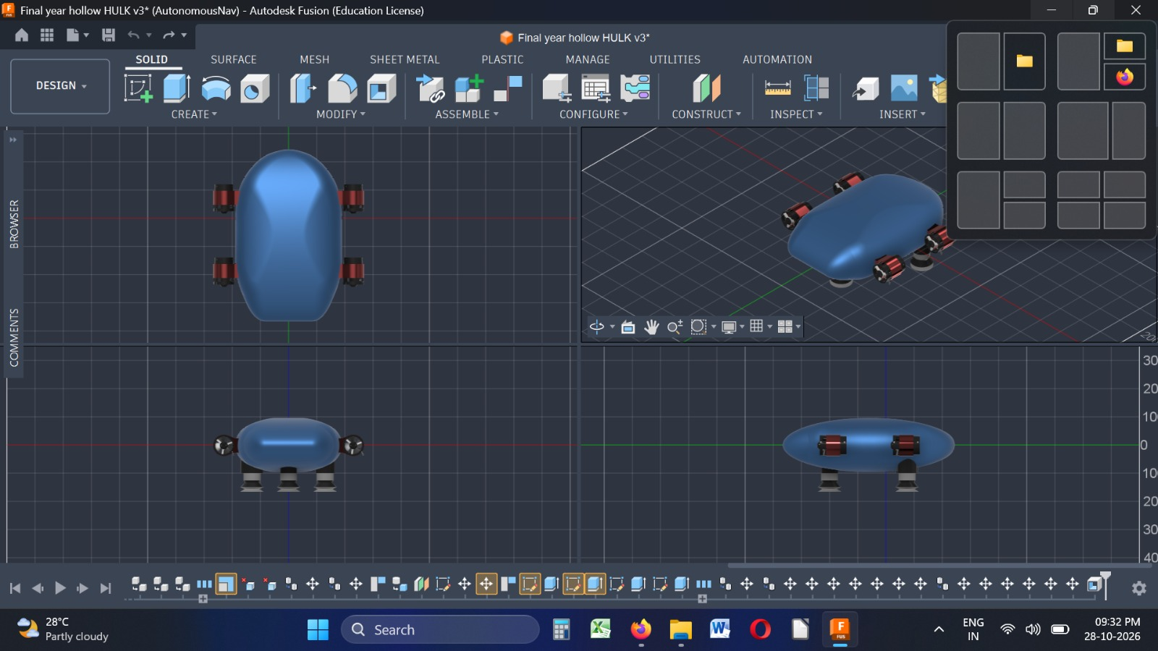
Modelling / Simulation /
Experimental Work

Slide 12
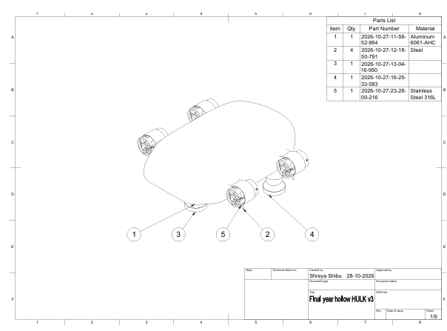
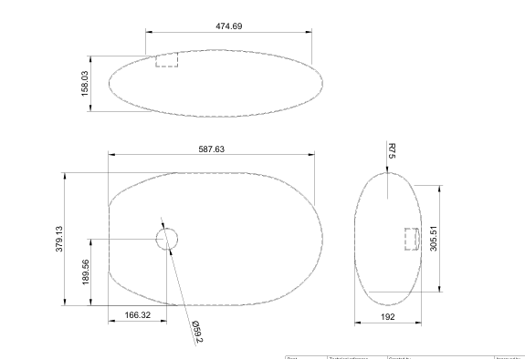
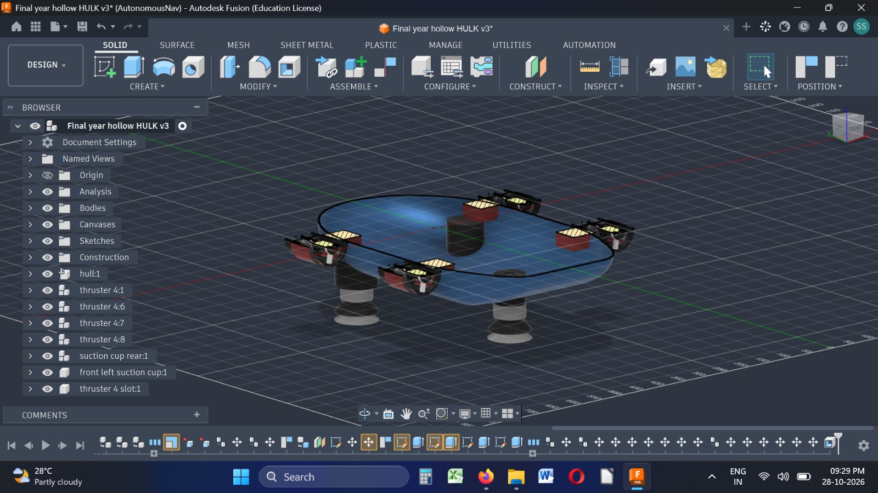
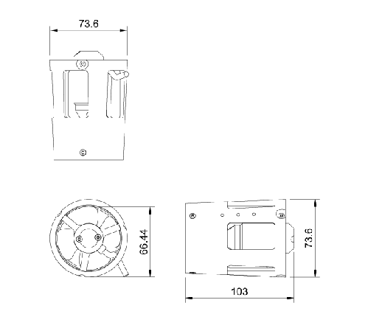
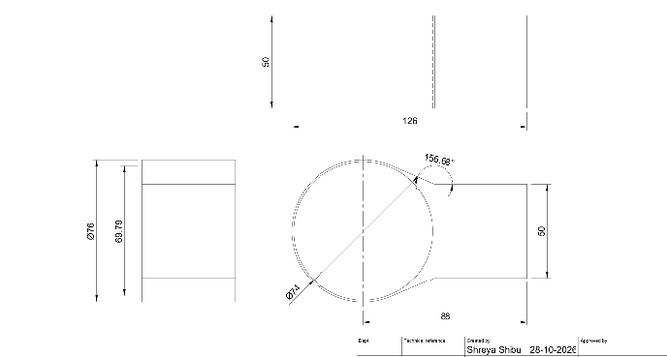
Modelling / Simulation /
Experimental Work

Slide 13
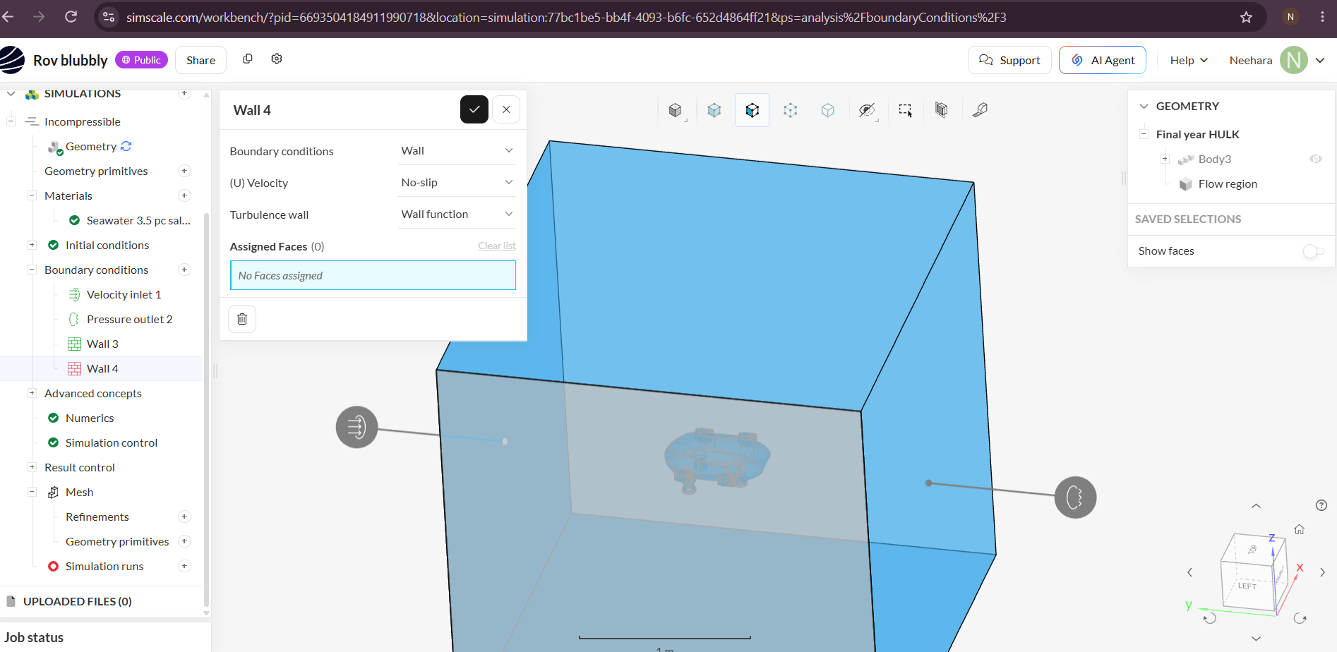
Modelling / Simulation /
Experimental Work

Slide 14
Future Work / Proposed Plan
Design Evaluation & Validation: Validate stability metrics, cross-reference drag reductions against baseline values, and compare iterative structural geometry versions.
Suction Mechanism: Integrate and optimize a suction-based attachment system to maintain stable contact with turbine surfaces under underwater currents.
Reinforcement Learning: Develop adaptive decision-making for autonomous inspection.
Prototype Development: Build the robot based on the validated design.
Prototype Testing: Evaluate stability, mobility, and inspection performance under underwater conditions.

Slide 15
CO/PO & SDG Mapping
CO1 – Problem Identification
Identify underwater inspection challenges through literature review.
PO2, PO4 | PSO3
CO2 – Project Planning
Define design requirements, constraints, tools, and project activities.
PO2, PO3, PO5, PO11 | PSO1, PSO3
CO3 – Design Development
Develop and evaluate the conceptual ROV design using CAD and hydrodynamic analysis.
PO1, PO2, PO3, PO5 | PSO1, PSO3
CO4 – Documentation
Present project progress, design decisions, and future work.
PO10 | PSO3
SDG 7
Affordable and Clean Energy
SDG 9
Industry, Innovation and Infrastructure

