Slide 1
Improve Efficiency of Reconciliation
Meghna Goel Shreya Khandelwal
Noinika Ganguly Tushar Agarwal

Slide 2
PROBLEM STATEMENT
Messages communicated between 2 or more IT applications are getting lost or corrupted and causing variance in the data maintained by these applications.
The main objective is to find those messages which got lost or corrupted without any sweat.

Slide 3
KEY PARAMETERS
Stability
Scalability: Million messages are send without the server getting down
Error minimization
Performance − Kafka has high throughput for both publishing and subscribing messages. It maintains stable performance even many TB of messages are stored.

Slide 4
Why we used Kafka
Kafka does not have individual message IDs. Messages are simply addressed by their offset in the log.
It lightens the load by not maintaining any indexes that record what messages it has.
There are no deletes. Kafka keeps all parts of the log for the specified time.

Slide 5
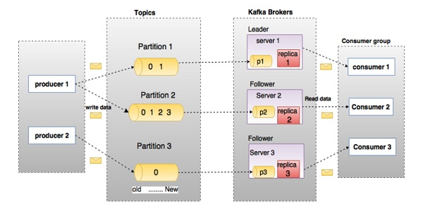
Main terminologies of kafka:-

Slide 6
ALTERNATE TECHIQUES
Blockchain is an alternative technique which can be used to solve the problem.
Although we are here using Apache Kafka because it has high throughput, is fault tolerant, durable and fasterprocessing and much easier in terms of processingeasier than the other techniques.
The problem with block chain is that if it is a not a robust network with grid of nodes, it becomes more difficult to reap its benefits.

Slide 7
CONCLUSION
Since our problem was how to communicate with millions of messages and how to process them, so we found that kafka messaging system is an efficient solution.

