Slide 1
Health insurance fraud detection using blockchain
J. Pavan Kumar (1602-20-737-151)
Ch. Shreya (1602-20-737-171)
Guide: Dr. Anil Kumar

Slide 2
AGENDA
1. Introduction
2. Abstract
3. Literature survey
4. Hyperledger fabric
5. Hyperledger fabric model
6. Implementation Part-1: developing chaincode
7. Implementation part-2: deploying chaincode into Hyperledger fabric and querying

Slide 3
Introduction
1. Outdated methods invite healthcare insurance fraud.
2. Duplicate claims exploit system vulnerabilities.
3. Urgent need for a secure fraud detection system.
4. Blockchain proposed for data integrity and security.
5. Immutable data prevents modification or deletion.
6. Blockchain tracks activities, aiding fraud detection.
7. Despite limitations, Blockchain addresses healthcare challenges effectively.

Slide 4
abstract
1. Healthcare costs rise, reliance on insurance grows.
2. Insurers face challenges due to data disparities.
3. Fraud surges with false claims and multiple benefits.
4. Lack of data integration hampers fraud prevention.
5. Blockchain proposed for secure, immutable data sharing.
6. Solution aims at monitoring and managing insurance activities.
7. Goal: Enhance fraud detection in health insurance.

Slide 5
Literature survey
1. Blockchain ensures trusted data with transparency.
2. Peer-to-peer network manages immutable, traceable data.
3. Components include distributed storage, consensus, cryptography, and more.
4. Three types: public, private, consortium blockchains.
5. Public for everyone, private for internal use.
6. Consortium involves multiple parties with controlled access.
7. Medical blockchain opts for semi-centralized consortium chain.

Slide 6
Literature survey continued…
1. Blockchain users: regulatory, insurance, hospitals, doctors.
2. Doctor signs and uploads medical record.
3. Hospital confirms and signs on the blockchain.
4. Insurance center queries for diagnosis reasonability.
5. Regulatory agency connects or interacts for auditing.
6. Abnormalities trigger instructions for control.
7. Blockchain tracks global business processes.

Slide 7
Literature survey continued…
1. Smart contracts control blockchain data actions.
2. Regulatory agency deploys smart contracts.
3. Doctor signs and uploads record to blockchain.
4. Hospital confirms and signs medical record.
5. Medical insurance center queries for validity.
6. Validity and integrity ensure authenticity and traceability.
7. Detailed process ensures secure and reliable data.

Slide 8
Hyperledger fabric
1. Open Source Enterprise Platform: Hyperledger Fabric, Linux Foundation governed, permissioned DLT.
2. Diverse Governance and Development: Governed by diverse committees and maintainers.
3. Modular Architecture for Innovation: Highly modular for versatile industry use cases.
4. General-Purpose Smart Contracts: Supports smart contracts in Java, Go, Node.js.
5. Permissioned Participants for Trust: Known participants, trust governed by legal frameworks.
6. Enterprise-Friendly Skill Set: No need to learn domain-specific languages.
7. Versatile Industry Use Cases: Optimized for banking, finance, healthcare, supply chain.

Slide 9
Hyperledger fabric model
1. Diverse Asset Exchange: Enables diverse exchanges with monetary value.
2. Partitioned Chaincode Execution: Isolates chaincode from transaction ordering for scalability.
3. Immutable Shared Ledger: Encodes complete transaction history for auditing.
4. Privacy and Confidentiality: Allows private multi-lateral transactions and data collections.
5. Trusted Security & Membership: Provides secure, permissioned membership for trusted networks.
6. Flexible Scalable Consensus: Unique consensus approach for enterprise flexibility and scalability.

Slide 10
Implementation Part-1: developing chaincode
1. Chaincode is a program implementing a prescribed interface.
2. It runs separately, managing ledger state through transactions.
3. Handles business logic like a "smart contract.“
4. Go, Node.js, or Java are the chaincode languages.
5. Invoked for ledger updates or queries.
6. May invoke another chaincode with permissions.
7. Different channel calls allow only read queries.

Slide 11
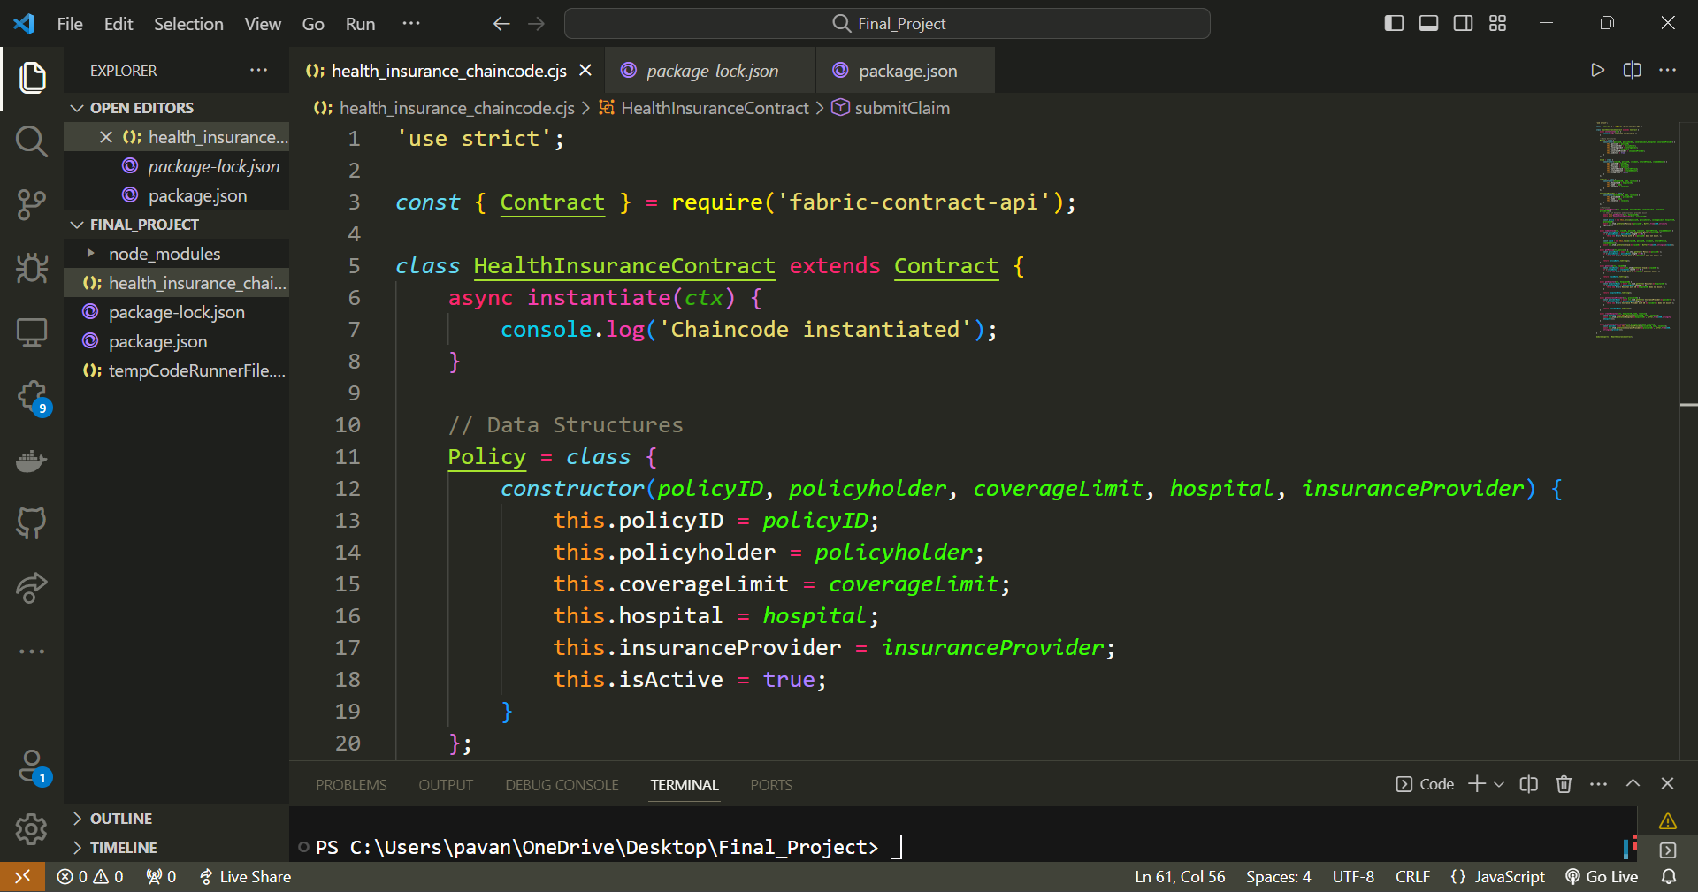
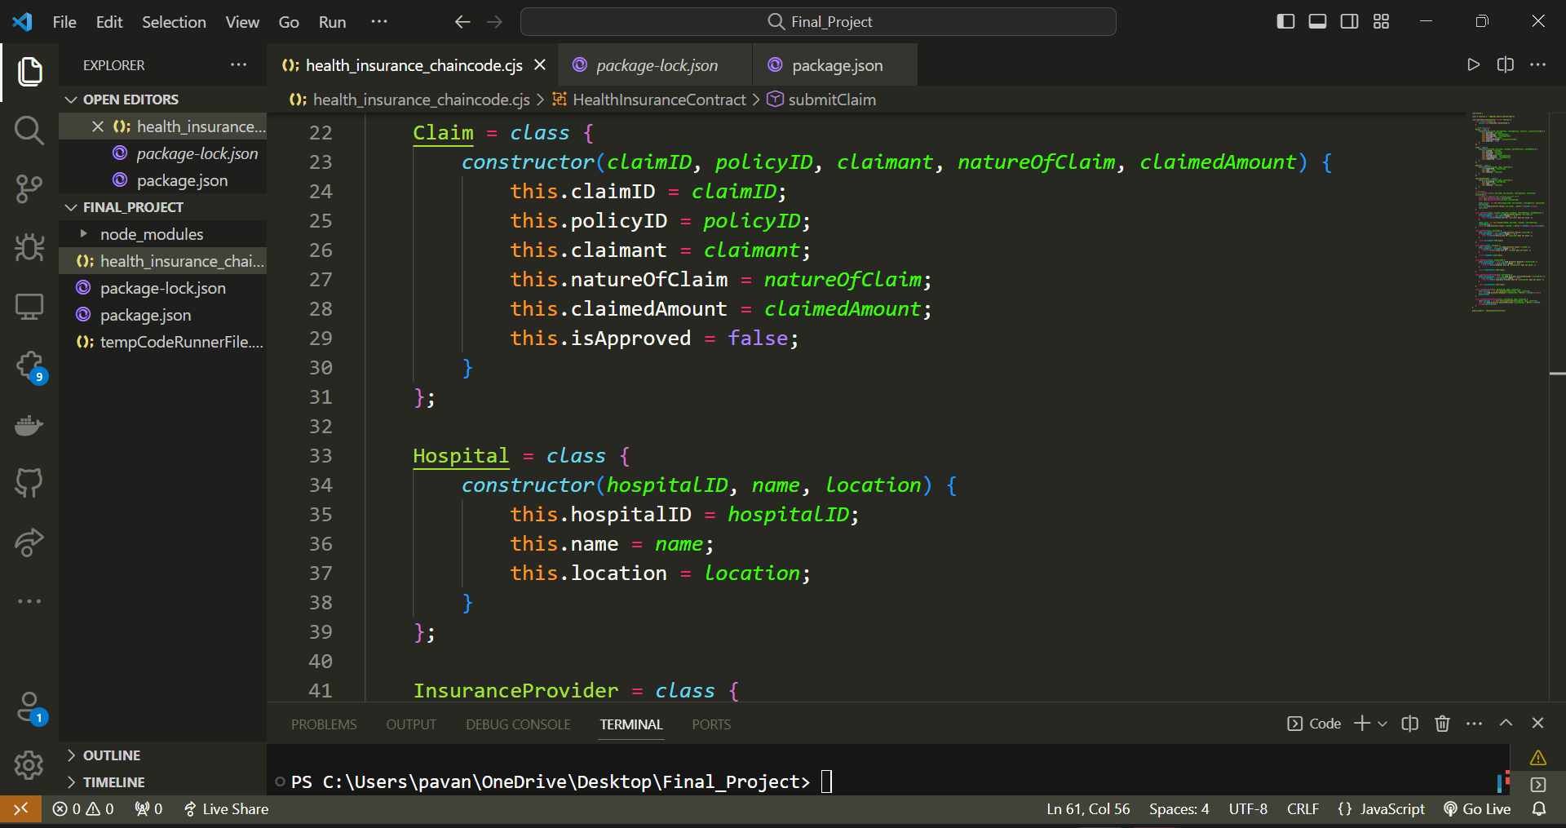
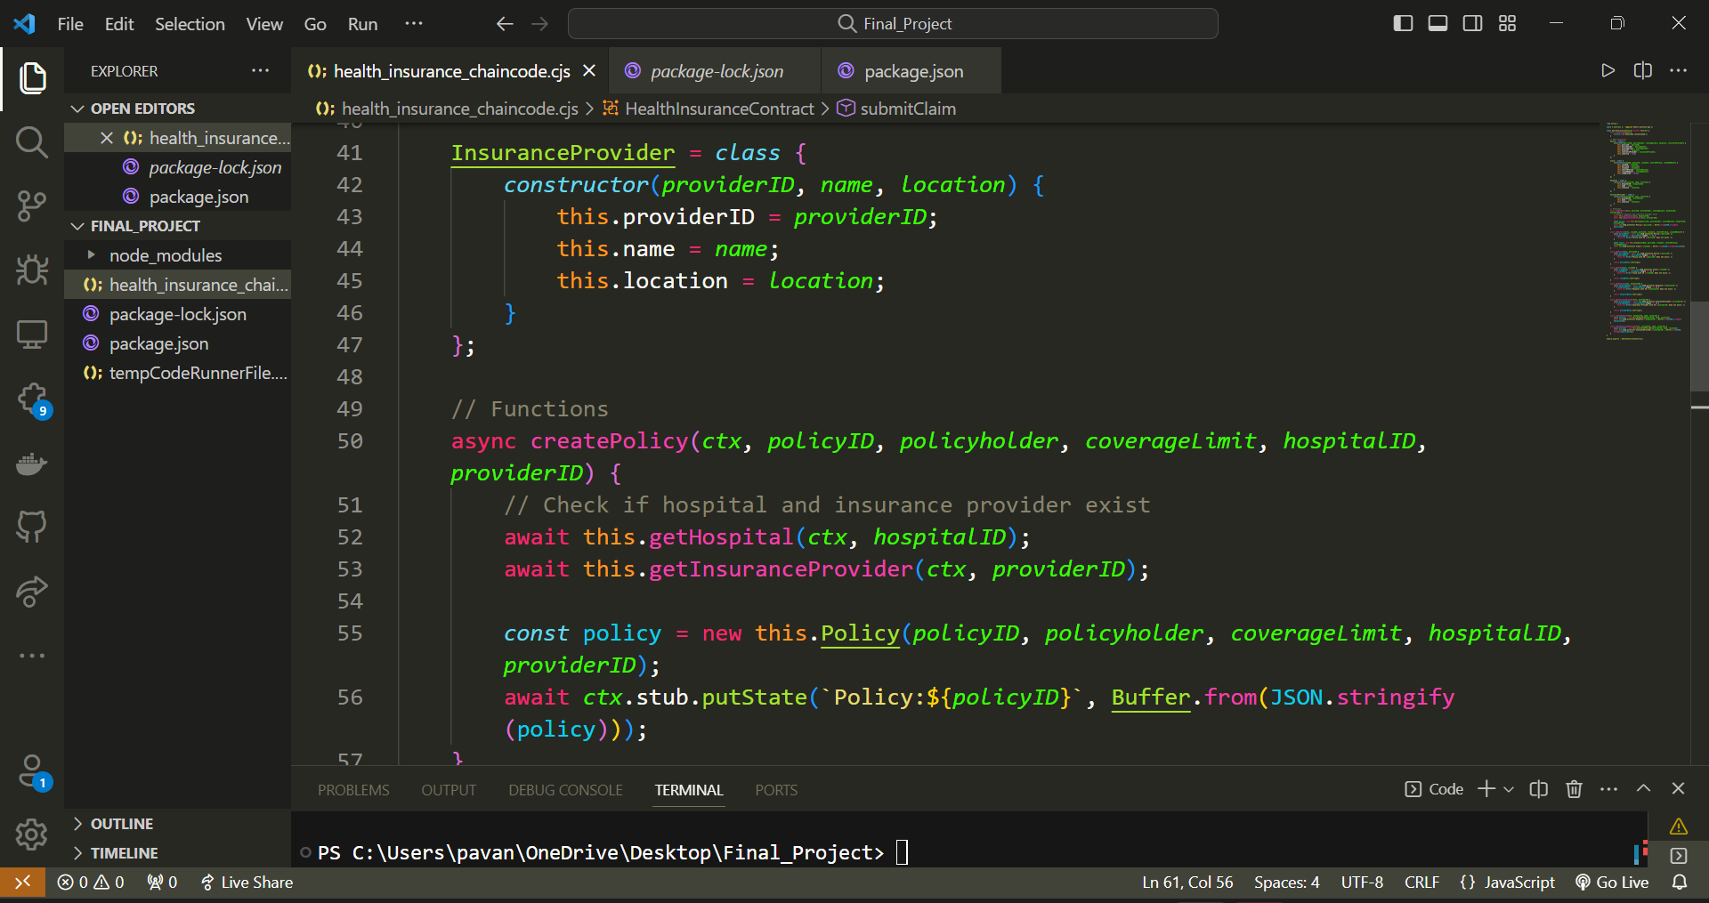
Implementation Part-1: developing chaincode continued…

Slide 12
Implementation part-2: deploying chaincode into Hyperledger fabric and querying
1. Package chaincode into compressed file.
2. Copy file to Fabric network directory.
3. Install chaincode on network peers.
4. Approve and commit chaincode definition.
5. Invoke chaincode functions for actions.
6. Monitor chaincode logs for issues.
7. Perform ongoing maintenance and updates.

Slide 13
Implementation part-2: deploying chaincode into Hyperledger fabric and querying continued..
1. Use `peer chaincode query` command.
2. Specify channel, chaincode, and query arguments.
3. Transaction is not submitted to the ledger.
4. Query-only, doesn't alter ledger state.
5. Retrieve data from the blockchain ledger.
6. Query executes locally on endorsing peers.
7. Result returned to the client application.

Slide 14
Implementation part-2: deploying chaincode into Hyperledger fabric and querying continued..
Example:
1. Create Hospital
peer chaincode invoke -o orderer.example.com:7050 -C mychannel -n health_insurance_chaincode -c '{"Args":["createHospital", "H001", "St. John's Hospital", "New York"]}’
2. Create an Insurance Provider
peer chaincode invoke -o orderer.example.com:7050 -C mychannel -n health_insurance_chaincode -c '{"Args":["createInsuranceProvider", "P001", "HealthCare Insurances", "New York"]}’
3. Patient
peer chaincode invoke -o orderer.example.com:7050 -C mychannel -n health_insurance_chaincode -c '{"Args":["createPolicy", "POL001", "John Doe", "100000", "H001", "P001"]}'
4. Submit a health insurance claim
peer chaincode invoke -o orderer.example.com:7050 -C mychannel -n health_insurance_chaincode -c '{"Args":["submitClaim", "CLM001", "POL001", "John Doe", "Hospitalization", "50000"]}’
5. Query Policy
peer chaincode query -C mychannel -n health_insurance_chaincode -c '{"Args":["getPolicy", "POL001"]}'

Slide 15
THANK YOU

