Slide 1

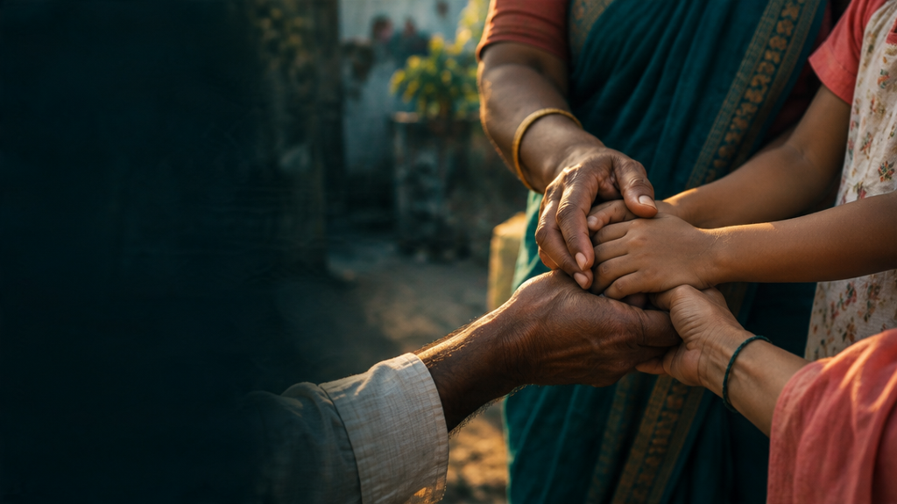
STUDENT PROJECT · 2026
NGO
Connect
Bridging Homeless Children, NGOs & Communities
Anushri Shinde · Shravani Asawale · Shreya Chavan
Diya Telnade · Pradnya Desai
COLLEGE NAME · ACADEMIC YEAR 2025–26
NGO CONNECT · STUDENT PROJECT · 2026
01

Slide 2
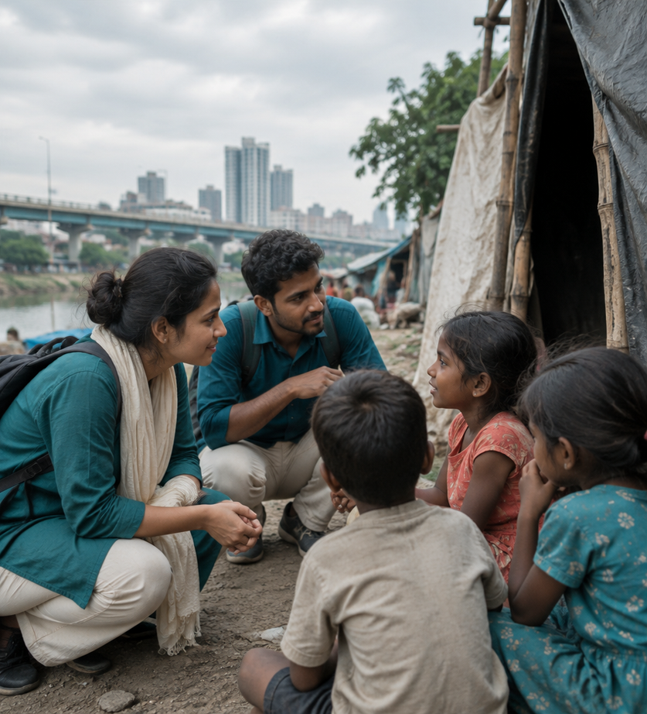
The missing link is
visible—and fixable
01
Children need safe shelter and quality education.
02
NGOs need sustainable, recurring support.
03
Communities need clear and trusted channels.
04
All three need a transparent bridge.
NGO CONNECT · STUDENT PROJECT · 2026
02

Slide 3


Four objectives.
One trusted pathway.
01
ACCESS
02
MICRO-FUNDING
Support admission into NGOs for shelter and education.
Propose a simple ₹1-per-household recurring model.
03
TRANSPARENCY
04
TRUST
Create a clear digital bridge between donors and NGOs.
Share regular progress and impact updates.
NGO CONNECT · STUDENT PROJECT · 2026
03

Slide 4

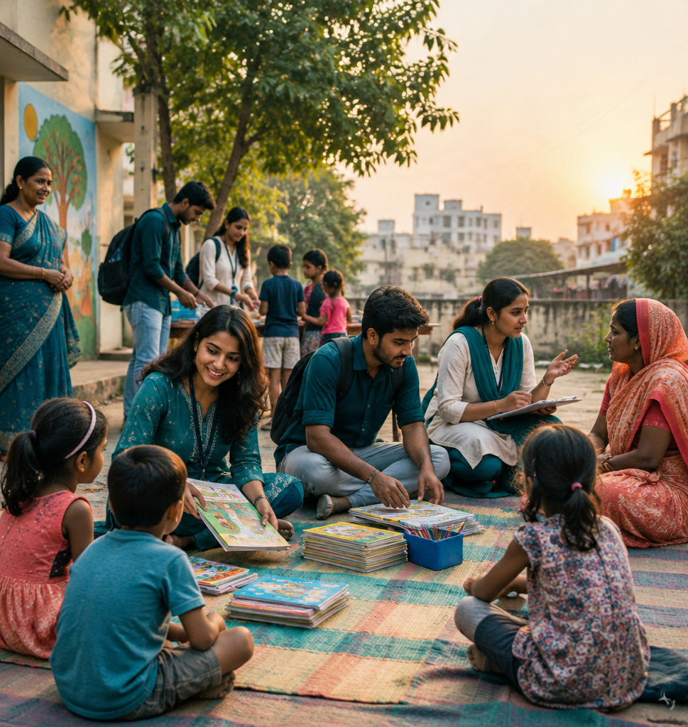
Small participation
can widen the circle
Urban homeless children need timely support, while NGOs and community networks often remain disconnected. A ₹1 contribution is intentionally easy to understand—and offers students and citizens a tangible way to participate.
The project prioritises verifiable action over distant intent.
NGO CONNECT · STUDENT PROJECT · 2026
04

Slide 5

₹1 can be a habit,
not a headline
HOUSEHOLDS
₹1 each
ILLUSTRATIVE EXAMPLE · HYPOTHETICAL
1,000 households × ₹1
= ₹1,000 per contribution cycle
NGO CONNECT
Transparent channel
A proposed recurring micro-funding model—not actual funds collected. Frequency, consent, payment handling and reporting would be defined before launch.
NGO SUPPORT
Proposed use & reporting
NGO CONNECT · STUDENT PROJECT · 2026
05

Slide 6
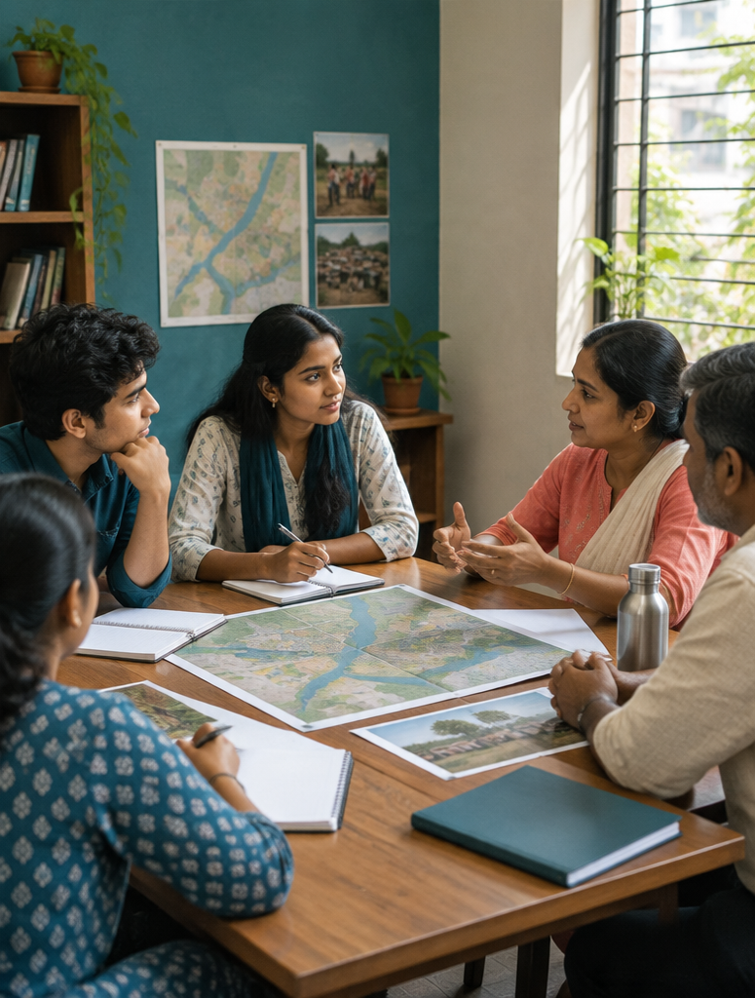


From listening
to reporting
1
Visit NGOs; understand capacity and constraints.
2
Identify children; coordinate safe onboarding.
3
Connect shelter, food and education support.
4
Roll out the proposed ₹1 recurring channel.
5
Publish progress and impact reports.
NGO CONNECT · STUDENT PROJECT · 2026
06

Slide 7


What success would enable
01
02
03
04
ACCESS
CONTINUITY
AWARENESS
REPLICATION
More children connected to shelter and education.
A possible steady stream of micro-support for operations.
Greater community involvement in child welfare.
A model other student groups and cities can adapt.
NGO CONNECT · STUDENT PROJECT · 2026
07

Slide 8


Six weeks to launch.
Learning continues.
01
02
03
04
WEEKS 1–2
WEEKS 3–4
WEEKS 5–6
ONGOING
NGO visits
Needs mapping
Partnership development
Child identification
Safe onboarding
Launch proposed
₹1 channel
Awareness drives
Feedback · reporting
NGO CONNECT · STUDENT PROJECT · 2026
08

Slide 9

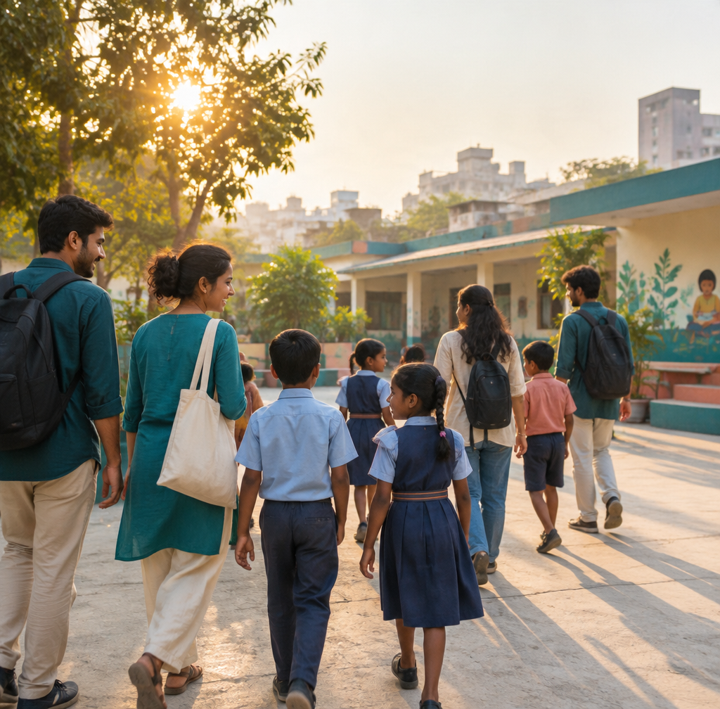
A practical bridge.
A shared next step.
NGO Connect proposes a transparent, sustainable link among homeless children, NGOs and communities—powered by accessible participation and accountable reporting.
FUTURE SCOPE
Digital platform development
Expanded NGO relationships
Stronger impact tracking
Replication by student groups and cities
NGO CONNECT · STUDENT PROJECT · 2026
09

Slide 10
References & context
Source names are listed for project research. No fabricated data or URLs are included.
01
Ministry of Women & Child Development
wcd.nic.in
02
UNICEF India
Reports on street and homeless children
03
Local NGO partner list
To be developed by the student team
04
Micro-donation research
Articles on community giving models
05
Census & NSSO
Context on urban homelessness
NGO CONNECT · STUDENT PROJECT · 2026
10

