Slide 1
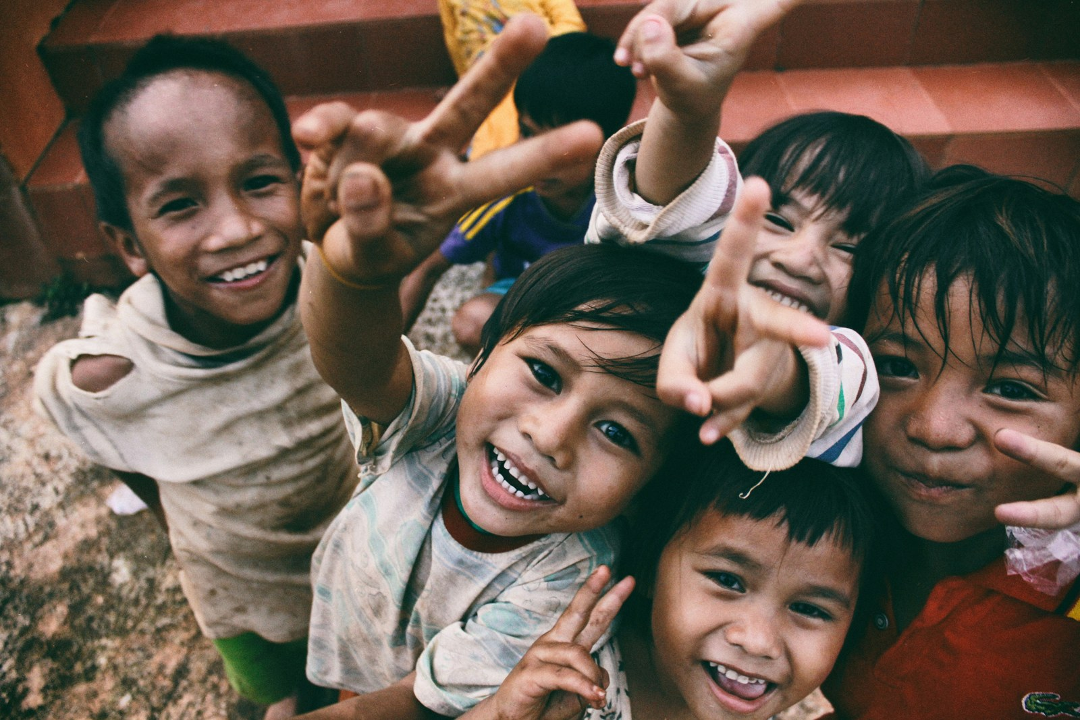
STUDENT PROJECT · 2026
NGO Connect
Bridging Homeless Children, NGOs & Communities
PRESENTED BY
Anushri Shinde
Shravani Asawale
Shreya Chavan
Diya Telnade
Pradnya Desai
NGO Connect | Slide 1 of 9
Anushri • Shravani • Shreya • Diya • Pradnya

Slide 2
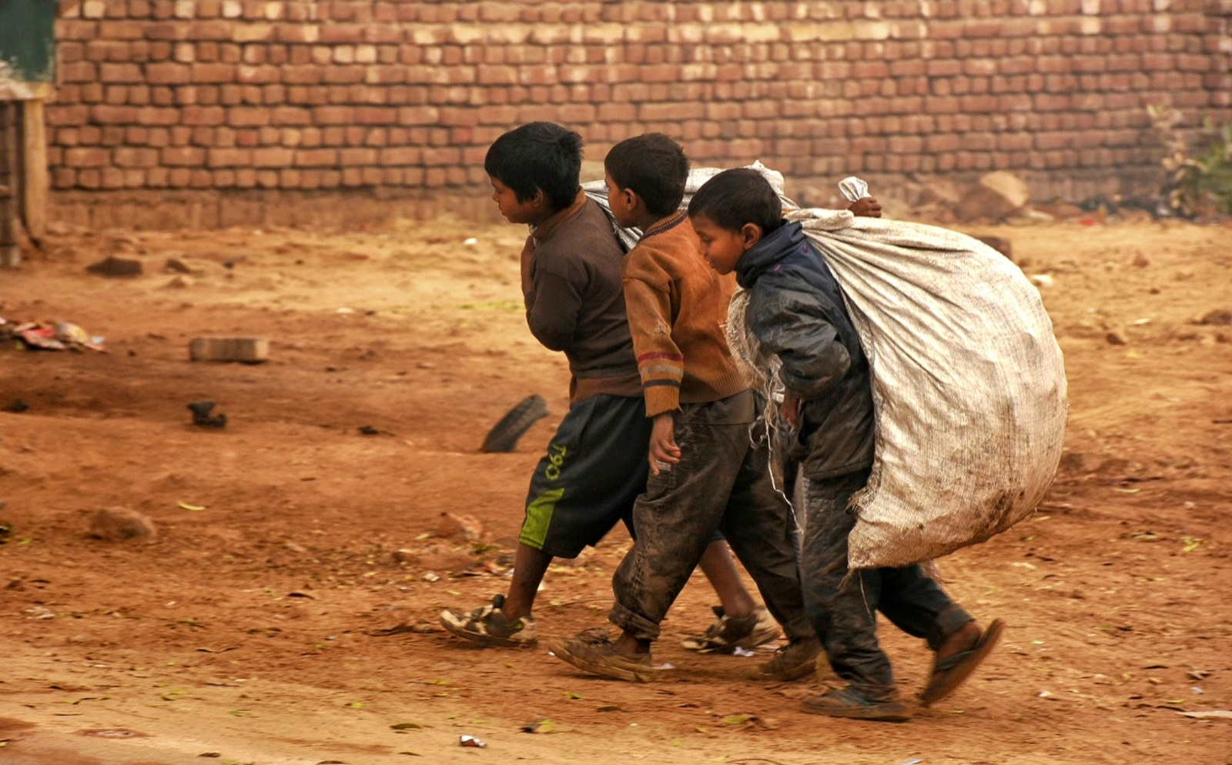
02 · PROBLEM STATEMENT
Problem Statement
The gap we aim to close
• Homeless children lack access to safe shelter and quality education.
• Many NGOs work sincerely but struggle with sustainable, recurring funding.
• Communities want to help but do not know where or how to contribute.
• A visible bridge between children in need, NGOs, and everyday donors is missing.
NGO Connect | Slide 2 of 9
Anushri • Shravani • Shreya • Diya • Pradnya

Slide 3
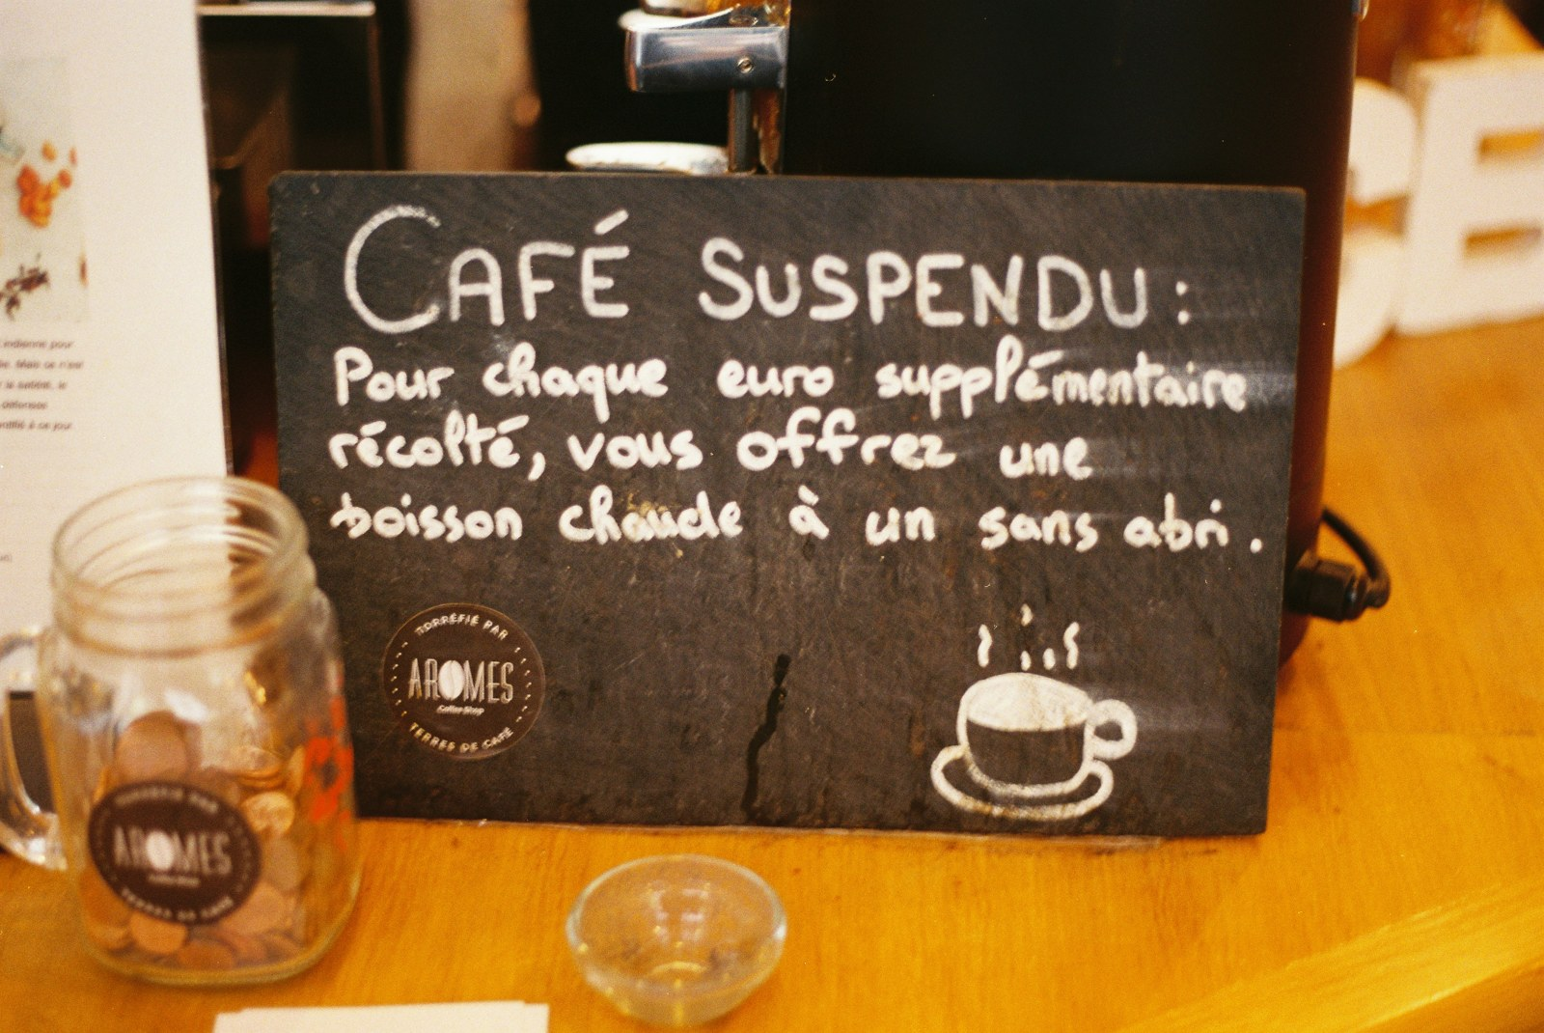
03 · OBJECTIVE
Objective
What NGO Connect will achieve
• Help admit homeless children into partnered NGOs with shelter & education.
• Launch a simple '1 Rupee per Household' micro-funding model.
• Create a transparent digital bridge between donors and NGOs.
• Build trust through regular impact updates and reports.
NGO Connect | Slide 3 of 9
Anushri • Shravani • Shreya • Diya • Pradnya

Slide 4
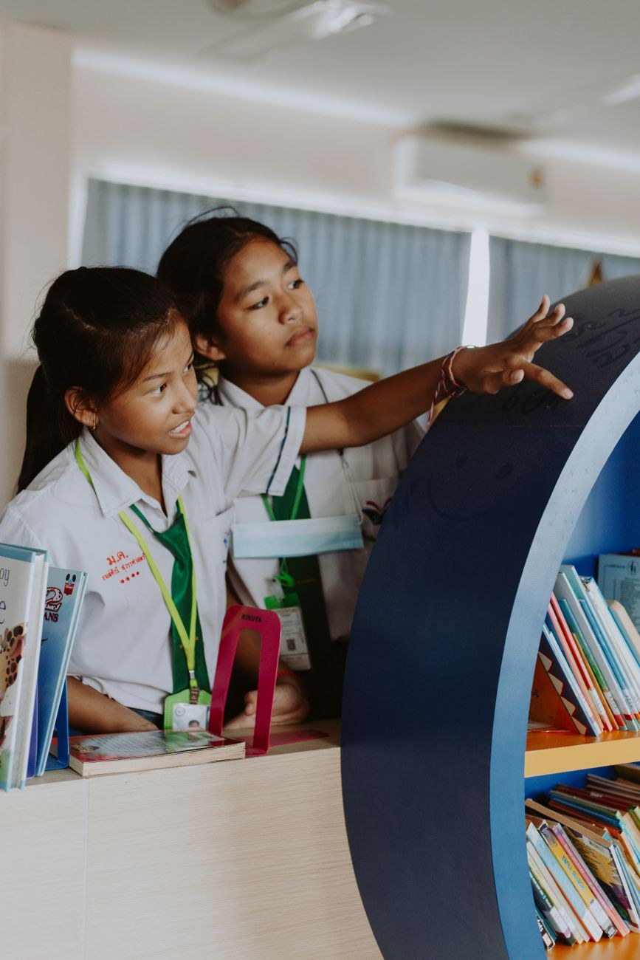
04 · NEED OF THE PROJECT
Need of the Project
Why this matters now
• Rising population of homeless and street children in urban areas.
• Widening gap between NGOs and public support networks.
• Micro-donations (as small as ₹1) have proven high adoption when made easy.
• Students and citizens seek tangible, verifiable ways to give back.
NGO Connect | Slide 4 of 9
Anushri • Shravani • Shreya • Diya • Pradnya

Slide 5

05 · PLAN & METHODOLOGY
Plan & Methodology
Our step-by-step approach
1. Visit local NGOs and understand their capacity and challenges.
2. Identify homeless children in the community and coordinate onboarding.
3. Connect children with NGOs offering shelter, food and schooling.
4. Roll out the '1 Rupee per Household' recurring funding channel.
5. Publish transparent progress and impact reports.
NGO Connect | Slide 5 of 9
Anushri • Shravani • Shreya • Diya • Pradnya

Slide 6

06 · EXPECTED OUTCOME
Expected Outcome
The change we anticipate
• More homeless children admitted into NGOs with shelter and schooling.
• A steady stream of micro-funding supporting daily NGO operations.
• Increased community awareness of local child welfare initiatives.
• A replicable model other student groups and cities can adopt.
NGO Connect | Slide 6 of 9
Anushri • Shravani • Shreya • Diya • Pradnya

Slide 7

07 · TIMELINE & CONCLUSION
Timeline & Conclusion
Phase-wise roll out
Phase 1 (Weeks 1–2): NGO visits, needs mapping and partnerships.
Phase 2 (Weeks 3–4): Child onboarding into partner NGOs.
Phase 3 (Weeks 5–6): Launch of ₹1/household funding channel.
Phase 4 (Ongoing): Awareness drives, feedback and impact reports.
Conclusion: NGO Connect turns small, consistent actions by many into lasting change for children who need it most.
NGO Connect | Slide 7 of 9
Anushri • Shravani • Shreya • Diya • Pradnya

Slide 8
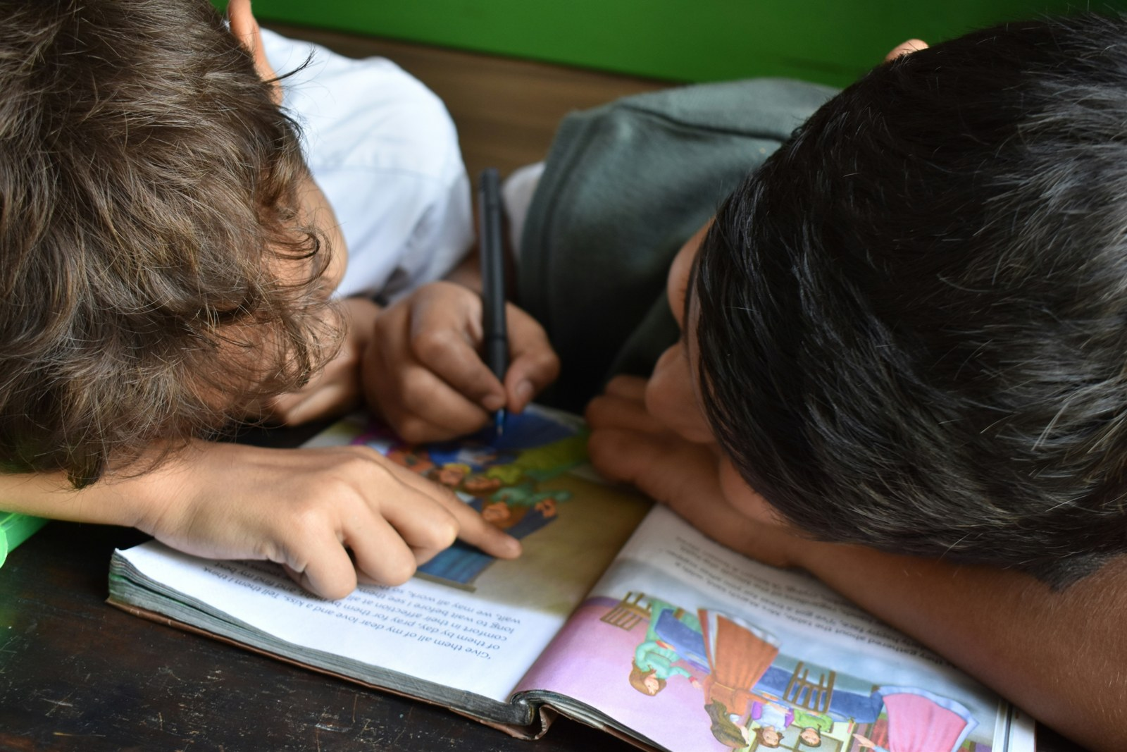
08 · REFERENCES
References
Sources & further reading
• Ministry of Women & Child Development — wcd.nic.in
• UNICEF India reports on street & homeless children
• Local NGO partner list (to be filled by team)
• Articles on micro-donation models and community giving
• Census & NSSO data on urban homelessness
NGO Connect | Slide 8 of 9
Anushri • Shravani • Shreya • Diya • Pradnya

Slide 9

CLOSING
Thank You
Every rupee, every voice, every child matters.
With gratitude —
Anushri, Shravani, Shreya, Diya & Pradnya
Let's build NGO Connect together.
NGO Connect | Slide 9 of 9
Anushri • Shravani • Shreya • Diya • Pradnya

