Slide 1
Movie Rental Store Analysis using Power BI
Data Analytics Project
Presented by: Shreya Dolas

Slide 2
Agenda
Introduction & Problem Statement
Dataset Overview
Data Cleaning
Exploratory Data Analysis (EDA)
Data Modeling (ER Diagram)
Dashboard & KPIs
Insights & Conclusion

Slide 3
Introduction & Problem Statement
Introduction:
Sakila database represents a DVD rental store business
Contains data on customers, films, rentals, payments, staff
Problem:
No clear visibility of business performance
Difficult to track customer behavior & revenue
Inventory and staff performance not optimized
Goal:
Build interactive Power BI dashboard
Provide actionable insights
Improve business decisions

Slide 4
Dataset Overview
About Dataset:
Relational database with multiple tables
Represents complete rental workflow
Key Tables:
Customer → Customer details
Film → Movie information
Rental → Rental transactions
Payment → Revenue data
Inventory → Film stock
Staff & Store → Operations

Slide 5
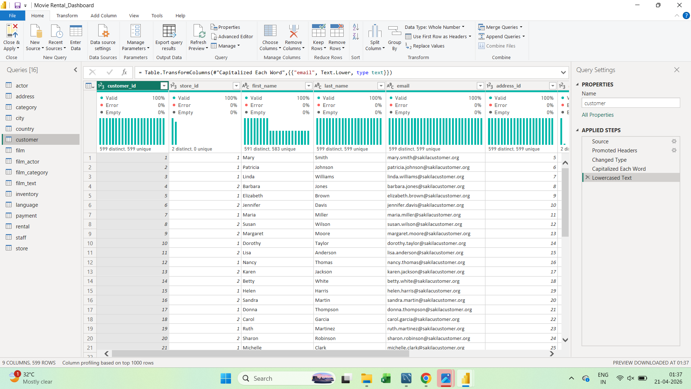
Data Cleaning
Steps Performed:
Removed null values
Handled missing data
Removed duplicates
Corrected data types
Data Validation:
Checked invalid entries
Ensured consistency across tables
Result:
Clean dataset ready for analysis

Slide 6
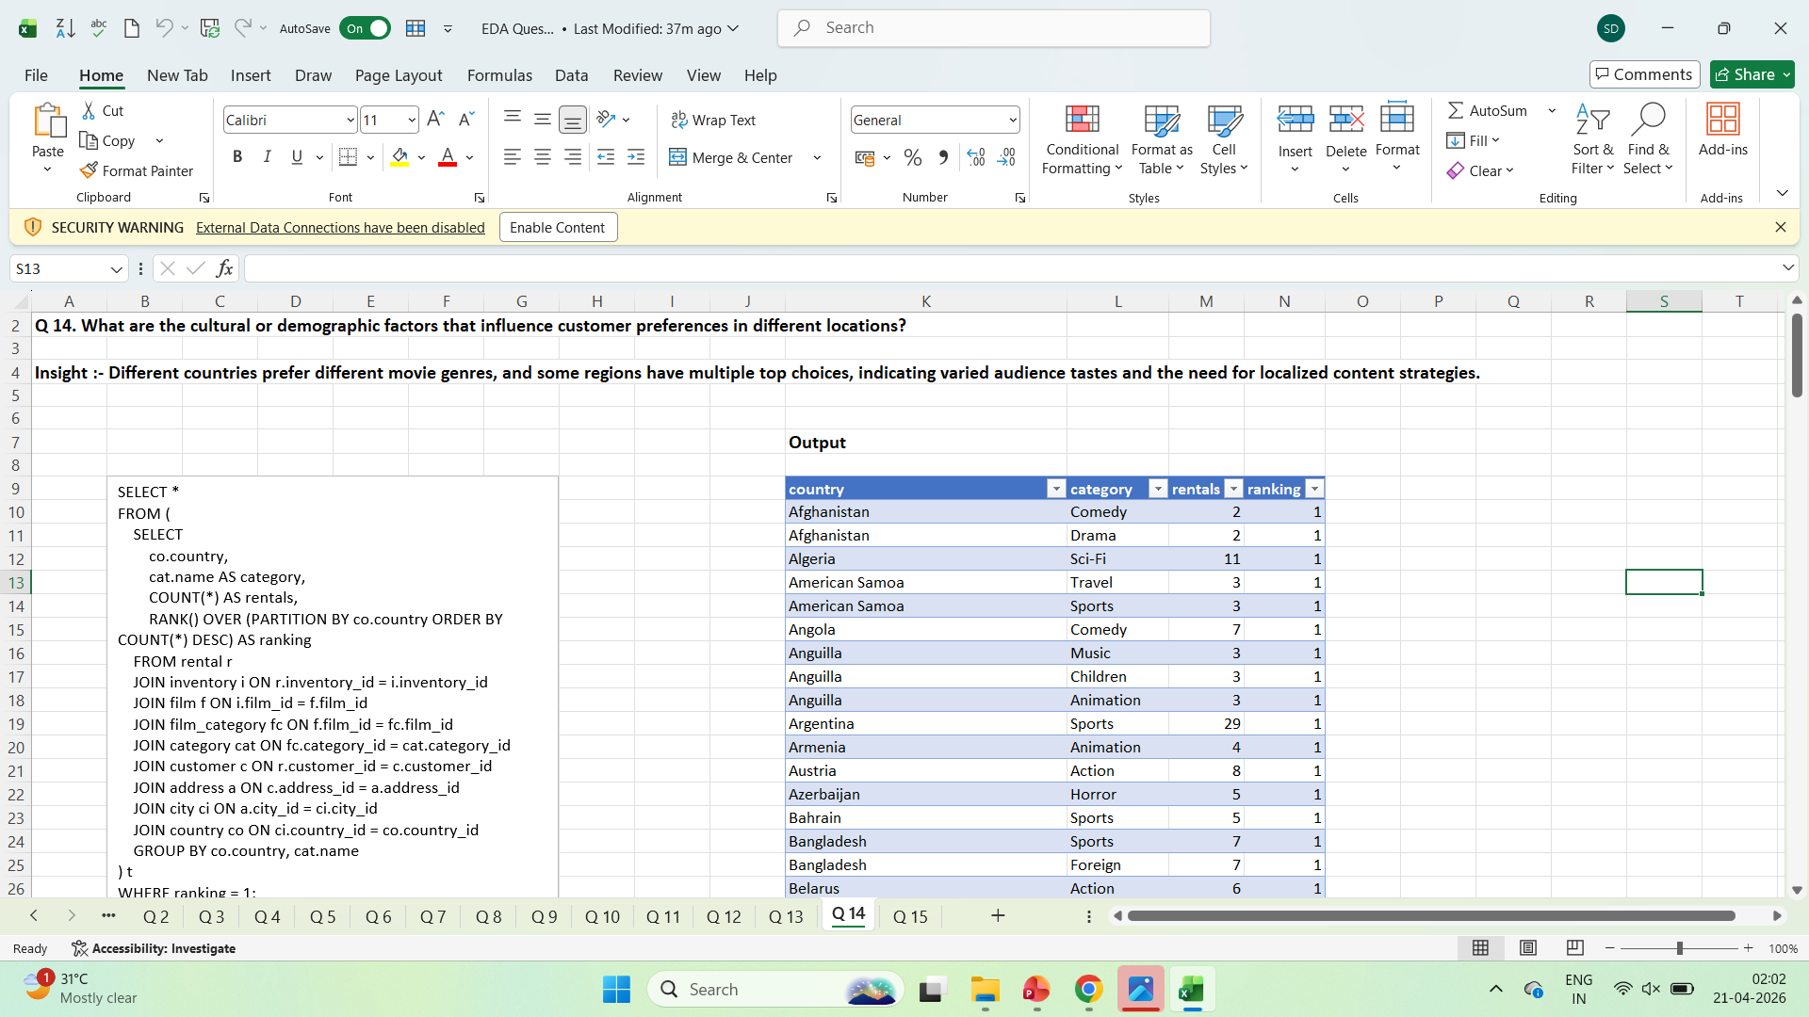
EDA & Key Analysis
Analysis Done:
Rental trends over time
Revenue analysis
Customer segmentation
Film category performance
Store-wise performance
Key Insights:
Few movies generate most revenue
Repeat customers contribute more
Peak rentals during weekends

Slide 7
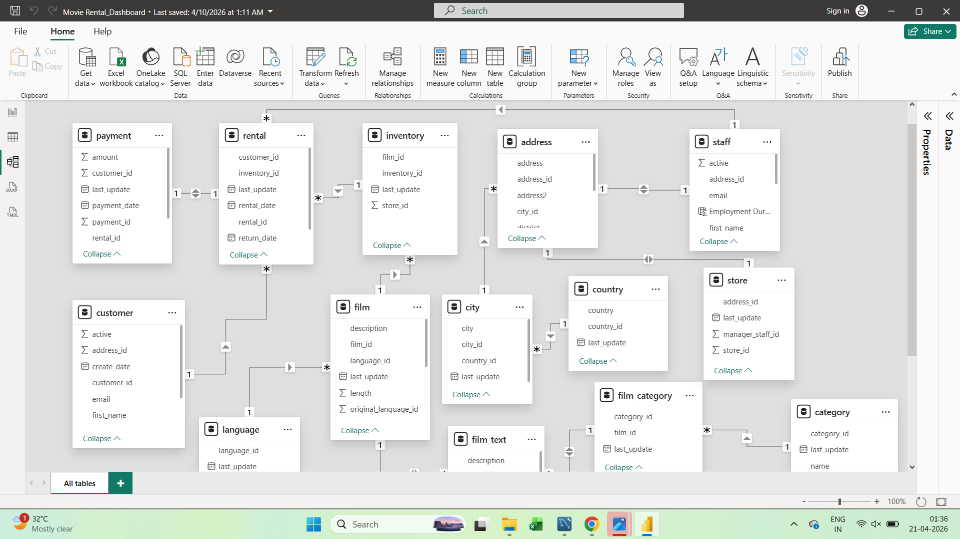
Data Model (ER Diagram)
Model Explanation:
Connected tables using relationships
Used primary & foreign keys
Followed star schema
Important Links:
Customer → Rental → Payment
Film → Inventory → Rental
Benefit:
Fast and efficient analysis

Slide 8
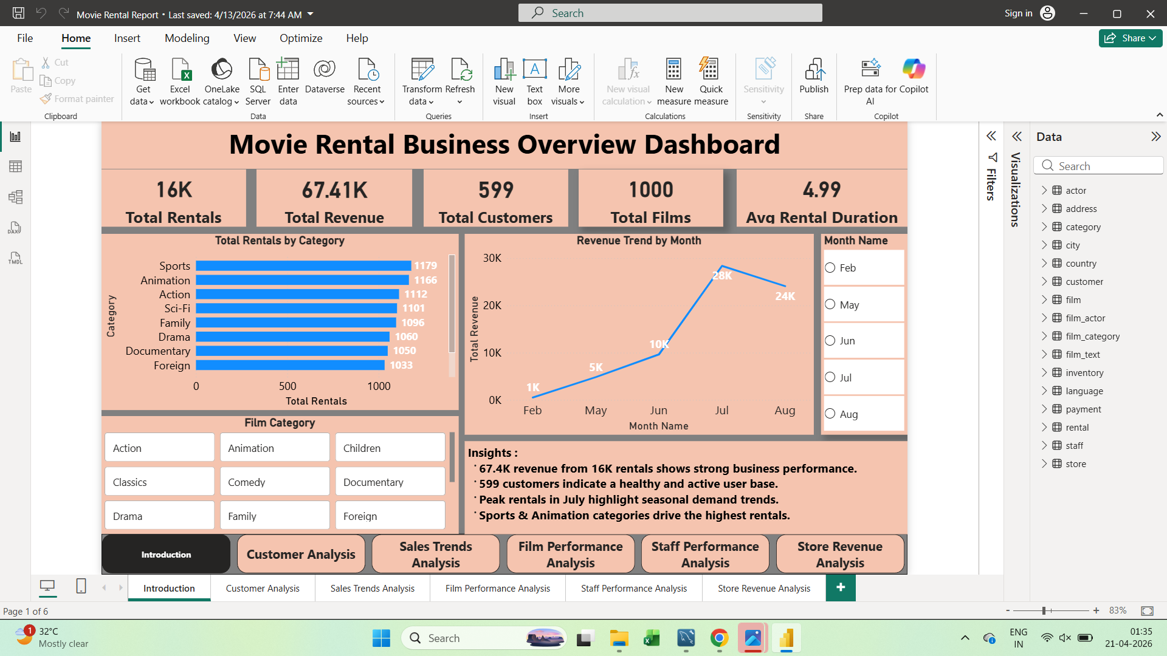
Dashboard & KPIs
KPIs:
Total Revenue
Total Rentals
Total Customers
Average Rental Duration
Dashboard Features:
Filters (Date, Category, Store)
Interactive visuals
Drill-down analysis

Slide 9
Insights & Conclusion
Key Insights:
Top films drive majority revenue
High-value customers identified
Certain categories are more popular
Staff performance varies
Conclusion:
Dashboard improves decision-making
Helps optimize inventory & marketing
Enhances customer satisfaction

