Slide 1

AI Driven Accessible Examination and Assessment
System for
Visually Impaired Students
BY: SHREIYA.D
Abstract
Traditional online exams are not accessible for visually
impaired students as they depend on reading and mouse clicks.
This project proposes an AI-driven accessible examination
system using Text-to-Speech (TTS), Speech-to-Text (STT), and
NLP voice commands. Admin uploads question paper PDF
which is auto-extracted using AI .Students login via voice-
enabled authentication (Name + Reg No with STT/TTS) and take
the exam completely by voice - questions are read aloud,
answers are spoken as "Option A", navigation by saying "Next,
Previous, Repeat, Submit". System also has keyboard fallback
ensuring 100% inclusivity. No external hardware is required .
Introduction
Education must be inclusive. 2.2 billion people have vision
impairment globally. Current exam portals like Google Forms,
Moodle fail for blind students. Our system bridges this gap by
making the entire exam flow hands-free and ear-driven using
Web Speech API and AI PDF parsing. Developed with React +
Fast API.

Slide 2
Objective
Main Objective:
To develop a fully inclusive, AI-driven examination system that
empowers visually impaired students to write exams
independently without a scribe.
Sub-Objectives:
1. Voice-Based Secure Login:
To provide voice-based authentication for blind students using
Name and Registration Number. System will use Speech-to-
Text (STT) to capture spoken input and Text-to-Speech (TTS) to
give audio guidance like "Please say your Registration
Number". This ensures login without needing to see or type.
2. AI Automation for Question Paper Creation:
To automate question paper creation via AI PDF extraction.
Admin uploads any PDF question paper, backend uses
PyMuPDF and AI parsing to automatically extract questions,
options (A, B, C, D), and correct answers and stores in database.
Saves 90% manual typing time.
3. Complete Hands-Free Examination:
To conduct complete exam using only voice. TTS will read
questions and options aloud automatically. STT will capture
student answers when student says "Option A", "Option B", etc.
No mouse, no keyboard needed.
4. NLP-Based Smart Voice Navigation:
To implement NLP commands for navigation. Student can say
"Next" to go next question, "Previous" to go back, "Repeat" to
hear question again, and "Submit" to finish exam. System

Slide 3
understands natural voice variations.
5. Hardware Independence:
To ensure no external hardware is needed. Entire system works
on internal laptop mic and speaker. Also provides keyboard
fallback for devices without mic, ensuring 100% accessibility in
any college lab.
Problem Statement
Visually impaired students cannot read questions, cannot see
options, cannot use mouse. They need a human scribe. No
privacy, dependency, and lack of self-confidence. Existing
system has no voice navigation, no audio feedback, no
accessible login.
Existing System
Moodle, Google Forms, Black board
Requires reading screen
Requires mouse/keyboard precision
Needs external scribe / screen reader (JAWS) which is
costly
PDF question papers are manually typed again

Slide 4
Disadvantages of of Existing System
No voice-controllable
No TTS/STTintegration
Scribe dependency - privacy issue
Expensive screen readers
No AI automation for paper creation
Not usable without hardware
assistance
Proposed System - What WE Are Doing
Admin: Uploads PDF -> AI (PyMuPDF) extracts Q&A -> Saves to
JSON DB.
Student Login: Enter Name + Reg No -> Can SPEAK name, HEAR
instructions via TTS ->Say "Start Exam".
Exam Engine: Auto speaks Q1, options -> Student says "Option

Slide 5
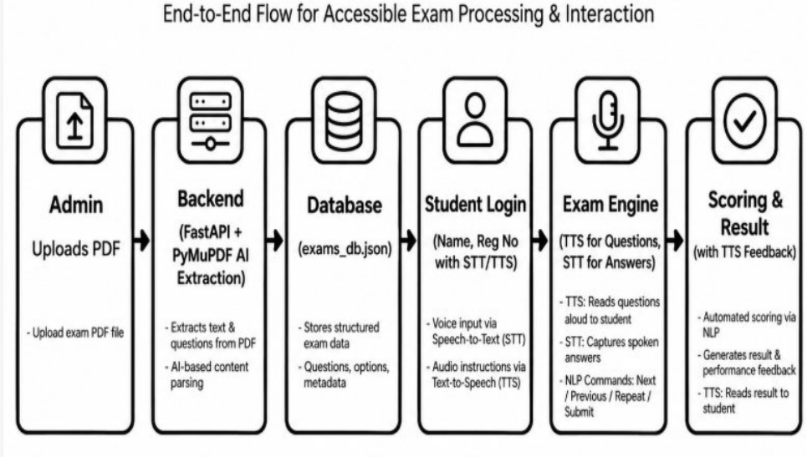
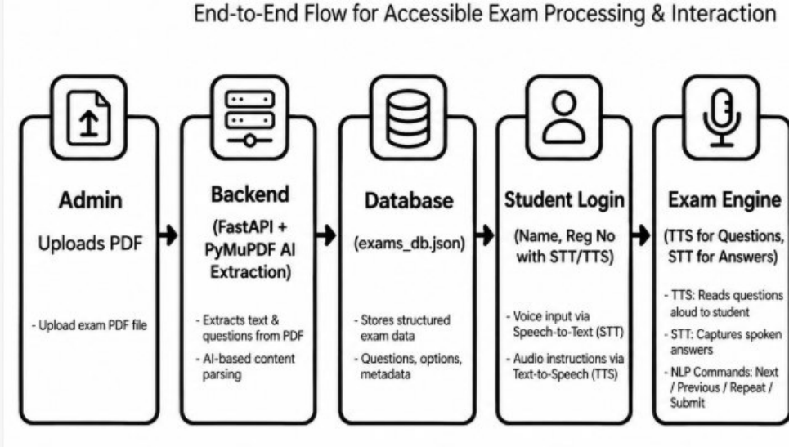

A" or "Next" ->TTS confirms ->Auto-
BLOCK DIAGRAM
Advantages
100% Voice Controlled –
No scribe needed
Privacy and Independence for blind students

Slide 6
AI PDF parsing saves 90% admin time
Dual Mode: Voice + Keyboard fallback - works without
mic also
No external hardware - uses internal laptop mic/speaker
Low cost - Uses Web Speech API (free) not paid JAWSNLP
based smart navigation
Software & Hardware Requirements
Software
Frontend: ReactJS, React-Router, Web Speech API
(Speech Recognition, Speech Synthesis)
Backend: Python Fast API, PyMuPDF (fitz), Uvicorn
Database: JSON / Local Storage (can be upgraded
to MongoDB)Browser
Google Chrome (best for Speech API)
IDE: VSCode
Hardware
Minimum: Any Laptop/PC with internal mic and
speaker (No external mic required)
Recommended: 4GB RAM, i3 Processor

Slide 7
References
Web Speech API - MDN Docs
PyMuPDF Documentation
FastAPI Documentation
WHO Report on Vision Impairment 2023
Research Paper: Accessible e-learning for visually
impaired - IEEE 2022

