Slide 1
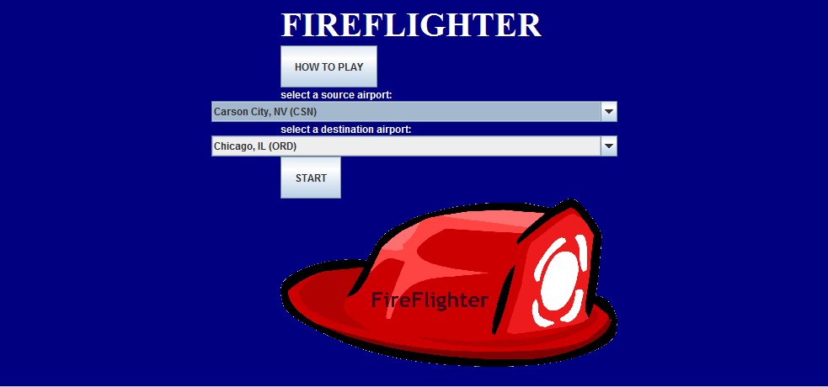
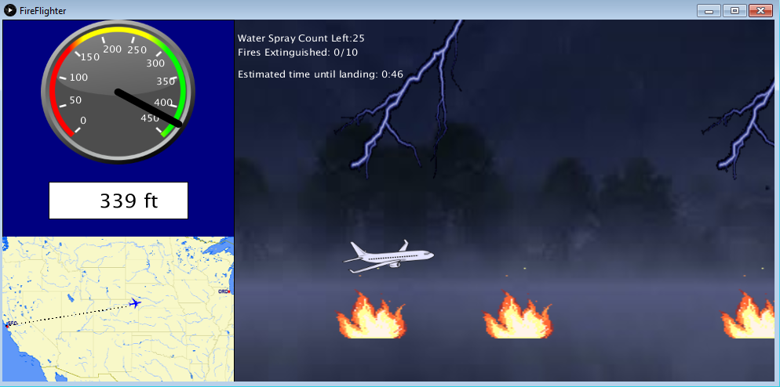
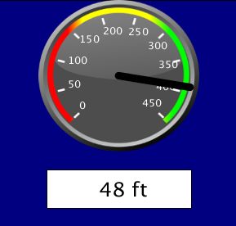
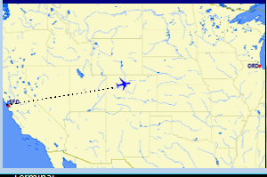

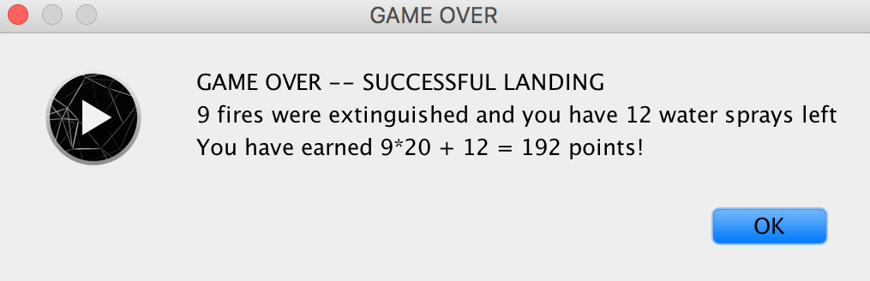
FIREFLIGHTER
By: Ashwini Suriyaprakash, Rujuta Swadi, Shreya Ganti
Notes:
All introduce their names
Ashwini introduced project

Slide 2
Introduction
Forest fires plague the Earth…
You have the chance to be pilot of a FireFlighter plane to extinguish the fires...
Single player flight simulation
Goals:
Successfully take off and land plane
Spray water efficiently to extinguish fires
Avoid lightning strikes
Monitor plane with location tracker, speed dial, and altitude
Notes:
Ashwini

Slide 3
Notes:
Ashwini

Slide 4
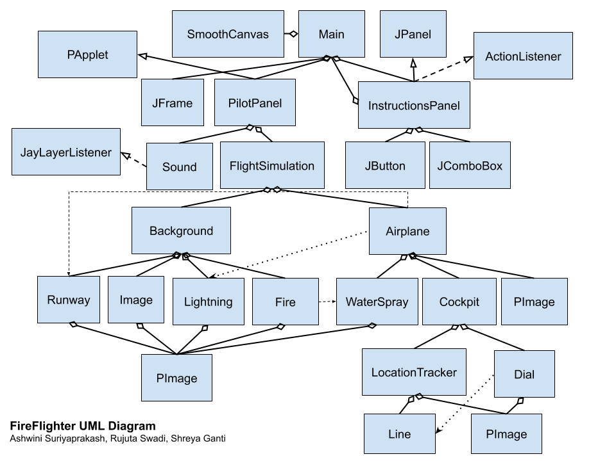
Code Overview: UML
Notes:
Shreya

Slide 5
Code Overview: Design Choices
HAS-A-relationships
Airplane HAS WaterSprays, Cockpit
Background HAS Runways, Lightning, Fires
PApplet vs. Swing graphics
PApplet for pilot view (more familiarity, better drawings, less laggy)
Swing for instructions screen (provides buttons and selection boxes)
Used PImage class from Processing to draw scenery images/gifs instead of a 2d tile map
Notes:
Shreya

Slide 6
Code Overview: Challenges
Location Tracker
Challenge: generating a geographic map based on source and destination airports selected
Solution: Scraping map images from Great Circle Maps website
Speed Dial
Challenge: Rotating the indicator depending on the plane’s speed
Solution: Trigonometric calculations and using graphics from Processing library
Notes:
Shreya

Slide 7
Controls
← decrease speed
→ increase speed
↑ increase altitude
↓ decrease altitude
ப space bar to drop water
Notes:
Rujuta

Slide 8
Controls
Rules
Successful takeoff: speed can’t be in dial’s red zone and plane should be in air
Successful landing: speed can’t be in dial’s green zone and plane should be on runway
Hints
Keep track of time remaining to prepare for successful landing
Lower elevation to avoid lightning
Notes:
Rujuta

Slide 9


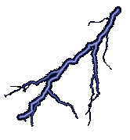
Current Features
Fires: generated at random locations along route
Water Sprays: needed to extinguish fires
Lightning: generated at random locations along route (being struck results in unsuccessful flight)
Notes:
Ashwini

Slide 10
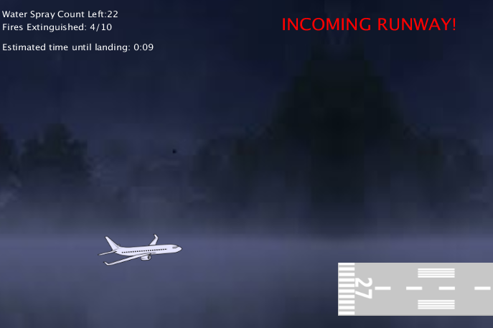
Current Features
Live Location Tracker
Customized map based on source & destination
Shows plane location
Incoming Runway Alert
Allows player to prepare for landing
Notes:
Ashwini

Slide 11

Current Features
Accurate speed dial
Refer to for takeoff and landing
Estimated Time Left
Allows player to prepare for landing
Points System
Points = (20*fires extinguished) + number of water sprays not used
Notes:
Shreya

Slide 12
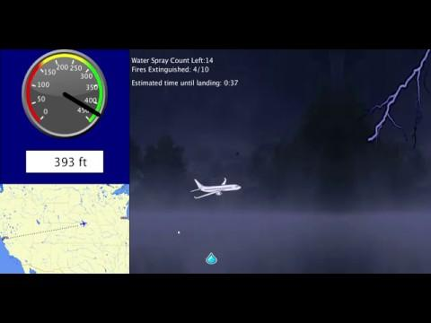
Run FireFlighter
Download zip and run jar file!
Notes:
Shreya

Slide 13
Bugs
Rare Exception: “IllegalStateException: Buffers have not been created”
Potential causes: bug in Processing library /some computers have slower processors
Plane in location tracker map continues moving until the actual plane lands (even if the plane has passed the landing runway)
Notes:
Rujuta

Slide 14
Bugs
Switching of source and destination airports on the location tracker map
Possible solutions:
Use more image processing to determine where each airport is
Allow user to switch source and destination if they are not displayed correctly
Notes:
Rujuta

Slide 15
Next Steps
Make the landing and brakes more realistic
More obstacles & weather to avoid (birds, other planes, rain, hail, snow, etc..)
Background of simulation customized based on selected source and destination
Store where players can buy plane upgrades
Flights with multiple take offs and landings
Refueling, stop-over airports
Top view simulation with 3D graphics
Notes:
Ashwini

Slide 16
Credits
Team Member Roles
Ashwini: Airplane, WaterSpray, Fire, Lightning, Background, LocationTracker, Image, Runway, Main
Shreya: Dial, LocationTracker, Cockpit, PilotPanel, FlightSimulation, Background, Main
Rujuta: Airplane, FlightSimulation, PilotPanel, InstructionsPanel, Sound, Main
Line class: from Ashwini’s Shapes library
Media (images, gifs, sounds)
Airplane image: http://clipart-library.com/airplane-cliparts.html
Background scenery image: https://www.videoblocks.com/video/dark-scary-lake-at-night-background-loop-raw-1-white-haze-floating-over-the-still-lake-surrounded-by-a-creepy-forest-seamless-looping-perfect-for-backgrounds-backdrops-intro-outro-or-credits-for-themes-like-halloween-apocalypse-9ulijtp
Fire/smoke gifs: http://www.animatedimages.org/cat-fire-90.htm
Water spray image: http://clipartportal.com/water-drop-clipart-png-6/
Speed dial image: http://www.clker.com/clipart-dial-5.html
Runway image: http://www.clker.com/clipart-24386.html
Map images: http://www.gcmap.com/
Small airplane tracker image: http://clipart-library.com/airplane-cliparts.html
Firefighter hat image: http://clipart-library.com/fire-hat-clipart.html
Sound mp3 file: https://www.soundjay.com/airplane-sound-effect.html
Used Stack Overflow for example code for Box Layout
Notes:
Rujuta

