Slide 1

Project Presentation of CO-OP Project at Industry (Module-2) (22CS421)
On
Predicting Stock Prices Using
Machine Learning vs. Deep Learning
Shreya Garg
2210992341
Supervised By
Dr. Gifty Gupta
Department of Computer Science and Engineering, Chitkara University, Punjab

Slide 2
Agenda
Introduction & Background
Literature Review
Methodology & Research Design
Dataset & Feature Engineering
Models & Experimental Setup
Results & Performance Comparison
Discussion
Limitations & Future Scope
Conclusion
2

Slide 3
Introduction
Stock price prediction sits at the crossroads of finance and computer science — complex, high-stakes, and notoriously difficult.
The Efficient Market Hypothesis suggests prices already reflect all available information — yet short-term exploitable patterns do exist.
Classical methods (ARIMA, Linear Regression) assume linearity and stationarity — rarely true for real markets.
Machine learning methods (SVR, Random Forest, Gradient Boosting) model non-linear relationships without stationarity assumptions.
Deep learning (LSTM, GRU) can learn long-range dependencies from raw sequences without explicit feature engineering.
Published comparisons are rarely controlled — different stocks, time windows, splits, metrics — making it hard to draw conclusions.
This study: six models, one dataset, identical conditions, five evaluation metrics.
3

Slide 4
Research Objectives
01
02
03
Lowest Error
Best Direction
ML vs DL
Which model achieves the lowest prediction error (RMSE & MAE) on unseen test data?
Which model most accurately predicts daily price direction — the key metric for trading?
Under what conditions do classical ML methods remain competitive with deep learning?
4

Slide 5
Literature Review
ARIMA (classical): assumed stationarity & linearity — rarely holds for real financial data [15].
SVM & ensemble methods (2000s): modelled non-linear relationships; improvement largely from better features, not better algorithms [11][12].
Fischer & Krauss (2018): strong LSTM performance on S&P 500 — but still used engineered features [1].
Sezer et al. (2020): reviewed 150+ papers; different datasets/metrics make fair comparison extremely difficult [2].
Nikou et al. (2019): classical ML with feature engineering remained highly competitive with deep learning [5].
Krauss et al. (2017): Gradient Boosting often matched or exceeded deep learning on S&P 500 [12].
Key consensus: deep learning advantages emerge most on large datasets (5,000+ samples); classical ML often wins on moderate-sized datasets [2][3][6].
Publication bias: positive results get published — literature likely overstates typical performance [6].
5

Slide 6
Methodology
Key Design Decisions
Data Collection (OHLCV, Jan 2019 – Dec 2023)
Controlled Experiment: Same dataset, same seeds, same metrics for all 6 models.
Temporal Integrity: No shuffling — chronological split maintained.
ML Pipeline: 16-dimensional feature vector per time step.
DL Pipeline: 30-day sliding window of raw closing prices.
Normalization: Min-max scaling [0,1] fitted on training data only — no leakage.
Evaluation: 5 metrics computed on held-out 239-day test set.
▼
Feature Engineering (16 Technical Indicators)
▼
Train / Test Split 80% Train | 20% Test
▼
ML Models (16 Features) + DL Models (30-day window)
▼
Model Evaluation (RMSE, MAE, R², MAPE, Dir. Acc.)
▼
Results & Analysis
6

Slide 7
Dataset & Feature Engineering
The Google Dataset
16 Engineered Features (ML Models)
1,192 usable trading days
January 2019 – December 2023
Four market regimes:
Jan 2019 – Feb 2020: Pre-pandemic growth
March 2020: COVID-19 crash
Apr 2020 – Nov 2021: Tech bull market
2022–2023: Partial bear market recovery
Split: 953 days train | 239 days test (80/20)
MA_10, MA_50
EMA_12, EMA_26
MACD
RSI (14-period)
Bollinger Band Width
Rolling Volatility
Volume MA (5-day)
Lag_1, Lag_2, Lag_3, Lag_5
7

Slide 8
Models & Experimental Setup
Machine Learning Models
Deep Learning Models
Linear Regression
LSTM-equivalent MLP
Standard OLS on 16-feature vector
3 hidden layers: 128 → 64 → 32
ReLU activation, Adam optimizer, 50 epochs
SVR (RBF kernel)
C=100, gamma=0.01, epsilon=0.01
GRU-equivalent MLP
2 hidden layers: 96 → 48
tanh activation, Adam optimizer, 50 epochs
Random Forest
200 trees, max depth 15
Gradient Boosting
300 iterations, learning rate 0.05
ML Input: 16 engineered features per day | DL Input: 30-day sliding window of raw closing prices
8

Slide 9
Results — Performance Metrics
Rank | Model | Type | RMSE ($) | MAE ($) | R² | MAPE (%) | Dir. Acc. (%)
1 | Linear Regression ★ | ML | 0.60 | 0.49 | 0.9987 | 0.43 | 88.66
2 | SVR (RBF) | ML | 0.65 | 0.52 | 0.9985 | 0.45 | 89.08
3 | Random Forest | ML | 0.95 | 0.76 | 0.9968 | 0.66 | 79.41
4 | Gradient Boosting | ML | 0.98 | 0.79 | 0.9965 | 0.69 | 81.09
5 | LSTM (Deep MLP) | DL | 2.87 | 2.17 | 0.9701 | 1.90 | 45.38
6 | GRU (Deep MLP) | DL | 3.09 | 2.36 | 0.9654 | 2.06 | 47.90
Table I: All Six Models on Google Test Set (239 trading days)
9

Slide 10
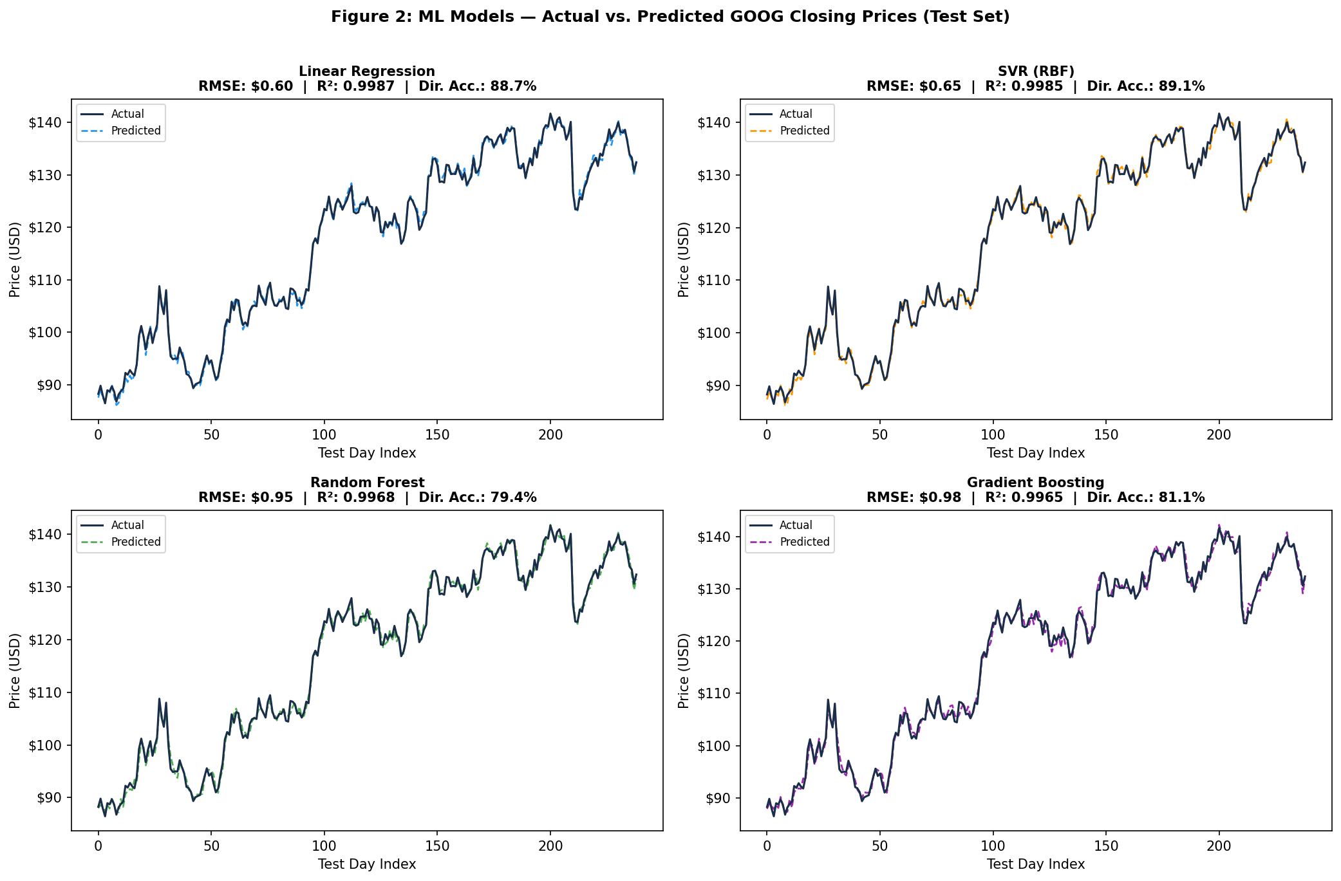
Results — ML Model Predictions
Figure 1: ML Models — Actual vs. Predicted Google Closing Prices
10

Slide 11
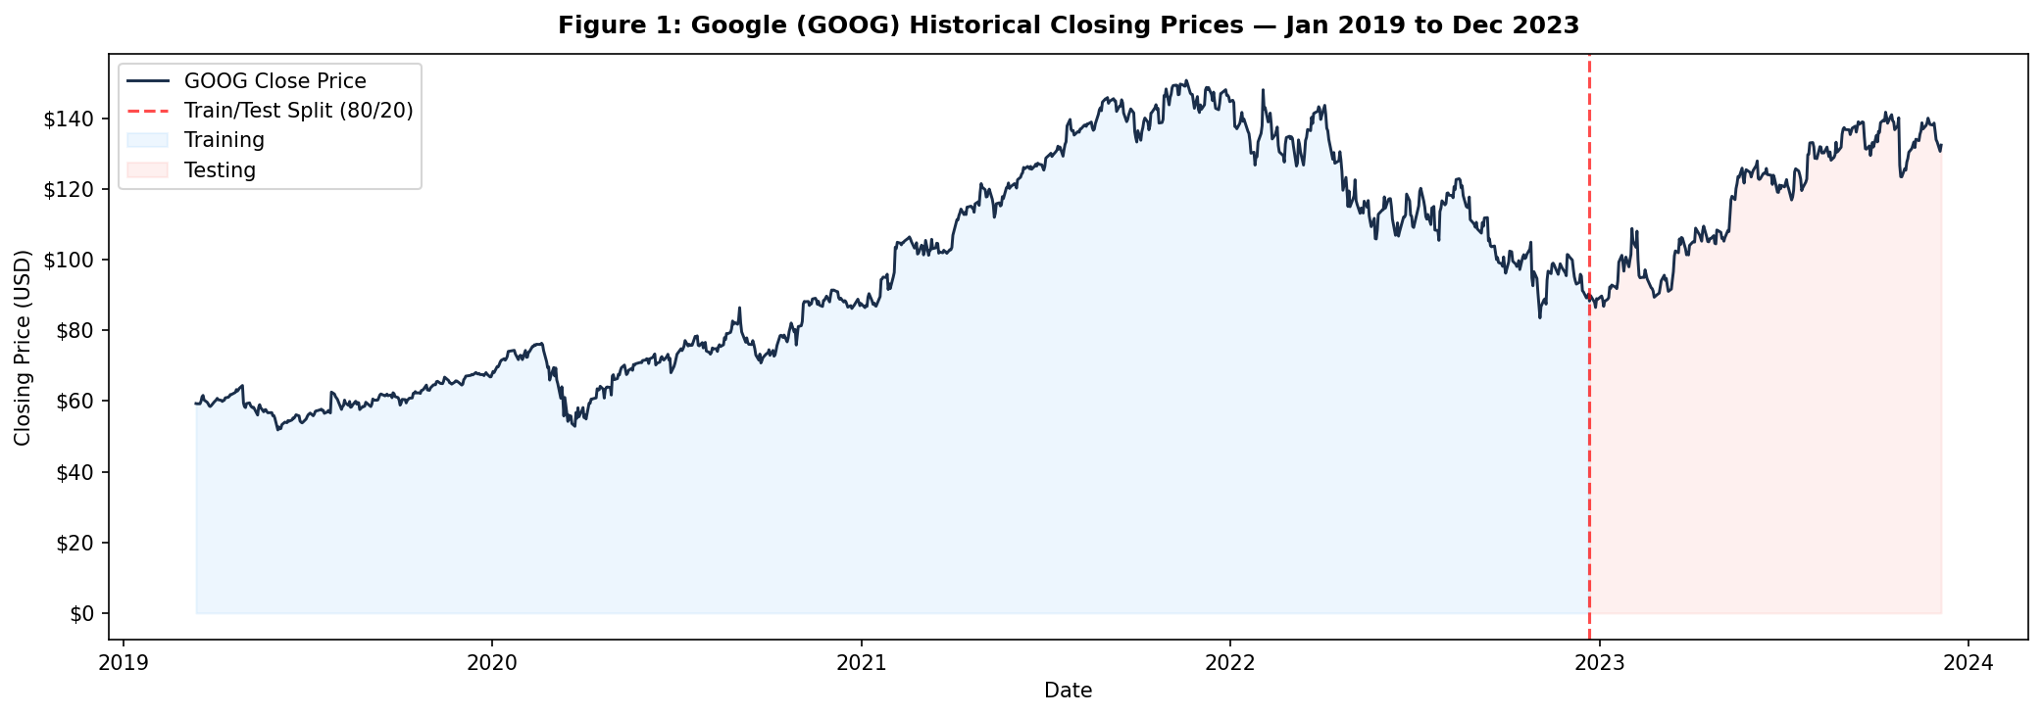
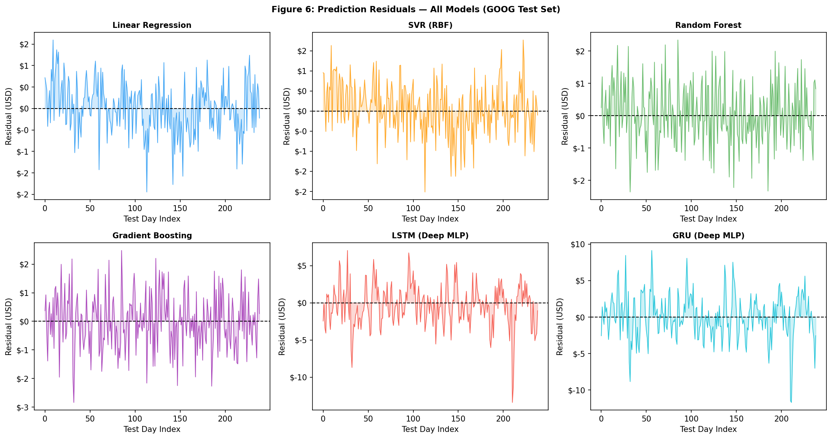
Results — Price History & DL Predictions
Figure 2: Google Historical Closing Prices
Figure 3: Deep Learning Models — Actual vs. Predicted Google Closing Prices
11

Slide 12
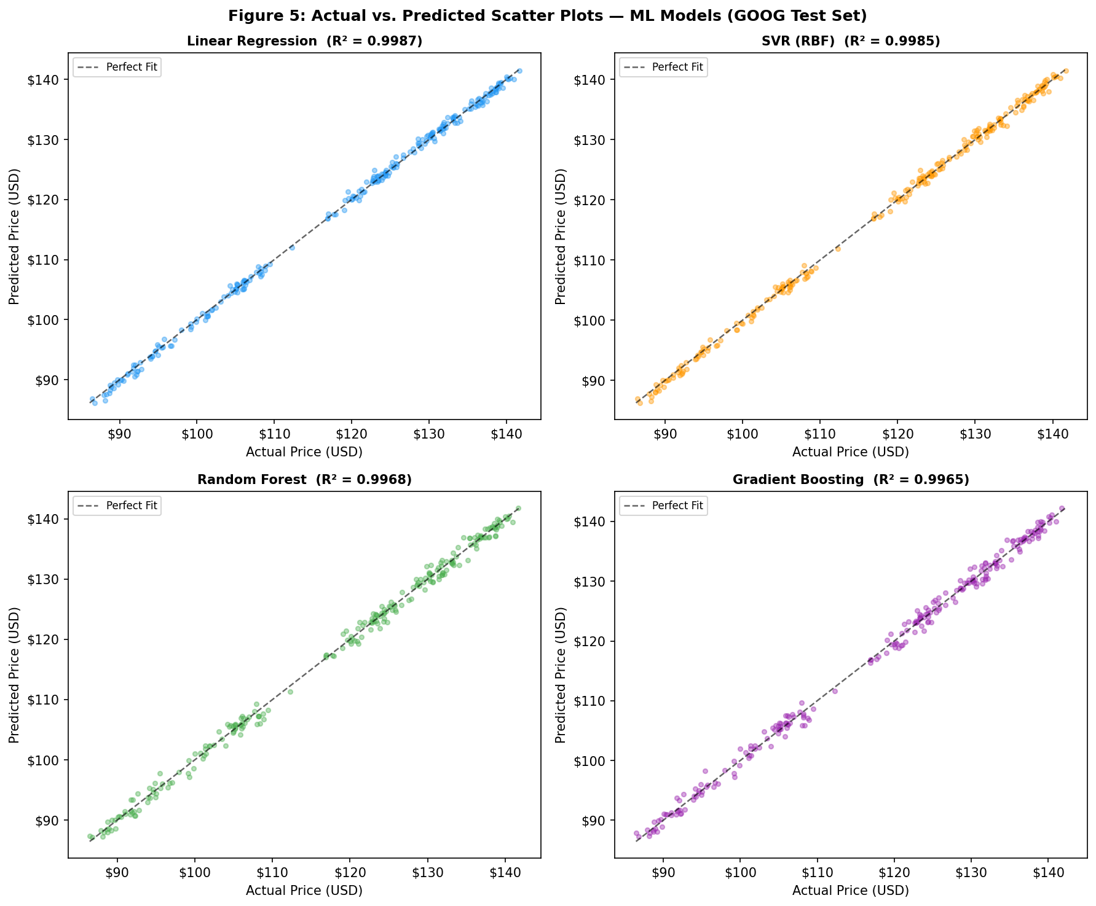
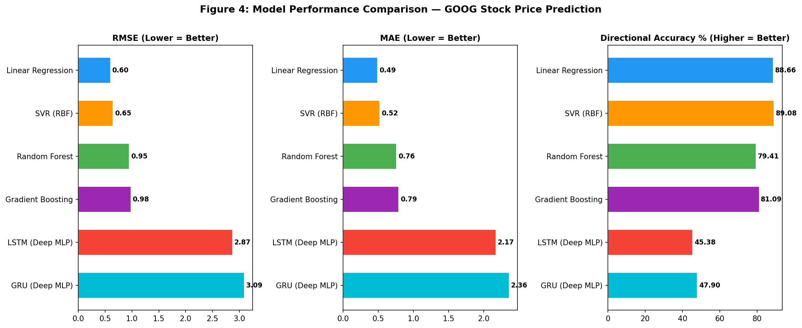
Results — Metric Comparison
Figure 4: Scatter Plots — Actual vs. Predicted Prices
Figure 5: Performance Comparison — RMSE, MAE, Directional Accuracy
12

Slide 13
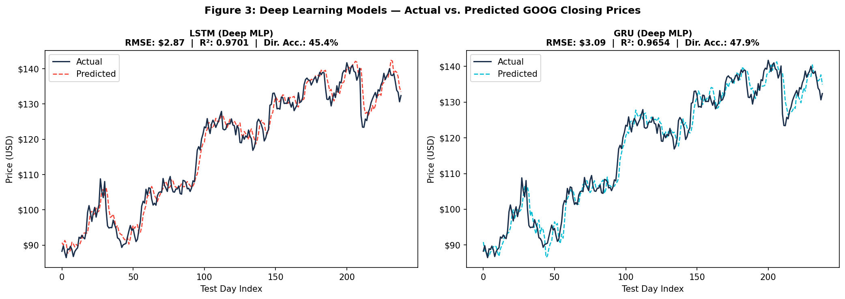
Results — Prediction Residuals
Figure 6: Prediction Residuals for All Six Models
13

Slide 14
Key Findings at a Glance
$0.60
89.08%
>$2.80
16 vs 30
Best RMSE
(Linear Regression)
Best Directional Accuracy
(SVR RBF)
DL Model RMSE
(LSTM & GRU)
Features vs Window
(ML vs DL input)
R² = 0.9987
~212 / 238 days correct
45–48% directional accuracy
Feature engineering wins
14

Slide 15
Discussion
Why ML Beat DL Here?
The Directional Accuracy Story
Comparison with Literature
ML had 16 engineered indicators; DL only saw raw 30-day price sequences.
Test period (2022–2023) had smooth trends — favourable for moving average features.
953 training samples falls below where deep learning typically shows its advantage.
SVR's 89.08% directional accuracy is the most practically significant result.
Nelson et al. [8]: directional accuracy matters more for trading than exact price.
Correctly predicting up/down on 9/10 days has real trading value.
Nikou et al. [5]: classical ML competitive with DL even with feature engineering.
Krauss et al. [12]: Gradient Boosting matched DL on S&P 500 data.
Consensus [2][3][6]: model choice should follow data characteristics, not fashion.
15

Slide 16
Limitations & Future Scope
Limitations
Future Scope
MLP approximations, not true LSTM/GRU recurrent architectures.
Single stock (GOOG) — limits generalizability.
Smooth test period favoured moving average features.
953 training samples below deep learning's optimal range.
No alternative data (news sentiment, macro indicators).
Implement true LSTM/GRU recurrent architectures.
Multi-asset evaluation across sectors and indices.
Integrate news sentiment and macroeconomic features.
Explore CNN-LSTM and Transformer-based hybrid models.
Test across volatile periods (2020 crash, 2022 bear).
Ensemble ML + DL predictions to combine strengths.
16

Slide 17
Conclusion
Compared six models on 1,192 trading days of real Google stock data (2019–2023).
Linear Regression achieved the best RMSE of $0.60 with R² = 0.9987.
SVR (RBF) achieved the best directional accuracy at 89.08% — correctly predicting price direction on ~212 of 238 test days.
Both deep learning models (LSTM, GRU) struggled: RMSE > $2.80, directional accuracy 45–48%.
Gap explained by richer ML features, smooth test conditions, and small dataset size.
Key takeaway: invest in feature engineering — it often matters more than algorithm choice on moderate-sized datasets.
Results align with emerging consensus in literature [2][3][5][6][12]: ML remains highly competitive on datasets of this scale.
17

Slide 18
Thank You
Shreya Garg | 2210992341
Department of Computer Science and Engineering
Chitkara University, Punjab
18

