Slide 1
CSP
Constraint Satisfaction Problems (CSPs) are a fundamental topic in artificial intelligence and computer science. They involve finding a solution that meets a set of constraints or conditions. Backtracking search is a powerful technique used to solve these problems.
The goal in a CSP is to assign values to all variables from their respective domains such that all constraints are satisfied.
Backtracking is used for depth first search that chooses values for one variable at a time and backtracks when a variable has no legal left to assign.
Examples of CSPs
  Sudoku: Filling a 9×9 grid with digits so that each row, column, and 3×3 subgrid contains all digits from 1 to 9 without repetition.
  Map Coloring: Coloring a map with a limited number of colors so that no adjacent regions share the same color.
  N-Queens: Placing N queens on an N×N chessboard so that no two queens threaten each other.

Slide 2
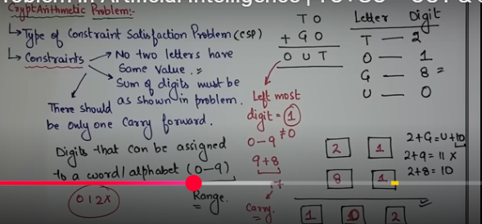
Cryptarithmetic Problem

Slide 3
Cryptarithmetic Problem
EAT + THAT = APPLE
1
Alphabet | Digit
E | 8
A | 1
T | 9
H | 2
P | 0
L | 3
1
E 8
A 1
T 9
1
T 9
H 2
A 1
T 9
A 1
P 0
P 0
L 3
E 8

Slide 4
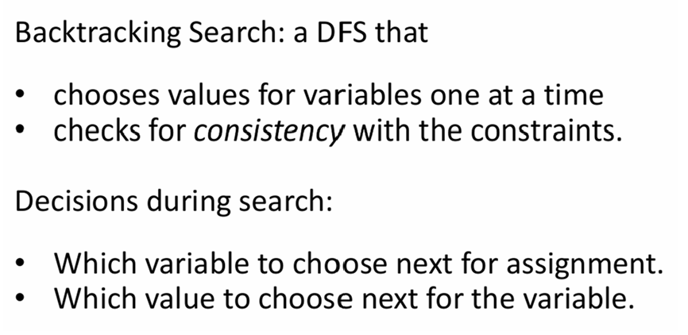
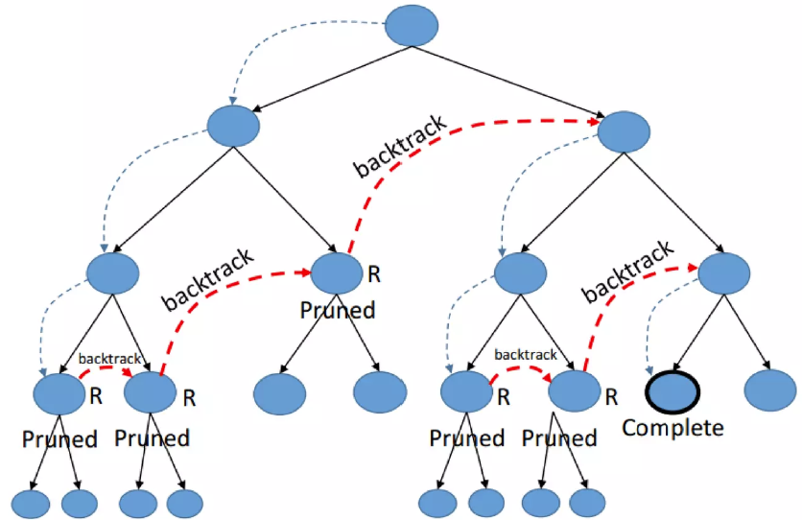
Backtracking Search

Slide 5
Improve Backtracking Efficiency
In constraint satisfaction problems, heuristics can be used to improve the performance of a bactracking solver. Three commonly given heuristics for simple backtracking solvers are:
Minimum-remaining-values (how many values are still valid for this variable)
Degree heuristic (how many other variables are affected by this variable)
Least-constraining-value (what value will leave the most other values for other variables)

Slide 6
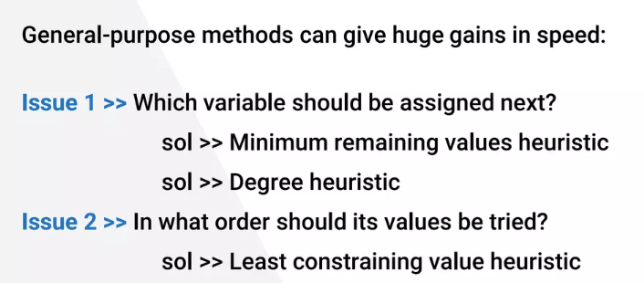
Improve Backtracking Efficiency

Slide 7
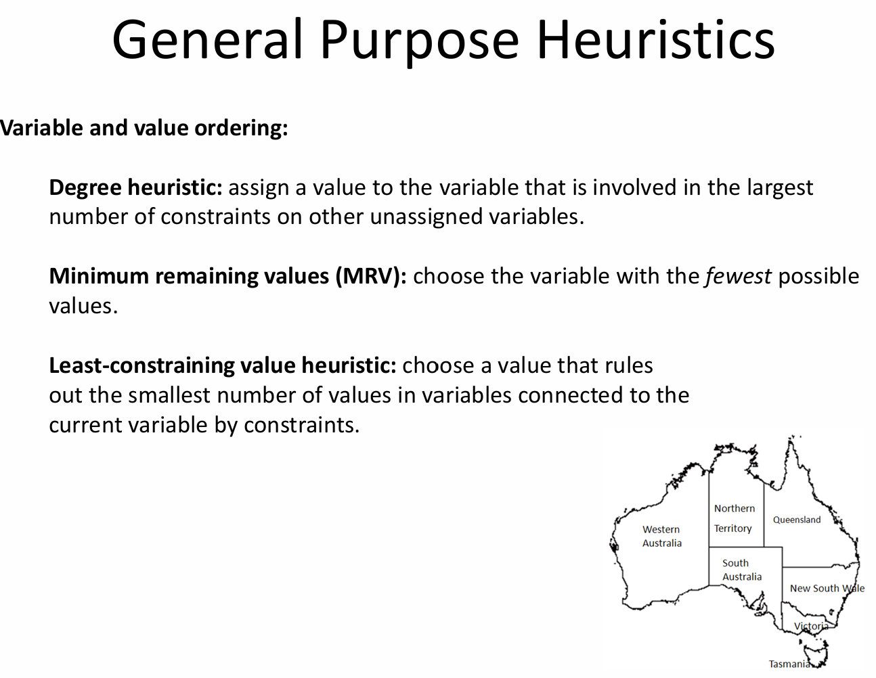
The Minimum Remaining Values (MRV) heuristic is a strategy used in solving Constraint Satisfaction Problems (CSPs). It helps in deciding which variable to assign a value to next. The idea is to choose the variable with the fewest legal values left, which means it is the most constrained variable.

Slide 8
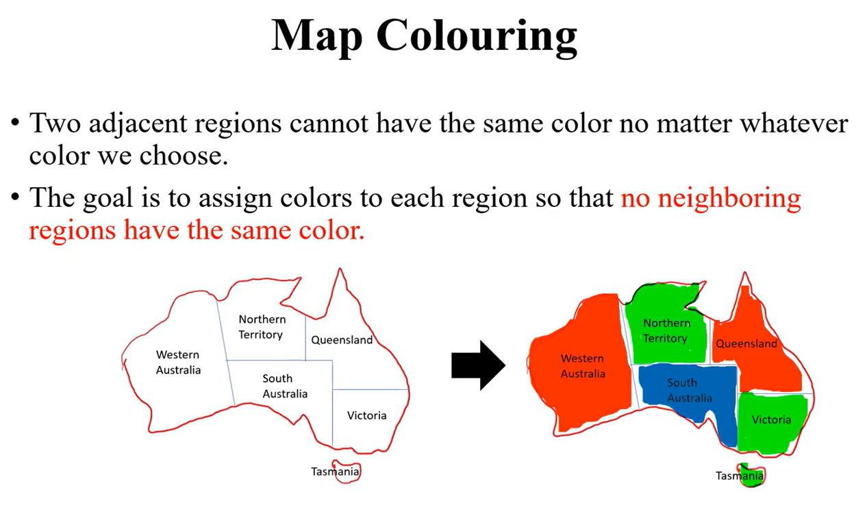

Slide 9
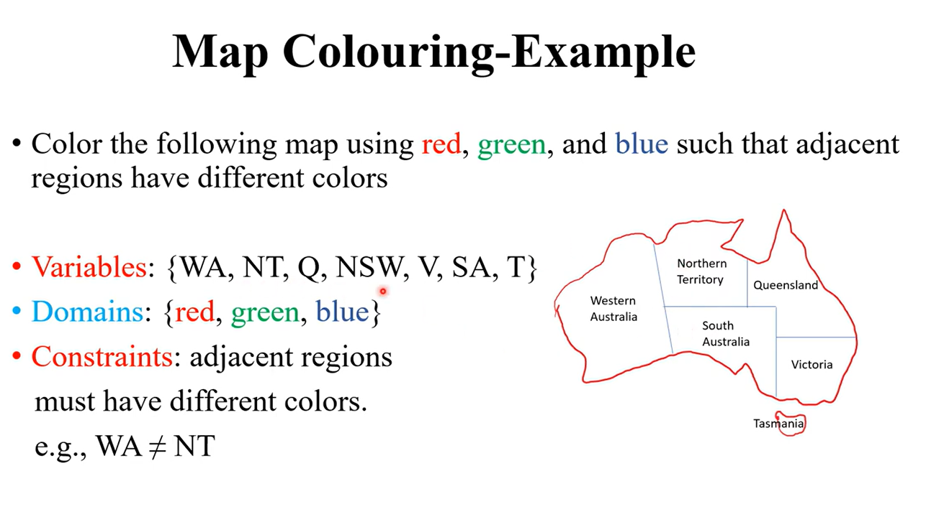

Slide 10
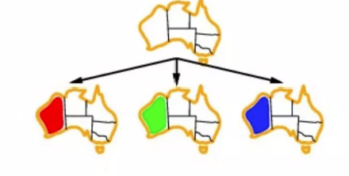
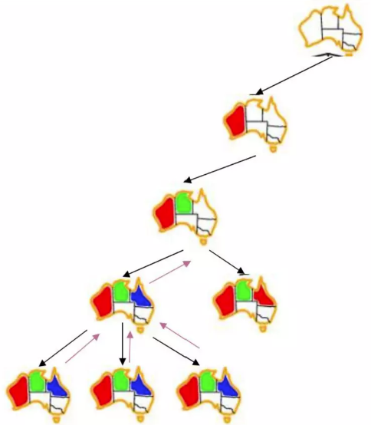
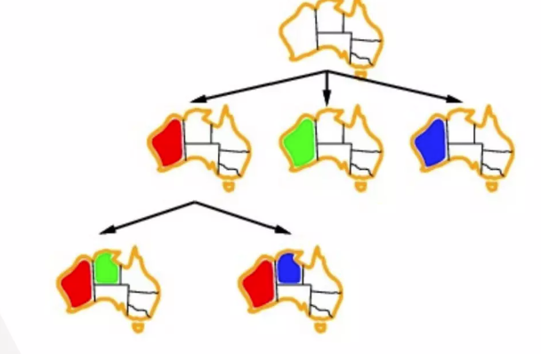

Slide 11
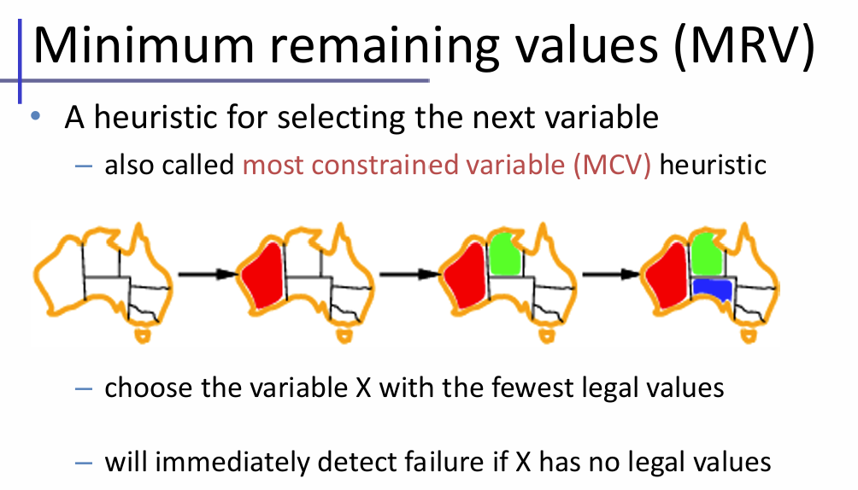
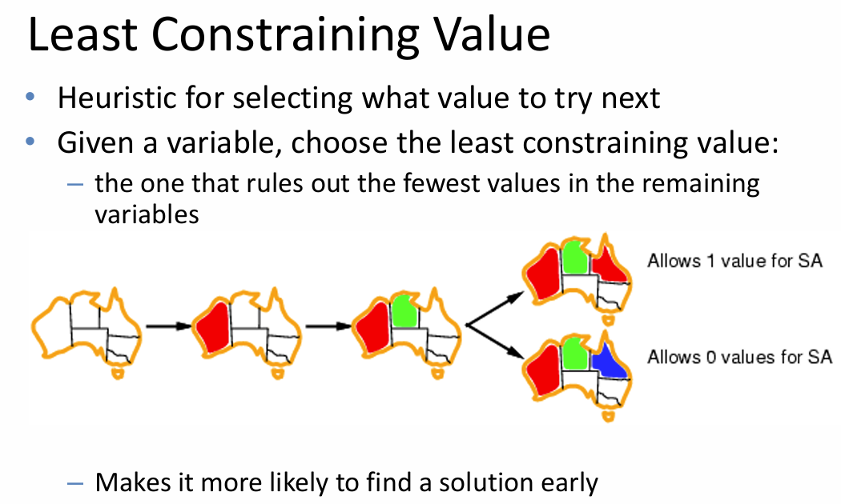
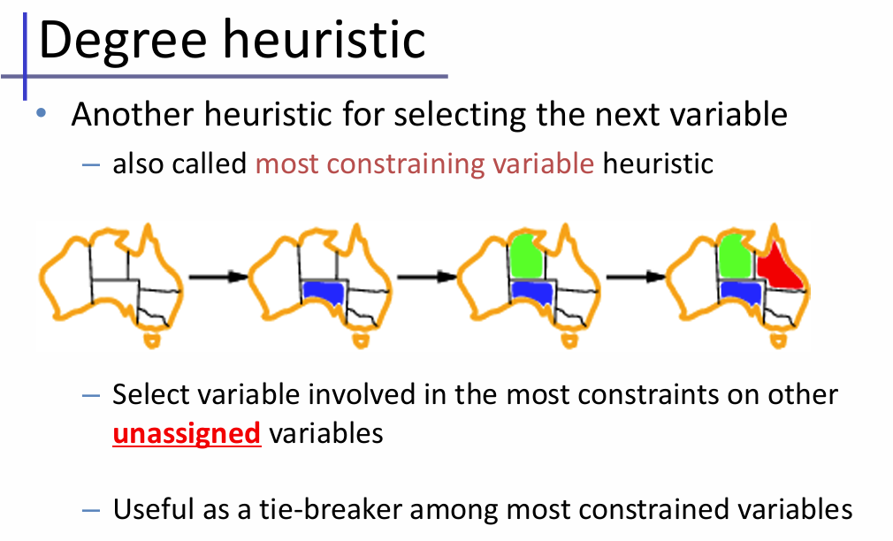

Slide 12
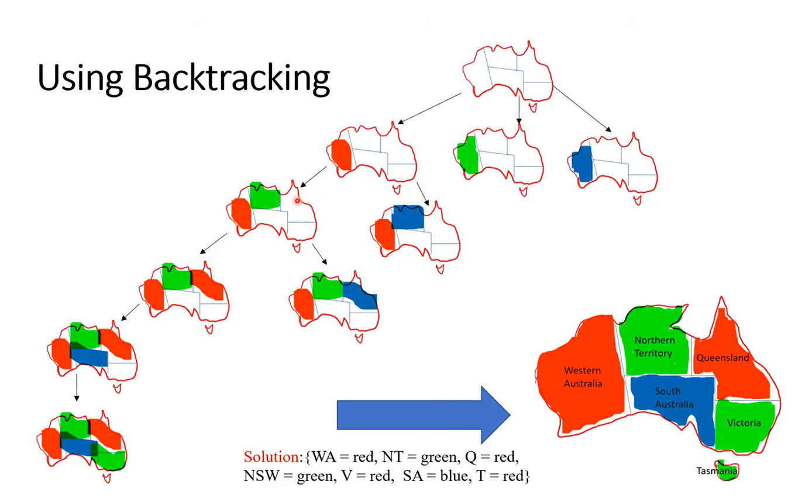

Slide 13
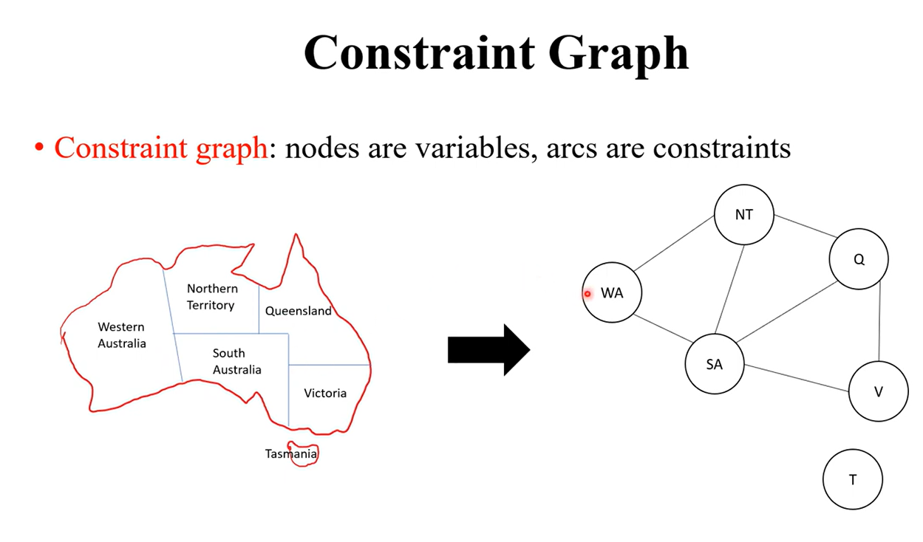

Slide 14
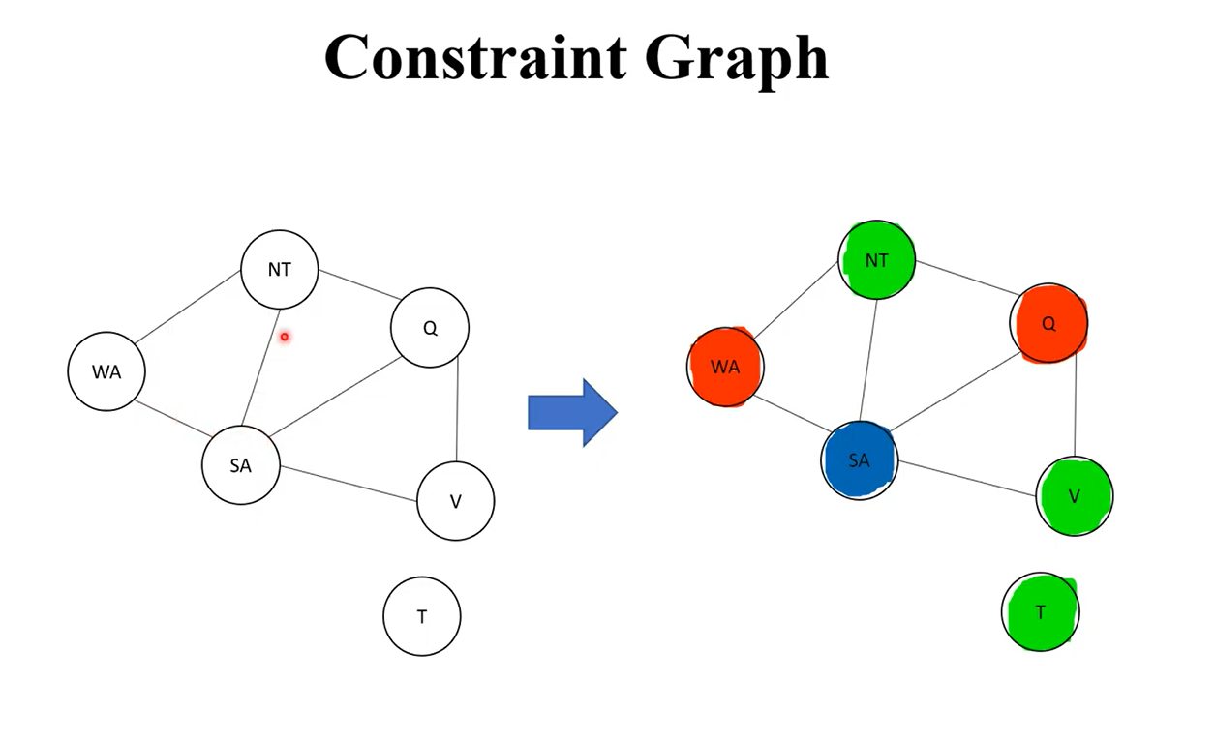

Slide 15
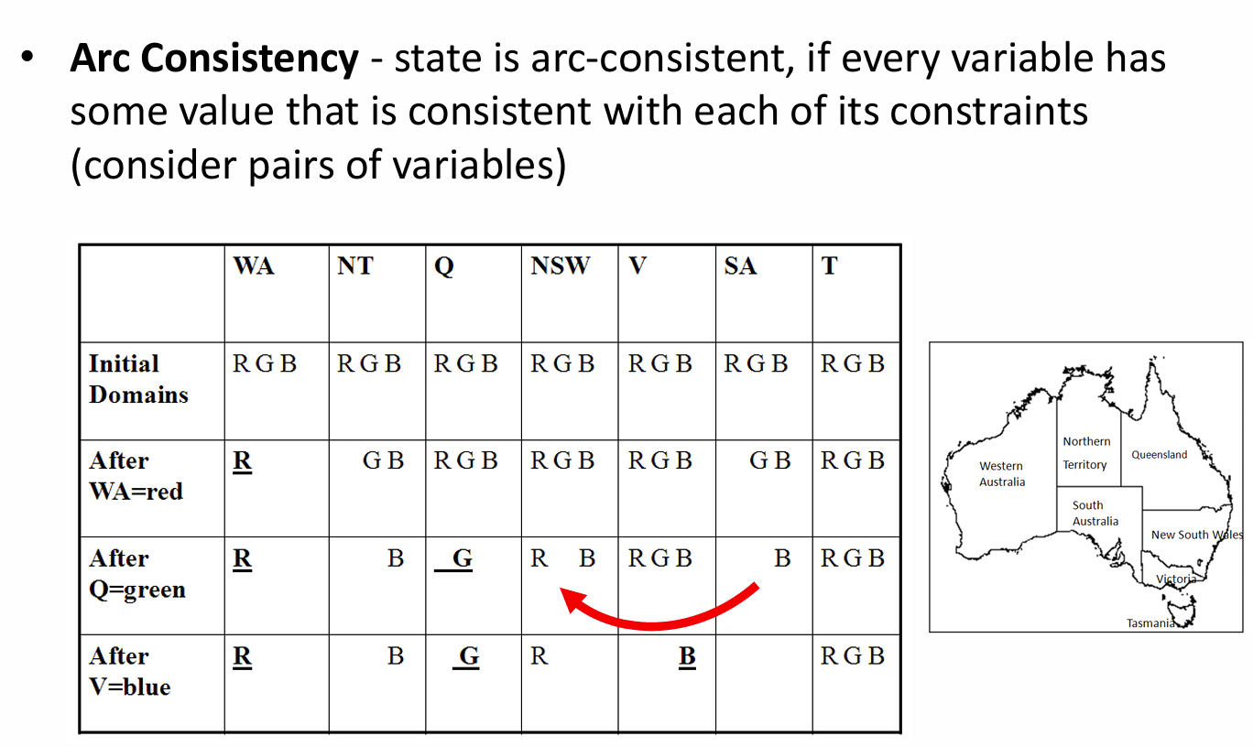

Slide 16
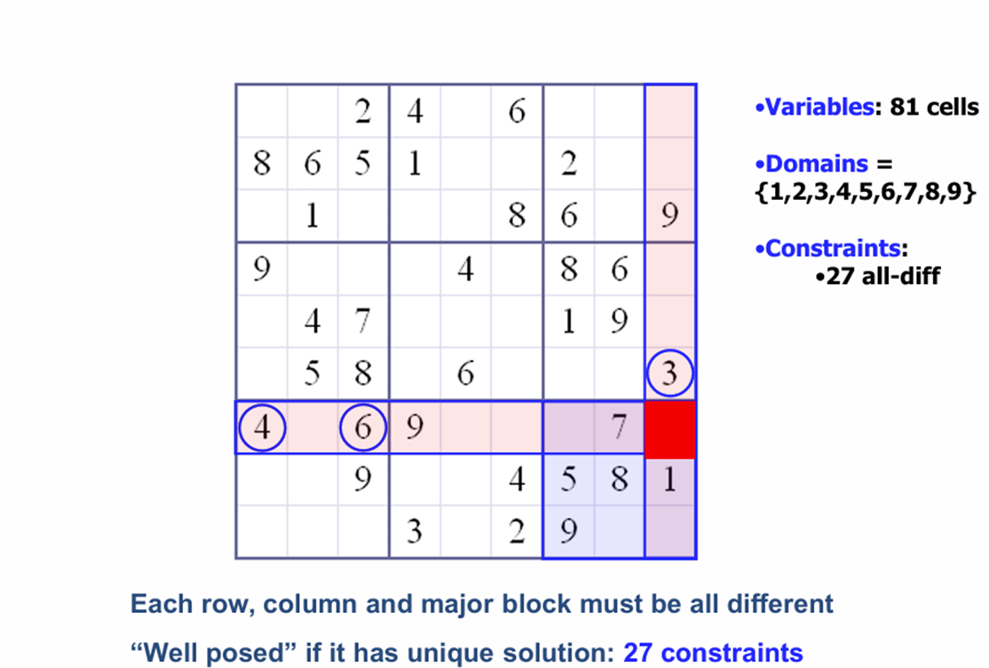
Example - Sudoku

Slide 17
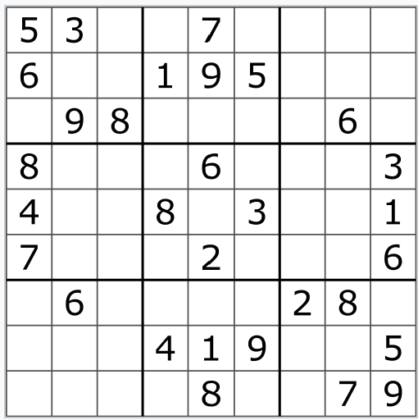
Example

