Slide 1
ARTIFICIAL INTELLIGENCE
A.I. IS THE FUTURE OF COMPUTING!

Slide 2
Artificial Intelligence
Artificial Intelligence (AI) refers to the technology that allows machines and computers to replicate human intelligence.
It enables systems to perform tasks that require human-like decision-making, such as learning from data, identifying patterns, making informed choices and solving complex problems.
AI improves continuously by utilizing methods like machine learning and deep learning.

Slide 3
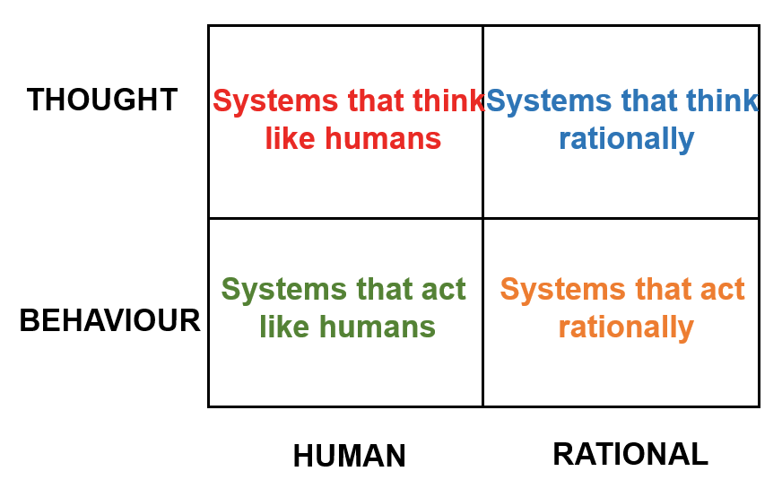
Artificial Intelligence

Slide 4
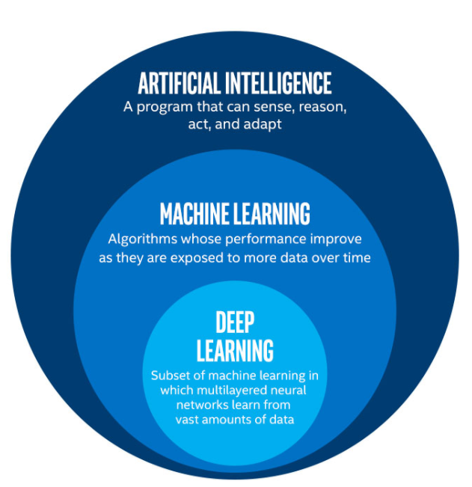
AI-ML-DL

Slide 5
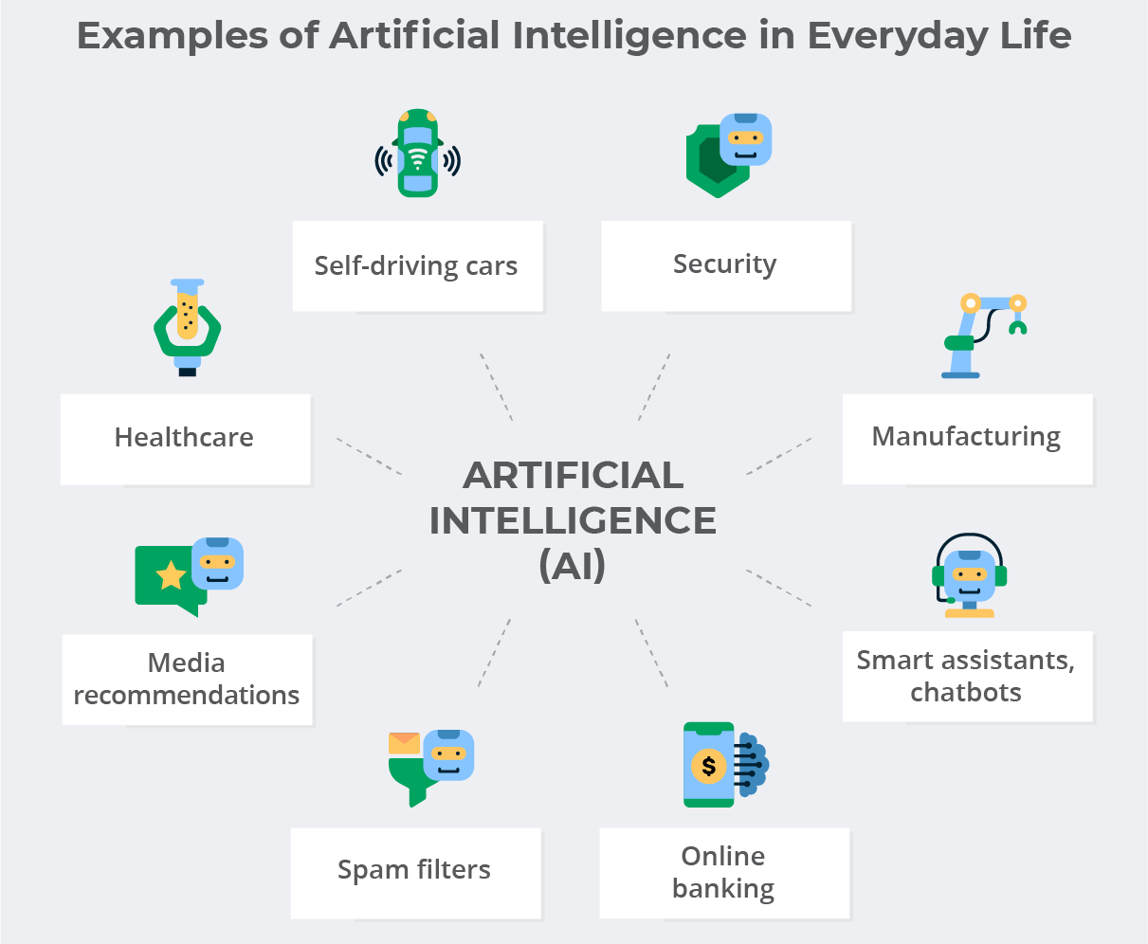

Slide 6
Textbooks
1. S. Russell and P. Norvig (2021), Artificial Intelligence: A Modern Approach (4th Edition), Prentice Hall, ISBN 9780134610993.
2. Elaine Rich, Kevin Knight, Shivashankar B, Nair (2017), Artificial Intelligence (3rd Edition), McGraw Hill Education, ISBN: 978-0070087705.

Slide 7
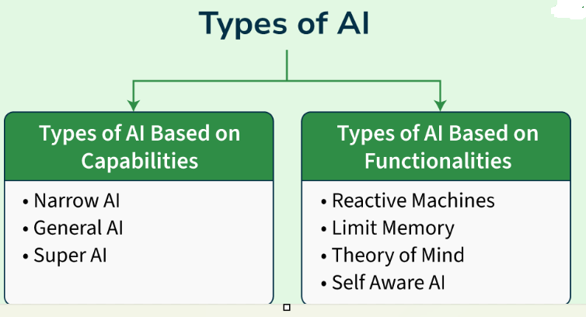

Slide 8
AI based on capabilities
Narrow AI (Weak AI)
Narrow AI is designed and trained on a specific task or a narrow range tasks. These Narrow AI systems are designed and trained for a purpose.
Examples:
Voice assistants like Siri or Alexa that understand specific commands.
Facial recognition software used in security systems.
Recommendation engines used by platforms like Netflix or Amazon.
General AI
refers to AI systems that have human intelligence and abilities to perform various tasks.
Systems have capability to understand, learn and apply across a wide range of tasks that are similar to how a human can adapt to various tasks.
Examples:
Robots that can learn new skills and adapt to unforeseen challenges in real-time.
AI systems that could autonomously diagnose and solve complex medical issues across various specializations.

Slide 9
Super AI
surpasses intelligence of human in solving-problem, creativity, and overall abilities. Super AI develops emotions, desires, need and beliefs of their own. They are able to make decisions of their own and solve problem of its own.
Examples
Currently, there is no true Super AI.
Examples of today's advanced AI systems include:
OpenAI's ChatGPT
Google DeepMind's Gemini
Anthropic's Claude
These are examples of Narrow AI (ANI), not Super AI.

Slide 10
Artificial Intelligence Based on Functionalities
Reactive machines are the most basic form of AI. They operate purely based on the present data and do not store any previous experiences or learn from past actions.
IBM’s Deep Blue, which defeated the world chess champion Garry Kasparov in 1997. It could identify the pieces on the board and make predictions but could not store any memories or learn from past games.
Examples of Reactive Machines
IBM Deep Blue (Chess-playing computer)
Basic rule-based expert systems
Simple game-playing AI that does not learn

Slide 11
Artificial Intelligence Based on Functionalities
Limited Memory AI can learn from past data to improve future responses. Most modern AI applications fall under this category. These systems use historical data to make decisions and predictions but do not have long-term memory.
Examples:
Self-driving cars: They observe the road, traffic signs, and movement of nearby cars, and make decisions based on past experiences and current conditions.
Chatbots that can remember recent conversations to improve the flow and relevance of replies.

Slide 12
Artificial Intelligence Based on Functionalities
Theory of Mind AI aims to understand human emotions, beliefs, intentions, and desires.
Examples:
Human-robot interaction where AI could detect emotions and adjust its responses to empathize with humans.
Collaborative robots that work alongside humans in fields like healthcare, adapting their tasks based on the needs of the patients.

Slide 13
Artificial Intelligence Based on Functionalities
Self-Aware AI is an advanced stage of AI that possesses self-consciousness and awareness. This type of AI would have the ability to not only understand and react to emotions but also have its own consciousness, similar to human awareness.
Fully autonomous systems that can make moral and ethical decisions.
AI systems that can independently pursue goals based on their understanding of the world around them.

Slide 14
Advantages of AI
Reduction in Human Error
One of the most significant benefits of AI is its ability to reduce errors and increase accuracy and precision. AI systems make decisions based on previously gathered information and a set of algorithms, which minimizes the chances of errors. For example, robotic surgery systems can perform complex procedures with precision, reducing the risk of human error and improving patient safety.
Enhanced Decision-Making
AI enhances decision-making by analyzing vast amounts of data to identify patterns and trends that may not be apparent to human analysts. This capability allows businesses and individuals to make informed decisions quickly and accurately. For instance, AI algorithms can analyze medical images to detect early signs of conditions like cancer, aiding doctors in providing timely treatment.
Zero Risks
AI can perform tasks that are dangerous for humans, thereby eliminating risks. Whether defusing a bomb, exploring space, or diving into the deepest parts of the ocean, AI-powered robots can handle these tasks without risking human lives. For example, fully automated production lines in manufacturing facilities use robots to perform hazardous tasks, ensuring worker safety.

Slide 15
24x7 Availability
Unlike humans, AI systems can work continuously without breaks. They can handle tedious and repetitive tasks efficiently, providing consistent performance. For example, online customer support chatbots can provide instant assistance to customers at any time, ensuring seamless customer service around the clock
Digital Assistance
AI-powered digital assistants interact with users, reducing the need for human personnel. These assistants can deliver content based on user requests and provide conversational searches. For instance, businesses use chatbots to answer customer queries, enhancing customer service and reducing operational costs.
Automation
AI can automate repetitive tasks, allowing humans to focus on more creative and strategic activities. For example, robots in manufacturing assembly lines handle tasks such as welding and painting with high accuracy and speed, improving efficiency and reducing costs.
Enhanced Safety and Fraud Detection
AI enhances safety and fraud detection by analyzing transaction patterns and identifying anomalies that may indicate fraudulent activities. For example, AI systems in the financial industry detect credit card fraud by analyzing millions of transactions and flagging suspicious activities.

Slide 16
Defining Artificial Intelligence
“AI is the study of how to make computers do things which, at the moment, people do better.” (Rich)
“AI is the part of computer science concerned with designing intelligent computer systems, that is, systems that exhibit characteristics we associate with intelligent human behavior.
  understanding language, reasoning, solving problems, and so on.” (Barr)
“AI is the study of ideas which enable computers to do things which make people seem intelligent.” (Winston)
AI is the study of intelligence using the ideas and methods of computation.” (Fahlman)

Slide 17
Defining Artificial Intelligence
“A bridge between art and science” (McCorduck)
“Tesler’s Theorem: AI is whatever hasn’t been done yet.” (Hofstadter)
“AI is a field of science and engineering concerned with the computational understanding of what is commonly called intelligent behavior, and with the creation of artifacts that exhibit such behavior.” (Shapiro)

Slide 18
An Attempted Definition
AI – the branch of computer science that is concerned with the automation of intelligent behavior (Luger & Stubblefield)
  AI is based on theoretical and applied principles in computer science like
    Data structures for knowledge representation
    Algorithms of applying knowledge
    Languages for algorithm implementation
Problem
  What is Intelligence?
This course discusses
  The collection of problems and methodologies studied by AI researchers

Slide 19
Brief Early History of AI
Aristotle – 2000 years ago
  The nature of world – changes frequently
  Logics – certain propositions can be said as “true”
  Modus ponens and reasoning system
    Eg:- If we know that “All men are mortal” & “ Socrates is a man”, then we can conclude that “Socrates is mortal”.
Copernicus – 1543
  Split between human mind and its surroundings – our ideas about the world are distinct from its appearance
Descrates (1680)
  Developed the concepts of Thought and mind
  Separate mind from physical world – must find a way to reconnect both
  Mental process can be formalized by mathematics

Slide 20
Modern History
Formal logic
  Leibniz – introduced formal logic & constructed a machine for automating its calculation
  Boole – mathematical formalization of the laws of logic (Boolean Algebra)
  Turing
  Frege – first-order predicate calculus
Graph theory
  Euler – represents the structure of relationships in the world
State space search

Slide 21
What is AI?
The science of making machines that:
Think like humans | Think rationally
Act like humans | Act rationally
Notes:
21

Slide 22
Scientific Goals of AI
AI seeks to understand the working of the mind in mechanistic terms, just as medicine seeks to understand the working of the body in mechanistic terms.
The mind is what the brain does.
-- Marvin Minsky
The strong AI position is that any aspect of human intelligence could, in principle, be mechanized
Notes:
22

Slide 23
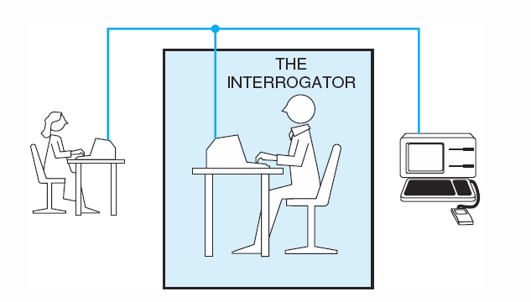
The Turing Test
The interrogator
cannot see and speak to either
does not know which is actually machine
May communicate with them solely by textual device
If the interrogator cannot distinguish the machine from the human, then the machine may be assumed to be intelligent.

Slide 24
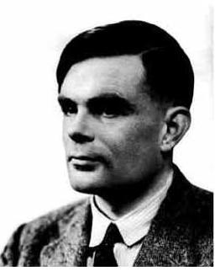
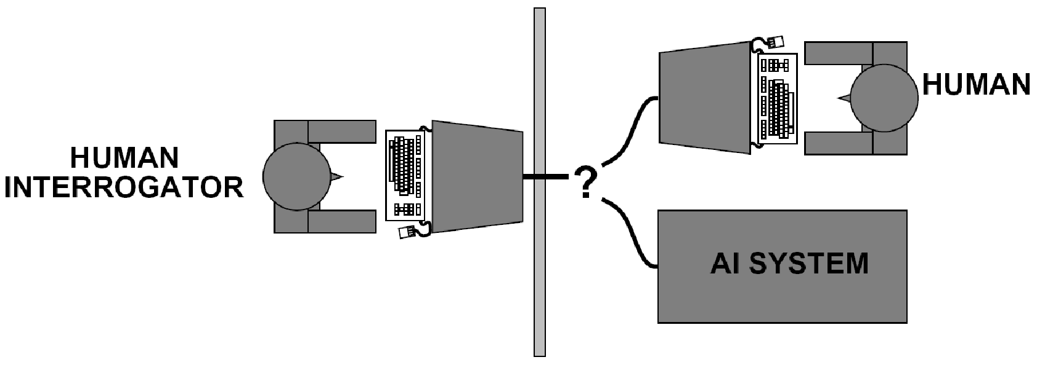
Acting Like Humans?
Turing (1950) ``Computing machinery and intelligence''
  ``Can machines think?'' → ``Can machines behave intelligently?''
  Operational test for intelligent behavior: the Imitation Game
  Predicted by 2000, a 30% chance of fooling a lay person for 5 minutes
  Anticipated all major arguments against AI in following 50 years
  Suggested major components of AI: knowledge, reasoning, language understanding, learning
Notes:
24

Slide 25
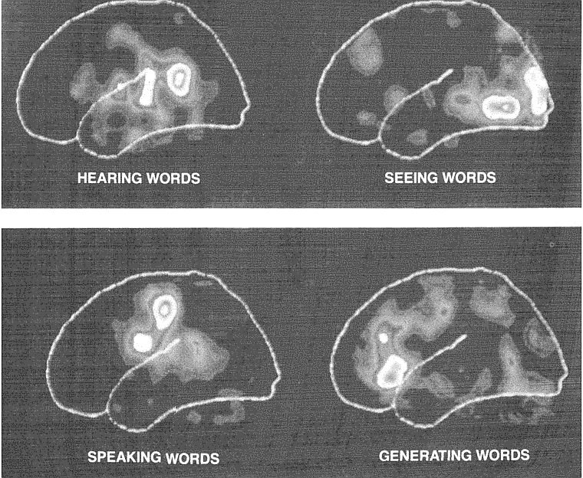
Imaging the Brain
Notes:
25

Slide 26
Questions
What is Intelligence?
  What is thinking?
What is machine?
  Is computer a machine?
Can a machine think?
  If yes are we machines?

Slide 27
Brains ~ Computers
1000 operations/sec
100,000,000,000 units
stochastic
fault tolerant
evolves, learns
1,000,000,000 ops/sec
1-100 processors
deterministic
crashes
designed, programmed
Notes:
27

Slide 28
Areas of Artificial Intelligence
Perception
  Machine vision
  Speech understanding
  Touch ( tactile or haptic) sensation
Natural Language Processing
  Natural Language Understanding
  Speech Understanding
  Language Generation
  Machine Translation
Institute of Computing
Notes:
28

Slide 29
Perception
Machine Vision:
  It is easy to interface a TV camera to a computer and get an image into memory; the problem is understanding what the image represents. Vision takes lots of computation; in humans, roughly 10% of all calories consumed are burned in vision computation.
Speech Understanding:
  Speech understanding is available now. Some systems must be trained for the individual user and require pauses between words. Understanding continuous speech with a larger vocabulary is harder.
Touch ( tactile or haptic) Sensation:
  Important for robot assembly tasks.
Notes:
29

Slide 30
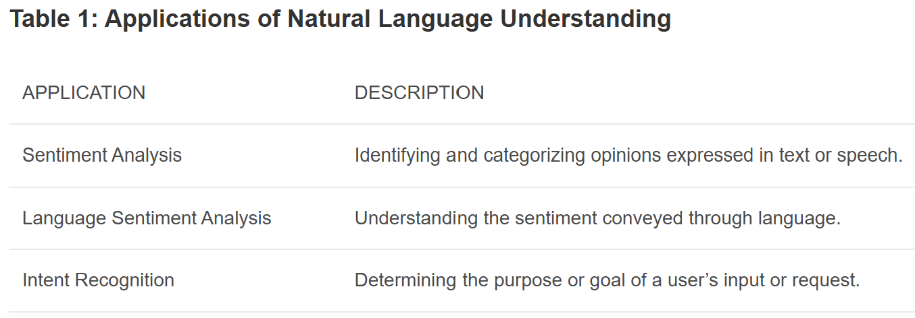
NLU
Natural Language Understanding (NLU)
Natural Language Understanding (NLU) is a branch of AI that focuses on comprehending and interpreting human language with computers. focuses on enabling computers to comprehend and interpret human language effectively.

Slide 31
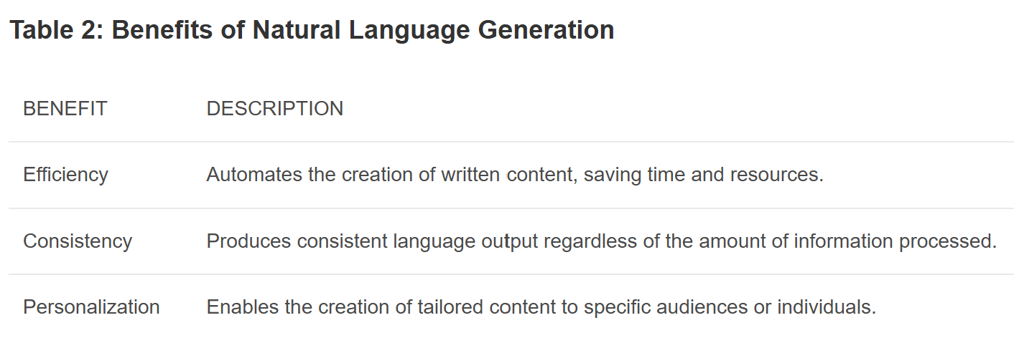
NLG
Natural Language Generation (NLG) is the process of generating human-like language by machines. NLG systems take structured data or other forms of information inputs and transform them into coherent and expressive natural language output. NLG can be used to automatically generate news articles, product descriptions, personalized recommendations, and much more.
An interesting use case for NLG is in the field of data visualization, where it can automatically generate descriptions or narratives that explain the patterns or insights derived from data visualizations, making them more accessible and understandable for non-technical users.

Slide 32
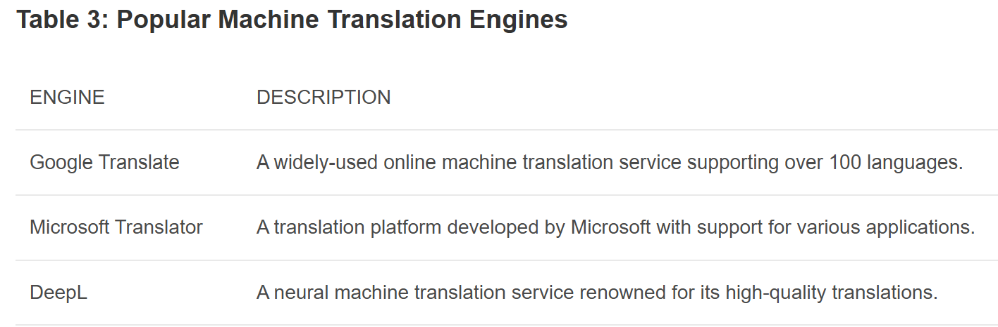
MT
Machine Translation (MT) is the automated process of translating text or speech from one language to another. MT systems utilize complex algorithms and statistical models to analyze linguistic patterns and translate content with reasonable accuracy.

Slide 33
Areas of Artificial Intelligence ...
  Robotics
  Planning
  Expert Systems
  Machine Learning
  Theorem Proving
  Symbolic Mathematics
  Game Playing
Notes:
33

Slide 34
Robotics
Although industrial robots have been expensive, robot hardware can be cheap: Radio Shack has sold a working robot arm and hand for $15. The limiting factor in application of robotics is not the cost of the robot hardware itself.
What is needed is perception and intelligence to tell the robot what to do; ``blind'' robots are limited to very well-structured tasks (like spray painting car bodies).
Notes:
34

Slide 35
Planning
Planning attempts to order actions to achieve goals.
Planning applications include logistics, manufacturing scheduling, planning manufacturing steps to construct a desired product.
There are huge amounts of money to be saved through better planning.
Notes:
35

Slide 36
Expert Systems
Expert Systems attempt to capture the knowledge of a human expert and make it available through a computer program. There have been many successful and economically valuable applications of expert systems.
Benefits:
    Reducing skill level needed to operate complex devices.
    Diagnostic advice for device repair.
    Interpretation of complex data.
    “Cloning'' of scarce expertise.
    Capturing knowledge of expert who is about to retire.
    Combining knowledge of multiple experts.
    Intelligent training.
Notes:
36

Slide 37
Expert systems are constructed by obtaining the knowledge of a human expert and coding it into a form that a computer may apply to similar problems.
  domain expert provides the necessary knowledge of the problem domain.
  knowledge engineer is responsible for implementing this knowledge in a program that is both effective and intelligent in its behavior.

Slide 38
Deficiencies of Current Expert Systems
1. Difficulty in capturing “deep” knowledge of the problem domain
2. Lack of robustness and flexibility
3. Inability to provide deep explanations
4. Difficulties in verification
  may be serious when expert systems are applied to air traffic control, nuclear reactor operations, and weapon systems.
5. Little learning from experience

Slide 39
Theorem Proving
Proving mathematical theorems might seem to be mainly of academic interest. However, many practical problems can be cast in terms of theorems. A general theorem prover can therefore be widely applicable.
Examples:
  Automatic construction of compiler code generators from a description of a CPU's instruction set.
  J Moore and colleagues proved correctness of the floating-point division algorithm on AMD CPU chip.
Notes:
39

Slide 40
Symbolic Mathematics
Symbolic mathematics refers to manipulation of formulas, rather than arithmetic on numeric values.
  Algebra
  Differential and Integral Calculus
Symbolic manipulation is often used in conjunction with ordinary scientific computation as a generator of programs used to actually do the calculations. Symbolic manipulation programs are an important component of scientific and engineering workstations.
> (solvefor '(= v (* v0 (- 1 (exp (- (/ t (* r c))))))) 't)‏
(= T (* (- (LOG (- 1 (/ V V0)))) (* R C)))‏
Notes:
40

Slide 41
Game Playing
Games are good vehicles for AI research because
  most games are played using a well-defined set of rules
  board configurations are easily represented on a computer
Games can generate extremely large search spaces.
  Search spaces are large and complex enough to require powerful techniques(heuristics) for determining what alternatives to explore in the problem space.
Notes:
41

Slide 42
Characteristics of A.I. Programs
Symbolic Reasoning: reasoning about objects represented by symbols, and their properties and relationships, not just numerical calculations.
Knowledge: General principles are stored in the program and used for reasoning about novel situations.
Eg: Medical expert system
Search: a ``weak method'' for finding a solution to a problem when no direct method exists. Problem: combinatoric explosion of possibilities.
Flexible Control: Direction of processing can be changed by changing facts in the environment.
Eg: Self Driving cars
Notes:
42

Slide 43
Symbolic Processing
Most of the reasoning that people do is non-numeric. AI programs often do some numerical calculation, but focus on reasoning with symbols that represent objects and relationships in the real world.
Objects.
    Properties of objects.
    Relationships among objects.
    Rules about classes of objects.
Examples of symbolic processing:
    Understanding English:
      (show me a good chinese restaurant in los altos)‏
    Reasoning based on general principles:
      if: the patient is male
      then: the patient is not pregnant
Symbolic mathematics:
    If y = m*x+b, what is the derivative of y with respect to x?
Notes:
43

Slide 44
Knowledge Representation
It is necessary to represent the computer's knowledge of the world by some kind of data structures in the machine's memory. Traditional computer programs deal with large amounts of data that are structured in simple and uniform ways. A.I. programs need to deal with complex relationships, reflecting the complexity of the real world.
Several kinds of knowledge need to be represented:
  Factual Data: Known facts about the world.
  General Principles: ``Every dog is a mammal.''
  Hypothetical Data: The computer must consider hypotheticals in order to reason about the effects of actions that are being contemplated.
Notes:
44

Slide 45
Representation Systems
What is it?
  Capture the essential features of a problem domain and make that information accessible to a problem-solving procedure
Measures
  Abstraction – how to manage complexity
  Expressiveness – what can be represented
  Efficiency – how is it used to solve problems
Trade-off between efficiency and expressiveness

Slide 46
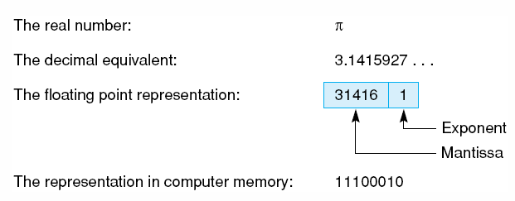
Representation of π
Different representations of the real number π.

Slide 47
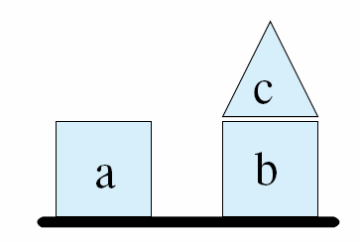
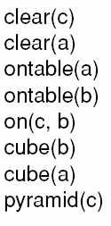

Block World Representation
A blocks world
Logical Clauses describing some important properties and relationships
General rule

Slide 48
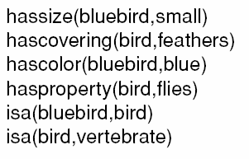
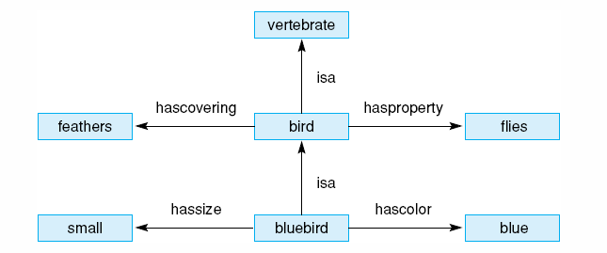
Bluebird Representations
Logical predicates representing a simple description of a bluebird.
Semantic network description of a bluebird.

Slide 49
State Space Search
State space
  State – any current representation of a problem
  State space
    All possible state of the problem
    Start states – the initial state of the problem
    Target states – the final states of the problem that has been solved
  State space graph
    Nodes – possible states
    Links – actions that change the problem from one state to another
State space search
  Find a path from an initial state to a target state in the state space
  Various search strategies
    Exhaustive search – guarantee that the path will be found if it exists
      Depth-first
      Breath-first
    Best-first search
      heuristics

Slide 50
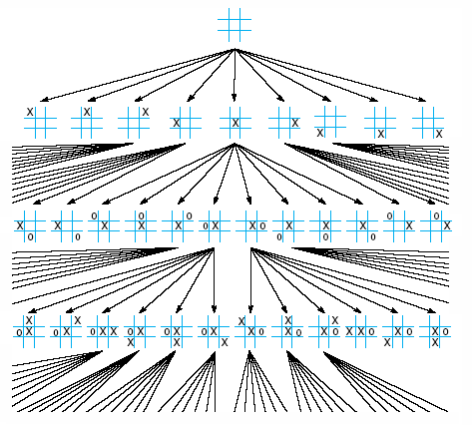
Tic-tac-toe State Space
Portion of the state space for tic-tac-toe.

Slide 51
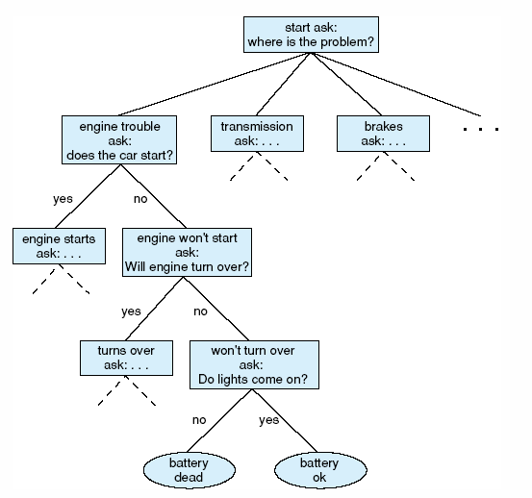
Auto Diagnosis State Space
State space description of the automotive diagnosis problem.

Slide 52
Assignment
Create and justify your own definition of artificial intelligence?
Describe whether or not you think it is possible to a computer to understand and use a natural language?
Describe your own criteria for computer software to be considered “intelligent”.
Discuss why you think the problem of machines "learning" is so difficult?
List two potentially negative effects on society of the development of AI techniques.

