Slide 1
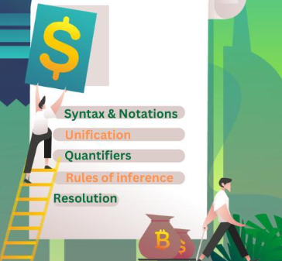
RESOLUTION

Slide 2
Course Outcome
Use suitable knowledge representation techniques for AI-based applications.
Session Outcomes
Understand the concept and principles of Resolution in Predicate Logic.
Apply unification and resolution rules to derive logical conclusions.
Use Resolution by Refutation to prove statements in AI-based knowledge representation.

Slide 3
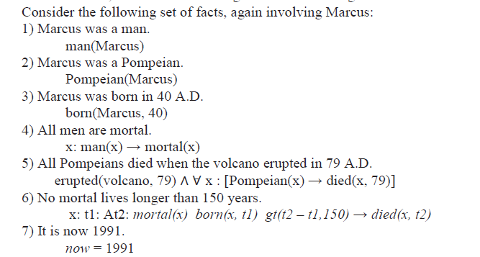

Slide 4
Resolution
Resolution is a theorem proving method
Its proves by refutation
  Attempts to prove that negation of the statement, contradicts
Conjunctive Normal Form(CNF)
AND of Ors
For example:
(A ∨ B) ∧ (C ∨ D)
Unification
  Attempt to unify two literals
Student(x)
Student(Ravi)
We can substitute: x = Ravi
Student(x) = Student(Ravi)

Slide 5
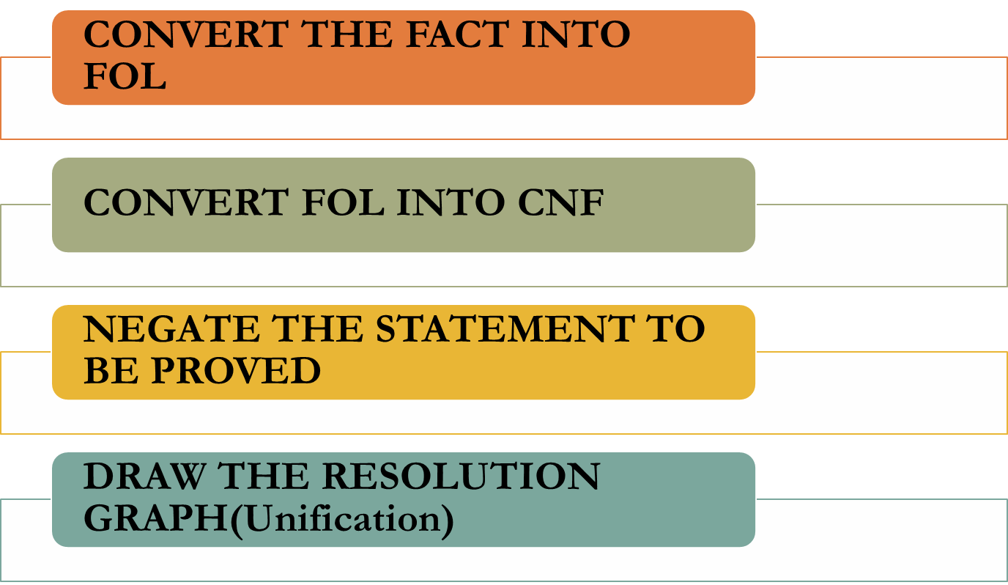
Steps for Resolution

Slide 6
FOL - CNF
1. Eliminate all implication(→) & rewrite. (a → b ¬a ∨ b)
Rule to remember P → Q = ¬P ∨ Q
Statement:
If a person studies, then the person passes.
Let:
S = Studies
P = Passes
Original:
S → P
After removing implication:
¬S ∨ P
2

Slide 7
Rule 2
¬(A ∧ B) = ¬A ∨ ¬B
Example:
It is not true that John is tall AND intelligent.
becomes:
John is not tall OR John is not intelligent.
Rule 3
¬(A ∨ B) = ¬A ∧ ¬B
Example:
It is not true that John is tall OR intelligent.
becomes:
John is not tall AND John is not intelligent.
These are based on De Morgan's laws.
2. Move negation (¬) inwards & rewrite.
This means that ¬ should be moved closer to the individual statement.
Rule 1
¬(¬A) = A
Example:
It is NOT true that John is NOT happy.
Therefore:
John is happy.

Slide 8
¬∀x P(x) = ∃x ¬P(x)
Meaning
“Not everyone is a student”
means:
“There exists at least one person who is not a student.”
Example
Original:
¬∀x Student(x)
Meaning:
Not everyone is a student.
Equivalent:
∃x ¬Student(x)
Meaning:
There is at least one person who is not a student.
¬∃x P(x) = ∀x ¬P(x)
Example
There does not exist any student who is absent.
becomes:
Every student is not absent.

Slide 9
3. Rename or standardize variables.
Each quantifier should use a unique variable.
Example:
∀x P(x) ∨ ∀x Q(x)
Both quantifiers use x.
We rename one variable:
∀x P(x) ∨ ∀y Q(y)
Why?
Because x in the first statement and x in the second statement may represent different things.
So we use:
x
y
to avoid confusion.

Slide 10
4. Eliminate existential quantifier.
Move all quantifiers, in order, to the left of each wff.”
This is called moving to the prenex form.
For example:
P(x) ∧ ∀y Q(y)
can be rearranged as:
∀y [P(x) ∧ Q(y)]
The quantifier is moved to the front.

Slide 11
Drop universal quantifier.
Example 1
∃x P(x)
means:
There exists some x such that P(x) is true.
We don't know what x is.
So we introduce a new constant, say:
P(s1)
Here s1 represents that unknown individual.
Example 2
Suppose:
∀x ∃y Loves(x,y)
Meaning:
For every person x, there exists someone y whom x loves.
Here y may depend on x.
So we use a Skolem function:
∀x Loves(x, f(x))
After dropping the universal quantifier:
Loves(x, f(x))

Slide 12
Existential situation | Use
∃x P(x) | Skolem constant
∀x ∃y P(x,y) | Skolem function

Slide 13
After Skolemization,
“Drop the quantifier prefix.”
For example:
∀x Student(x) → Human(x)
After conversion:
¬Student(x) ∨ Human(x)
We don't need to write ∀x anymore because variables in clauses are assumed to be universally quantified.

Slide 14
Associative property of OR
a ∨ (b ∨ c) = (a ∨ b) ∨ c
This simply means the grouping of OR doesn't matter.
For example:
A ∨ (B ∨ C)
can become:
A ∨ B ∨ C
Example
John is tall OR John is intelligent OR John is rich.
We can simply write:
Tall(John) ∨ Intelligent(John) ∨ Rich(John)

Slide 15
Convert into AND of ORs
Remove disjunctions of conjunctions and create conjunctions of disjunctions.
Important rule:
(A ∧ B) ∨ C
becomes:
(A ∨ C) ∧ (B ∨ C)
Example
Suppose:
(Student ∧ Intelligent) ∨ Hardworking
Convert:
(Student ∨ Hardworking) ∧ (Intelligent ∨ Hardworking)
Now it is CNF.

Slide 16
Create separate clauses
Create a separate clause for each conjunction.”
Suppose we have:
(A ∨ B) ∧ (C ∨ D)
We create two clauses:
Clause 1: A ∨ B
Clause 2: C ∨ D
So our clause set becomes:
{A ∨ B, C ∨ D}

Slide 17
Standardize variables apart
Example:
Clause 1:
P(x) ∨ Q(x)
Clause 2:
R(x) ∨ S(x)
Rename the second x:
P(x) ∨ Q(x)
R(y) ∨ S(y)
This prevents accidental mixing of variables between clauses.

Slide 18
Algorithm: Converting wffs to Clause Form
1. Remove all implies, i.e. → by applying the following:
a → b is equivalent to ~a \/ b.
2. Use the following rules to reduce the scope of each negation operator to a single term:
        ~(~a) = a
        ~(a /\ b) = ~a \/ ~b
        ~(a \/ b) = ~a /\ ~b
        ~∀x: p(x) = ∃x: ~p(x)
        ~∃x: p(x) = ∀x: ~p(x)
3. Each quantifier must be linked to a unique variable. For example, consider ∀x: p(x) \/ ∀x: q(x). In this both quantifiers are using the same variable and one must changed to another variable: ∀x: p(x) \/ ∀y: q(y).

Slide 19
4. Move all quantifiers, in order, to the left of each wff.
5. Remove existential quantifiers by using Skolem constants or functions. For example, ∃x: p(x) becomes p(s1) and ∀x ∃y: q(x,y) is replaced with ∀x: q(s2(x), x).
6. Drop the quantifier prefix.
7. Apply the associative property of disjunctions:
a \/ (b \/ c) = (a \/ b) \/ c
and remove brackets giving a \/ b \/ c.

Slide 20
8. Remove all disjunctions of conjunctions from predicates, i.e. create conjunctions of disjunctions instead, by applying the following rule iteratively:
(a /\ b) \/ c = (a \/ c) /\ (b \/ c)
9. Create a separate clause for each conjunction.
10. Rename variables in the clauses resulting from step 9. to ensure that no two clauses refer to the same variable.

Slide 21
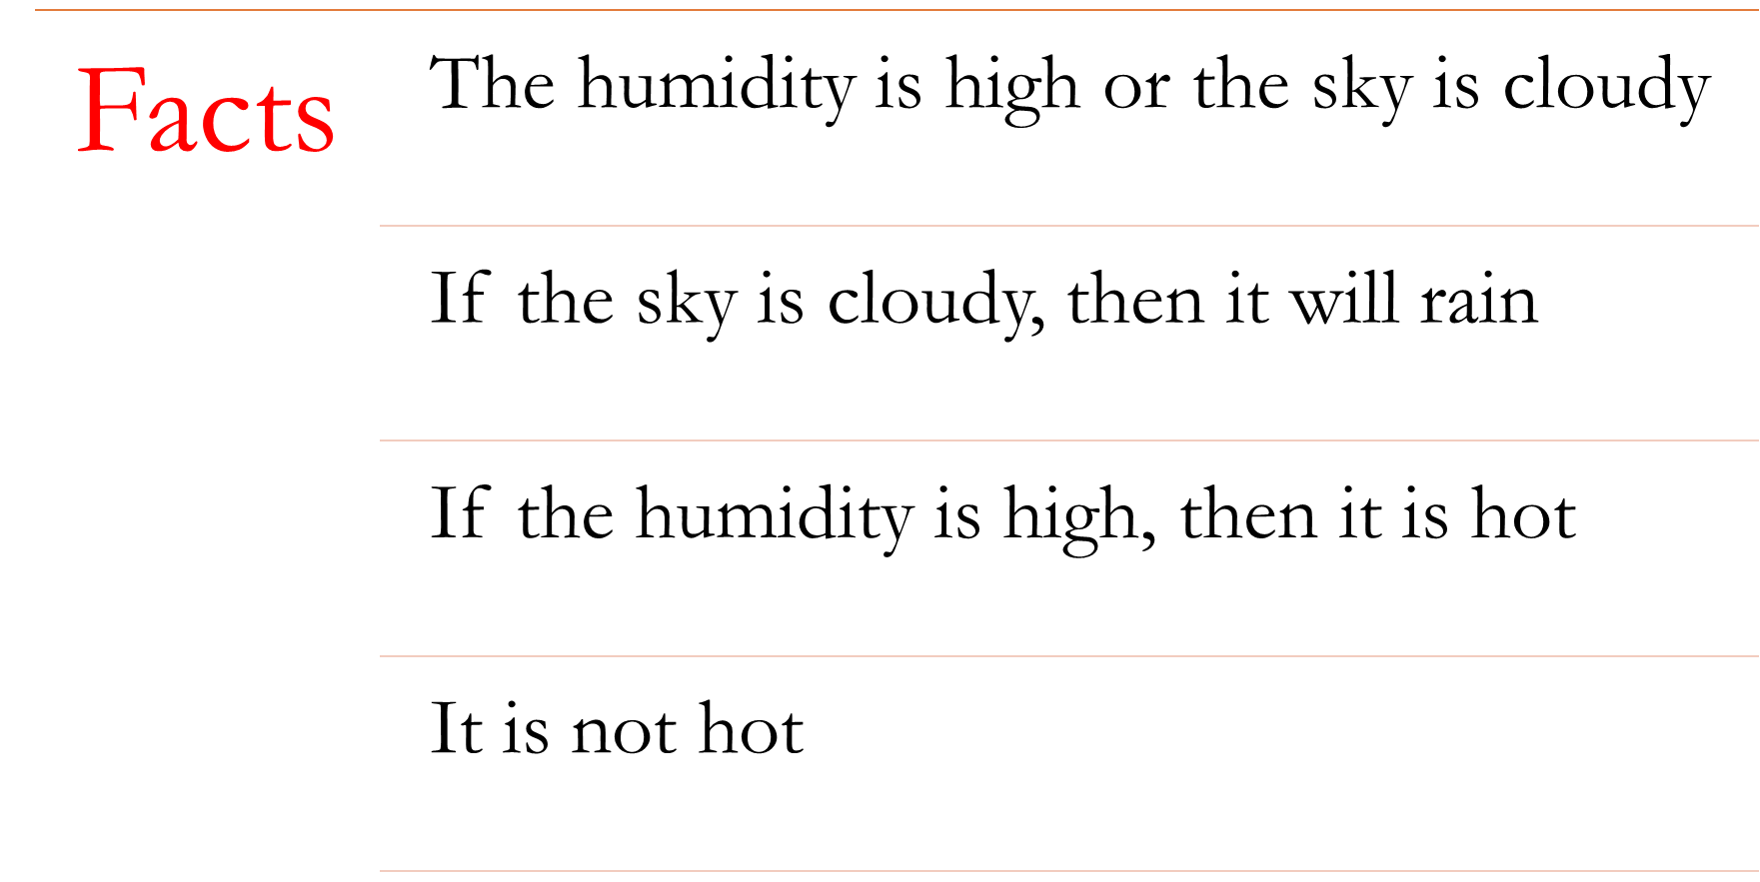


Slide 22
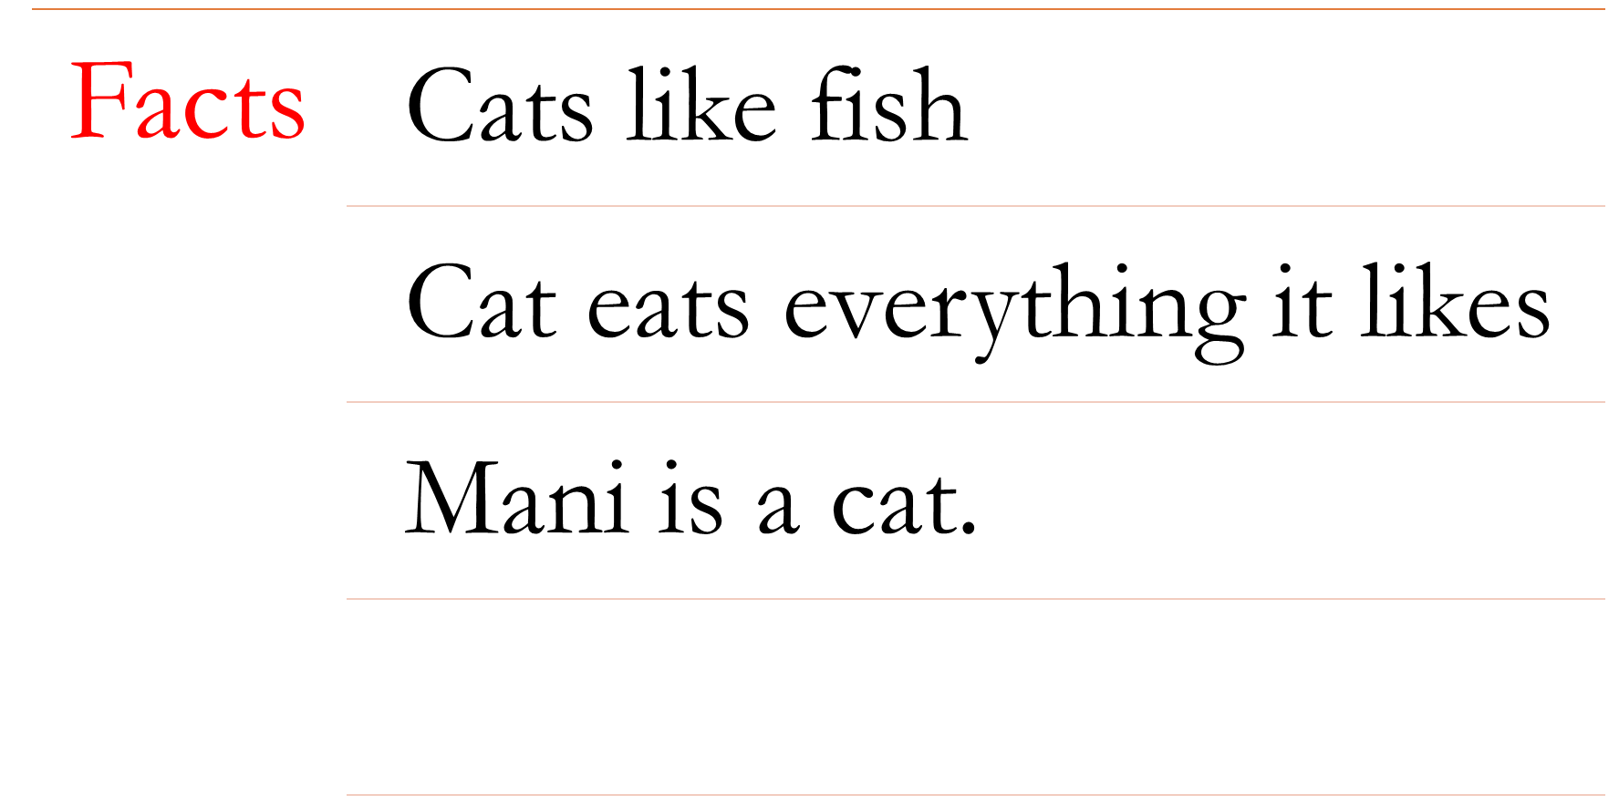


Slide 23
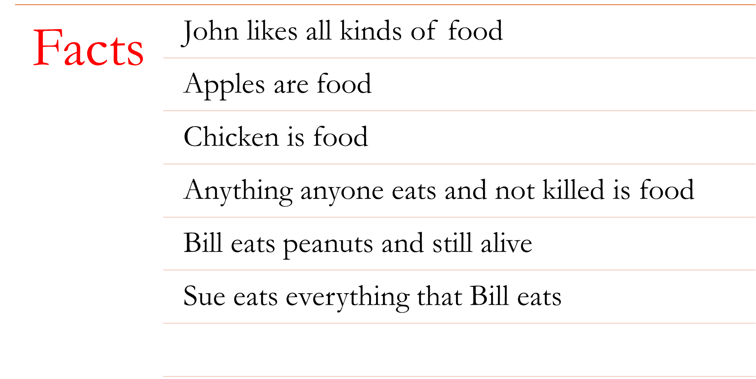


Slide 24
Conversion of facts into FOL
1. ∀x Food(x) → Likes(John, x)
2. Food(Apples)
3. Food(Chicken)
4. ∀x ∀ y Eats(y, x) ∧ ¬KilledBy(y, x) → Food(x)
5. Eats(Bill, Peanuts) ∧ ¬KilledBy(Bill, Peanuts)
6. ∀x Eats(Bill, x) → Eats(Sue, x)

Slide 25
CNF Normalization
Eliminate →
Reduce the scope of negation
Variable renaming
Move all qualifiers left without changing their order
Eliminate all existential quantifiers using Skolemization
Drop all universal quantifiers
Convert to conjunct of disjuncts
Separate into a set of disjuncts
Standardize the variables apart so that different clauses contain different variable names

Slide 26
Convert into CNF
1. ¬Food(x) ∨ Likes(John, x)
2. Food(Apples)
3. Food(Chicken)
4. ¬Eats(y, x) ∨ KilledBy(y, x) ∨ Food(x)
5. Eats(Bill, Peanuts) ∧ ¬KilledBy(Bill, Peanuts)
7. ¬Eats(Bill, x) ∨ Eats(Sue, x)

Slide 27
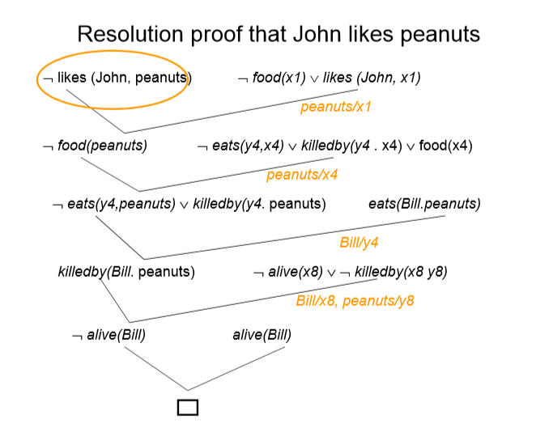

Slide 28
Example :
1. All dogs are animal.
2. Fido is a dog.
3. All animals will die.
Prove fido will die

Slide 29
Step 1 Convert stmt to FOL
1. All dogs are animal.
∀x: dog(x) → animal(x)
2. Fido is a dog.
Dog(Fido)
3. All animals will die.
∀y: animal(y) → die(y)

Slide 30
Step 2:Convert FOL to CNF a → b is equivalent to ~a \/ b.
Statement 1
Original:
∀x Dog(x) → Animal(x)
Remove implication:
¬Dog(x) ∨ Animal(x)
Statement 2
Dog(Fido)
Already in CNF.
Statement 3
Original:
∀y Animal(y) → Die(y)
Remove implication:
¬Animal(y) ∨ Die(y)
So our clauses are:
¬Dog(x) ∨ Animal(x)
Dog(Fido)
¬Animal(y) ∨ Die(y)

Slide 31
Step 3: Negate the stmt to be proved
Fido will die == die(Fido)
Negation: ¬ die(Fido)
Now we have:
¬Dog(x) ∨ Animal(x)
Dog(Fido)
¬Animal(y) ∨ Die(y)
¬Die(Fido) ← negated goal
Now resolution begins.

Slide 32
RESOLUTION PRO0F
Resolve Clause 1 and Clause 2
Clause 1:
¬Dog(x) ∨ Animal(x)
Clause 2:
Dog(Fido)
Unify:
x = Fido
Then:
¬Dog(Fido) ∨ Animal(Fido)
and
Dog(Fido)
Dog(Fido) and ¬Dog(Fido) cancel.
Therefore:
Animal(Fido)

Slide 33
Resolve with Clause 3
Clause 3:
¬Animal(y) ∨ Die(y)
We have:
Animal(Fido)
Set:
y = Fido
Then:
Die(Fido)
Resolve with negated goal
We also have:
¬Die(Fido)
Therefore:
Die(Fido)
and
¬Die(Fido)
produce a contradiction:
The empty clause means contradiction.
Therefore our original assumption:
¬Die(Fido)
was false.
Hence:
Fido will die.

Slide 34
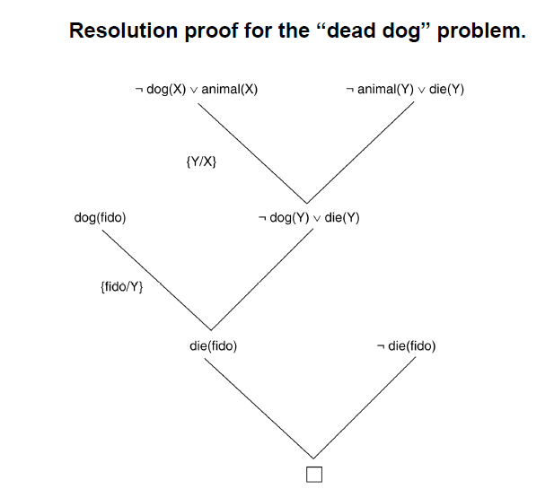

Slide 35
Example : Lucky Student
1. Anyone passing his history exams and winning the lottery is happy.
2. Anyone who studies or is lucky can pass all his exams.
3. John did not study but he is lucky.
4. Anyone who is lucky wins the lottery.
Prove that John is happy!

Slide 36
Let's represent it.
HistoryPass(x) = x passes history exam
Lottery(x) = x wins lottery
Happy(x) = x is happy
Study(x) = x studies
Lucky(x) = x is lucky

Slide 37
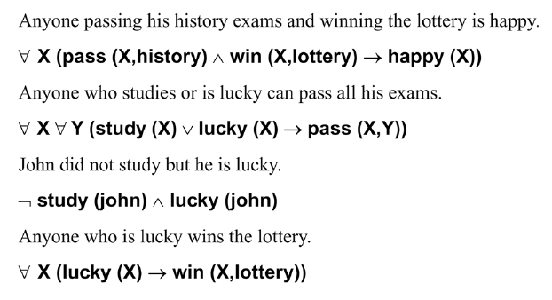

Slide 38
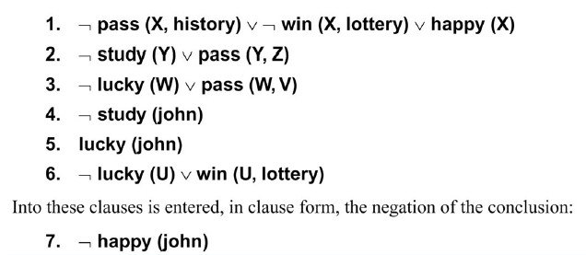

Slide 39
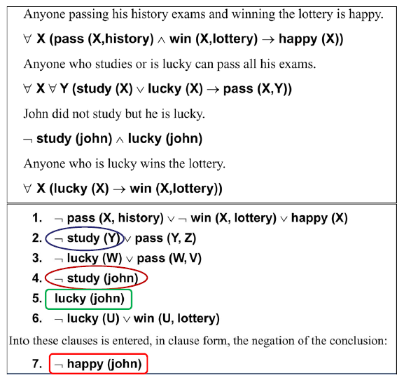

Slide 40
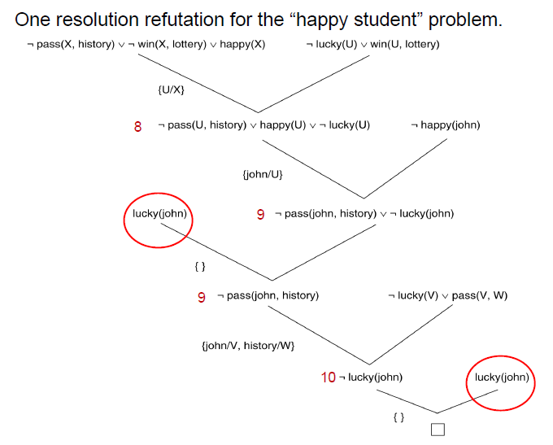

Slide 41
Example : Exciting life
1. All people that are not poor and are smart are happy.
2. Those people that read are not stupid.
3. John can read and is wealthy.
4. Happy people have exiting lives.
Can anyone be found with an exciting life?

Slide 42
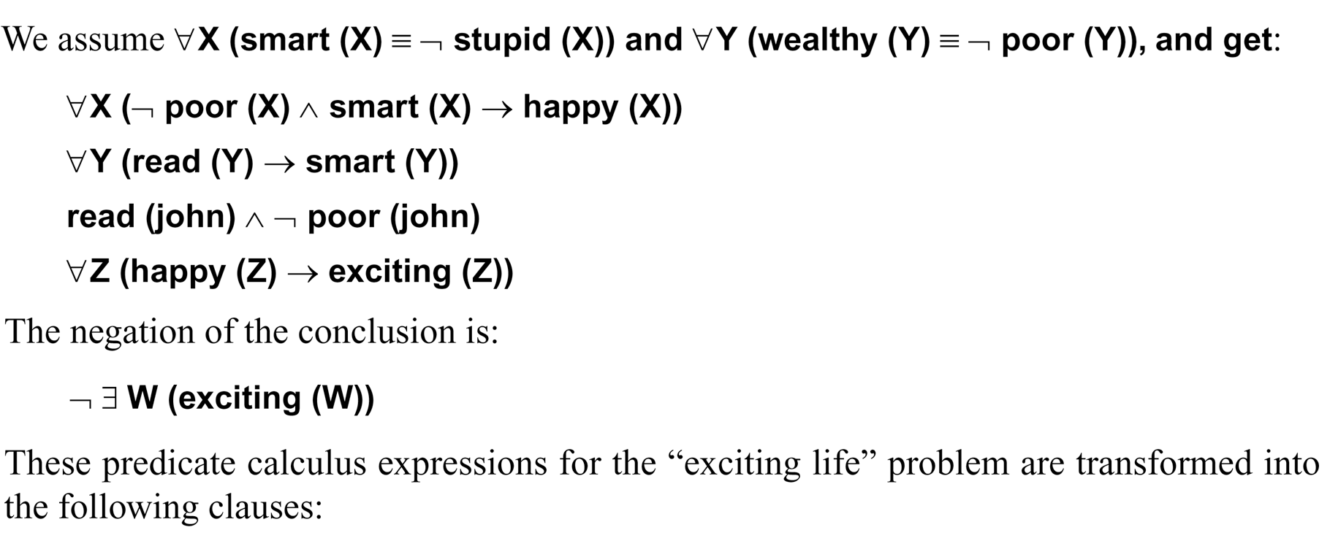

Slide 43
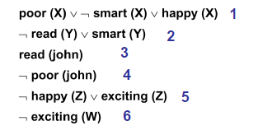

Slide 44
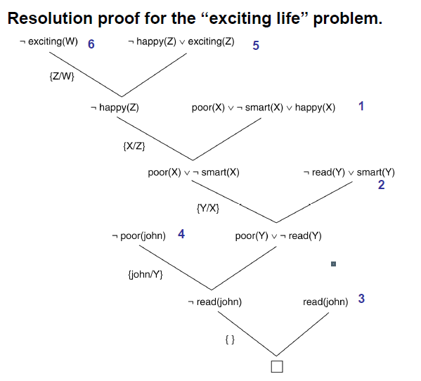

Slide 45
Practice Question
Knowledge Base:
Either (I have a sweet tooth and I like chocolate) or (I like chocolate and I like cake)
Rules:
If I like cake, then I also like Danish.
If I like Danish, that implies I have a sweet tooth.
If I have a sweet tooth and I like chocolate, then I am a chocoholic.
Goal: I am a chocoholic
(a) Convert these sentences to propositional logic.
(b) Put the resulting sentences into Conjunctive Normal Form.
(c) Using proof by refutation and resolution as the single inference rule, show the resolution proof that proves the goal.

Slide 46
Forward Chaining and backward chaining in AI
Inference engine:
The inference engine is the component of the intelligent system in artificial intelligence, which applies logical rules to the knowledge base to infer new information from known facts. The first inference engine was part of the expert system. Inference engine commonly proceeds in two modes, which are:
Forward chaining
Backward chaining

Slide 47
Forward chaining
Forward chaining is also known as a forward deduction or forward reasoning method when using an inference engine. Forward chaining is a form of reasoning which start with atomic sentences in the knowledge base and applies inference rules (Modus Ponens) in the forward direction to extract more data until a goal is reached.
The Forward-chaining algorithm starts from known facts, triggers all rules whose premises are satisfied, and add their conclusion to the known facts. This process repeats until the problem is solved.
Properties of forward chaining:
It is a down-up approach, as it moves from bottom to top.
It is a process of making a conclusion based on known facts or data, by starting from the initial state and reaches the goal state.
Forward-chaining approach is also called as data-driven as we reach to the goal using available data.
Forward -chaining approach is commonly used in the expert system, such as CLIPS, business, and production rule systems.

Slide 48
Backward Chaining
Backward-chaining is also known as a backward deduction or backward reasoning method when using an inference engine. A backward chaining algorithm is a form of reasoning, which starts with the goal and works backward, chaining through rules to find known facts that support the goal.
Properties of backward chaining:
It is known as a top-down approach.
Backward-chaining is based on modus ponens inference rule.
In backward chaining, the goal is broken into sub-goal or sub-goals to prove the facts true.
It is called a goal-driven approach, as a list of goals decides which rules are selected and used.
Backward -chaining algorithm is used in game theory, automated theorem proving tools, inference engines, proof assistants, and various AI applications.
The backward-chaining method mostly used a depth-first search strategy for proof.

Slide 49
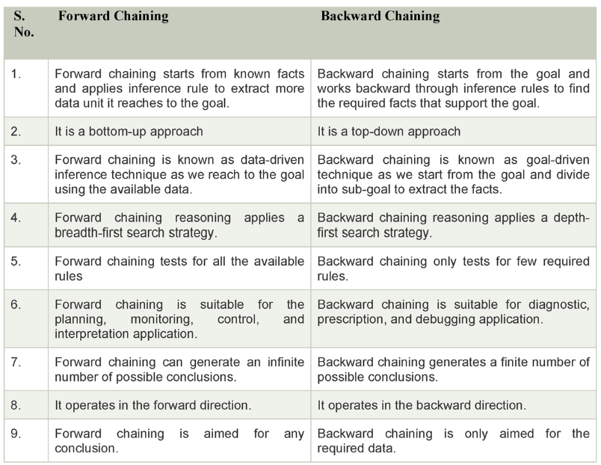

Slide 50
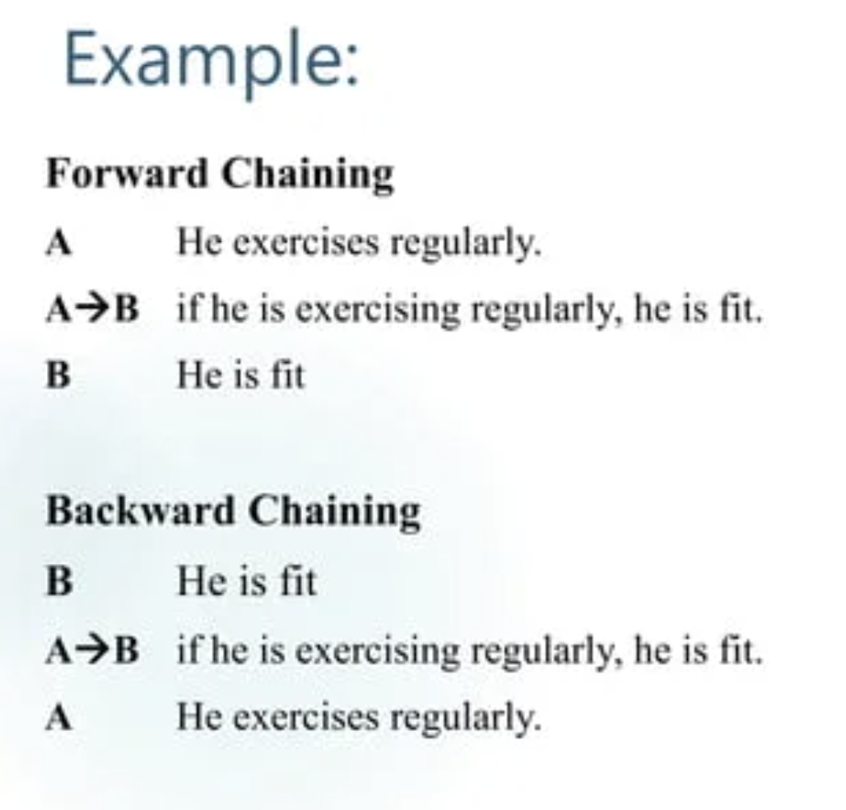
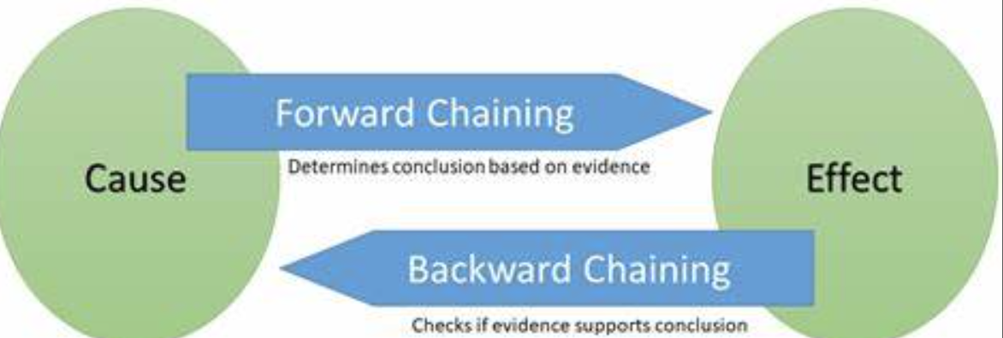

Slide 51
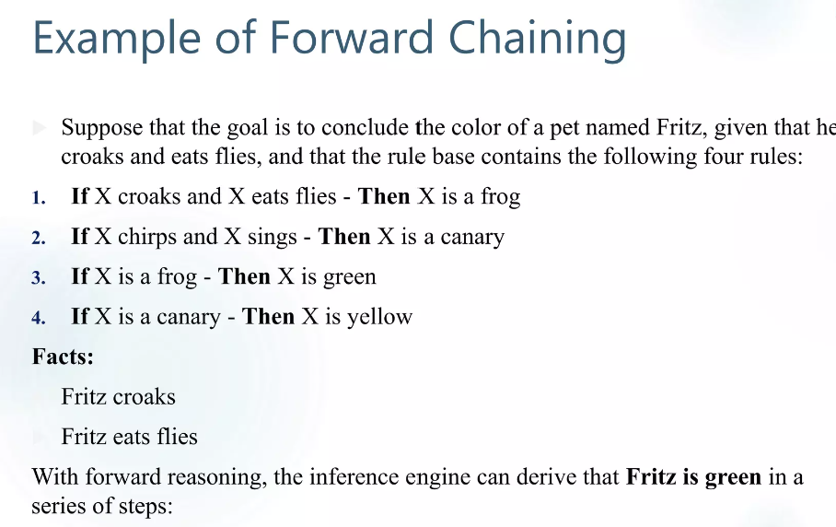

Slide 52
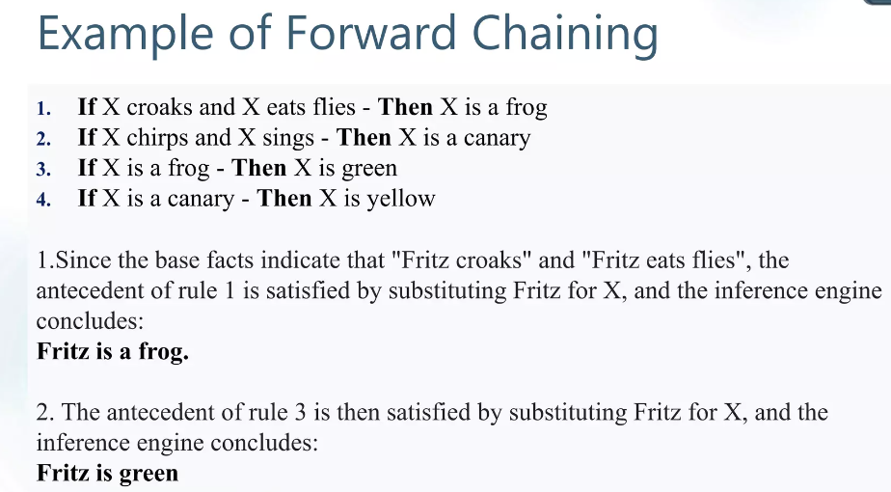

Slide 53
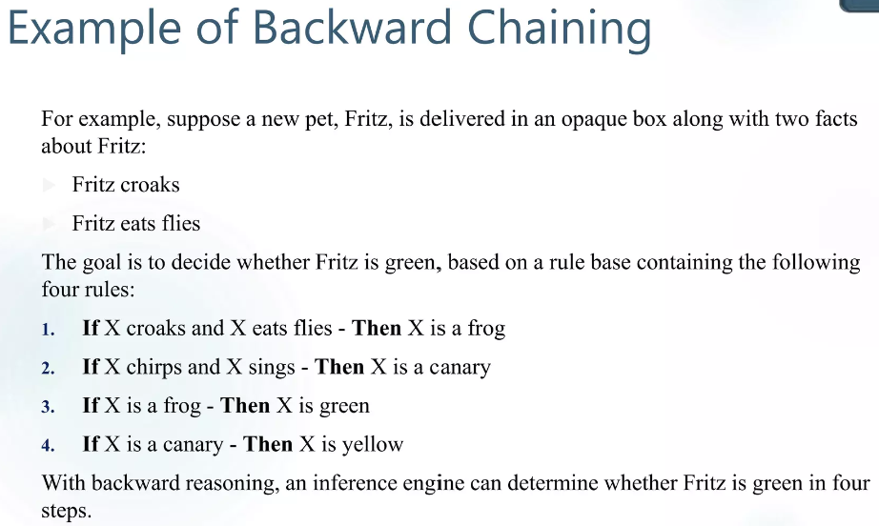

Slide 54
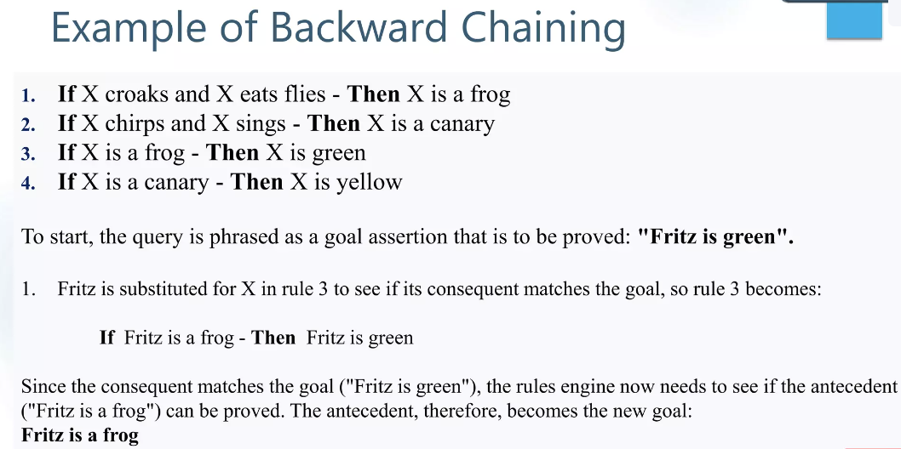

Slide 55
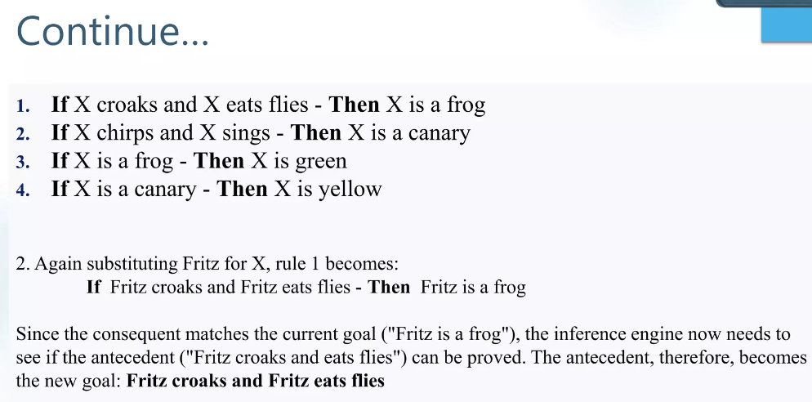

Slide 56
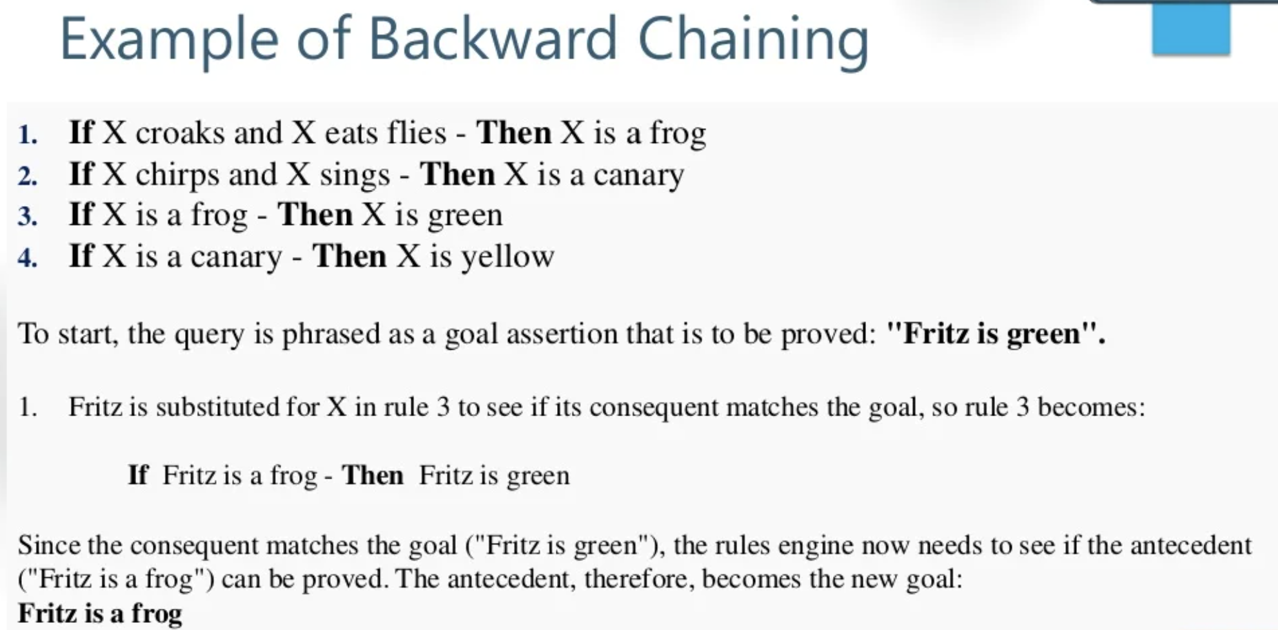

Slide 57
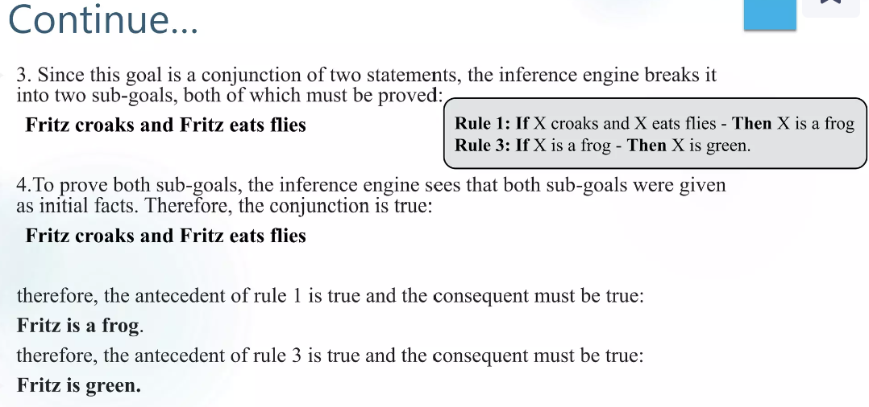

Slide 58
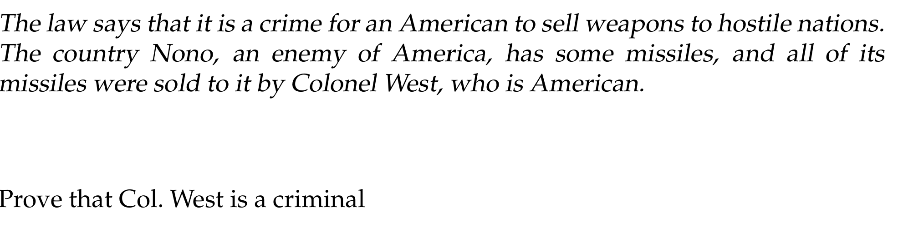
Example

Slide 59
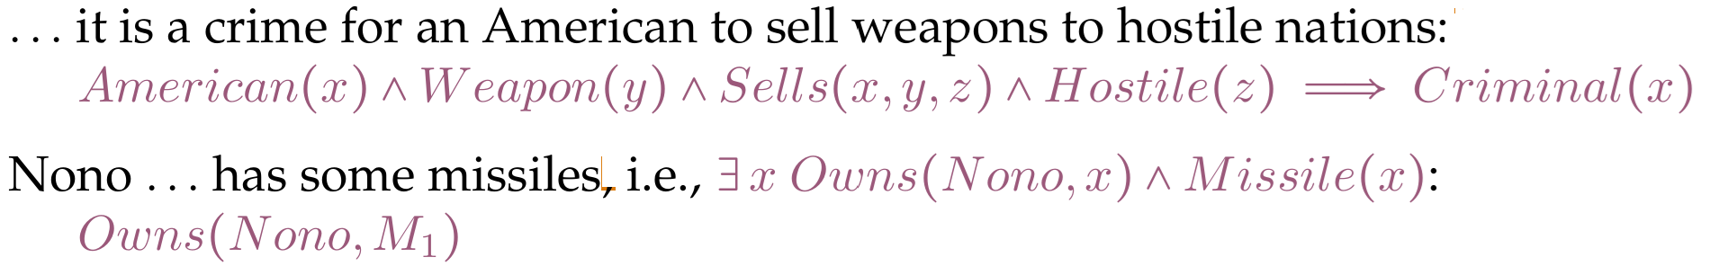
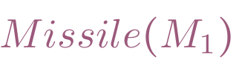
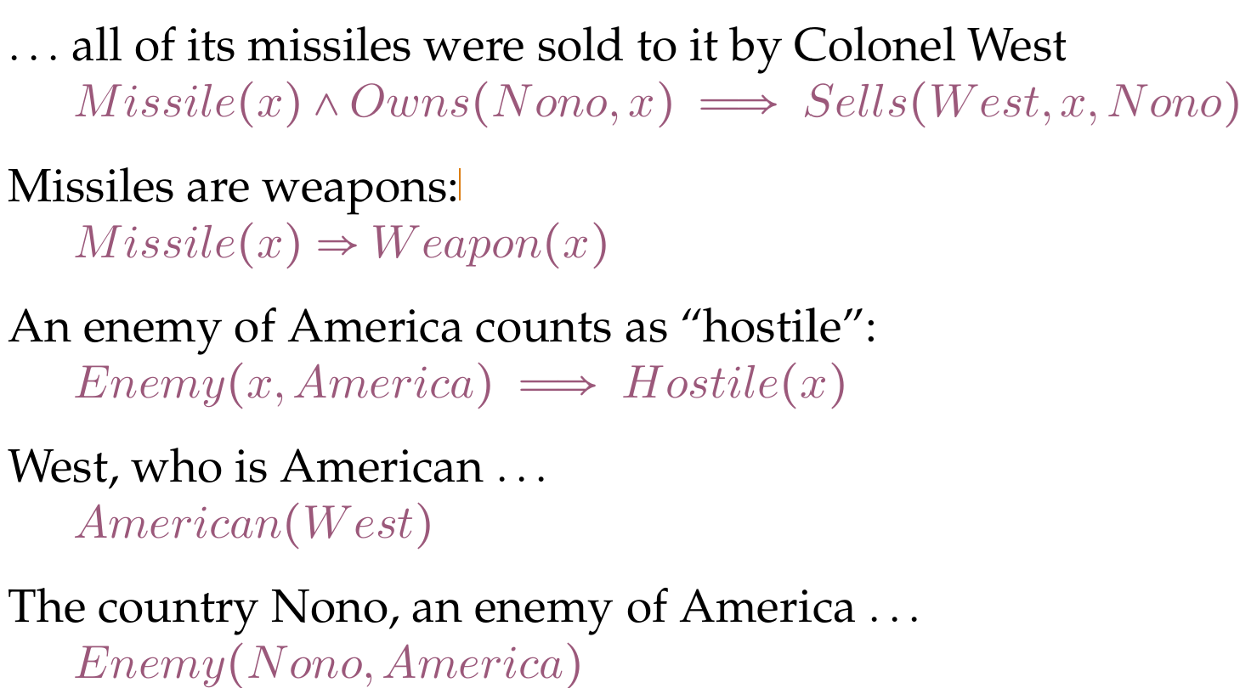

Slide 60
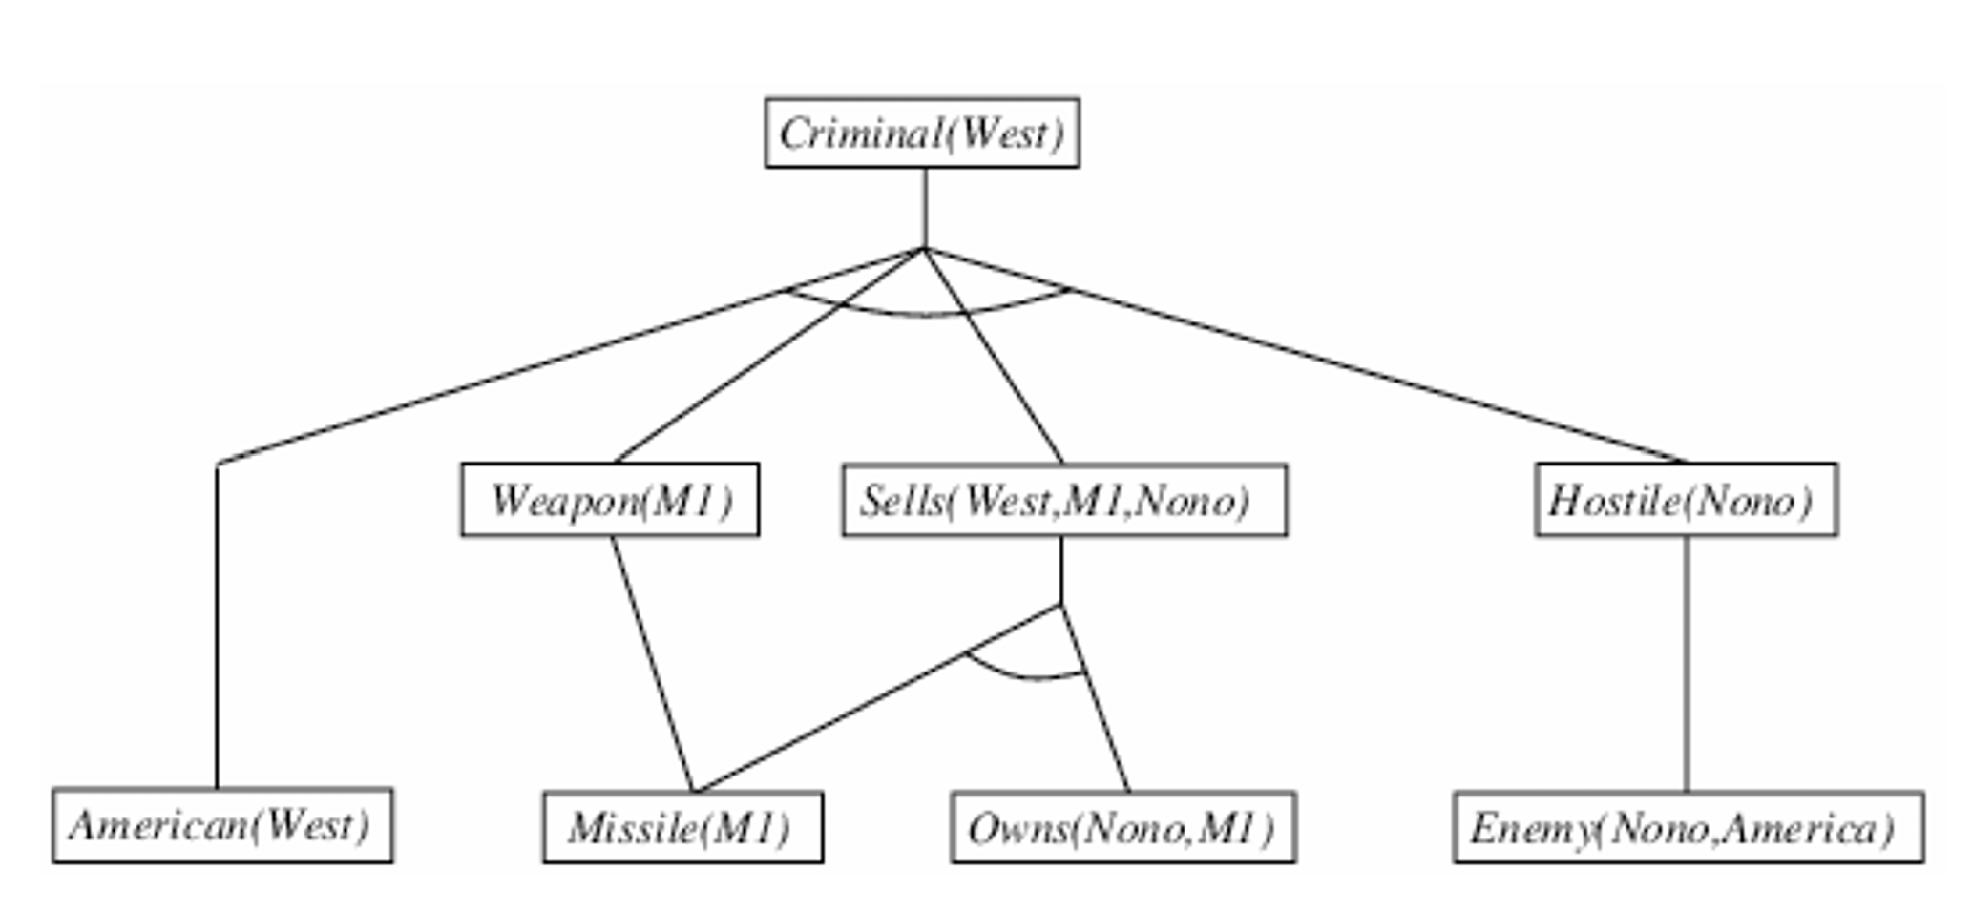
Forward Chaining

Slide 61
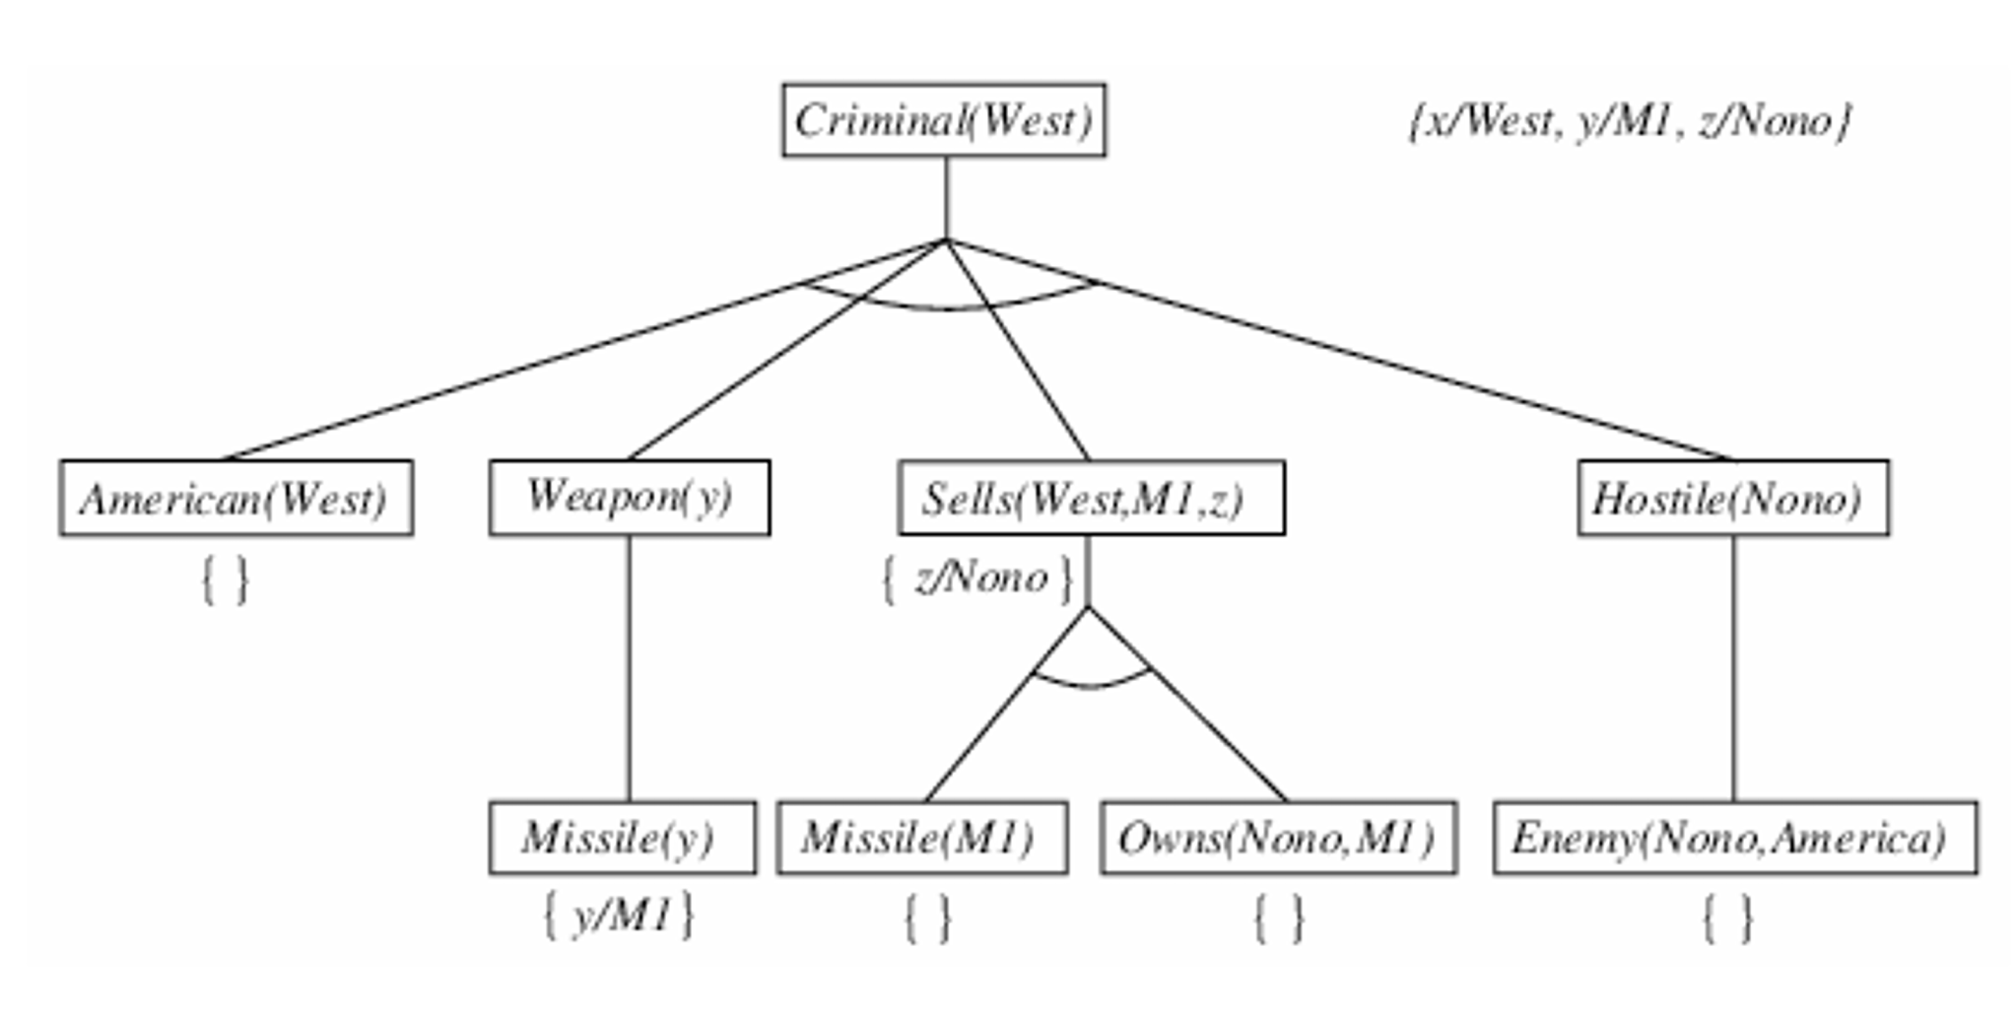
Backward Chaining

