Slide 1

News Aggregator
A Full Stack MERN Web Application | College Internship Certification Project
Shreya Sundli
24BCE2546
Siddharth Verma
23BCT0159
Vakati Narayani Nayani
24BAI1200
Bhavy Hrishikesh
22BIT0371
Course: ETHNUS MERN Full Stack · Faculty Guide: [Name] · Date: [Date]

Slide 2
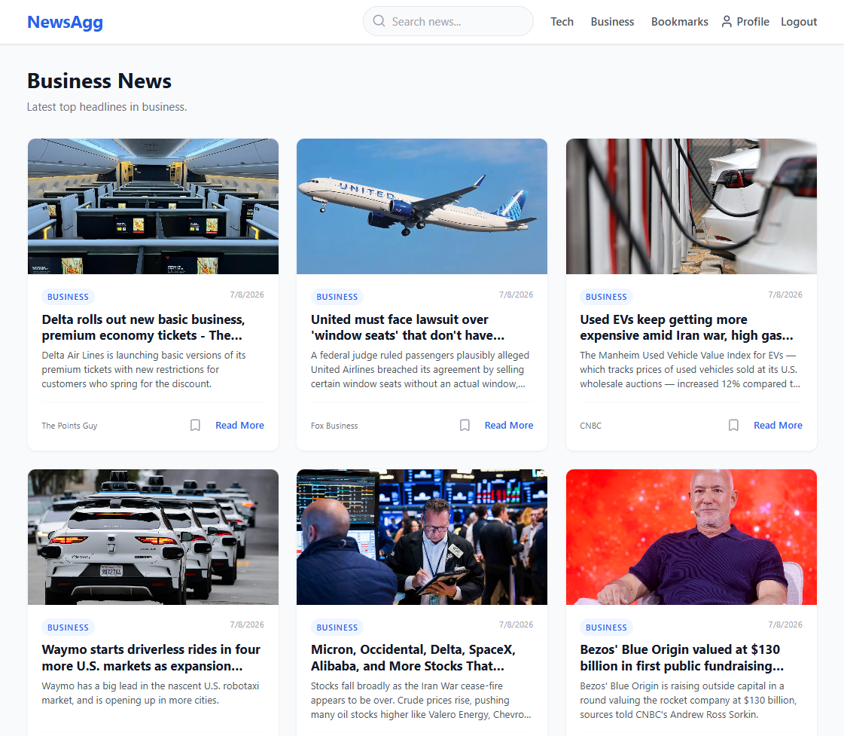
Project Overview
What It Is
A personalized news aggregator where users browse top headlines, search by keyword, filter by category, save bookmarks, and manage profile preferences.
Domain & Type
News · Full-Stack Web Application
Learning Outcomes Demonstrated
CRUD Operations
User Authentication
REST API Design
MongoDB Integration

Slide 3
Technology Stack — MERN
M —> MongoDB Atlas
E —> Express.js
Cloud NoSQL database via Mongoose ODM
REST API backend with 11 routes and middleware stack
R — React.js
N — Node.js
Functional components, hooks, Context API, React Router
JavaScript runtime powering the server
Supporting tools: JWT, bcrypt, Tailwind CSS, Axios, Helmet, CORS, express-validator

Slide 4

System Architecture
User Browser
Vercel Frontend
Render API
MongoDB / NewsAPI
Frontend hosted on Vercel, backend on Render, and database on MongoDB Atlas.
External news data is sourced from NewsAPI.org with a local JSON fallback when no API key is available.

Slide 5
Core Features
Authentication
Browse & Filter
Registration, login, and logout with JWT-based session management
Latest headlines with category-based filtering
Search
Bookmarks
Keyword-based news search across all sources
Save and remove articles for later reading
Profile & Preferences
Responsive UI
Personalized feed based on preferred categories
Fully adaptive layout for desktop, tablet, and mobile

Slide 6

Authentication & Security
Password Security
Hashed with bcrypt at 10 salt rounds before storage
Token-Based Sessions
JWT issued on login/register with 30-day expiry; persisted via localStorage + AuthContext
Route Protection
Backend routes secured via authMiddleware; frontend routes guarded by ProtectedRoute.jsx
Security Middleware
Helmet, CORS, and express-validator input validation on all endpoints

Slide 7
CRUD Operations Demonstrated
CREATE
Register new user account · Save a bookmark
READ
Fetch news headlines · Retrieve user profile · Load bookmarks · Category feed · Search results
UPDATE
Update user profile details · Modify preferred news categories
DELETE
Remove a saved bookmark from the user's collection

Slide 8
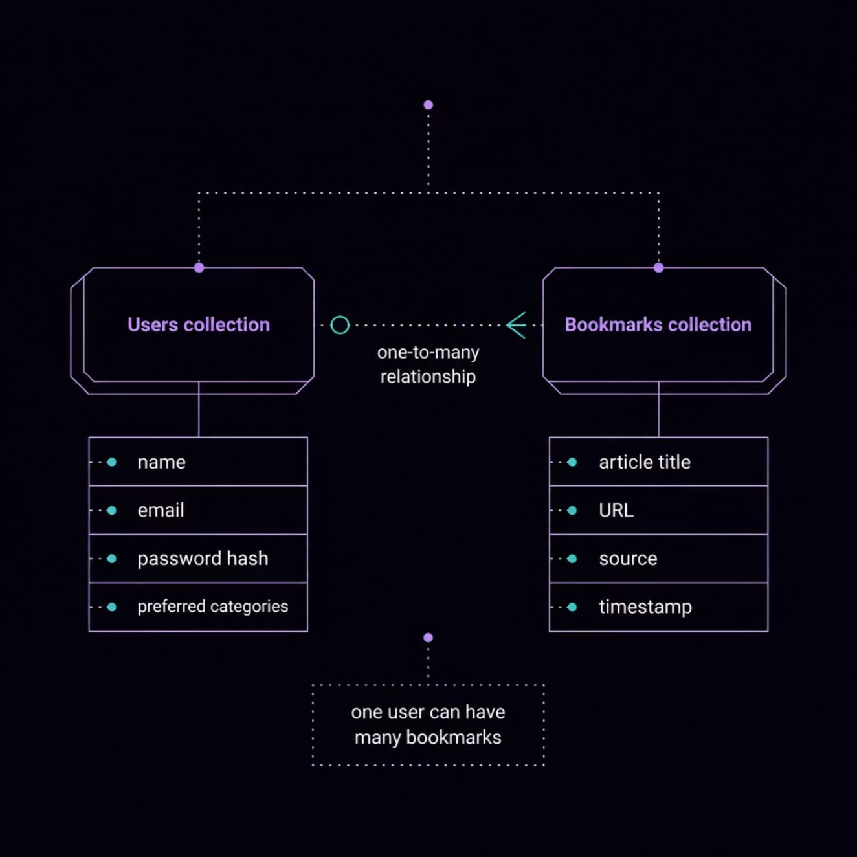
Database & API Design
MongoDB Collections
Users - Account credentials, profile data, category preferences
Bookmarks - Saved articles linked to user via reference
REST API Endpoints
POST /api/auth/register
Register new user
POST /api/auth/login
Authenticate and issue JWT
GET /api/news
Fetch latest headlines
GET /api/news/category/:name
Filter by category
GET /api/news/search
Keyword search
POST /api/bookmarks
Save bookmark
GET /api/bookmarks
List saved articles
DELETE /api/bookmarks/:id
Remove bookmark

Slide 9
Team Contributions
Shreya Sundli · 24BCE2546
Siddharth Verma · 23BCT0159
Frontend Development
Backend Development
React UI & component design
Routing & navigation
Tailwind CSS styling
Responsive layout
Express.js REST API
Controllers & routes
Middleware stack
MVC architecture
Vakati Narayani Nayani · 24BAI1200
Bhavy Hrishikesh · 22BIT0371
Database & Auth
Integration & Deployment
MongoDB schema design
Mongoose models
JWT authentication
bcrypt security
NewsAPI + fallback logic
Vercel & Render deployment
Testing & QA
README documentation

Slide 10
Conclusion & Future Scope
Project Summary
Thank You
Successfully built a full-stack MERN application demonstrating authentication, CRUD operations, REST API design, and responsive UI - meeting all certification learning outcomes.
We appreciate your time and evaluation.
Shreya Sundli · Siddharth Verma
Vakati Narayani Nayani · Bhavy Hrishikesh
Questions & Discussion Welcome
Future Improvements
Dark mode toggle
Infinite scroll for news feed
Push notifications for breaking news
Admin dashboard & analytics
Social sharing integration

