Slide 1

Covid-19 Tracker App
RNS INSTITUTE OF TECHNOLOGY
BENGALURU - 98
DEPARTMENT OF INFORMATION SCIENCE & ENGINEERING
Presentation on Internship
Shreya Uday Hasyagar
USN: 1RN18IS101
ENMAZ Engineering Services Pvt. Ltd.
Internal Guide
Mrs. Shwetha GN
Asst. Prof, Dept of ISE, RNSIT
External Guide
Mr. Akshay D R
CEO, ENMAZ Engineering Services Pvt. Ltd, Bengaluru

Slide 2
AGENDA
Abstract
About the Company
Introduction
Literature Survey
Requirements
System Design
Detailed Design
Implementation
Testing
Conclusion and Future Enhancements
References
Q & A

Slide 3
ABSTRACT
The World Health Organization has declared the outbreak of the novel coronavirus, Covid-19 as pandemic across the world. COVID-19 has become biggest impediment for the survival of the human race, at present.
As mobile technology is now an important component of human life, hence it is possible to use the power of mobile technology against the treat of COVID-19.
The application is featured with all the real-time attributes about the novel coronavirus disease and its measures and controls. To achieve all these functionalities, many tools and APIs are used in this application.
The system purposely aims to maintain the digital protection of the society, create public awareness, and not create any agitation situation among the individuals of the society.

Slide 4
ABOUT THE COMPANY
Enmaz has a simple yet robust solution that helps any Industry / Factory digitize their work floor in no time. The products offered will help in remote monitoring, controlling and also analyzing any machine parameter or process
The company provides products like Marvel Translators, Marvel Sensors, Gateway, Cloud Software etc.
The products provided by the company includes Reliable Hardware, Innovative Software with Competitive Costs.
The company provided an internship in the domain Flutter, which is an open source framework by Google for building beautiful, natively compiled, multi-platform applications from a single codebase.

Slide 5
INTRODUCTION
In Wuhan city of China, due to some unknown causes a local outbreak of pneumonia was notice in December 2019. As of April 25, 2019, more than 22,398 confirmed COVID-19 cases were found in INDIA.
In this pandemic condition, a couple of mobile applications are introduced by government institutions and others, which are providing valuable information to the people to aware of the pandemic situation.
The Government of India took the initiative and developed a mobile application named AarogyaSetu to connect essential health services with the people of INDIA. MICROSOFT BING has taken the novel attempt to implement a software solution for the COVID-19 pandemic across the world for data transparency and increasing traceability.
An application with a lot of information may be confusing for the user with less knowledge on how to use mobile/web. We propose a simple Covid-19 Tracker which provides most important functionalities. The application uses API to fetch the real-time number of active cases, number of recovered and deaths. It provides means to find any country of his choice and allow the user to set a default country for frequent updates.
The application provides users information on top COVID-19 symptoms and precautions to be taken to prevent from getting affected. It also tries to burst some myths related to COVID-19 and provides important information about the virus.

Slide 6
LITERATURE SURVEY
A Literature survey describes the concept of how the concept has emerged, how it has been implemented and what is the current status.
Paper [1]
In this paper, a healthcare mobile application prototype was developed successfully and installed on an Android smartphone. The application offers convenient telemedicine services that enable patients to be diagnosed online by medical specialists. The application also facilitates the ordering of medications using online payment. Medications can be delivered directly to the desired location, and in emergency cases, patients can call for ambulance service. The system enables medical doctors and nurses to monitor their patient’s health continuously. Pharmacies can also use the application to offer and deliver their medical products to patients. The development of prototype was discussed in phases and the future enhancement along with the final version of the application that can be developed is examined and recorded for further studies.
Paper [2]
Flutter developers have to deal with a state management issue when developing their applications. In order to solve this problem, multiple architectures have been developed. This paper proposes a new Flutter architecture based on the Clean Architecture by Uncle Bob. The Flutter Clean Architecture (FCA) proposed in this paper is packaged and released through a Flutter package. The architecture is tested by developing a full application from scratch using the package and documenting the process. The Flutter Clean Architecture provides a solution to the state management problem as well as a potential overall choice for Flutter mobile application architecture.

Slide 7
LITERATURE SURVEY
Paper [3]
Examination of most recent cross-stage mobile application improvement approaches which are at present accessible in the market are successfully weighed up in this paper. This exploration paper investigated how unique devices which are as of now accessible in the market. An application is developed on Flutter for farming solution and it contains features that help farmers plan their crop cycles and accordingly decide the optimum time or climate for growing any crop. The main objective of the app is to provide farmers with a complete solution to help maximize their yield and resolve their queries. The paper mentions the key features of the App and the information it provides in the lifecycle of farming.
Paper [4]
Cross-platform mobile application development is the pressing priority in today’s world and generation. Developers are enforced to either construct the same application numerous times for various operating systems or accept a low-quality similar solution that trades native speed and accuracy for portability. In this paper authors explain Flutter and its features and advantages over other technologies. The paper is concluded with the contribution of the App to the society. The App is helping the retailers and small to medium shop owners to attract new customers, retain existing ones, and motivate increased purchase among current consumers.

Slide 8
LITERATURE SURVEY
Paper [5]
In this paper, a study has been undertaken to indicate the benefits of using Flutter over other app development platforms. The paper consists of working of different platforms and their role in application development. Cross-platform frameworks that show resemblance to Flutter were discussed and implemented by various companies, yet neither of them suffices to satisfy the requirement of industrial development. In spite of the ineffective precursors, Flutter which is backed up by Google, drew attention and developers found it easier to use as well.
Authors conclude the paper by stating that Flutter is a tool with a promising feature, if the community continues to grow in the direction that it is right now. Considering that Flutter’s strong side is being a cross-platform solution, Flutter still performs well on a single application base if compared to native applications.

Slide 9
REQUIREMENTS
The best thing about using Flutter for creating cross-platform native mobile apps is the fact that you can build those on almost any OS.
Here are some System Requirements for Android Studio which is needed for running an Android simulator.
Windows:
Microsoft® Windows® 7/8/10 (64-bit)
4 GB RAM minimum, 8 GB RAM recommended
2 GB of available disk space minimum,
4 GB Recommended (500 MB for IDE + 1.5 GB for Android SDK and emulator system image)
1280 x 800 minimum screen resolution

Slide 10
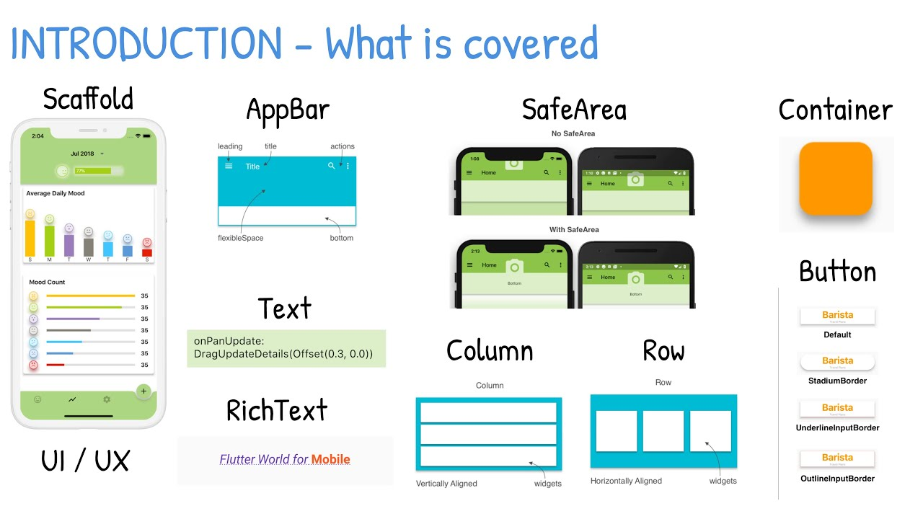
SYSTEM DESIGN
Basic widgets
Flutter comes with a suite of powerful basic widgets, of which the following are commonly used:
Text: The Text widget lets you create a run of styled text within your application.
Row, Column: These flex widgets let you create flexible layouts in both the horizontal (Row) and vertical (Column) directions. The design of these objects is based on the web’s flexbox layout model.
Scaffold: Implements the basic Material Design visual layout structure. This class provides APIs for showing drawers, snack bars, and bottom sheets.
Container: The Container widget lets you create a rectangular visual element
vljgh

Slide 11
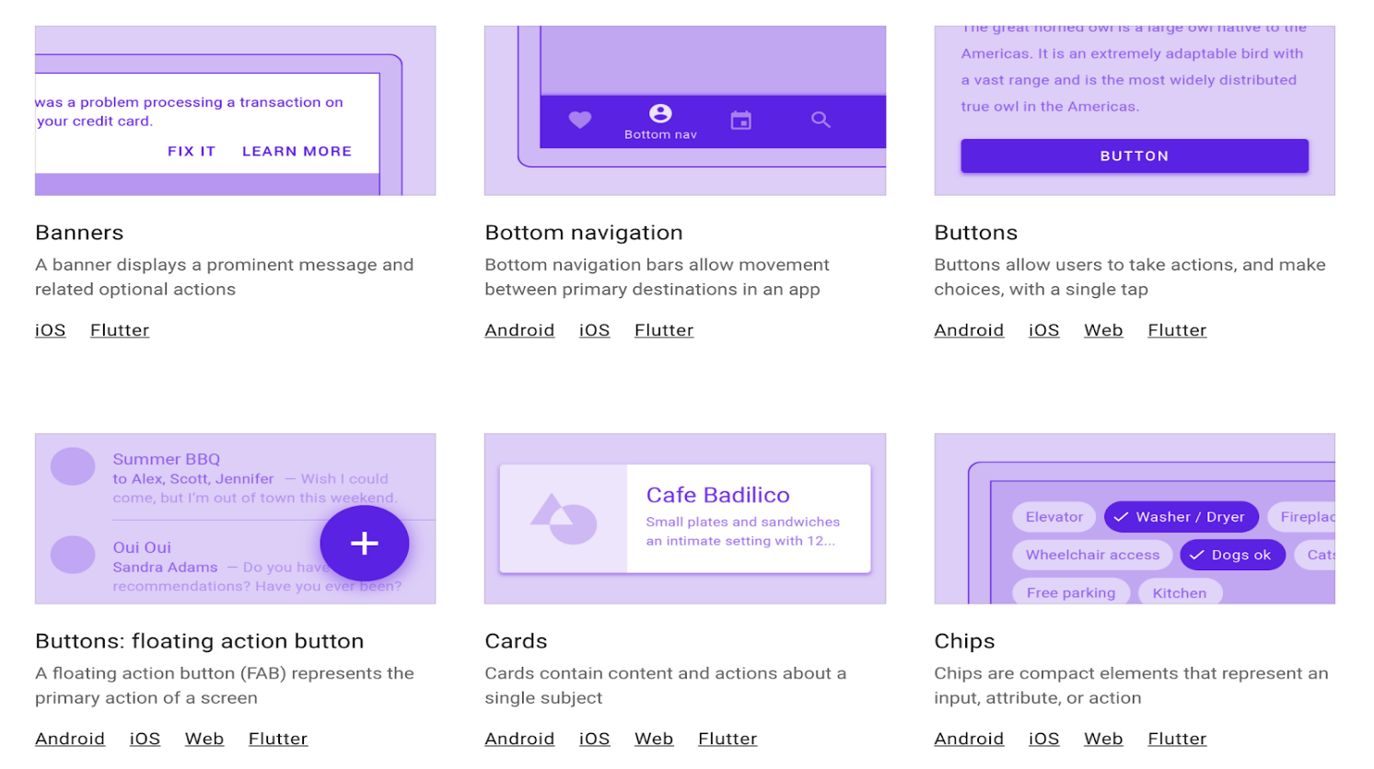
SYSTEM DESIGN
What is Material design?
Material is an adaptable design system, backed by open-source code, that helps developers easily build high-quality, digital experiences. From design guidelines to developer components, Material can help developers build products faster. Material design guidelines provide best practices and user interface design.
App structure and navigation
Buttons
Input and selections
Dialogs, alerts, and panels
Information displays
Layout

Slide 12
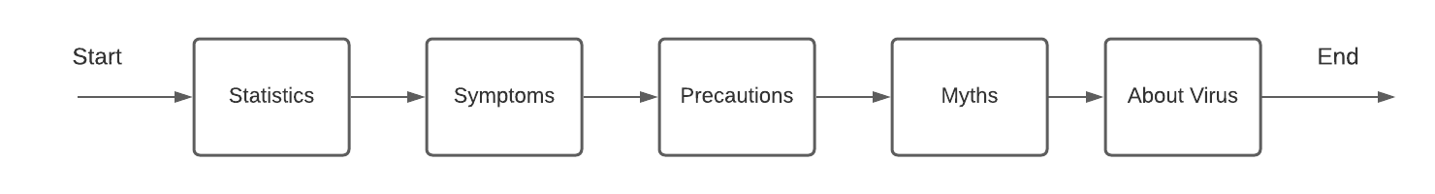
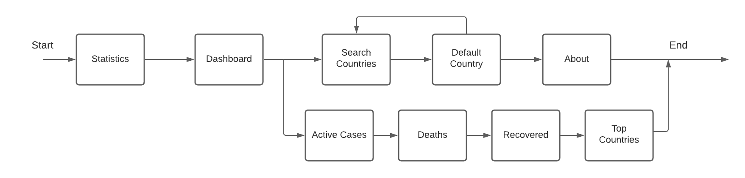
DETAILED DESIGN
The user is provided with many options to choose like View the Statistics, read about the Symptoms of COVID-19, read about Precautions to be taken, Myths regarding the virus and more information About the virus. The user can choose any of the options in any random way.

Slide 13
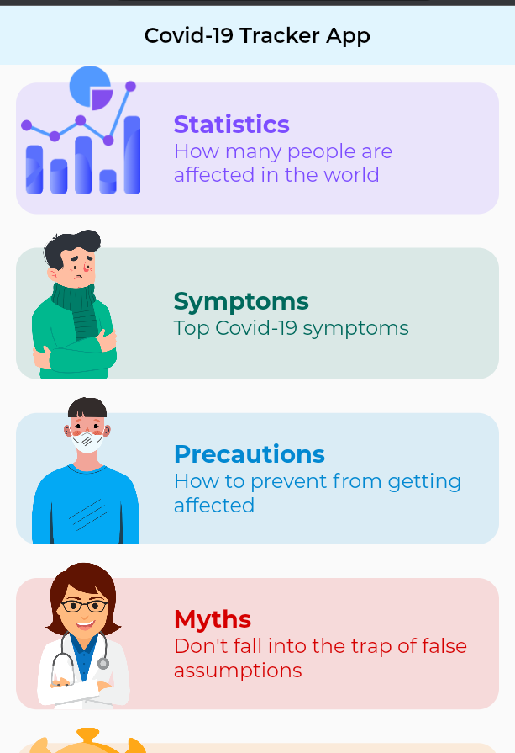
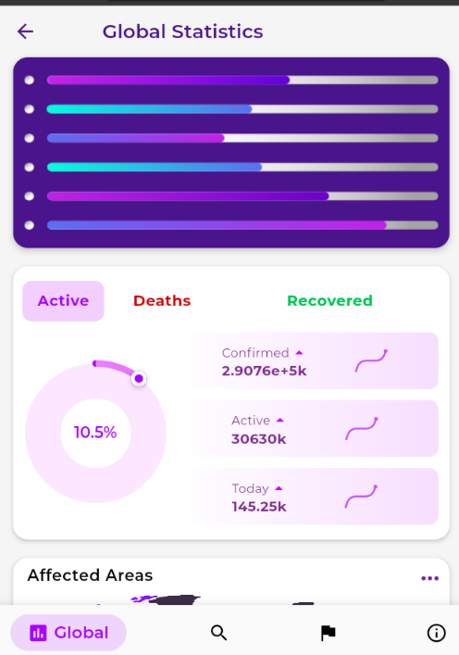
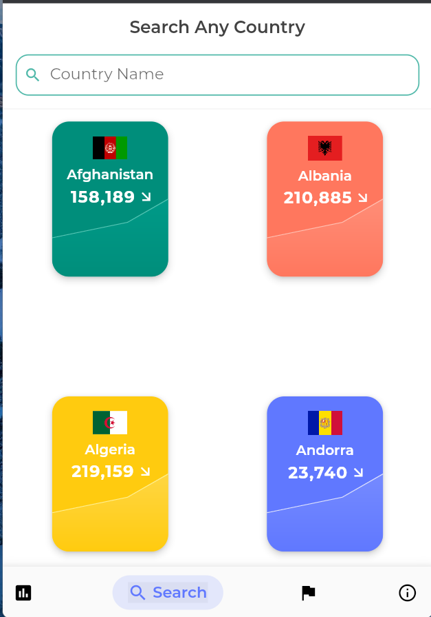
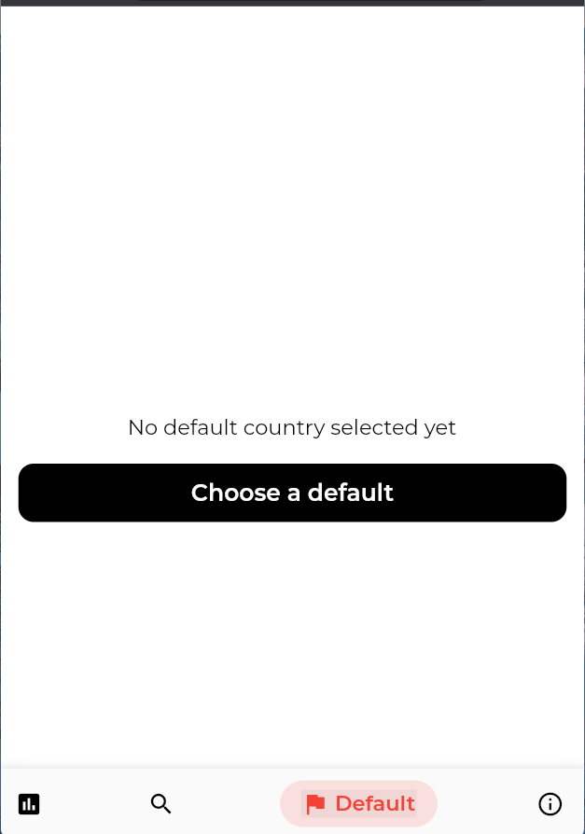
DETAILED DESIGN
The following screens can be visited in order, as mentioned in the system flow diagram, in previous slide.

Slide 14
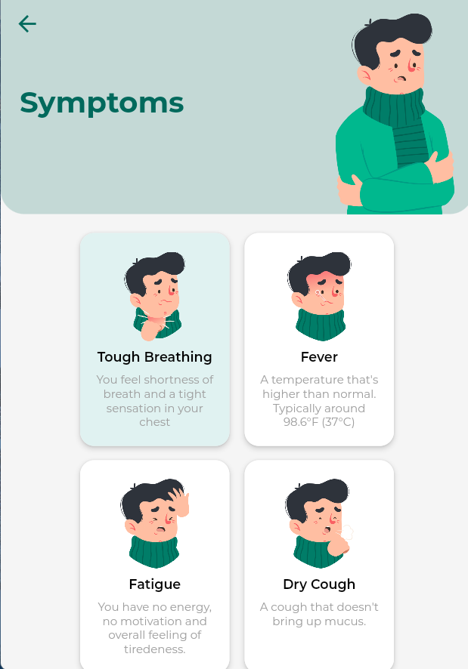
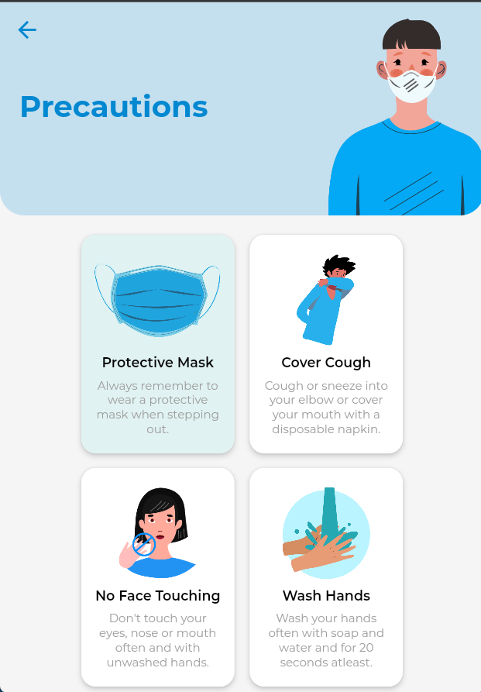
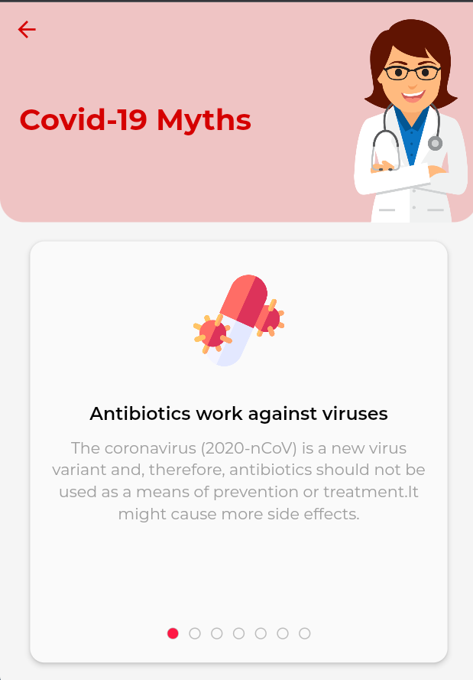
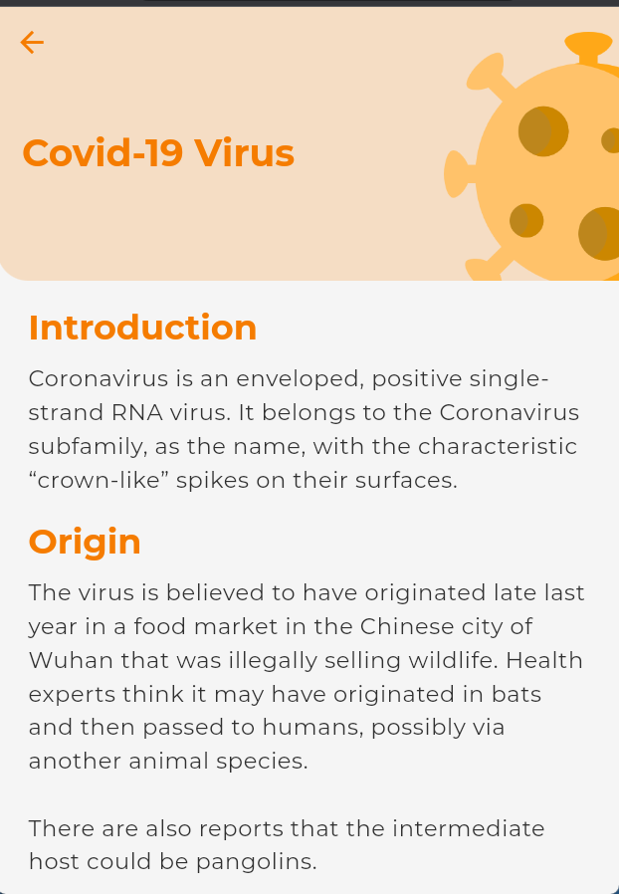
DETAILED DESIGN

Slide 15
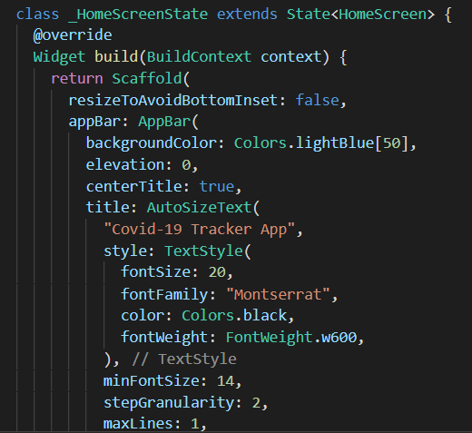
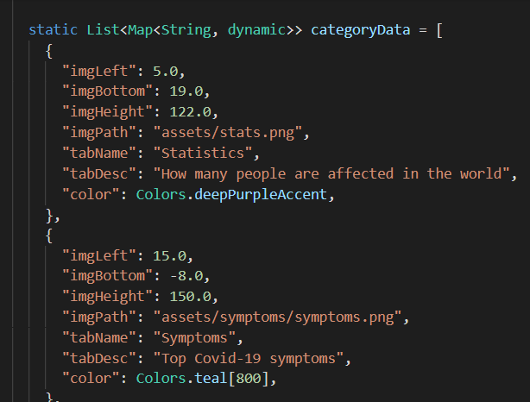
IMPLEMENTATION
The snippet is used to include basic design to the home page like AppBar, font, colors, and other necessary widgets
The snippet is used to display different features that the app provides on the home screen

Slide 16
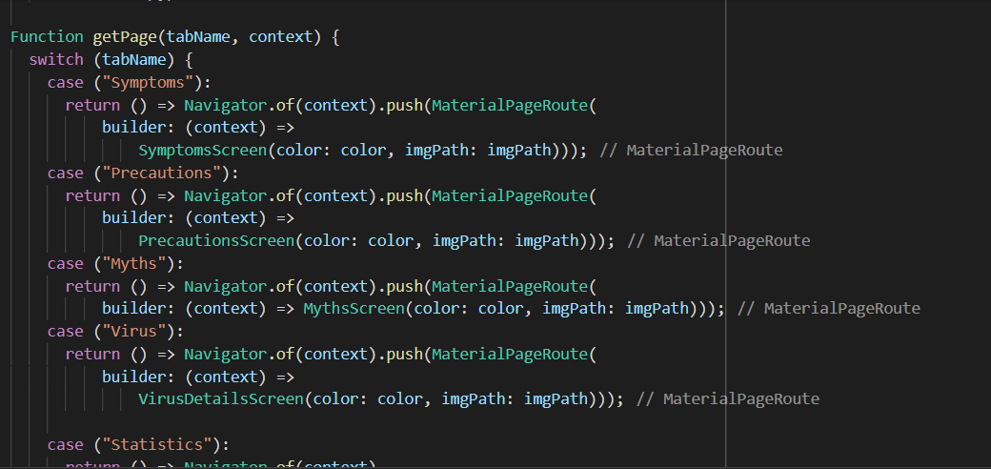
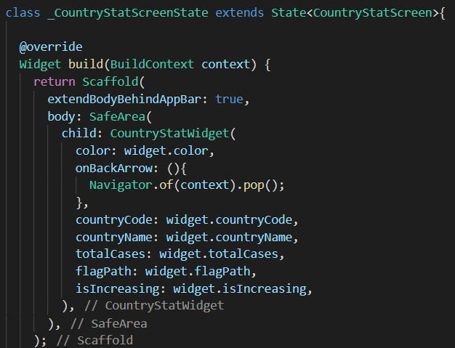
IMPLEMENTATION
The snippet is used to switch the tabs and fetch the specified screens, when a particular card is selected.
The snippet is implemented to display different statistics of the country and uses mainly Scaffold.

Slide 17
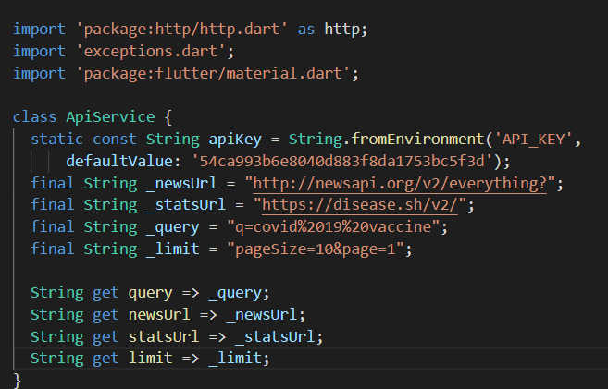
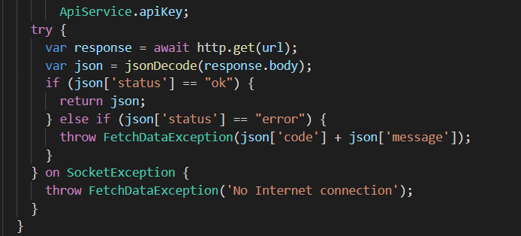
IMPLEMENTATION
The snippet shows the API Key along with the URL which provide the service.
The snippet converts the http response to a Post. It checks for the necessary conditions and throws exceptions if the errors are found.

Slide 18
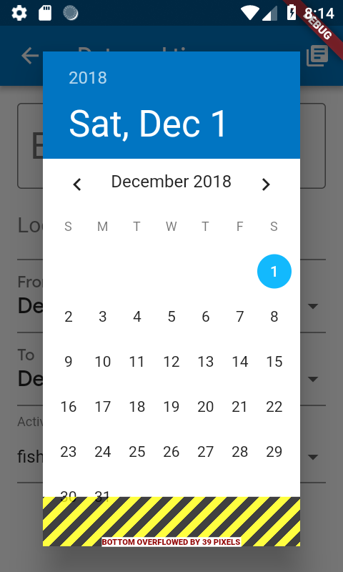
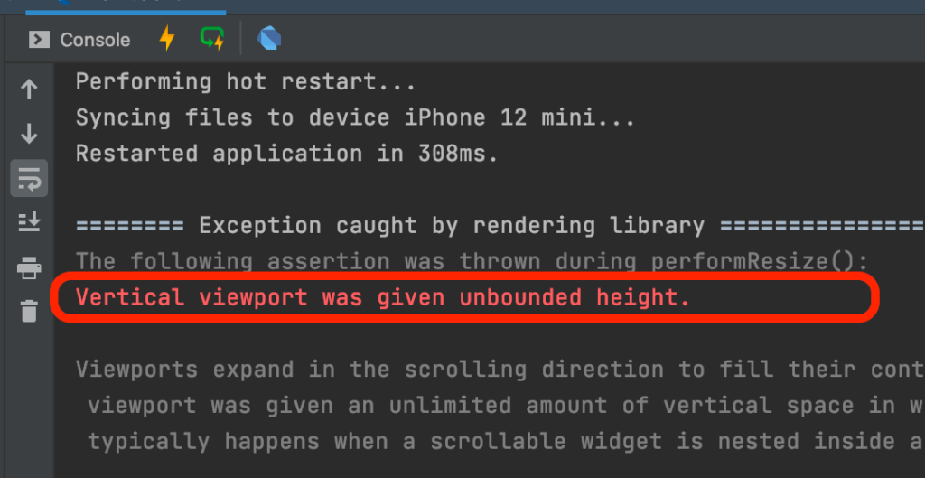
TESTING
Testing is the process of evaluating and verifying that a software product or application does what it is supposed to do.
Common Flutter Errors
1) A Render-Flex Overflowed: Render-Flex overflow is one of the most frequently encountered Flutter framework errors. When it happens, you’ll see yellow & black stripes indicating the area of overflow in the app UI.
2) Vertical viewport was given unbounded height : This is another common layout error you could run into while creating a UI in Flutter app. The error is often caused when a ListView (or other kinds of scrollable widgets such as GridView) is placed inside a Column

Slide 19
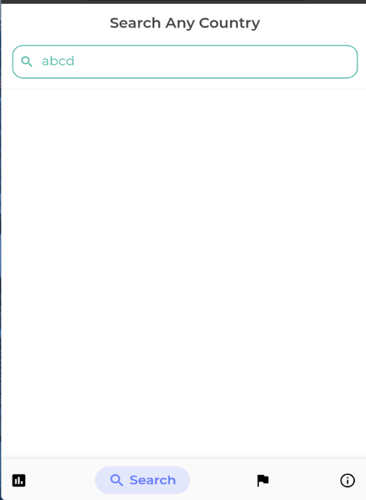
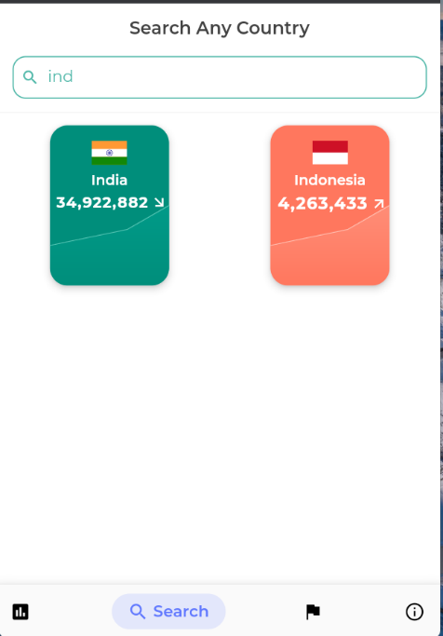
TESTING
The below fig displays the scenario when the user enters a non-existing country name. As we expect, no country is displayed until the correct input is provided.
The below fig represents the scenario when the user has entered few letters in the search bar and the countries with name matching to the entered value is displayed to the user to be selected.

Slide 20
TESTING
Handling Errors in REST API
The simplest way we handle errors is to respond with an appropriate status code. Here are some common response codes:
400 Bad Request – client sent an invalid request, such as lacking required request body or parameter
401 Unauthorized – client failed to authenticate with the server
403 Forbidden – client authenticated but does not have permission to access the requested resource
404 Not Found – the requested resource does not exist
412 Precondition Failed – one or more conditions in the request header fields evaluated to false
500 Internal Server Error – a generic error occurred on the server
503 Service Unavailable – the requested service is not available

Slide 21
CONCLUSIONS
The app provides efficient means to find information related to COVID-19 by displaying most necessary details to the user and is beginner friendly. It successfully provides the digital protection of the society, creates public awareness, and helps users to be up to date with essential details.

Slide 22
FUTURE ENHANCEMENTS
The app can be extended to have many new features such as:
Use APIs to provide COVID-19 news of different countries and default country
Make the app accurate.
Provide geo-locations.
Make it contact COVID-19 centers
Allow the users to book vaccination slots.
Take basic self-assessment tests by users.
Provide information on nearby containment zones.

Slide 23
REFERENCES
https://flutter.dev/learn
https://docs.flutter.dev/reference/tutorials
https://www.tutorialspoint.com/flutter/index.htm
https://www.geeksforgeeks.org/flutter-material-design/
https://www.ibm.com/cloud/learn/rest-apis
https://www.raywenderlich.com/24499516-getting-started-with-flutter
https://www.w3adda.com/flutter-tutorial

Slide 24
REFERENCE PAPERS
Ragda Mamoun, Mohamed Nasor, Sahar H. Abulikailik. Design and Development of Mobile Healthcare Application Prototype Using Flutter. 2020 International Conference on Computer, Control, Electrical, and Electronics Engineering (ICCCEEE)
Shady Boukhary, Eduardo Colmenares. A Clean Approach to Flutter Development through the Flutter Clean Architecture Package. 2019 International Conference on Computational Science and Computational Intelligence (CSCI)
Madhuram. M, Ashu Kumar, Pandyamanian. Cross Platform Development using Flutter. International Journal of Engineering Science and Computing, April 2019
Aakanksha Tashildar, Nisha Shah, Rushabh Gala, Trishul Giri, Pranali Chavhan Application Development using Flutter. International Research Journal of Modernization in Engineering Technology and Science 2020
Achal Agrawal, Amit Agrawal, Rahul Arya, Hardik Jain, Jyoti Manoorkar. Comparison of Flutter with Other Development Platforms. International Journal of Creative Research Thoughts 2021

Slide 25
Question and Answer

Slide 26
THANK YOU

