Slide 1
Spring AOP

Slide 2
Why we need AOP?
helps to seprate the cross cutting concerns like logging, transaction etc
What is cross Cutting concern?
  the crosscutting concern is a concern which is applicable throughout the application and it affects the entire application.
  For example: logging, security and data transfer are the concerns which are needed in almost every module of an application.

Slide 3
What is AOP?
In computing, aspect-oriented programming is a programming paradigm that aims to increase modularity by allowing the separation of cross-cutting concerns.

Slide 4
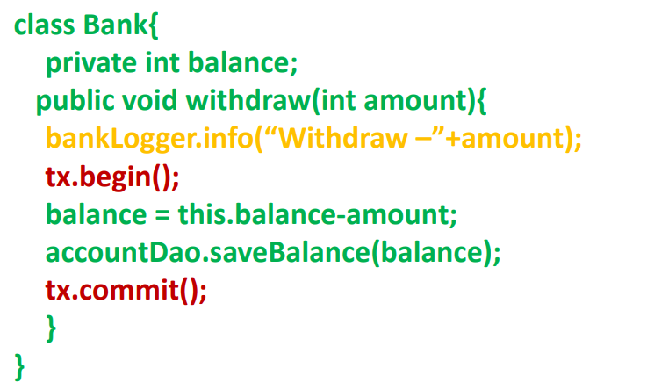
Cross Cutting concerns

Slide 5
AOP – Definations
Join point
Advice
Pointcut
Introduction
Target Object
Aspect
Interceptor
AOP Proxy
Weaving

Slide 6
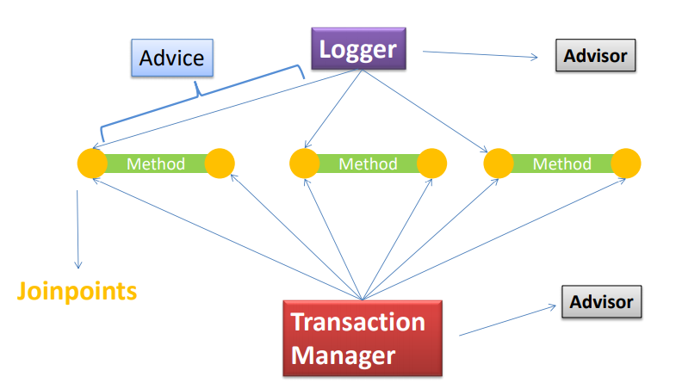
AOP – Definations

Slide 7
Advice
  defines what needs to be applied and when.
Jointpoint
  is where the advice is applied.
Pointcut
  is the combination of different joinpoints where the advice needs to be applied. (It is an expression language of AOP that matches join points.)

Slide 8
Aspect
  is applying the Advice at the pointcuts.
Target Object
  The target object is an object being advised by one or more aspects. It will always be a proxy object. It is also referred to as the advised object.

Slide 9
Interceptor
  It is an aspect that contains only one advice.
AOP Proxy
  It is used to implement aspect contracts, created by AOP framework. It will be a JDK dynamic proxy or CGLIB proxy in spring framework.

Slide 10
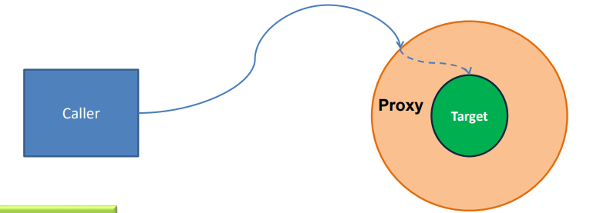
Weaving
  It is the process of linking aspects with other objects to create the advised proxy objects. This can be done at
    compile time,
    load time
    Runtime.

Slide 11
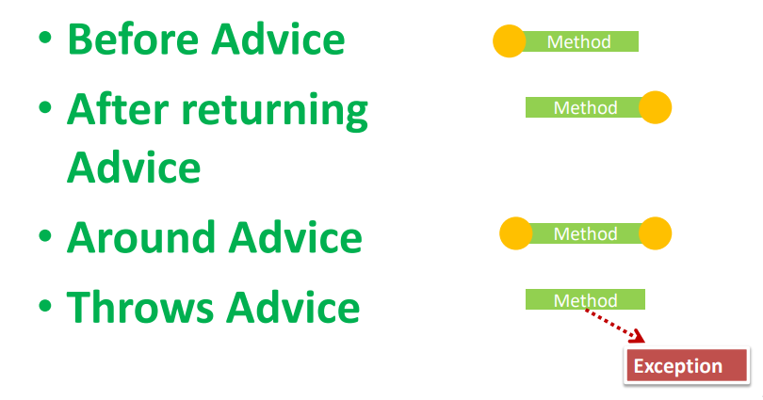
Advice Types

Slide 12
Spring AspectJ AOP implementation
There are two ways to use Spring AOP AspectJ implementation:
By annotation
By xml configuration

