Slide 1
LDAP by Shreya Hedau

Slide 2
What is LDAP?
LDAP is the abbrivation of Lightweight Directory Access Protocol.
It is a standard protocol used by applications to access information in a directory
(In simple terms it is a store where we can store the data)

Slide 3
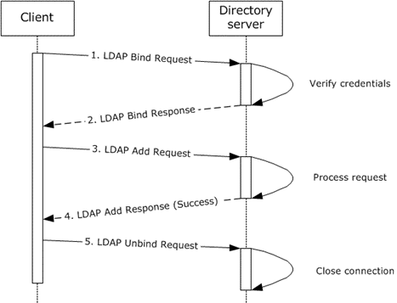
How ldap works?

Slide 4
Why LDAP is necessary ?
User has more account today, email, fname, lname,dept etc..
So when we update the data, we may have issues like normalization
How to synchronize the user info. when his work is related to more than one department?

Slide 5
We can generally store data in 2 ways
Table
Hierarchy
So here we have an alternate way to store the data in hierarchical way.
  Ldap stores in hierarchical way

Slide 6
Table
Id | Name | Email
1 | abcd | abcd@gmail.com

Slide 7
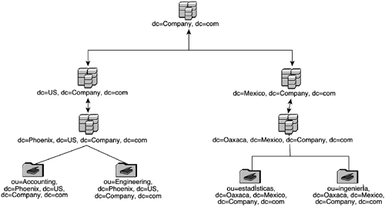
Hierarchy

Slide 8
Terminologies used
dc = domain component(root)
cn = common name
DIT = Directory Infromation tree
dn = distinguished name(is the unique name with with tree is identified)
Ldif = ldap data interchange format(it have set of entires.)

Slide 9
Note
Schema defines ObjectClass & Attributes
To use an attribute, include the ObjectClass to which the attribute belongs
Attributes fall under ObjectClass
We can only use those attributes that are defined in a schema
To use non-standard attributes, custom schema needs to be defined.

Slide 10
Ldif file have entries like..
dn: dc=springframework,dc=org
objectclass: top
objectclass: domain
objectclass: extensibleObject
dc: springframework
dn: uid=ben,ou=people,dc=springframework,dc=org
objectclass: top
objectclass: person
objectclass: organizationalPerson
objectclass: inetOrgPe
cn: Ben Alex
sn: Alex
uid: ben
userPassword: benspassword

