Slide 1


Analysis and forecasting of funding trends in pediatric epilepsy research
Instructor: Professor Roy Wada
Group 7:
Abhishek Mehra
Manav Jatakia
Nihar Shah
Shreya Joshi
Prateek Pandey

Slide 2

Grik Therapeutics
Pipeline:
Lead candidate GRIK0002 in pre-clinical development for Dravet Syndrome.
Molecular Mechanistic Pharmacology, Molecule Modeling, Endogenous Regulators, and Neurobiology driving innovation.
Revolutionizing Epilepsy Care.
Cracking the Code: Ion Channel Alchemy.
Brain Waves: Redefining CNS Solutions.
Problem Definition
Introduction
Analysis
Recommendations
Next Steps
Conclusion
Q/A

Slide 3
Problem definition
Challenge: The project tackles the economic burden in rare pediatric epilepsy research, a field often overshadowed by more prevalent neurological disorders.
Goal: To forecast future funding trends and identify strategic opportunities for GRIK Therapeutics, leveraging data analytics to inform the development of innovative treatments for rare pediatric epilepsies.
Problem Definition
Introduction
Analysis
Recommendations
Next Steps
Conclusion
Q/A

Slide 4
What have we focused on?
Data Breakdown: A deep dive into how funding for pediatric epilepsy research has changed from 2014 to 2023.
Future Predictions: Using data science techniques to forecast total funding cost in 2024.
Visual Vibes: Interactive and eye-catching Dashboards to showcase our findings in a way that’s easy to understand.
Strategic Moves: Smart tips and actionable steps for GRIK Therapeutics to secure more research funds and plan their next moves.
Problem Definition
Introduction
Analysis
Recommendations
Next Steps
Conclusion
Q/A

Slide 5



Data used?
Problem Definition
Introduction
Analysis
Recommendations
Next Steps
Conclusion
Q/A

Slide 6
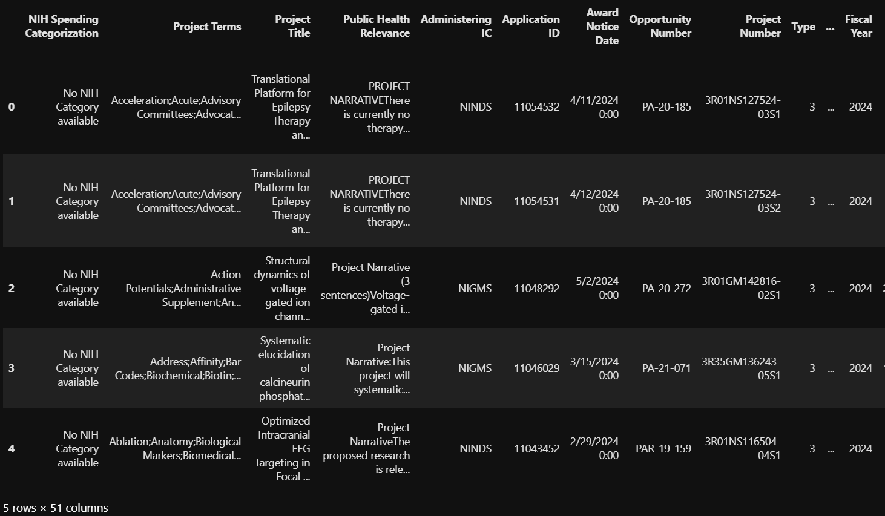
Sample NIH data
10 years of historic data (2014-2024).
51 Attributes, providing end-to-end project details.
130 USA based projects.
Problem Definition
Introduction
Analysis
Recommendations
Next Steps
Conclusion
Q/A

Slide 7
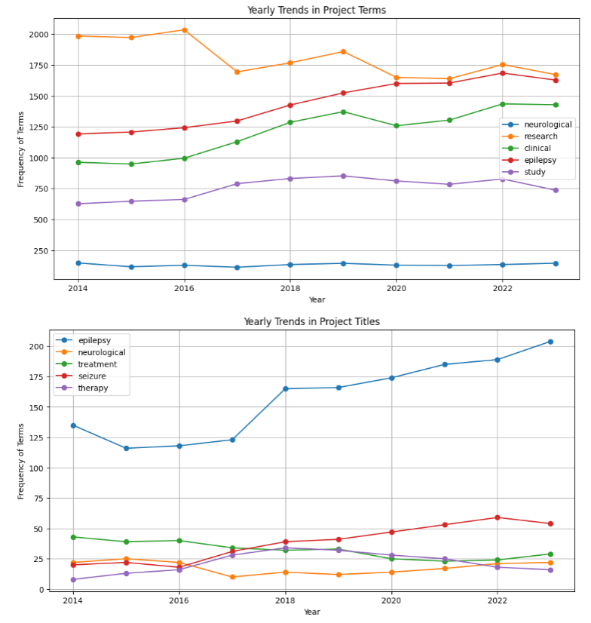
Trend Analysis of Project title and keywords
Project Terms
The top five terms are "neurological," "research," "clinical," "epilepsy," and "study."
Project Titles
The terms "epilepsy," "neurological," "treatment," "seizure," and "therapy" are frequently used.
Problem Definition
Introduction
Analysis
Recommendations
Next Steps
Conclusion
Q/A

Slide 8
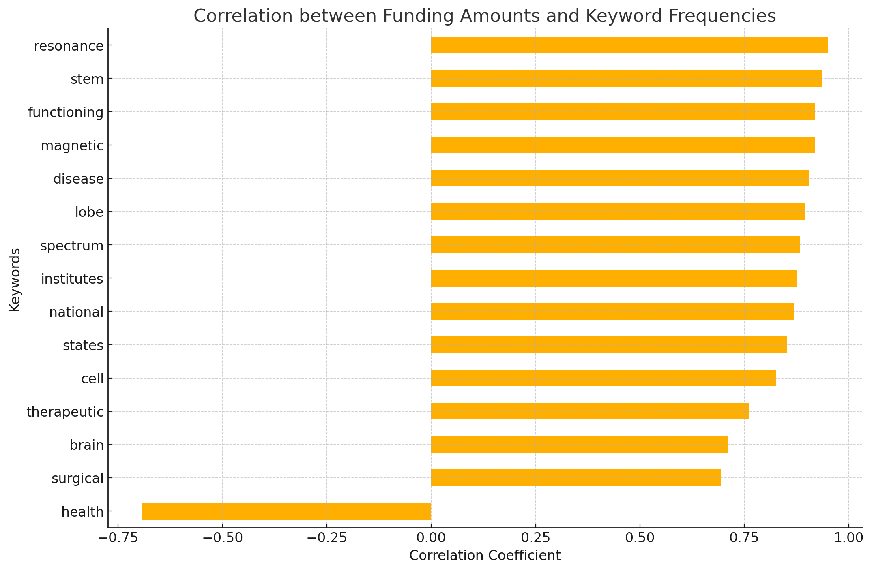
Project Funding and Keyword Correlation
Keywords like "resonance," "stem," "functioning," "magnetic," and "disease" show high positive correlations with funding amounts.
Negative Correlations: If there were any significant negative correlations, it would indicate areas that receive less funding relative to their keyword frequency, but none are shown here above the threshold of 0.3.
Problem Definition
Introduction
Analysis
Recommendations
Next Steps
Conclusion
Q/A

Slide 9
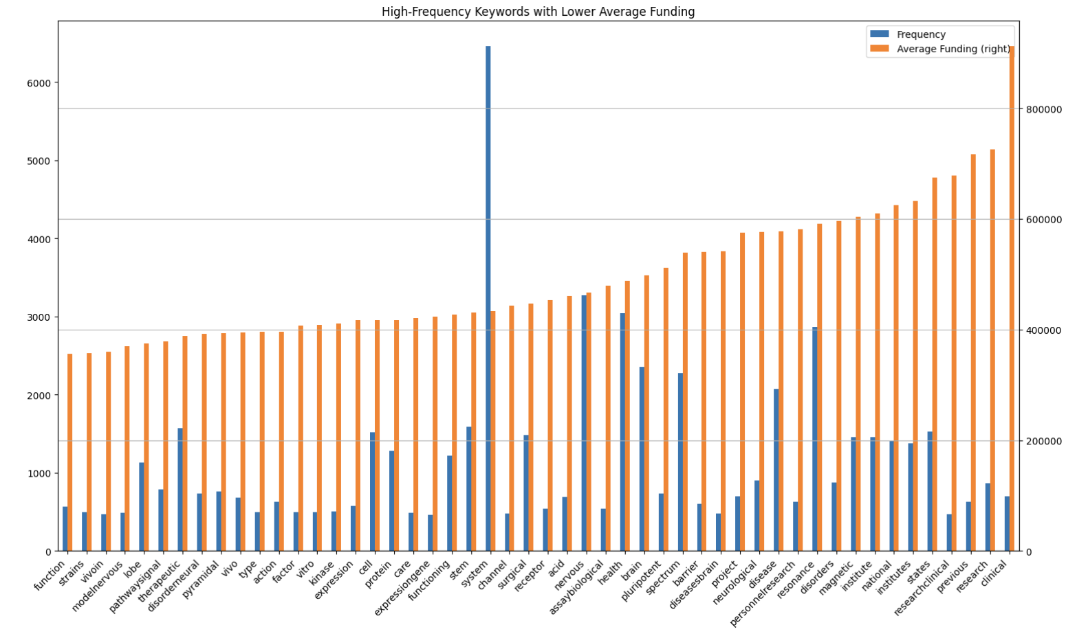
High Frequency Keywords with lower average Funding
Problem Definition
Introduction
Analysis
Recommendations
Next Steps
Conclusion
Q/A

Slide 10
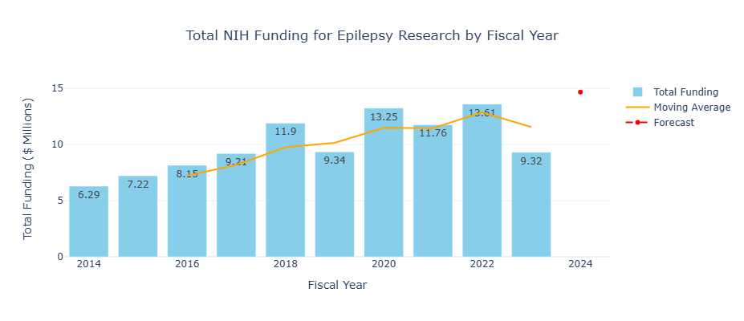
Total funding Epilepsy received in last 10 years
Max funding was raised in 2022.
2020, and 2022 have raised over $13 Million.
Until May 2024, Epilepsy research has raised $5.8 Million.
For 2024 moving average predicts the total funding of over $14 Million
Problem Definition
Introduction
Analysis
Recommendations
Next Steps
Conclusion
Q/A

Slide 11
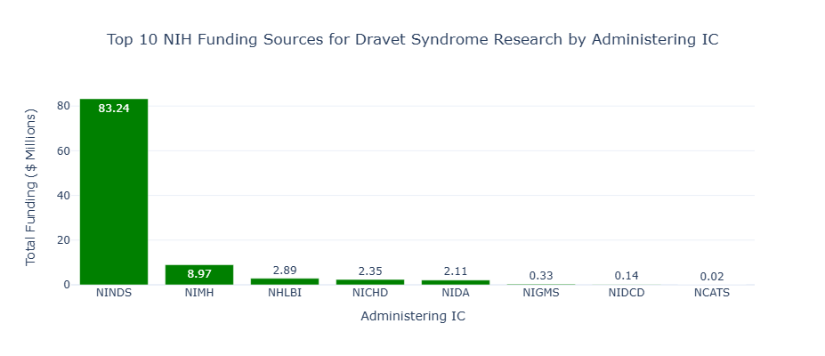
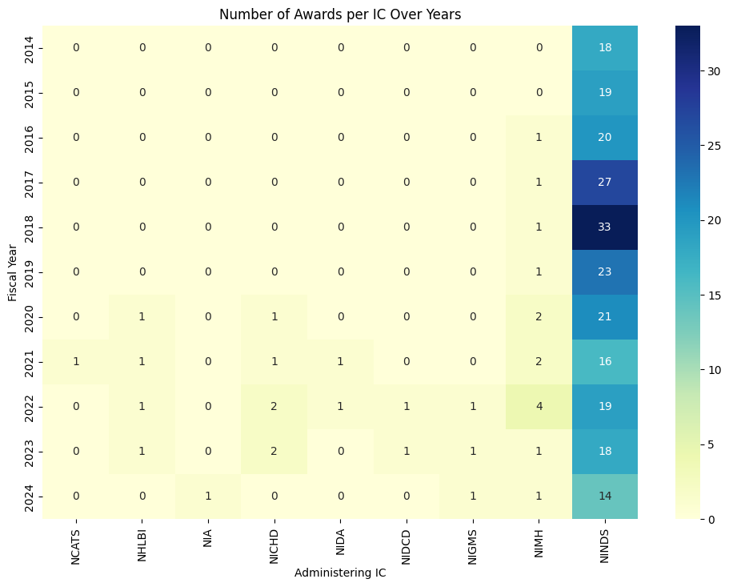
Top 10 Administering IC to target
NINDS Administers the highest amount of funds.
NINDS, NIMH, and NICHD are the top administers to target for our research.
Problem Definition
Introduction
Analysis
Recommendations
Next Steps
Conclusion
Q/A

Slide 12
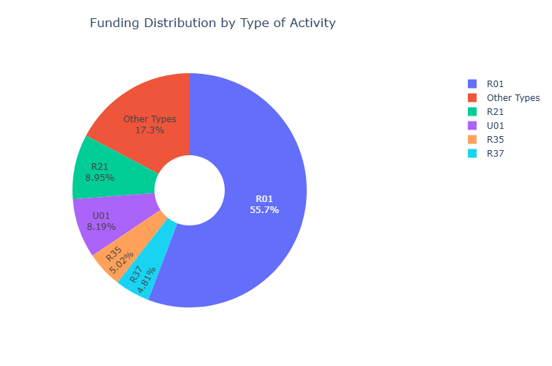
Dynamic Breakdown of Funding Distribution by Type of Activity
R01 Grants: 55.7% - Dominant funding category for specific research projects.
Other Types: 17.3% - Includes various unspecified grants.
R21 Grants: 8.95% - Supports exploratory and developmental research.
U01 Agreements: 8.19% - Significant for cooperative research projects.
R35 Research: 5.02% - Provides long-term support for exceptional research programs.
R37 Research: 4.81% - Offers extended funding to experienced researchers for sustained project development.
Problem Definition
Introduction
Analysis
Recommendations
Next Steps
Conclusion
Q/A

Slide 13
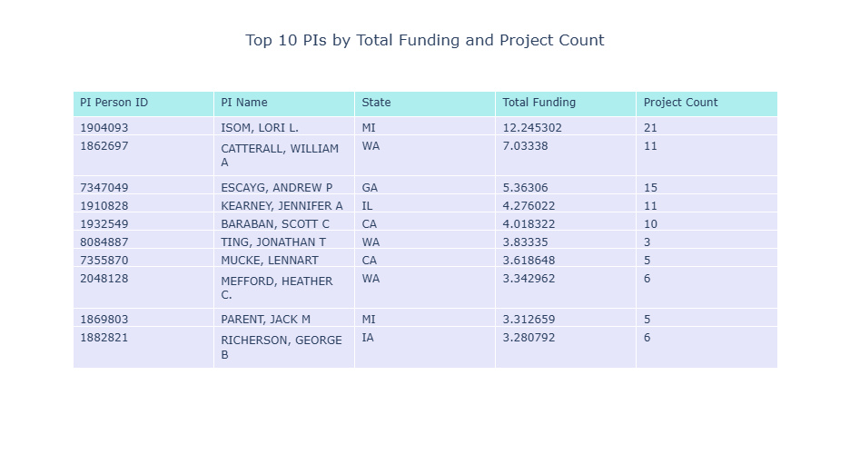
Network Analysis: Top PIs to target
LORI L. Is the PI with most Project experience and has monitored most Funds.
These top 10 PI can provide valuable insights into our research funding approach.
Problem Definition
Introduction
Analysis
Recommendations
Next Steps
Conclusion
Q/A

Slide 14
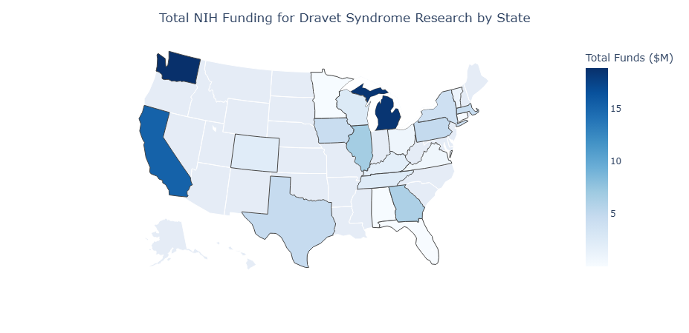
State-level funding trends
Over the past 10 years, we can observe significant funding allocated to states like MI, WA, and CA.
In 2024, WA raised maximum funding.
MA is one of the top 10 states to raise the most funding.
Problem Definition
Introduction
Analysis
Recommendations
Next Steps
Conclusion
Q/A

Slide 15

Power BI Dashboard for Pitchbook data
Problem Definition
Introduction
Analysis
Recommendations
Next Steps
Conclusion
Q/A

Slide 16
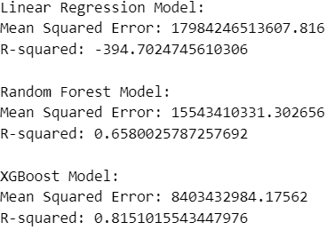
Data modeling
The primary objective of our project is to develop a robust predictive model that can accurately forecast the funding amounts awarded to research proposals.
Optimize funding allocation and resource management based on accurate cost predictions.
Problem Definition
Introduction
Analysis
Recommendations
Next Steps
Conclusion
Q/A

Slide 17
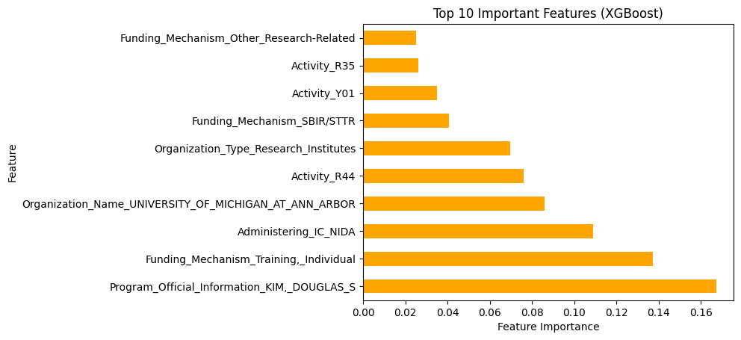
Data modeling
Problem Definition
Introduction
Analysis
Recommendations
Next Steps
Conclusion
Q/A

Slide 18
Next steps for Grik Therapeutics
Funding Mechanism
Training Individual
Research Related
Activity Type
R01
R21
R35 or R37
Administering IC
NINDS
NIMH
NICHD
Top PI Collabs
Isom, Lori L. (MI)
Catterall, William A. (WA)
Feng, Huajun (MA)
Werley, Christopher (MA)
Use Strong Keywords
Brain Desiease
Surgical / non-Surgical
Peer Reviews / Endorsements
Increase connection and network.
Research backed by Top PIs and research Institutes.
Problem Definition
Introduction
Analysis
Recommendations
Next Steps
Conclusion
Q/A

Slide 19
Conclusion
Keywords Analysis
Project Title
Project Abstract
Project Terms
NIH Data Analysis
Funding analysis using:
Pitchbook Data Anlysis
Network Analysis
Dashboard (Python)
Location
Fund category
Fund type
Dashboard (Power BI)
Data Modeling and Forecasting
Total Funds has a non-linear relation with attributes.
Best Model: XGBoost
Best R^2: 0.8151
Recommendations
Use Strong Keywords
Select most funded Activity type
Get Endorsements from top PIs and Research Institutes
Exploratory Analysis
Problem Definition
Introduction
Analysis
Recommendations
Next Steps
Conclusion
Q/A

Slide 20

Q/A time!
Problem Definition
Introduction
Analysis
Recommendations
Next Steps
Conclusion
Q/A

Slide 21

Thank you for your time

