Slide 1
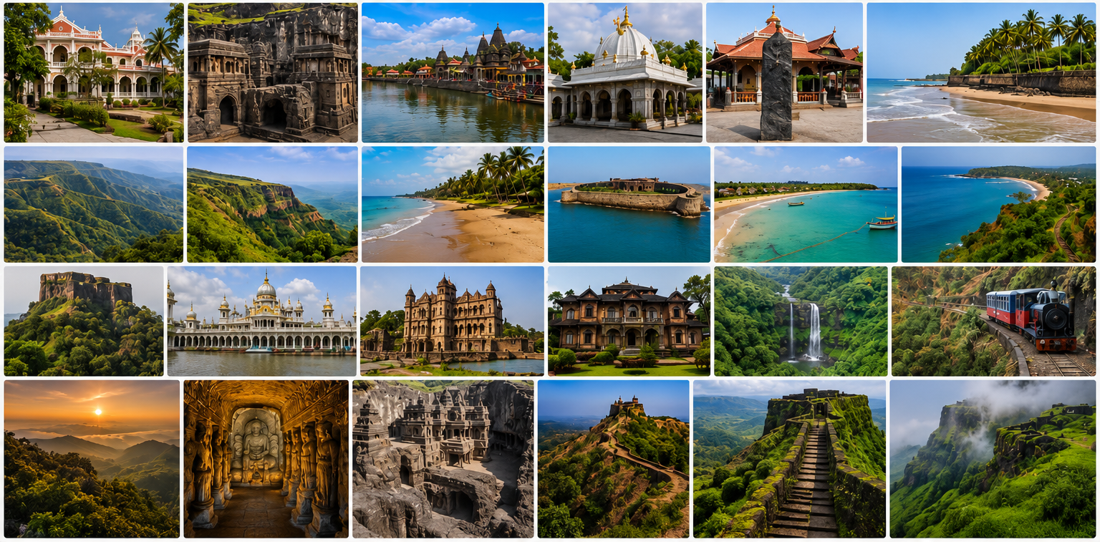
EXPLORE MAHARASHTRA
This is a MySQL database project that stores information about Maharashtra's tourist destinations, attractions, festivals, hotels, blogs, and visitor reviews. It helps organize tourism information in one place, making it easy for travelers to explore and plan their trips.

Slide 2
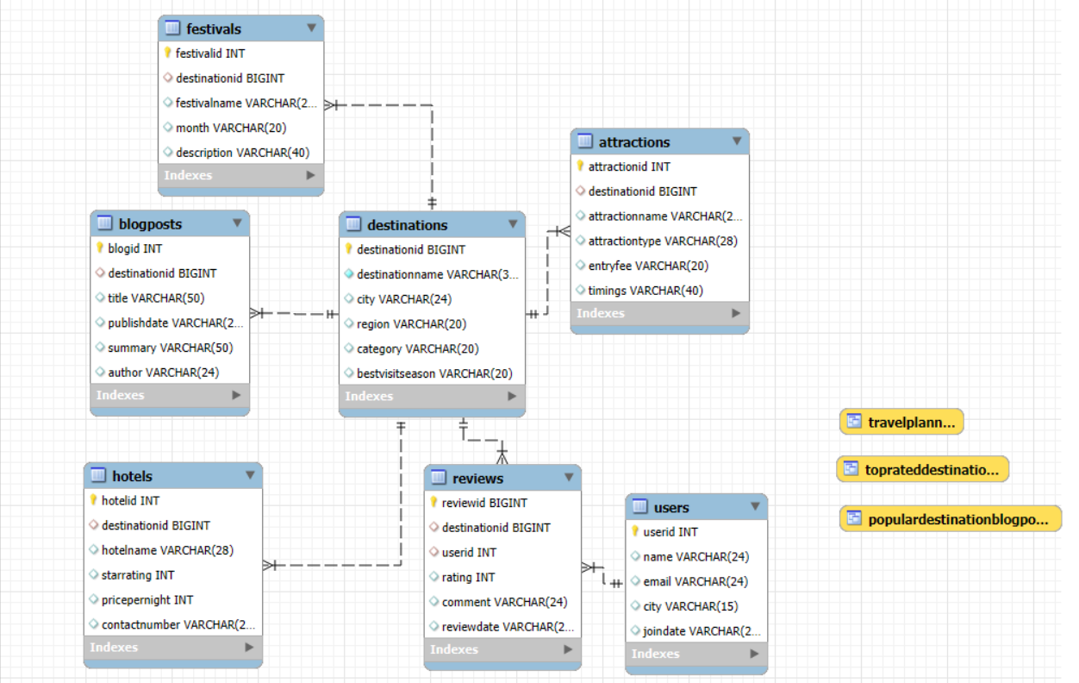
ER DIAGRAM

Slide 3
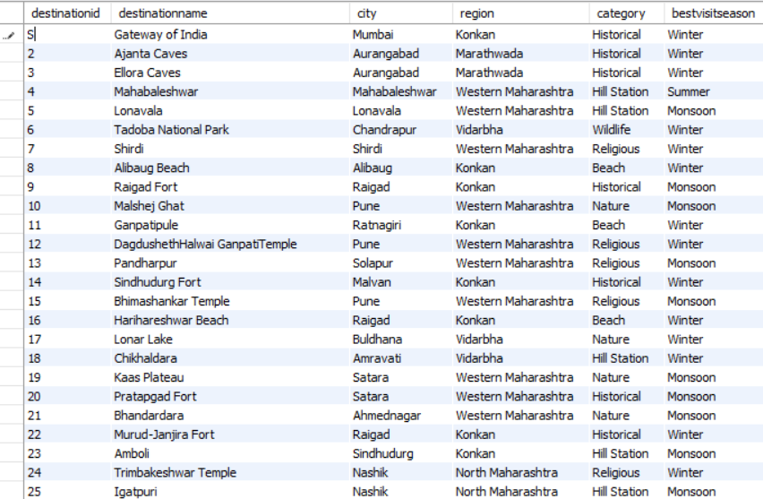
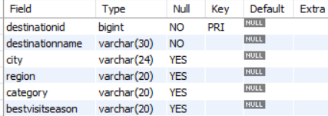
Destinations- table structure

Slide 4
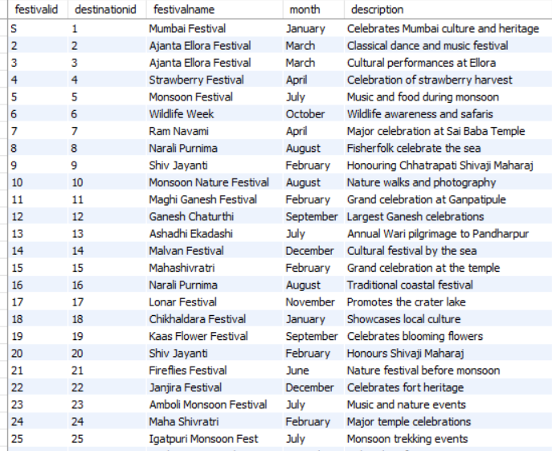
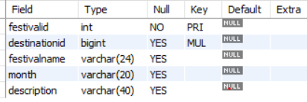
Festivals-table structure

Slide 5
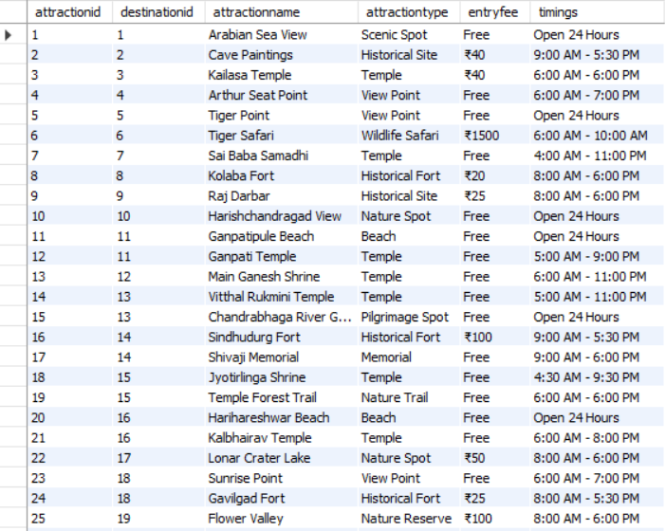
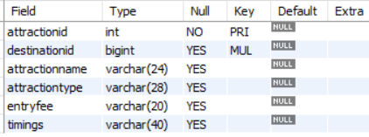
Attractions-table structure

Slide 6
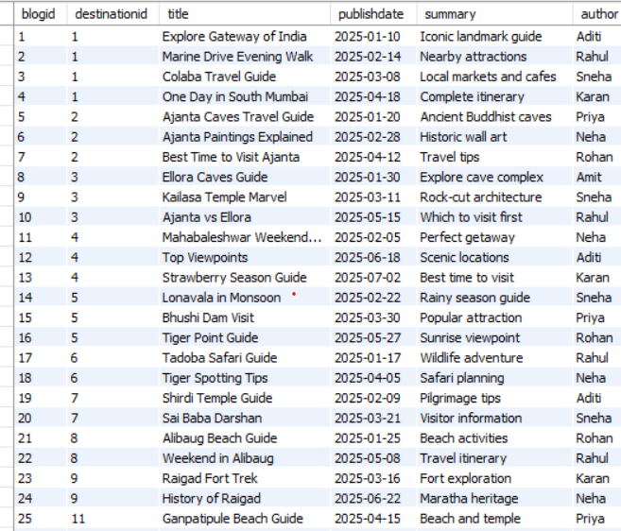
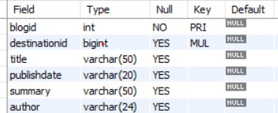
Blogposts- table structure

Slide 7
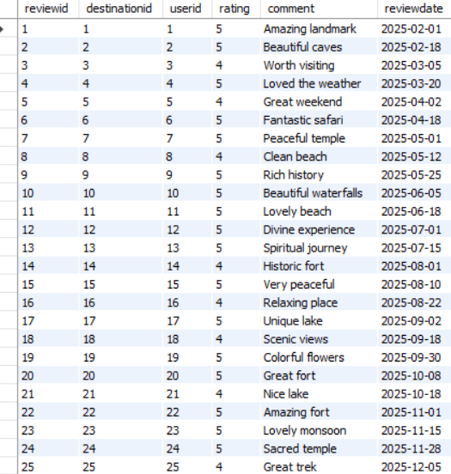
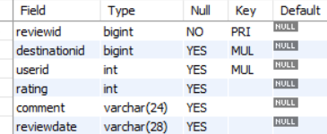
Reviews-table structure

Slide 8
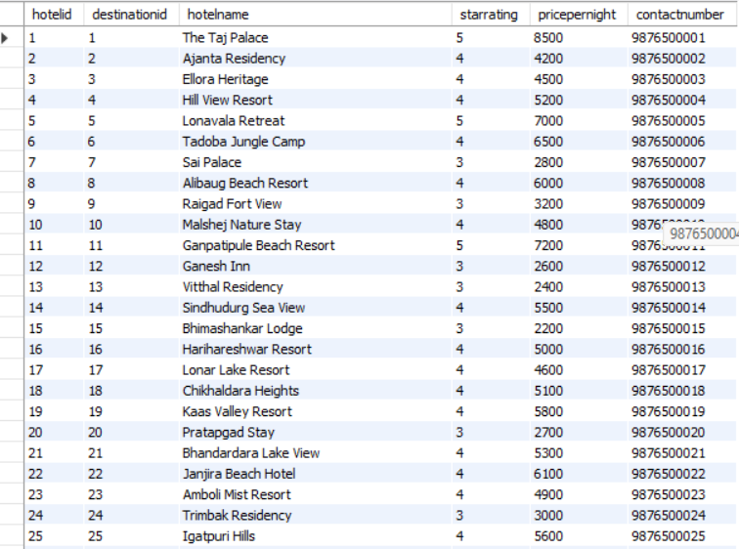
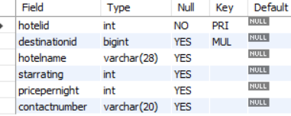
Hotels-table structure

Slide 9
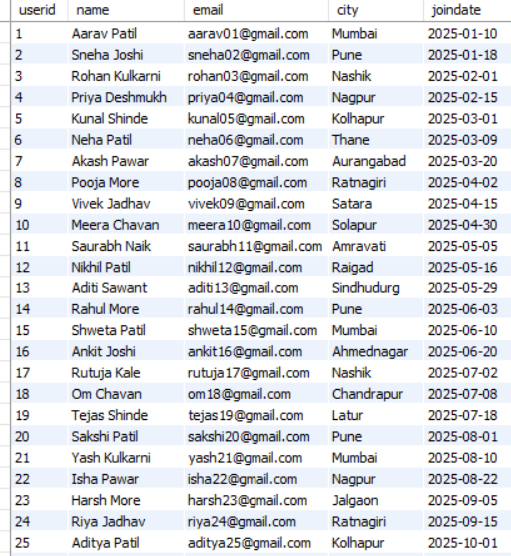
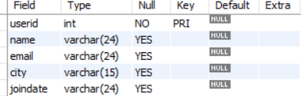
Users-table structure

Slide 10
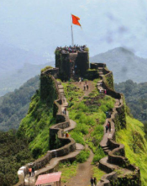
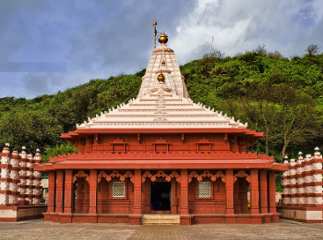
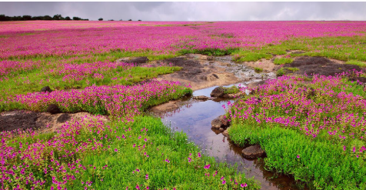
JOINS

Slide 11
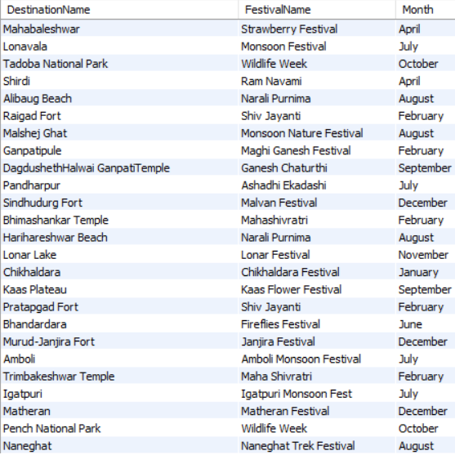
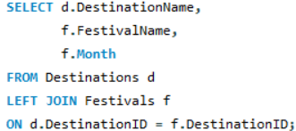
Destination with festivals
This is a left join to show the destinations along with the festivals celebrated at that destination to provide the users that when they visit the destination what festivals they can celebrate at that specific month.

Slide 12
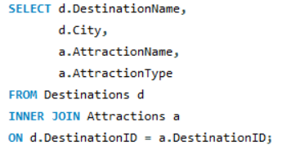
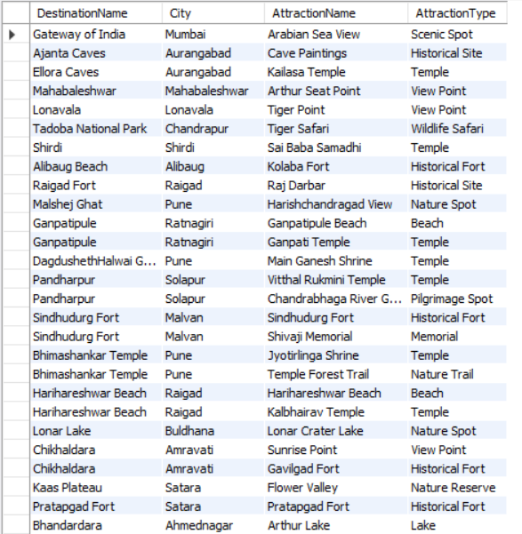
Destinations with the attractions
This query using inner join shows the attractions for that destination for travellers to see that what kind of place they are visiting viz. scenic spot or historical site etc.

Slide 13
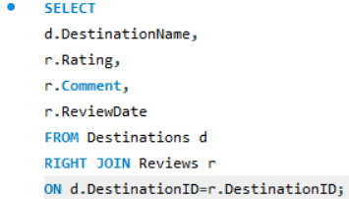
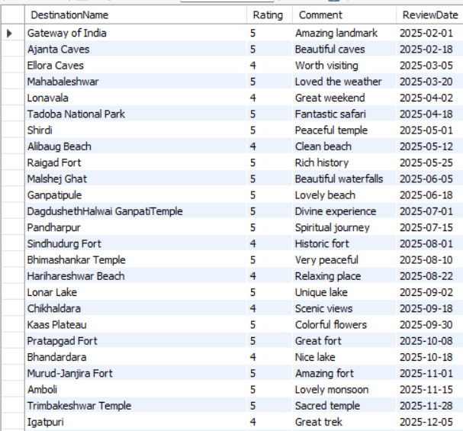
Destinations along with the reviews
Here right join is used to show the destinations with the reviews given by other users who have visited the place so that the travellers who will plan their visit get an idea of what they can expect at that destination.

Slide 14
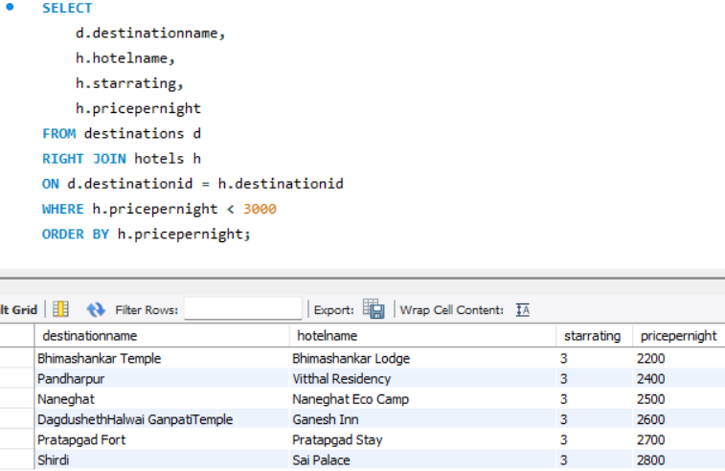
Budget friendly stay finder
This query using right join, the hotels with price less than 3000 are shown for different destinations for people travelling on a budget.

Slide 15
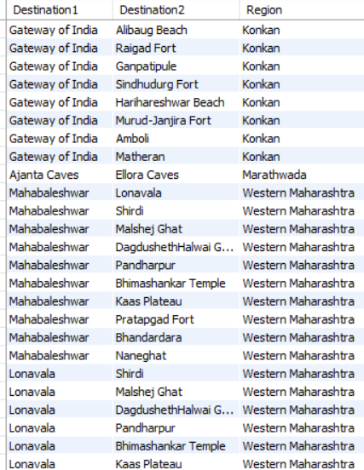
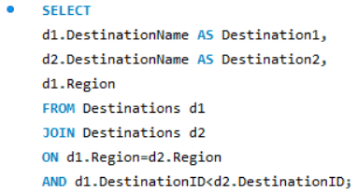
Destinations in the same region
This SELF JOIN compares the Destinations table with itself to find different tourist destinations located in the same region, helping travelers discover nearby places to include in their trip while avoiding duplicate pairs.

Slide 16
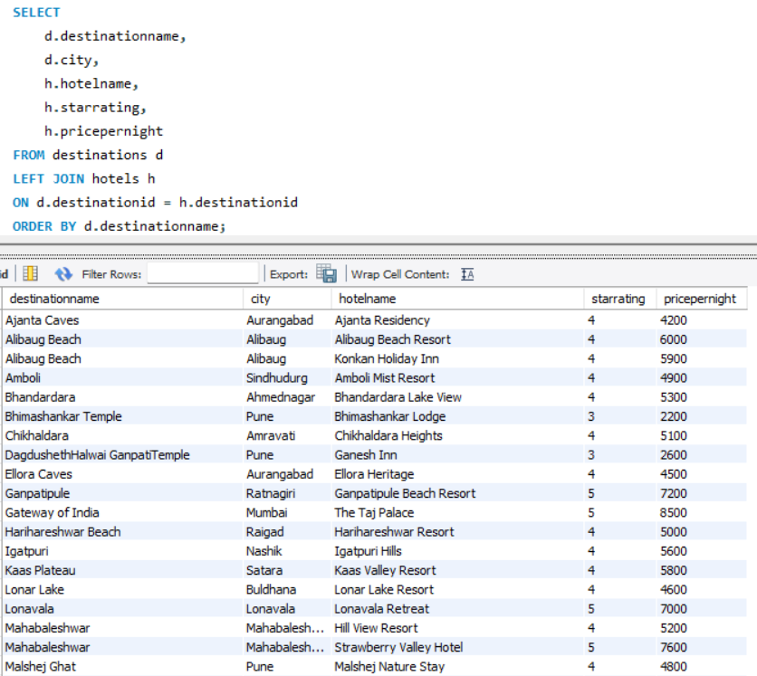
Destinations with the hotels available there
This query ,using a left join shows the hotels available at the destinations.

Slide 17
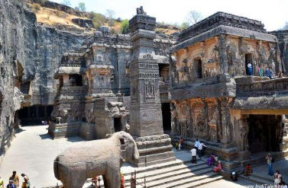
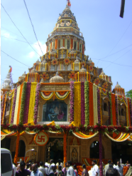
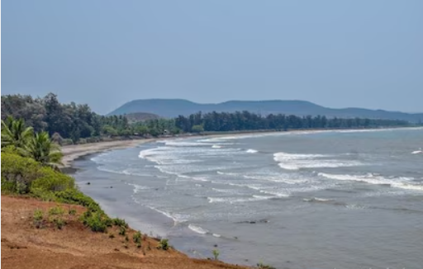
SUBQUERIES

Slide 18
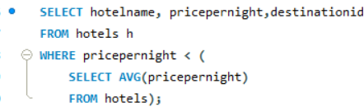
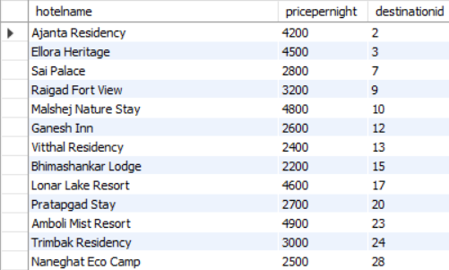
Showing hotels less than the average price of the hotels we have listed
This query displays hotels whose price is below the average price of all hotels, helping tourists identify budget-friendly accommodation across Maharashtra.(corelated subquery)
."

Slide 19
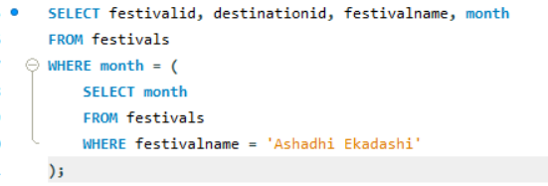
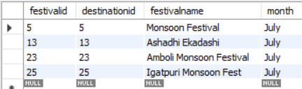
Festivals celebrated in the same month
Displays all festivals celebrated in the same month as Ashadhi Ekadashi using a single-row subquery. This helps tourists discover other festivals occurring during the same travel season.

Slide 20
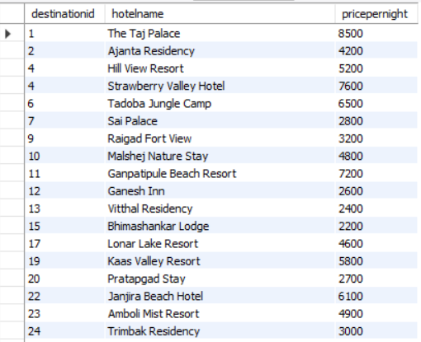
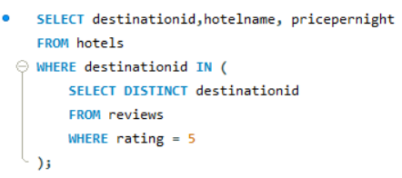
Hotels with 5 star rating
This query (multirow query) finds hotels located in destinations that have received at least one 5-star review. It helps tourists discover accommodation in highly rated destinations.

Slide 21


Latest Blogpost shared on the website
This subquery shows the lastest blogposts shared on the website using singlerow subquery.

Slide 22
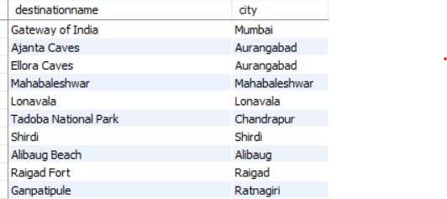
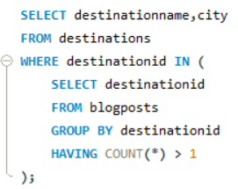
Destinations with Multiple Blogposts
This query displays destinations that have multiple travel blogs, indicating popular places with extensive travel experiences shared by different authors using multiline subquery

Slide 23
VIEWS

Slide 24
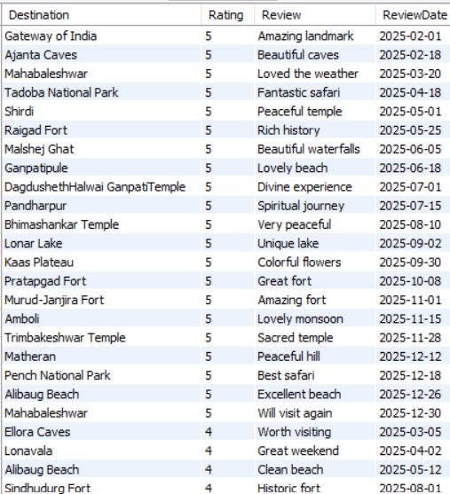
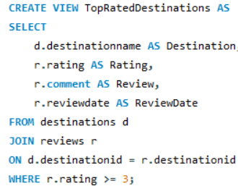
Views- top rated destinations
This view stores all destinations that have received ratings of 4 stars or above. It can be reused by travel websites or administrators to quickly display highly recommended destinations without writing the join query repeatedly.
This is a practical example of why SQL views are used: to simplify frequently used queries and improve readability.
Type of join- INNER JOIN

Slide 25
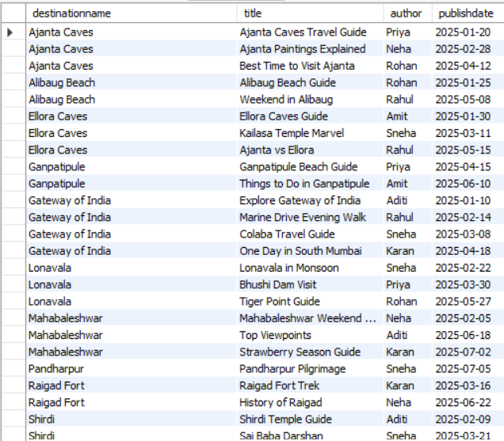
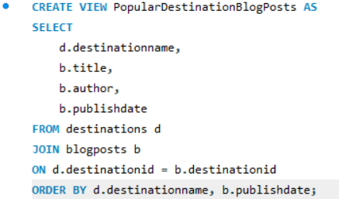
Popular Destination Blogposts

Slide 26
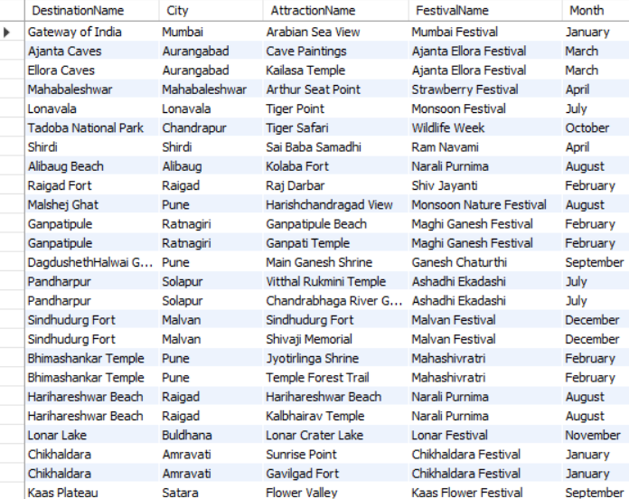
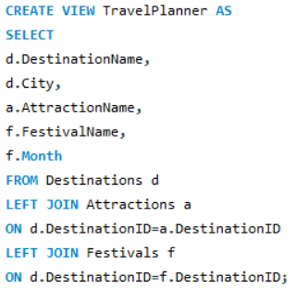
Travel Planner
TravelPlanner is a view that combines destinations, their attractions, and festivals into a single table. It provides tourists with a quick overview to help them plan their visit more easily.

Slide 27
THANKYOU

