Slide 1

Book your movie
-Shreya Kotalwar

Slide 2
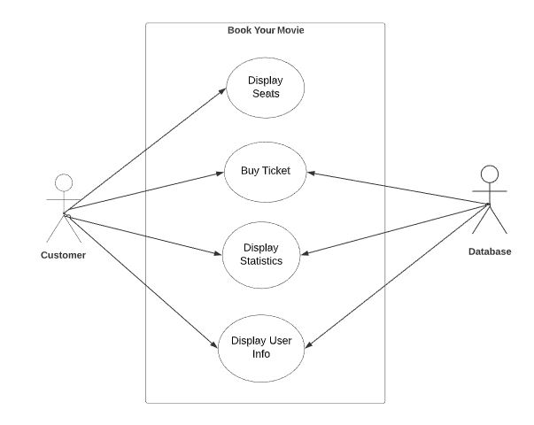
Use case diagram

Slide 3
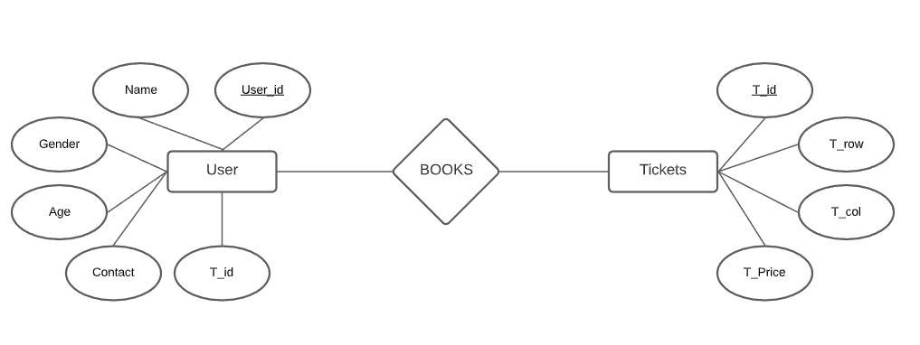
Er diagram

