Slide 1


Sales and Advertising Analysis
Shreyak vashisht

Slide 2
The Question
Is my sales and advertising cost aligned ?
can I have high sales with less advertising cost ?
For each sale how much am I spending on my advertising cost ?

Slide 3
The Method
Scrape
Analyze
Model
Improve
Validate
Predict
Notes:
I started off with scrapping the data then I did some EDA on my data checked between multiple models using test train split finalized ridge regression based on the metric r square , did some more testing using cross validation again using the metric r ^2 tested my model on the test data had some severe underfitting so I increased the training size of the data increased the complexity of the model and did my predictions

Slide 4
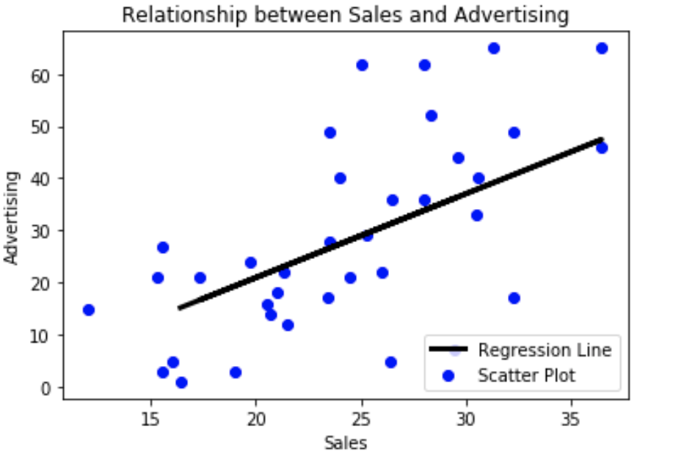
Interpretation and Conclusion
Notes:
There is clearly a significant relationship between advertising and sales, but how can I use it to my favor ?

Slide 5
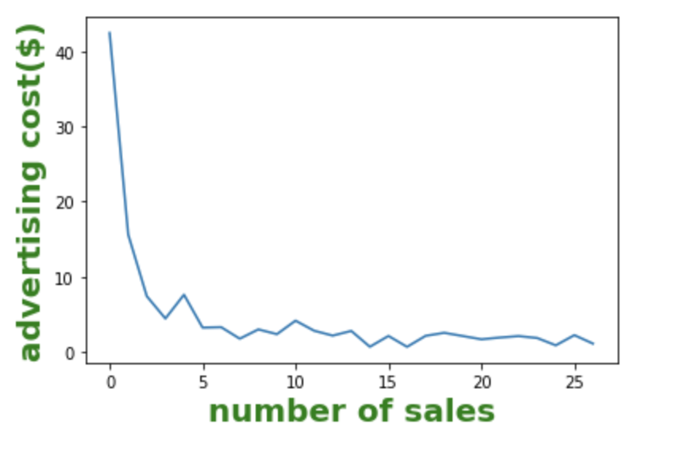
Notes:
This graph is advertising cost per number of sales, we can clearly see here that for a single sale the advertising cost is really high but as the number of sales increase the the advertising cost drops

Slide 6
The Recommendations
Do not
Do not be afraid to advertise
Push
Push for bulk sales
Set
set control limit on sales , set commissions for clearing the control limits
Notes:
Do not be afraid to advertise as there is a solid linear relationship
Push for bulk sales

Slide 7

Questions

Slide 8
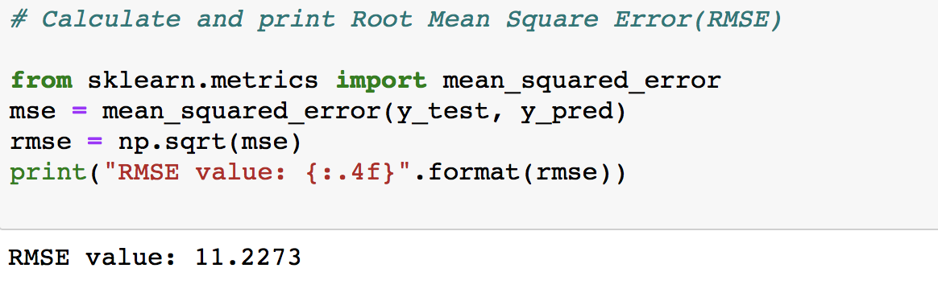
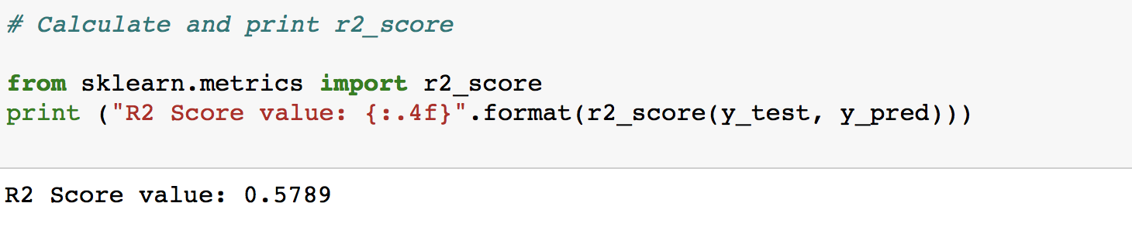
Appendix
Notes:
Here are the two performance matrix I used the first one is RMSE ,RMSE shows me the standard deviation of the unexplained variance of the model ,the more concentrated data around the regression line sp lower the residualas so what I am trying to say is lower value of rmse gives better fit of the data

Slide 9
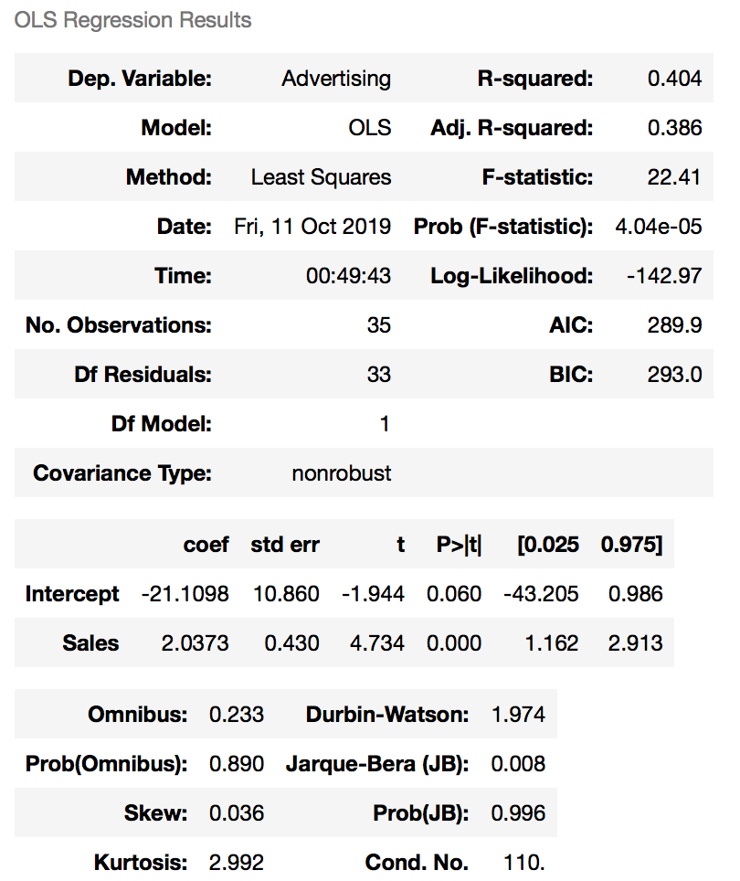
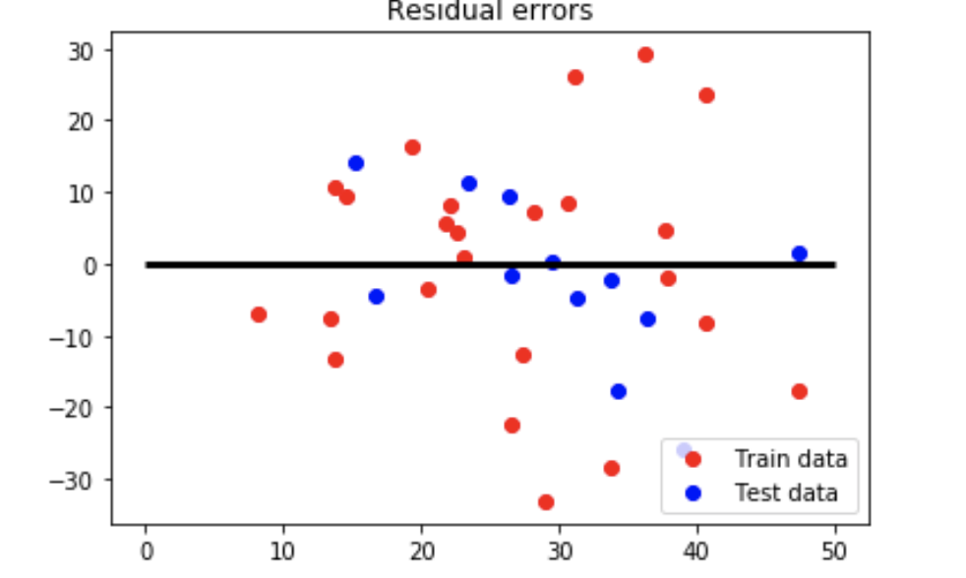

Slide 10
