Slide 1

Churn Analysis
Notes:
Good morning everyone !! I am presenting churn analysis on Kkbox

Slide 2
Client And Business Problem
Client - Kkbox is a Subscription based Taiwanese music streaming service developed mainly for Southeast Asia
Business Problem -Attracting new customers is more expensive than retaining existing ones
Solution - a predictive model which helps business by predicting which feature are responsible for customer churn
Notes:
Since the music streaming service providers are becoming more competitive day by day one of the major problem these companies are
facing is customer retention. Attracting new customers is much more expensive than retaining existing ones. Hence this predictive model helps the business by predicting the features responsible for churn .

Slide 3
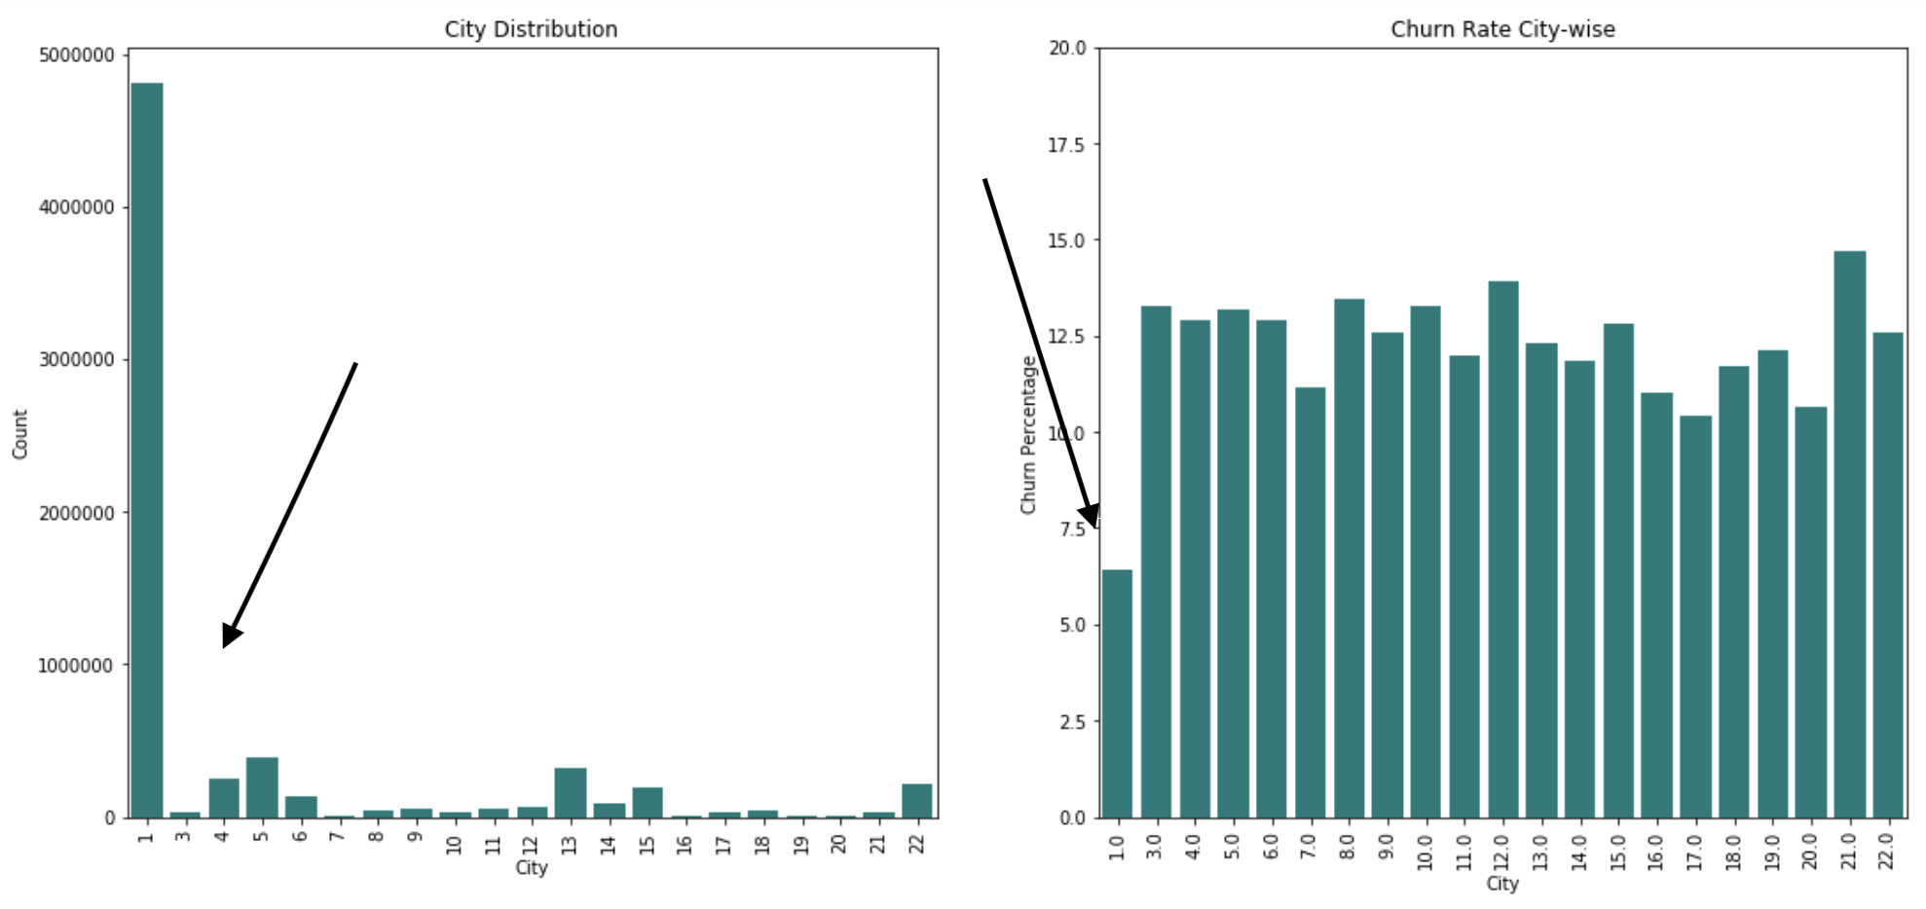
Some insights and EDA
Notes:
# this is the city wise distribution on the right and the churn asscociated with each city
Here we can see that city 1 has the maximum amount of users and is also contributing the least amount of churn

Slide 4
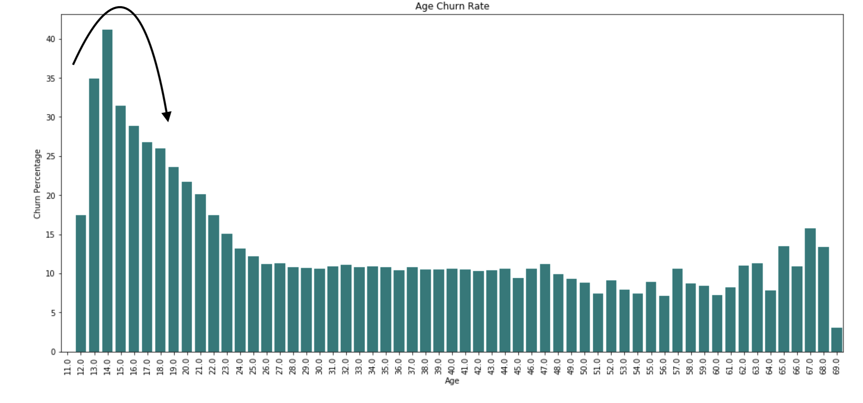
Some insights and EDA
Notes:
This chart represents the age groups related to the maximum amount of churn

Slide 5
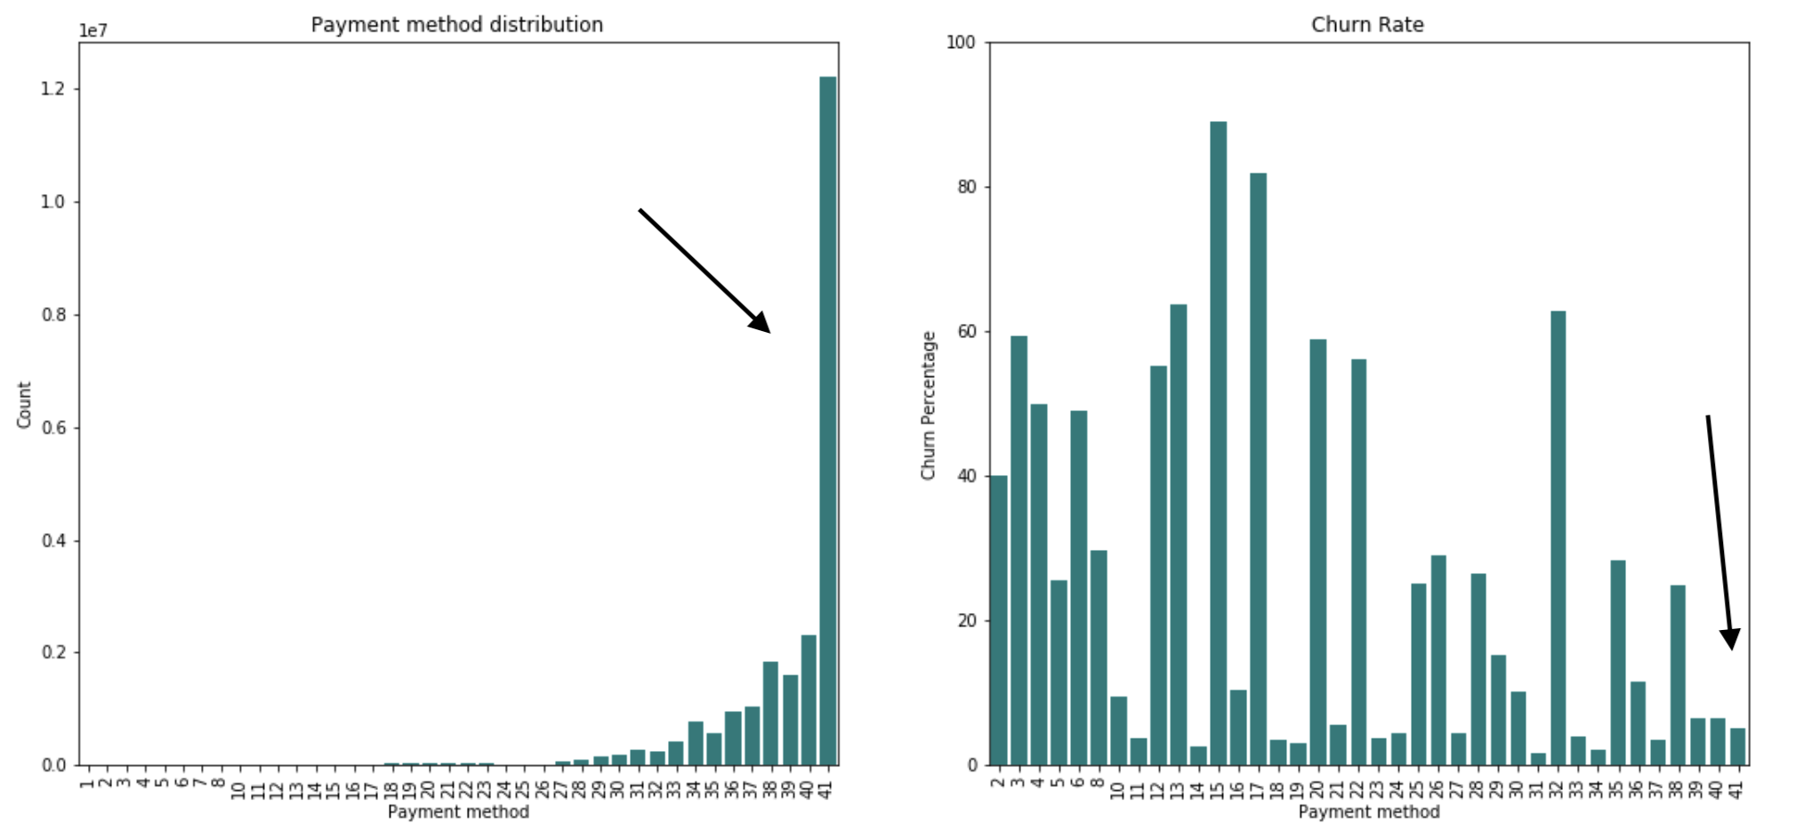
Some insights and EDA
Notes:
Here we have all the payment methods and payment method related to the churn
What’s interesting here is the fact that payment method 41 is the most widely used payment method and and is associated with the most loyal customers

Slide 6
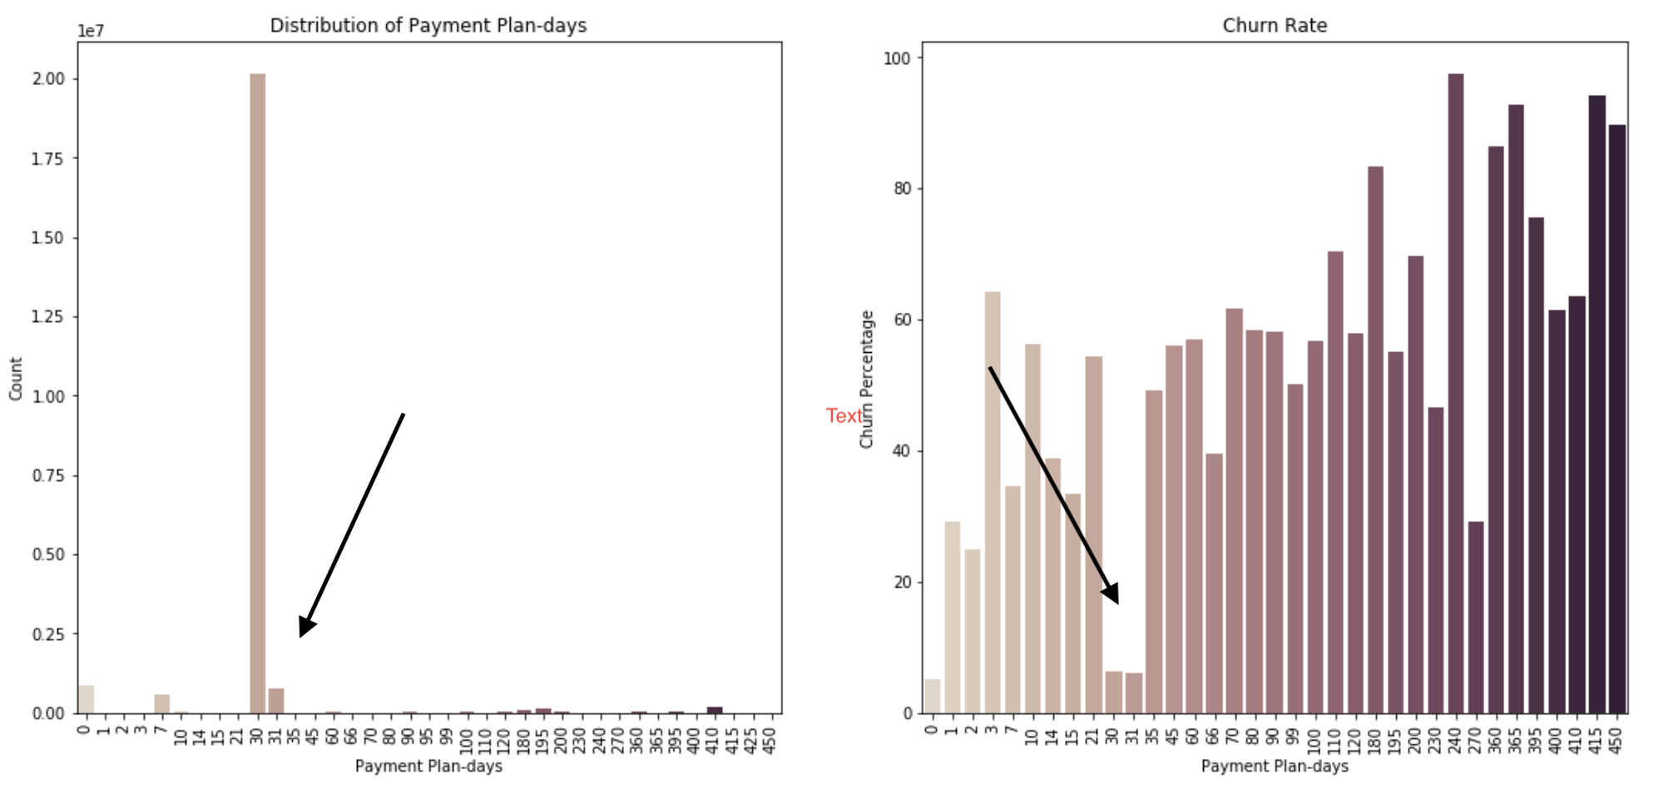
Some insights and EDA
Notes:
Similarly here we have the payment plan days most widely used and payment plans associated with churn
Another similarly interesting observation because the lowest churn payment plans (30 day,31day,0 day) actually are the most used plan and the plans with maximum churn are not even used at all

Slide 7
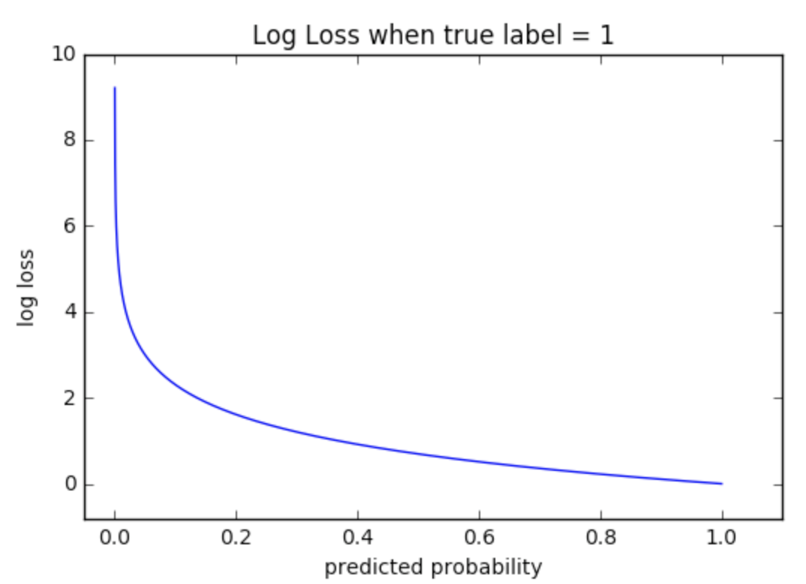
Choosing Metric
Log loss is a classification loss function
Log loss works by penalizing false classification
Why choose log loss over accuracy ?
Accuracy =counts the predictions where predicted val equals actual val
Log loss considers the uncertainty based on how much it varies from actual label
Perfect model log loss = 0
Notes:
Log loss is a common classification loss function which works by penalizing false and confident values the reason I chose log loss over accuracy/roc curve is that my goal is to reduce the probability divergence from the actual label so I could predict my feature corectly instead of optimizing for a specific precision or recall value
Log loss Penalizes classifiers that are confident about an incorrect classification heavily
So The bottom line is that it’s better to be somewhat wrong than emphatically wrong.

Slide 8

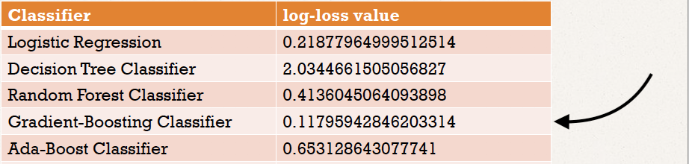
Model Building
This problem is highly balanced so we used SMOTE to balance the classes
Simple classification , followed by ensemble methods to evaluate our metric
Choosing GBC because of the lowest value of log loss
Notes:
The problem is highly balanced so we used SMOTE to handle the balanced classes I used simple classification lagorithms followed by ensemble methods to evaluate out metric
I chose gradient boosting classifier as a base line model because of its low log loss value

Slide 9
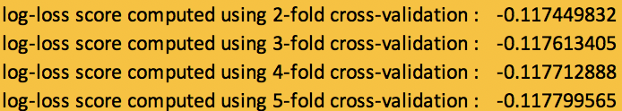
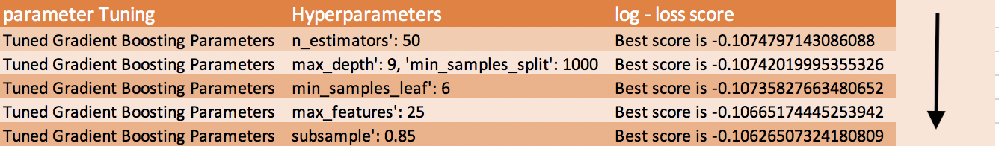
Model Optimization
Using cross-validation to check consistency of the model
Hyperparameter Tuning using Gridsearchcv and gradient boosting
Notes:
I ran the model through the cross validation process to check for consistency of the selected model
Then I did hyper parameter tuning using Gridsearchcv AND gradient boosting to single out and select the best parameters
I ran 5 parameter tests each for a specific hyperparameter and using the result for the next test
With each test there was an improvement in the log loss score .

Slide 10

Result
The final log loss score on the test data is,
score improved from ~0.1179 to ~0.01026
Notes:
The final result on the testing data set is a this score I managed to reduce which is approximately 86 % improvement in the score

Slide 11
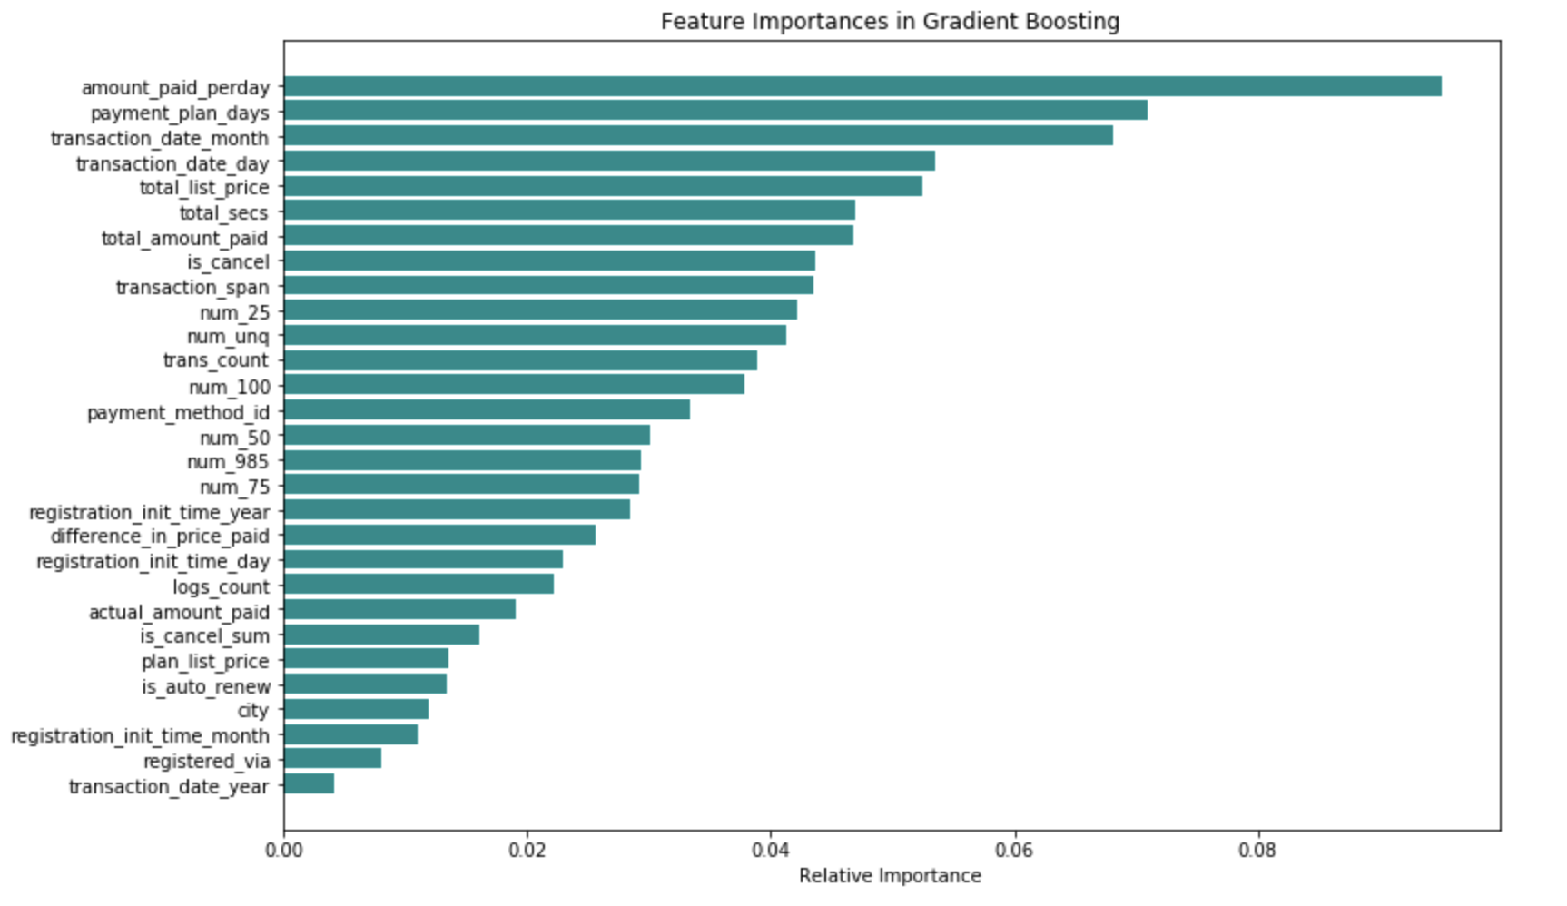
Conclusion
Notes:
The final conclusion is that these are the top festures whuch will be responsible for contributing the maximum amount of churn which was not surprising because the top feature are directly related to the subscription price

Slide 12
Recommendations
Getting rid of excessive payment plans
Decreasing the cost, for highest contributing plans
Solid marketing plan to attract age group 16-21 as they are the highest churn contributors
Eliminate excessive payment methods, forcing customers to top 5-6 payment methods

