Slide 1
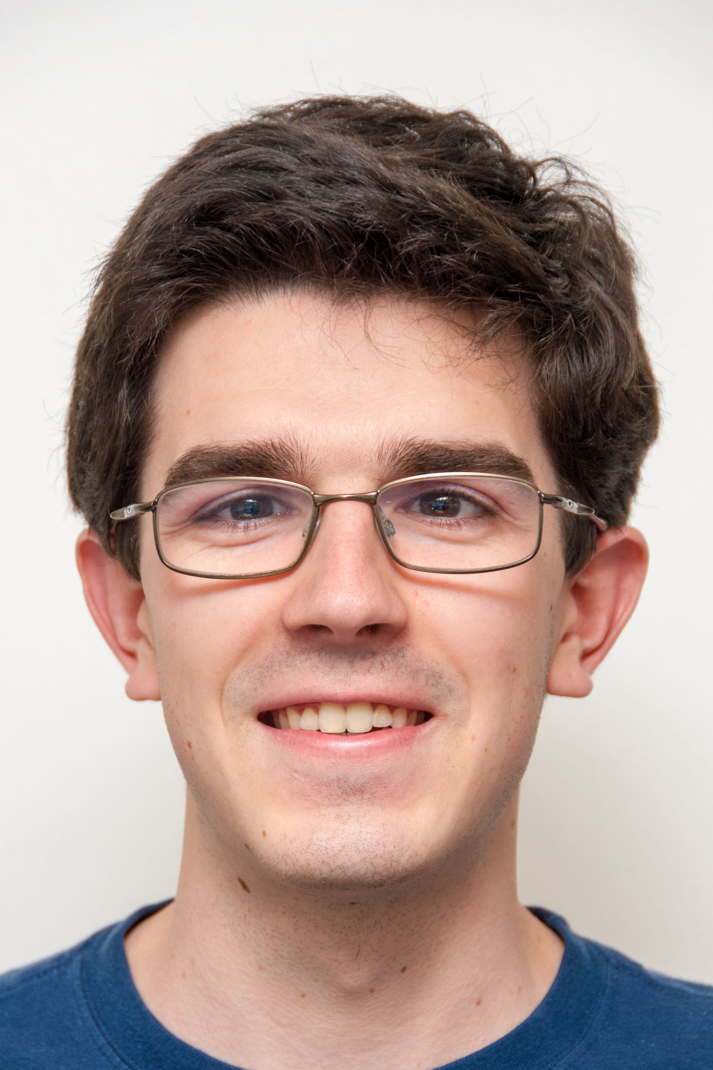
Computational Structures in Data Science
Lecture #3: Loops and Functions
UC Berkeley EECS Lecturer
Michael Ball
January 31, 2020
https://cs88.org

Slide 2
Administrivia
More spots opened for lab sections
Please try to attend labs you signed up for. (See Piazza)
Reminder: iClickers next week.
Can register them at any time during the semester.
We’re going to be doing live coding, so review videos, not just slides.

Slide 3

Computational Concepts Today
Conditional Statement
Functions
Iteration
1/31/2020

Slide 4
Things you can do now:
Write a program that makes a decision.
Write your own functions
Use loops so you can process lots of data.
1/31/2020

Slide 5
A Brief Review: Files, Terminals
This is mostly lab 0 review.
It will take time to get used to everything!
Things we’ll do:
Use the command line to run files
Review the difference between notebooks and files

Slide 6
Let’s talk About Python
Expression 3.1 * 2.6
Call expression max(0, x)
Variables
Assignment Statement x = <expression>
Define Function: def <function name> (<parameter list>):
Control Statements: if … for … while … list comprehension
1/31/2020
Notes:
z = 1,2
x,y = 3,4
a,b = z

Slide 7
Conditional statement
Do some statements, conditional on a predicate expression
Example:
if <predicate>:
<true statements>
else:
<false statements>
if (temperature>98.6):
print(“fever!”)
else:
print(“no fever”)
1/31/2020

Slide 8
Defining Functions
def <function name> (<argument list>) :
expression
return
Abstracts an expression or set of statements to apply to lots of instances of the problem
A function should do one thing well
1/31/2020

Slide 9
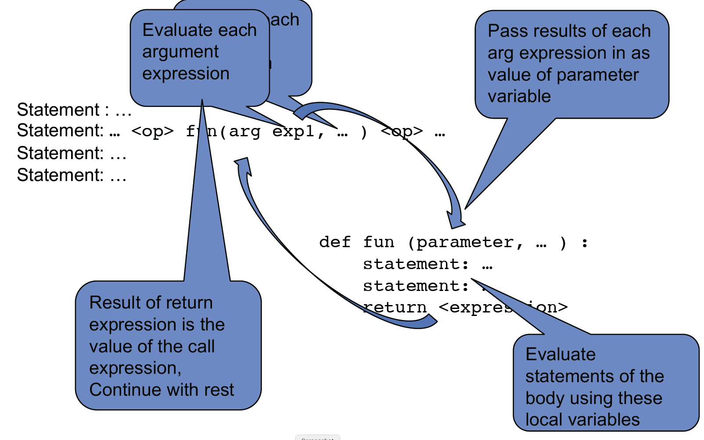
Functions: Calling and Returning Results
1/31/2020

Slide 10
Functions and Arguments
>>> x = 3
>>> y = 4 + max(17, x + 4) * 0.5
>>> z = x + y >>> print(z) 15.5
def max(x, y):
return x if x > y else y
def max(x, y):
if x > y:
return x
else:
return y

Slide 11
How to write a good Function
Give a descriptive name
Function names should be lowercase. If necessary, separate words by underscores to improve readability. Names are extremely suggestive!
Chose meaningful parameter names
Again, names are extremely suggestive.
Write the docstring to explain what it does
What does the function return? What are corner cases for parameters?
Write doctest to show what it should do
Before you write the implementation.
Python Style Guide: https://www.python.org/dev/peps/pep-0008/
1/31/2020

Slide 12
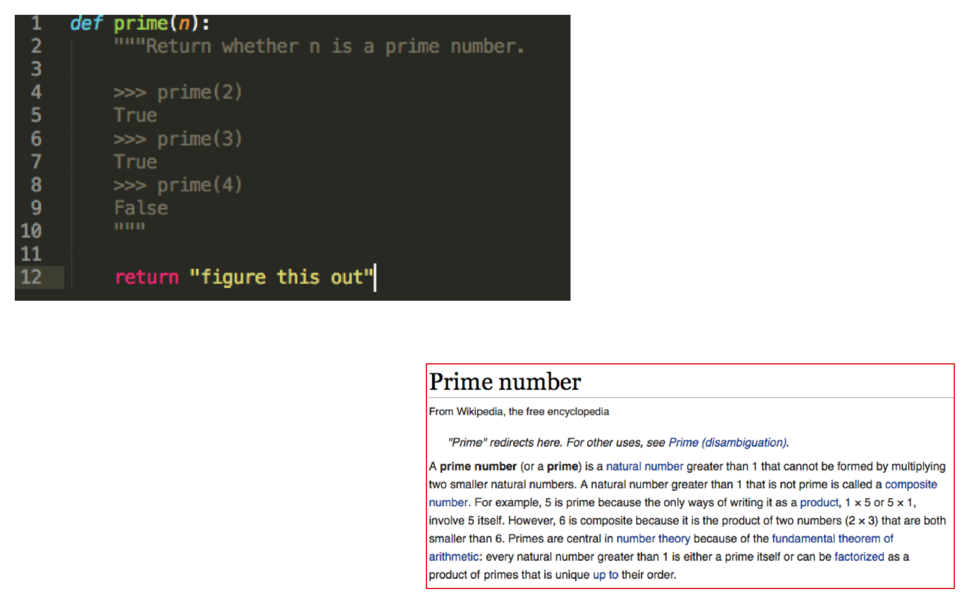
Example: Prime Numbers
Why do we have prime numbers?
https://www.youtube.com/watch?v=e4kevnq2vPI&t=72s&index=6&list=PL17CtGMLr0Xz3vNK31TG7mJIzmF78vsFO
1/31/2020

Slide 13
for statement – iteration control
Repeat a block of statements for a structured sequence of variable bindings
<initialization statements>
for <variables> in <sequence expression>:
<body statements>
<rest of the program>
def cum_OR(lst):
"""Return cumulative OR of entries in lst.
>>> cum_OR([True, False])
True
>>> cum_OR([False, False])
False
"""
co = False
for item in lst:
co = co or item
return co
1/31/2020

Slide 14
while statement – iteration control
Repeat a block of statements until a predicate expression is satisfied
<initialization statements>
while <predicate expression>:
<body statements>
<rest of the program>
def first_primes(k):
""" Return the first k primes.
"""
primes = []
num = 2
while len(primes) < k :
if prime(num):
primes = primes + [num]
num = num + 1
return primes
1/31/2020

Slide 15
Data-driven iteration
describe an expression to perform on each item in a sequence
let the data dictate the control
[ <expr with loop var> for <loop var> in <sequence expr > ]
def dividers(n):
"""Return list of whether numbers greater than 1 that divide n.
>>> dividers(6)
[True, True]
>>> dividers(9)
[False, True, False]
"""
return [divides(n,i) for i in range(2,(n//2)+1) ]
1/31/2020

Slide 16
Thoughts for the Wandering Mind
Could we build a complete computer that has no instructions, only data?
1/31/2020
Notes:
Single Instruction Computer: See Patterson & Hennesey

