Slide 1

Computational Structures in Data Science
UC Berkeley EECS Lecturer
Michael Ball
Lecture #4: Lists and Functions
February 3, 2020
https://cs88.org
Notes:
1

Slide 2
Tech in the News
“Scientists are unraveling the Chinese coronavirus with unprecedented speed and openness”
https://www.washingtonpost.com/science/2020/01/24/scientists-are-unraveling-chinese-coronavirus-with-unprecedented-speed-openness/
“An AI Epidemiologist Sent the First Warnings of the Wuhan Virus”
https://www.wired.com/story/ai-epidemiologist-wuhan-public-health-warnings/
09/23/19
UCB CS88 Fa19 L3
2

Slide 3
Announcements!
Register iClickers at any point
CS Mentors Drop-In Sections
https://piazza.com/class/k5kga9pwx0l754?cid=47
Amazing student group that provides tutoring
Midterm: Weds 3/4, 7-9pm.
Final Exam:
Trying to only have 1 exam. Section 2, look out for a message soon.
If you have DSP accommodations, please let us know! We’re here to help. ☺
09/23/19
UCB CS88 Fa19 L3
3

Slide 4
Computational Concepts Toolbox
Data type: values, literals, operations,
e.g., int, float, string
Expressions, Call expression
Variables
Assignment Statement
Sequences: list
Data structures
Call Expressions
Function Definition Statement
Conditional Statement
Iteration:
data-driven (list comprehension)
control-driven (for statement)
while statement
09/23/19
UCB CS88 Fa19 L3
4
Notes:
z = 1,2
x,y = 3,4
a,b = z
4

Slide 5

Computational Concepts today
Higher Order Functions
Functions as Values
Functions with functions as argument
Functions with functions as return values
Big Idea: Software Design Patterns
09/23/19
UCB CS88 Fa19 L3
5

Slide 6
Control Structures Review
The result of list(range(0,10)) is… A) [0, 1, 2, 3, 4, 5, 6, 7, 8, 9] B) [0, 1, 2, 3, 4, 5, 6, 7, 8, 9, 10] C) [1, 2, 3, 4, 5, 6, 7, 8, 9, 10] D) [1, 2, 3, 4, 5, 6, 7, 8, 9] E) an error
http://bit.ly/88Lec3Q1
Solution: A) list(range(m,n)) creates a list with elements from m to n-1.
09/23/19
UCB CS88 Fa19 L3
6

Slide 7
Types of Things We’ve Seen So Far
ints / Integers
1, -1, 0, …
floats (“decimal numbers”)
1.0, 3.14159, 20.0
strings
“Hello”, “CS88”
list / Arrays
['CS88', 'DATA8', 'POLSCI2', 'PHILR1B’]
functions
max(), min()

Slide 8
Additional Types
ranges
A function, but is also its own type
range(0, 10)
A “sequence”.
tuple / A list you cannot change.
('CS88', 'DATA8', 'POLSCI2', 'PHILR1B’)
More sequence types:
map
filter

Slide 9
for statement – iteration control
Repeat a block of statements for a structured sequence of variable bindings
<initialization statements>
for <variables> in <sequence expression>:
<body statements>
<rest of the program>
def cum_OR(lst):
"""Return cumulative OR of entries in lst.
>>> cum_OR([True, False])
True
>>> cum_OR([False, False])
False
"""
co = False
for item in lst:
co = co or item
return co
2/3/2020

Slide 10
while statement – iteration control
Repeat a block of statements until a predicate expression is satisfied
<initialization statements>
while <predicate expression>:
<body statements>
<rest of the program>
def first_primes(k):
""" Return the first k primes.
"""
primes = []
num = 2
while len(primes) < k :
if prime(num):
primes = primes + [num]
num = num + 1
return primes
2/3/2020

Slide 11
Data-driven iteration
describe an expression to perform on each item in a sequence
let the data dictate the control
“List Comprehensions”
[ <expr with loop var> for <loop var> in <sequence expr > ]
def dividers(n):
"""Return list of whether numbers greater than 1 that divide n.
>>> dividers(6)
[True, True]
>>> dividers(9)
[False, True, False]
"""
return [divides(n,i) for i in range(2,(n//2)+1) ]
2/3/2020

Slide 12
Control Structures Review
The result of [i for i in range(3,9) if i % 2 == 1] is… A) [3, 4, 5, 6, 7, 8, 9] B) [3, 4, 5, 6, 7, 8] C) [1, 3, 5, 7, 9] D) [3, 5, 7, 9] E) [3, 5, 7]
http://bit.ly/88Lec3Q2
Solution: E) [3, 5, 7]
09/23/19
UCB CS88 Fa19 L3
12

Slide 13
Types And Actions
Every object has a bunch of functions or actions that you can use with that object.
len()
+ , - , *, /, **
min(), max()
Strings:
<string>.split(<sep>) → List
<string>.join(<list>) → String
2/3/2020

Slide 14
iClicker Question
What is the value of thing after running:
thing = [ print('I like '+ course) for course in courses ]
Nothing
[ “I like CS88”, “I like DATA8”, … ]
[]
[ None, None, None, None ]
Error

Slide 15
Control Structures Review
The result of len([i for i in range(1,10) if i % 2 == 0)]) is… A) 5 B) 4 C) 3 D) 2 E) 1
http://bit.ly/88Lec3Q3
Solution: B) len([2, 4, 6, 8]) == 4
09/23/19
UCB CS88 Fa19 L3
15

Slide 16
Example “Acronym”
“The University of California at Berkeley” → “UCB"

Slide 17
iClicker Question
>>> uni = ‘The University of California at Berkeley’
>>> words = uni.split(‘ ‘)
>>> thing = [ w[0] for w in words ] A) [] B) [‘The’, ’University’, ‘of’, ‘California’, ‘at’, ‘Berkeley’ ] C) ‘TUoCaB’ D) [ ‘T’, ‘U’, ‘o’, ‘C’, ‘a’, ‘B’ ] E) Error
Solution: D)
09/23/19
UCB CS88 Fa19 L3
17

Slide 18
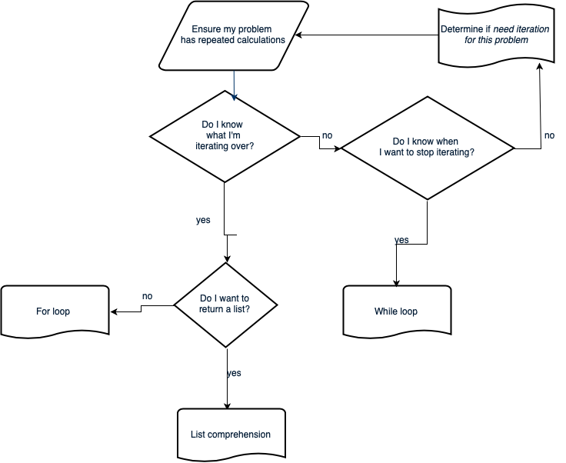
Iteration flow chart
09/23/19
UCB CS88 Fa19 L3
18
Notes:
Roll the three slides into a flow chart. Do I have a sequence of things I’m iterating through / Can I easily make it? If not, Do I have a condition for when I should stop iterating? If not, go back to defining your problem, iteration might not be the correct tool. If so, while loop. If you have a seq, do I want to return a list? If so, most likely list comp will be more compact. If not, for loop.
18

Slide 19
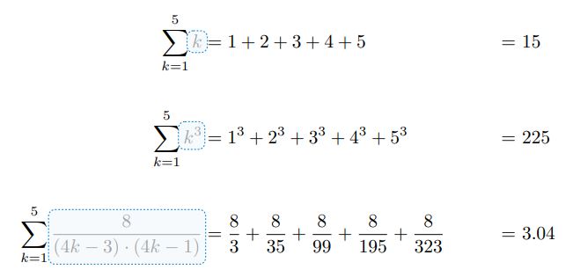
An Interesting Example
09/23/19
UCB CS88 Fa19 L3
19

Slide 20
Environment Diagrams aka what python tutor makes
Environment Diagrams are organizational tools that help you understand code
Terminology:
- Frame: keeps track of variable-to-value bindings, each function call has a frame
- Global Frame: global for short, the starting frame of all python programs, doesn’t correspond to a specific function
- Parent Frame: The frame of where a function is defined (default parent frame is global)
- Frame number: What we use to keep track of frames, f1, f2, f3, etc
- Variable vs Value: x = 1. x is the variable, 1 is the value
Steps:
1 Draw the global frame
2 When evaluating assignments (lines with single equal), always evaluate right side first
3 When you call a function MAKE A NEW FRAME!
4 When assigning a primitive expression (number, boolean, string) right the value in the box
5 When assigning anything else, draw an arrow to the value
6 When calling a function, name the frame with the intrinsic name – the name of the function that variable points to
7 The parent frame of a function is the frame in which it was defined in (default parent frame is global)
8 If the value isn’t in the current frame, search in the parent frame
NEVER EVER EVER draw an arrow from one variable to another.
Source:
http://markmiyashita.com/cs61a/environment_diagrams/rules_of_environment_diagrams/
http://albertwu.org/cs61a/notes/environments.html
09/23/19
UCB CS88 Fa19 L3
20

Slide 21
Another example
Higher Order Functions
http://pythontutor.com/composingprograms.html#code=def%20square%28x%29%3A%0A%20%20%20%20return%20x%20*%20x%0A%20%20%20%20%0As%20%3D%20square%0Ax%20%3D%20s%283%29%0A%0Adef%20make_adder%28n%29%3A%0A%20%20%20%20def%20adder%28k%29%3A%0A%20%20%20%20%20%20%20%20return%20k%20%2B%20n%0A%20%20%20%20return%20adder%0A%20%20%20%20%0Aadd_2%20%3D%20make_adder%282%29%0Aadd_3%20%3D%20make_adder%283%29%0Ax%20%3D%20add_2%28x%29%0A%0Adef%20compose%28f,%20g%29%3A%0A%20%20%20%20def%20h%28x%29%3A%0A%20%20%20%20%20%20%20%20return%20f%28g%28x%29%29%0A%20%20%20%20return%20h%0A%0Aadd_5%20%3D%20compose%28add_2,%20add_3%29%0Ay%20%3D%20add_5%28x%29%0A%0Az%20%3D%20compose%28square,%20make_adder%282%29%29%283%29&cumulative=true&mode=edit&origin=composingprograms.js&py=3&rawInputLstJSON=%5B%5D
09/23/19
UCB CS88 Fa19 L3
21

Slide 22
Higher Order Functions
Functions that operate on functions
A function
A function that takes a function arg
def odd(x):
return x%2==1
odd(3)
True
Why is this not ‘odd’ ?
def filter(fun, s):
return [x for x in s if fun(x)]
filter(odd, [0,1,2,3,4,5,6,7])
[1, 3, 5, 7]
09/23/19
UCB CS88 Fa19 L3
22

Slide 23
Higher Order Functions (cont)
A function that returns (makes) a function
def leq_maker(c):
def leq(val):
return val <= c
return leq
>>> leq_maker(3)
<function leq_maker.<locals>.leq at 0x1019d8c80>
>>> leq_maker(3)(4)
False
>>> filter(leq_maker(3), [0,1,2,3,4,5,6,7])
[0, 1, 2, 3]
09/23/19
UCB CS88 Fa19 L3
23

Slide 24
Three super important HOFS (Wait for lab)
* For the builtin filter/map, you need to then call list on it to get a list. If we define our own, we do not need to call list
list(map(function_to_apply, list_of_inputs))
Applies function to each element of the list
list(filter(condition, list_of_inputs))
Returns a list of elements for which the condition is true
reduce(function, list_of_inputs)
Reduces the list to a result, given the function
09/23/19
UCB CS88 Fa19 L3
24

Slide 25
Computational Concepts today
Higher Order Functions
Functions as Values
Functions with functions as argument
Functions with functions as return values
Environment Diagrams
Big Idea: Software Design Patterns
09/23/19
UCB CS88 Fa19 L3
25

