Slide 1

Computational Structures in Data Science
UC Berkeley EECS
Lecturer
Michael Ball
Lecture #6: Higher Order Functions
Feb. 10, 2020
cs88.org
Notes:
1

Slide 2
Computing in the News
Lots of discussion about facial recognition
"The End of Privacy as We Know It?"
https://www.nytimes.com/2020/02/10/podcasts/the-daily/facial-recognition-surveillance.html
" A secretive start-up promising the next generation of facial recognition software has compiled a database of images far bigger than anything ever constructed by the United States government: over three billion, it says. Is this technology a breakthrough for law enforcement — or the end of privacy as we know it?"
" Facial Recognition Moves Into a New Front: Schools "
https://www.nytimes.com/2020/02/06/business/facial-recognition-schools.html
" Lockport's Aegis software studies images of faces captured by 300 newly installed cameras and calculates whether those faces match a "persons of interest" database compiled by school administrators; if the system finds a match, it alerts security staff who vet the image for confirmation."
02/10/2020
UCB CS88 Fa20 L6
2

Slide 3
iClicker Check-In
How are you feeling about CS88 so far?
A) It's going very well! ☺
B) It's going good…
C) So, so…
D) Not so great…
E) Terribly. ☹
02/10/2020
UCB CS88 Fa20 L6
3

Slide 4
Announcements!
Bonus Questions in Labs
Extra practice, not just coding.
Goal is to focus on the concepts.
Different styles of questions promote different ways of thinking and synthesizing information.
Half point extra for each lab you complete, ~5 points throughout the semester. (Labs are 40 points total.)
https://codestyle.herokuapp.com/cs88-lab02
02/10/2020
UCB CS88 Fa20 L6
4

Slide 5

Computational Concepts Toolbox
Data type: values, literals, operations,
e.g., int, float, string
Expressions, Call expression
Variables
Assignment Statement
Sequences: list
Data structures
Call Expressions
Function Definition Statement
Conditional Statement
Iteration:
data-driven (list comprehension)
control-driven (for statement)
while statement
02/10/2020
UCB CS88 Fa20 L6
5
Notes:
5

Slide 6
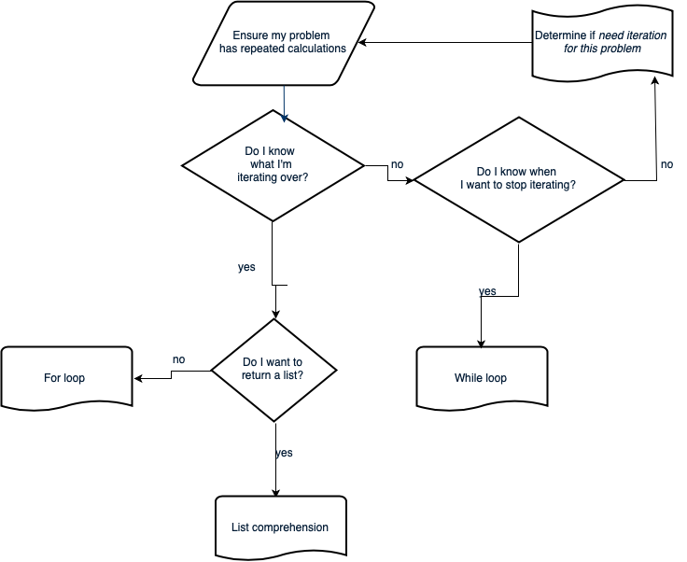
Iteration flow chart
02/10/2020
UCB CS88 Fa20 L6
6
Notes:
Roll the three slides into a flow chart. Do I have a sequence of things I’m iterating through / Can I easily make it? If not, Do I have a condition for when I should stop iterating? If not, go back to defining your problem, iteration might not be the correct tool. If so, while loop. If you have a seq, do I want to return a list? If so, most likely list comp will be more compact. If not, for loop.
6

Slide 7
Computational Concepts today
Higher Order Functions
Functions as Values
Functions with functions as argument
Functions that return a function
In Python, we use () to call a function.
We don't need to do this!
02/10/2020
UCB CS88 Fa20 L6
7

Slide 8
Functions: A New Kind of Data!
Lists, Numbers, Strings: All kinds of data
Code is its own kind of data, too!
Why?
More expressive programs, a new kind of abstraction.
This will be one of the trickier concepts in CS88.
Big Idea: Software Design Patterns
02/10/2020
UCB CS88 Fa20 L6
8

Slide 9
iClicker Question
Question: What's the result of the following?
def greet(name):
print('Hello, ' + name)
hello = greet
def greet(name):
print('Hi, ' + name)
hello('CS88')
A) Error
B) prints "Hello, CS88"
C) prints "Hi, CS88"
D) "I'm lost…."
02/10/2020
UCB CS88 Fa20 L6
9

Slide 10
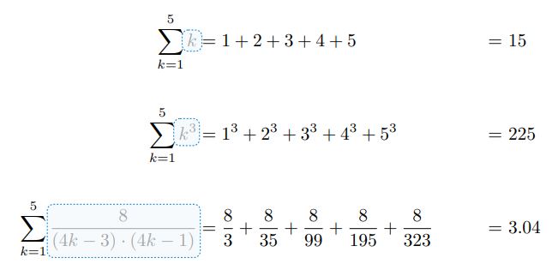
An Interesting Example
02/10/2020
UCB CS88 Fa20 L6
10

Slide 11
Environment Diagrams aka what python tutor makes
Environment Diagrams are organizational tools that help you understand code
Terminology:
- Frame: keeps track of variable-to-value bindings, each function call has a frame
- Global Frame: global for short, the starting frame of all python programs, doesn’t correspond to a specific function
- Parent Frame: The frame of where a function is defined (default parent frame is global)
- Frame number: What we use to keep track of frames, f1, f2, f3, etc
- Variable vs Value: x = 1. x is the variable, 1 is the value
Steps:
1 Draw the global frame
2 When evaluating assignments (lines with single equal), always evaluate right side first
3 When you call a function MAKE A NEW FRAME!
4 When assigning a primitive expression (number, boolean, string) right the value in the box
5 When assigning anything else, draw an arrow to the value
6 When calling a function, name the frame with the intrinsic name – the name of the function that variable points to
7 The parent frame of a function is the frame in which it was defined in (default parent frame is global)
8 If the value isn’t in the current frame, search in the parent frame
NEVER EVER EVER draw an arrow from one variable to another.
Source:
http://markmiyashita.com/cs61a/environment_diagrams/rules_of_environment_diagrams/
http://albertwu.org/cs61a/notes/environments.html
02/10/2020
UCB CS88 Fa20 L6
11

Slide 12
Another example
Higher Order Functions
http://pythontutor.com/composingprograms.html#code=def%20square%28x%29%3A%0A%20%20%20%20return%20x%20*%20x%0A%20%20%20%20%0As%20%3D%20square%0Ax%20%3D%20s%283%29%0A%0Adef%20make_adder%28n%29%3A%0A%20%20%20%20def%20adder%28k%29%3A%0A%20%20%20%20%20%20%20%20return%20k%20%2B%20n%0A%20%20%20%20return%20adder%0A%20%20%20%20%0Aadd_2%20%3D%20make_adder%282%29%0Aadd_3%20%3D%20make_adder%283%29%0Ax%20%3D%20add_2%28x%29%0A%0Adef%20compose%28f,%20g%29%3A%0A%20%20%20%20def%20h%28x%29%3A%0A%20%20%20%20%20%20%20%20return%20f%28g%28x%29%29%0A%20%20%20%20return%20h%0A%0Aadd_5%20%3D%20compose%28add_2,%20add_3%29%0Ay%20%3D%20add_5%28x%29%0A%0Az%20%3D%20compose%28square,%20make_adder%282%29%29%283%29&cumulative=true&mode=edit&origin=composingprograms.js&py=3&rawInputLstJSON=%5B%5D
02/10/2020
UCB CS88 Fa20 L6
12

Slide 13
Three super important HOFS
* For the builtin filter/map, you need to then call list on it to get a list. If we define our own, we do not need to call list
list(map(function_to_apply, list_of_inputs))
Applies function to each element of the list
list(filter(condition, list_of_inputs))
Returns a list of elements for which the condition is true
reduce(function, list_of_inputs)
Applies the function, combining items of the list into a "single" value.
02/10/2020
UCB CS88 Fa20 L6
13

Slide 14
Today's Task: Acronym
Input: "The University of California at Berkeley"
Output: "UCB"
def acronym(sentence):
"""YOUR CODE HERE"""
P.S. Pedantry alert: This is really an initialism but that's rather annoying to say and type. ☺ (However, the code we write is the same, the difference is in how you pronounce the result.) The more you know!
02/10/2020
UCB CS88 Fa20 L6
14

Slide 15
MAP
list(map(function_to_apply, list_of_inputs))
Transform each of items by a function.
e.g. square()
Inputs (Domain): • Function
• Sequence Output (Range):
• A sequence
def map(function, sequence):
return [ function(item) for item in sequence ]
02/10/2020
UCB CS88 Fa20 L6
15

Slide 16
What does this do?
list(map(capitalize, ['michael', 'Alex', 'Srinath', 'julia']
)) Assume capitalize('michael') == 'Michael'
A) ['michael', 'Alex', 'Srinath', 'julia']
B) ['Michael', 'Alex', 'Srinath', 'Julia']
C) []
D) Error
E) I'm lost.
02/10/2020
UCB CS88 Fa20 L6
16

Slide 17
FILTER
list(filter(function, list_of_inputs))
*Keeps* each of item where the function is true.
Inputs (Domain): • Function
• Sequence Output (Range):
• A sequence
def filter(function, sequence):
return [ item for item in sequence if function(item) ]
02/10/2020
UCB CS88 Fa20 L6
17

Slide 18
What does this do?
list(filter(return_false, range(100)
)) Assume return_false(42) == False
A) range(0, 100) # A standard range object
B) [0, 1, 2, … 96, 97, 98, 99]
C) [ ]
D) Error
E) I'm lost.
02/10/2020
UCB CS88 Fa20 L6
18

Slide 19
REDUCE
reduce(function, list_of_inputs)
Successively combine items of our sequence
• function: add(), takes 2 inputs gives us 1 value.
Inputs (Domain): • Function, with 2 inputs
• Sequence Output (Range):
• An item, specifically, the output of our function.
def reduce(function, sequence):
result = function(sequence[0], sequence[1])
for index in range(2, len(sequence)):
result = function(result, sequence[index])
return result
02/10/2020
UCB CS88 Fa20 L6
19

Slide 20
Higher Order Functions
Functions that operate on functions
A function
A function that takes a function arg
def odd(x):
return x%2==1
odd(3)
True
Why is this not ‘odd’ ?
def filter(fun, s):
return [x for x in s if fun(x)]
filter(odd, [0,1,2,3,4,5,6,7])
[1, 3, 5, 7]
02/10/2020
UCB CS88 Fa20 L6
20

Slide 21
Higher Order Functions (cont)
A function that returns (makes) a function
def leq_maker(c):
def leq(val):
return val <= c
return leq
>>> leq_maker(3)
<function leq_maker.<locals>.leq at 0x1019d8c80>
>>> leq_maker(3)(4)
False
>>> filter(leq_maker(3), [0,1,2,3,4,5,6,7])
[0, 1, 2, 3]
02/10/2020
UCB CS88 Fa20 L6
21

Slide 22
Computational Concepts today
Higher Order Functions
Functions as Values
Functions with functions as argument
Functions with functions as return values
Environment Diagrams
Big Idea: Software Design Patterns
02/10/2020
UCB CS88 Fa20 L6
22

