Slide 1

Computational Structures in Data Science
UC Berkeley EECS Lecturer Michael Ball
Lecture 11
Abstract Data Types
March 6, 2020
http:cs88.org

Slide 2
Computational Concepts Toolbox
Data type: values, literals, operations,
e.g., int, float, string
Expressions, Call expression
Variables
Assignment Statement
Sequences: tuple, list
indexing
Data structures
Tuple assignment
Call Expressions
Function Definition Statement
Conditional Statement
Iteration:
data-driven (list comprehension)
control-driven (for statement)
while statement
Higher Order Functions
Functions as Values
Functions with functions as argument
Assignment of function values
Recursion
Lambda - function valued expressions
Notes:
z = 1,2
x,y = 3,4
a,b = z

Slide 3
Announcements
Midterm scores out early next week
Please don't come to class if you're sick.

Slide 4
Today’s Lecture
Abstract Data Types
More use of functions!
Value in documentation and clarity
New Python Data Types
Dictionaries, a really useful tool!

Slide 5
Why Abstract Data Types?
“Self-Documenting”
contact_name(contact)
Vs contact[0]
“0” may seem clear now, but what about in a week? 3 months?
Change your implementation
Maybe today it’s just a Python List
Tomorrow: It could be a file on your computer; a database in web

Slide 6
Abstract Data Type
Operations
Object
Constructors
A new Data Type
Selectors
Internal Representation
Operations
Implementation on that
Internal representation
External Representation
Interface
Abstraction Barrier!

Slide 7
Creating Abstractions
Compound values combine other values together
date: a year, a month, and a day
geographic position: latitude and longitude
a game board
Data abstraction lets us manipulate compound values as units
Isolate two parts of any program that uses data:
How data are represented (as parts)
How data are manipulated (as units)
Data abstraction: A methodology by which functions enforce an abstraction barrier between representation and use

Slide 8
Reminder: Lists
Lists
Constructors:
list( … )
[ <exps>,… ]
[<exp> for <var> in <list> [ if <exp> ] ]
Selectors: <list> [ <index or slice> ]
Operations: in, not in, +, *, len, min, max
Mutable ones too (but not yet
Tuples
A lot like lists, but you cannot edit them. We'll revisit on Monday.

Slide 9
A Small ADT
def point(x, y): # constructor
return [x, y] x = lambda point: point[0] # selector
y = lambda point: point[1]
def distance(p1, p2): # Operator
return ((x(p2) - x(p1)**2 + (y(p2) - y(p1))**2) ** 0.5
origin = point(0, 0)
my_house = point(5, 5)
campus = point(25, 25)
distance_to_campus = distance(my_house, campus)

Slide 10
Creating an Abtract Data Type
Constructors & Selectors
Operations
Express the behavior of objects, invariants, etc
Implemented (abstractly) in terms of Constructors and Selectors for the object
Representation
Implement the structure of the object
An abstraction barrier violation occurs when a part of the program that can use the higher level functions uses lower level ones instead
At either layer of abstraction
Abstraction barriers make programs easier to get right, maintain, and modify
Few changes when representation changes

Slide 11
Clicker: Changing Representations?
Assuming we update our selectors, what are valid representations for our point(x, y) ADT?
Currently point(1, 2) is represented as [1, 2]
A) [y, x] # [2, 1]
B) “X: ” + str(x) + “ Y: ” + str(y) # “X: 1 Y: 2”
C) str(x) + ' ' + str(y) # '1 2'
D) All of the above
E) None of the above

Slide 12
An Abstract Data Type: Key-Value Pair
Collection of key-Value bindings
Key : Value
Many real-world examples
Dictionary, Directory, Phone book, Course Schedule, Facebook Friends, Movie listings, …
Given some Key, What is the value associated with it?

Slide 13
Key-Value ADT
Constructors
kv_empty: create an empty KV
kv_add: add a key:value binding to a KV
kv_create: create a KV from a list of key,value tuples
Selectors
kv_items: list of (key,value) tuple in KV
kv_keys: list of keys in KV
kv_values: list of values in KV
Operations
kv_len: number of bindings
kv_in: presence of a binding with a key
kv_display: external representation of KV

Slide 14
A Layered Design Process
Build the application based entirely on the ADT interface
Operations, Constructors and Selectors
Build the operations in ADT on Constructors and Selectors
Not the implementation representation
This is the end of the abstraction barrier.
Build the constructors and selectors on some concrete representation

Slide 15
Example: Tic Tac Toe and Phone Book
See the companion notebook.

Slide 16
Clicker: Changing Representations?
Which of these violates a board ADT?
A) diag_left = diagonal(board, 0)
B) board[0][2] = 'x'
C) all_rows = rows(board)
D) board = empty_board()
E) None of the above

Slide 17
A little application
phone_book_data = [
("Christine Strauch", "510-842-9235"),
("Frances Catal Buloan", "932-567-3241"),
("Jack Chow", "617-547-0923"),
("Joy De Rosario", "310-912-6483"),
("Casey Casem", "415-432-9292"),
("Lydia Lu", "707-341-1254")
]
phone_book = pb_create(phone_book_data)
print("Jack Chows's Number: ", pb_get(phone_book, "Jack Chow"))
print("Area codes")
area_codes = list(map(lambda x:x[0:3], pb_numbers(phone_book)))
print(area_codes)

Slide 18
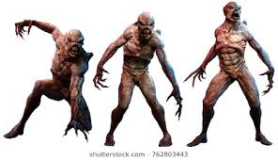
Dictionaries
Lists, Tuples, Strings, Range
Dictionaries
Constructors:
dict( <list of 2-tuples> )
dict( <key>=<val>, ...) # like kwargs
{ <key exp>:<val exp>, … }
{ <key>:<val> for <iteration expression> }
Selectors: <dict> [ <key> ]
<dict>.keys(), .items(), .values()
<dict>.get(key [, default] )
Operations:
Key in, not in, len, min, max
<dict>[ <key> ] = <val>

Slide 19
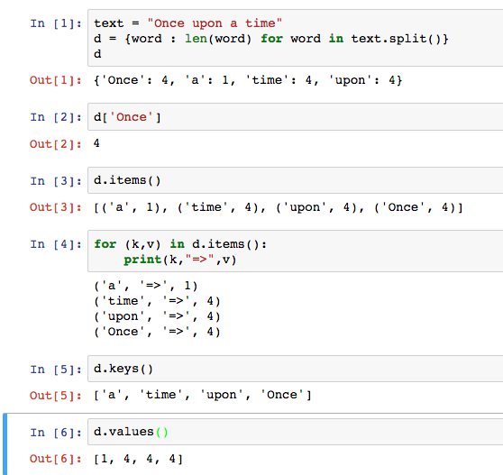
Dictionary Example

Slide 20
Clicker ?: Dictionaries
What is the result of the final expression?
my_dict = { ‘course’: ’CS 88’, semester = ‘Fall’ }
my_dict[‘semester’] = ’Spring’
my_dict[‘semester’]
‘Fall’
‘Spring’
Error

Slide 21
Limitations
Dictionaries are unordered collections of key-value pairs
Dictionary keys have two restrictions:
A key of a dictionary cannot be a list or a dictionary (or any mutable type)
Two keys cannot be equal; There can be at most one value for a given key
This first restriction is tied to Python's underlying implementation of dictionaries
The second restriction is part of the dictionary abstraction
If you want to associate multiple values with a key, store them all in a sequence value

Slide 22
Beware
Built-in data type dict relies on mutation
Clobbers the object, rather than “functional” – creating a new one
Throws an errors of key is not present
We will learn about mutation shortly

Slide 23
Example 3
KV represented as dict

Slide 24
C.O.R.E concepts
Perform useful computations treating objects abstractly as whole values and operating on them.
Compute
Operations
Provide operations on the abstract components that allow ease of use – independent of concrete representation.
Abstract Data Type
Representation
Constructors and selectors that provide an abstract interface to a concrete representation
Evaluation
Execution on a computing machine
Abstraction Barrier

Slide 25
Building Apps over KV ADT
friend_data = [
("Christine Strauch", "Jack Chow"),
("Christine Strauch", "Lydia Lu"),
("Jack Chow", "Christine Strauch"),
("Casey Casem", "Christine Strauch"),
("Casey Casem", "Jack Chow"),
("Casey Casem", "Frances Catal Buloan"),
("Casey Casem", "Joy De Rosario"),
("Casey Casem", "Casey Casem"),
("Frances Catal Buloan", "Jack Chow"),
("Jack Chow", "Frances Catal Buloan"),
("Joy De Rosario", "Lydia Lu"),
("Joy De Lydia", "Jack Chow")
]
Construct a table of the friend list for each person

Slide 26
Example: make_friends
def make_friends(friendships):
friends = kv_empty()
for (der, dee) in friendships:
if not kv_in(friends, der):
friends = kv_add(friends, der, [dee])
else:
der_friends = kv_get(friends, der)
friends = kv_add(kv_delete(friends, der),
der, [dee] + der_friends)
return friends

