Slide 1

Computational Structures in Data Science
UC Berkeley EECS Lecturer Michael Ball
Lecture 12:
Mutability
March 9, 2020
http://inst.eecs.berkeley.edu/~cs88

Slide 2
Announcements
Maps project due Wed 4/1
Midterm scores out tomorrow
Watch Piazza for announcements about labs and office hours
We will not be tracking participation today, but hope you still check in

Slide 3
Computational Concepts Toolbox
Data type: values, literals, operations,
Expressions, Call expression
Variables
Assignment Statement
Sequences: tuple, list
Dictionaries
Data structures
Tuple assignment
Function Definition Statement
Conditional Statement
Iteration: list comp, for, while
Lambda function expr.
Higher Order Functions
Functions as Values
Functions with functions as argument
Assignment of function values
Higher order function patterns
Map, Filter, Reduce
Function factories – create and return functions
Recursion
Linear, Tail, Tree
Abstract Data Types: Mutability
Notes:
z = 1,2
x,y = 3,4
a,b = z

Slide 4
Review: Creating an Abtract Data Type
Operations
Express the behavior of objects, invariants, etc
Implemented (abstractly) in terms of Constructors and Selectors for the object
Representation
Constructors & Selectors
Implement the structure of the object
An abstraction barrier violation occurs when a part of the program that can use the higher level functions uses lower level ones instead
At either layer of abstraction
Abstraction barriers make programs easier to get right, maintain, and modify
Few changes when representation changes

Slide 5
Dictionaries – by example
Constructors:
dict( hi=32, lo=17)
dict([('hi',212),('lo',32),(17,3)])
{'x':1, 'y':2, 3:4}
{wd:len(wd) for wd in "The quick brown fox".split()}
Selectors:
water[‘lo’]
<dict>.keys(), .items(), .values()
<dict>.get(key [, default] )
Operations:
in, not in, len, min, max
‘lo’ in water
Mutators
water[ ‘lo’ ] = 33

Slide 6
Objects
An Abstract Data Type consist of data and behavior bundled together to abstract a view on the data
An object is a concrete instance of an abstract data type.
Objects can have state
mutable vs immutable
Next lectures: Object-oriented programming
A methodology for organizing large(er) programs
A core component of the Python language
In Python, every value is an object
All objects have attributes
Manipulation happens through method

Slide 7
Mutability
Immutable – the value of the object cannot be changed
integers, floats, booleans
strings, tuples
Mutable – the value of the object can …
Lists
Dictionaries
>>> adict = {'a':1, 'b':2}
>>> adict
{'b': 2, 'a': 1}
>>> adict['b']
2
>>> adict['b'] = 42
>>> adict['c'] = 'elephant'
>>> adict
{'b': 42, 'c': 'elephant', 'a': 1}
>>> alist = [1,2,3,4]
>>> alist
[1, 2, 3, 4]
>>> alist[2]
3
>>> alist[2] = 'elephant'
>>> alist
[1, 2, 'elephant', 4]

Slide 8
From value to storage …
A variable assigned a compound value (object) is a reference to that object.
Mutable object can be changed but the variable(s) still refer to it
x = [1, 2, 3]
y = 6
x[1] = y
x[1]
frame
1
•
2
6
•
3
•
x:
•
y:
6
…

Slide 9
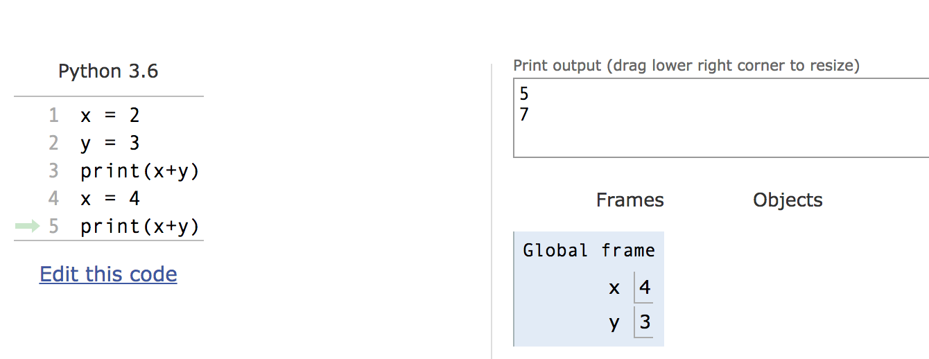
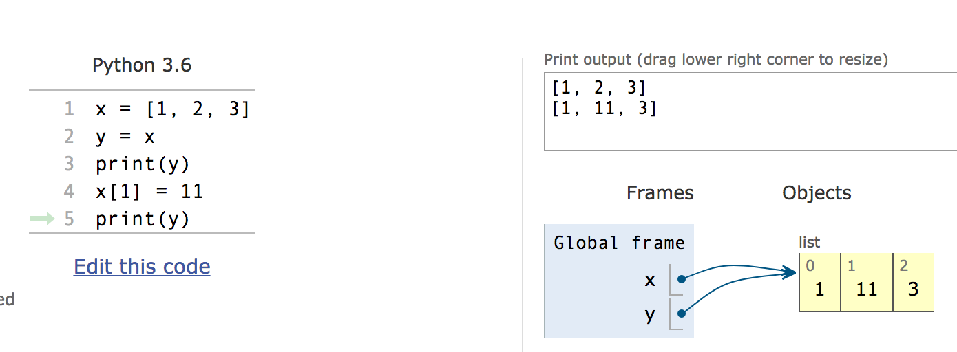
Mutation makes sharing visible

Slide 10
Copies, ‘is’ and ‘==‘
>>> alist = [1, 2, 3, 4]
>>> alist == [1, 2, 3, 4] # Equal values?
True
>>> alist is [1, 2, 3, 4] # same object?
False
>>> blist = alist # assignment refers
>>> alist is blist # to same object
True
>>> blist = list(alist) # type constructors copy
>>> blist is alist
False
>>> blist = alist[ : ] # so does slicing
>>> blist is alist
False
>>> blist
[1, 2, 3, 4]
>>>

Slide 11
Mutating Input Data
Functions can mutate objects passed in as an argument
Declaring a new variable with the same name as an argument only exists within the scope of our function
BUT, we can still modify the object passed in, even though it was created in some other frame or environment.
Python Tutor

Slide 12
Creating mutating ‘functions’
Pure functions have referential transparency
c = greet() + name() is “referentially transparent” if we can replace that expression with the value, maybe that’s “Hello, CS 88”
Result value depends only on the inputs
Same inputs, same result value
Functions that use global variables are not pure
They can be “mutating”
>>> counter = -1
>>> def count_fun():
... global counter
... counter += 1
... return counter
...
>>> count_fun()
0
>>> count_fun()
1

Slide 13
Creating mutating ‘functions’
>>> counter = -1
>>> def count_fun():
... global counter
... counter += 1
... return counter
...
>>> count_fun()
0
>>> count_fun()
1
>>> def make_counter():
... counter = -1
... def counts():
... nonlocal counter
... counter +=1
... return counter
... return counts
...
>>> count_fun = make_counter()
>>> count_fun()
0
>>> count_fun()
1
>>> nother_one = make_counter()
>>> nother_one()
0
>>> count_fun()
2
How do I make a second counter?

Slide 14
Are these ‘mutations’ of seq?
def sum(seq):
psum = 0
for x in seq:
psum = psum + x
return psum
def reverse(seq):
rev = []
for x in seq:
rev = [x] + rev
return rev
A) Yes, both B) Only sum C) Only reverse D) None of them
Solution: D) No change of seq

Slide 15
Creating mutable objects
Follow the ADT methodology, enclosing state within the abstraction

Slide 16
Useless bank account
def account(name, initial_deposit):
return (name, initial_deposit)
def account_name(acct):
return acct[0]
def account_balance(acct):
return acct[1]
def deposit(acct, amount):
return (acct[0], acct[1]+amount)
def withdraw(acct, amount):
return (acct[0], acct[1]-amount)
>>> my_acct = account('David Culler', 175)
>>> my_acct
('David Culler', 175)
>>> deposit(my_acct, 35)
('David Culler', 210)
>>> account_balance(my_acct)
175

Slide 17
Bank account using dict
def account(name, initial_deposit):
return {'Name' : name, 'Number': 0,
'Balance' : initial_deposit}
def account_name(acct):
return acct['Name']
def account_balance(acct):
return acct['Balance']
def deposit(acct, amount):
acct['Balance'] += amount
return acct['Balance']
def withdraw(acct, amount):
acct['Balance'] -= amount
return acct['Balance']
>>> my_acct = account('David Culler', 93)
>>> account_balance(my_acct)
93
>>> deposit(my_acct, 100)
193
>>> account_balance(my_acct)
193
>>> withdraw(my_acct, 10)
183
>>> account_balance(my_acct)
183
>>> your_acct = account("Fred Jones",0)
>>> deposit(your_acct, 75)
75
>>> account_balance(my_acct)
183

Slide 18
State for a class of objects
account_number_seed = 1000
def account(name, initial_deposit):
global account_number_seed
account_number_seed += 1
return {'Name' : name, 'Number': account_number_seed,
'Balance' : initial_deposit}
def account_name(acct):
return acct['Name']
def account_balance(acct):
return acct['Balance']
def account_number(acct):
return acct['Number']
def deposit(acct, amount):
acct['Balance'] += amount
return acct['Balance']
def withdraw(acct, amount):
acct['Balance'] -= amount
return acct['Balance']
>>> my_acct = account('David Culler', 100)
>>> my_acct
{'Name': 'David Culler', 'Balance': 100, 'Number': 1001}
>>> account_number(my_acct)
1001
>>> your_acct = account("Fred Jones", 475)
>>> account_number(your_acct)
1002
>>>

Slide 19
Hiding the object inside
account_number_seed = 1000
accounts = []
def account(name, initial_deposit):
global account_number_seed
global accounts
account_number_seed += 1
new_account = {'Name' : name, 'Number': account_number_seed,
'Balance' : initial_deposit}
accounts.append(new_account)
return len(accounts)-1
def account_name(acct):
return accounts[acct]['Name’]
. . .
def deposit(acct, amount):
account = accounts[acct]
account['Balance'] += amount
return account['Balance']
def account_by_number(number):
for account, index in zip(accounts,range(len(accounts))):
if account['Number'] == number:
return index
return -1

Slide 20
Hiding the object inside
>>> my_acct = account('David Culler', 100)
>>> my_acct
0
>>> account_number(my_acct)
1001
>>> your_acct = account("Fred Jones", 475)
>>> accounts
[{'Name': 'David Culler', 'Balance': 100, 'Number': 1001}, {'Name': 'Fred Jones', 'Balance': 475, 'Number': 1002}]
>>> account_by_number(1001)
0
>>> account_name(account_by_number(1001))
'David Culler’
>>> your_acct
1
>>> account_name(your_acct)
'Fred Jones'
>>>

Slide 21
Hazard Beware
def remove_account(acct):
global accounts
accounts = accounts[0:acct] + accounts[acct+1:]
>>> my_acct = account('David Culler', 100)
>>> your_acct = account("Fred Jones", 475)
>>> nother_acct = account("Wilma Flintstone", 999)
>>> account_name(your_acct)
'Fred Jones'
>>> remove_account(my_acct)
>>> account_name(your_acct)
'Wilma Flintstone'
>>>

Slide 22
A better way …
account_number_seed = 1000
accounts = []
def account(name, initial_deposit):
global account_number_seed
global accounts
account_number_seed += 1
new_account = {'Name' : name, 'Number': account_number_seed,
'Balance' : initial_deposit}
accounts.append(new_account)
return account_number_seed
def _get_account(number):
for account in accounts:
if account['Number'] == number:
return account
return None
def account_name(acct):
return _get_account(acct)['Name']
. . .

Slide 23
A better way …
account_number_seed = 1000
accounts = []
def account(name, initial_deposit):
global account_number_seed
global accounts
account_number_seed += 1
new_account = {'Name' : name, 'Number': account_number_seed,
'Balance' : initial_deposit}
accounts.append(new_account)
return account_number_seed
def _get_account(number):
for account in accounts:
if account['Number'] == number:
return account
return None
def account_name(acct):
return _get_account(acct)['Name']
. . .
>>> my_acct = account('David Culler', 100)
>>> your_acct = account("Fred Jones", 475)
>>> nother_acct = account("Wilma Flintstone", 999)
>>> account_name(your_acct)
'Fred Jones'
>>> remove_account(my_acct)
>>> account_name(your_acct)
'Fred Jones’
>>> your_acct
1002

