Slide 1
Smart Labeling and Inspection System
Overview, Solution, and Final Reports
Team Name: IntelliTrace
Mentor Name: Dr. Sapna Jha
Team Members: Harini Mode
Shreya Karmakar
Tejasri Anantapalli

Slide 2
Table of Contents
S.No. | Content | Slide No.
1. | Overview of Problem | 3
2. | Challenges & Need for Smart Traceability | 4-5
3. | Solving the Problem | 6-15
4. | Final Reports | 16-17
5. | Learning Outcomes of Internship | 18

Slide 3
Overview of Problem
In today’s manufacturing industries, accurate product labeling and complete traceability are essential for maintaining high quality and meeting compliance standards. However, many factories still rely on manual or semi-automated labeling systems, which are prone to human errors, data mismatches, and poor integration with quality control systems. These limitations often lead to incorrect labels, missing or invalid data, and non-compliance with regulatory requirements such as RoHS and ISO.

Slide 4
Challenges & Need for Smart Traceability
Traditional systems often result in:
Product recalls due to mislabeling or undetected defects
Regulatory violations leading to fines or bans
Inefficiencies in production and auditing processes
Loss of customer trust caused by inconsistent product quality

Slide 5
Challenges & Need for Smart Traceability
To overcome these challenges, there is a need for a smart, AI-powered traceability system that can:
Automatically read and verify labels using OCR and QR/barcode scanning
Detect physical and printing defects through computer vision
Log inspection data in real time for full traceability
Make intelligent pass/fail decisions without human intervention
This project simulates such a system to improve labeling,
inspection, and compliance in modern manufacturing
environments.

Slide 6
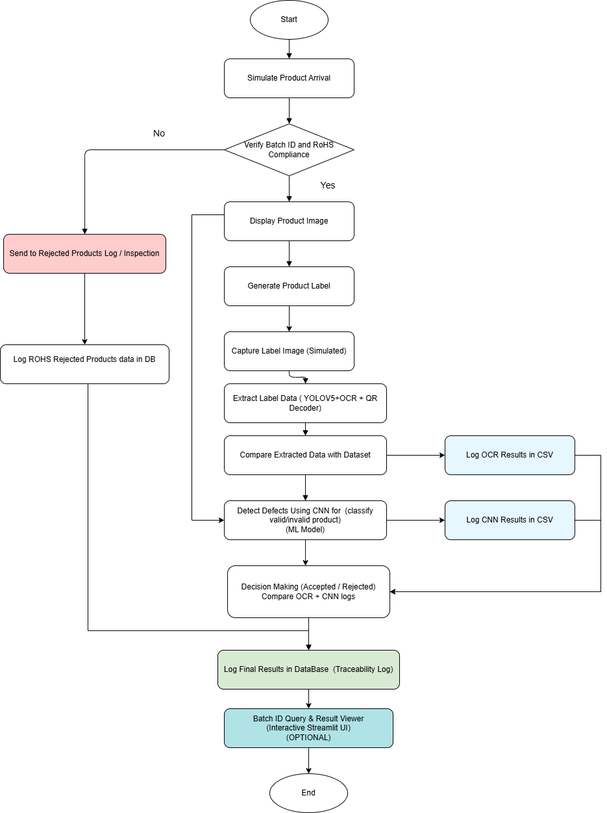
Solving the Problem
To overcome the drawbacks of semi-automated and error-prone labeling systems in manufacturing, our solution integrates AI, computer vision, and machine learning into a Smart Product Traceability Station. Here’s how the problem is solved:

Slide 7
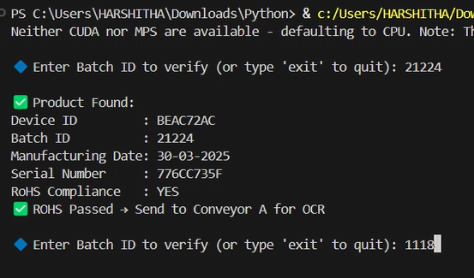
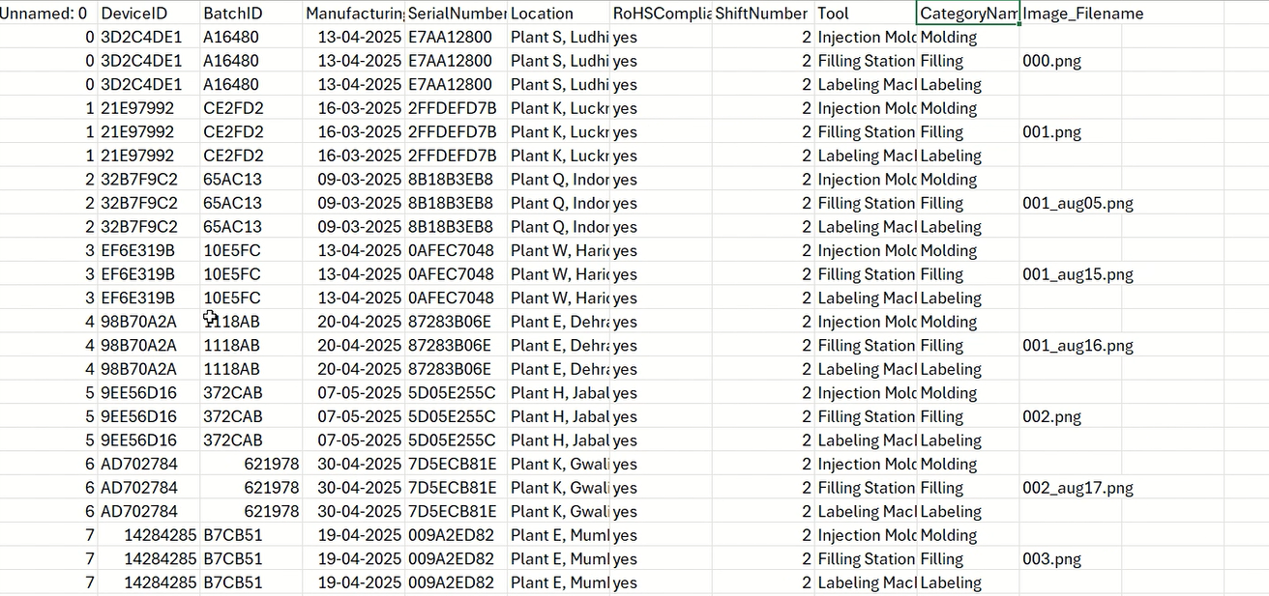
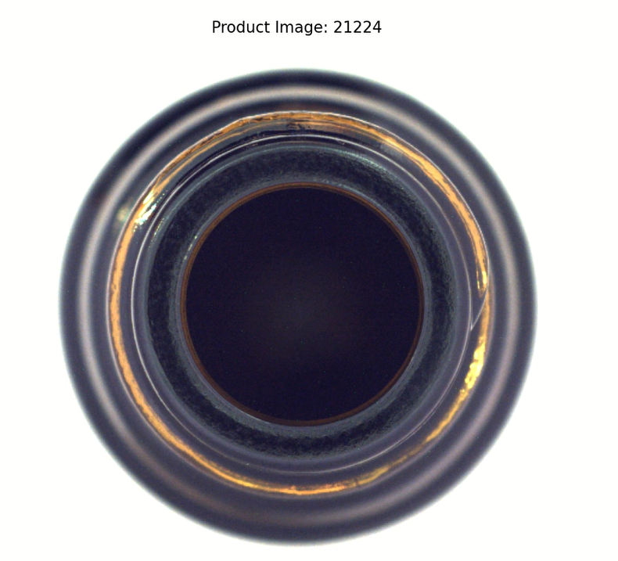
Solving the Problem
1. Automated Product Verification
Every product's Batch ID and RoHS Compliance is verified at the beginning of the process.
Non-compliant products are immediately rejected and logged into the database.

Slide 8
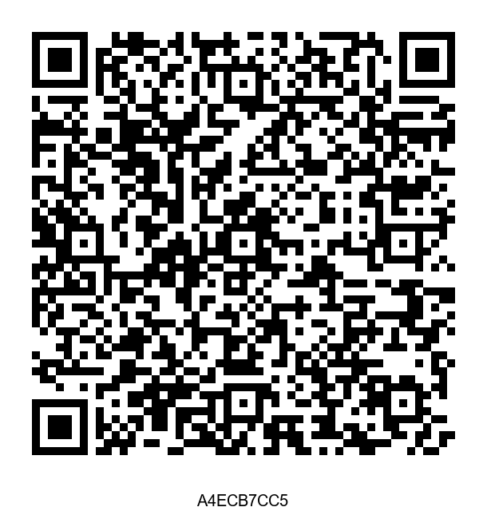
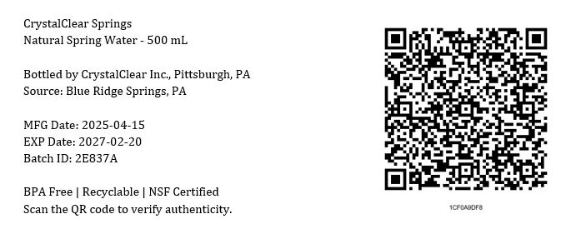
Solving the Problem
2. Label Generation & QR Integration
For compliant products, a label is generated using the qrcode and PIL libraries.
The label includes:
QR code with JSON-encoded metadata
Human-readable fields such as Device ID, Serial Number, and Manufacturing Date

Slide 9
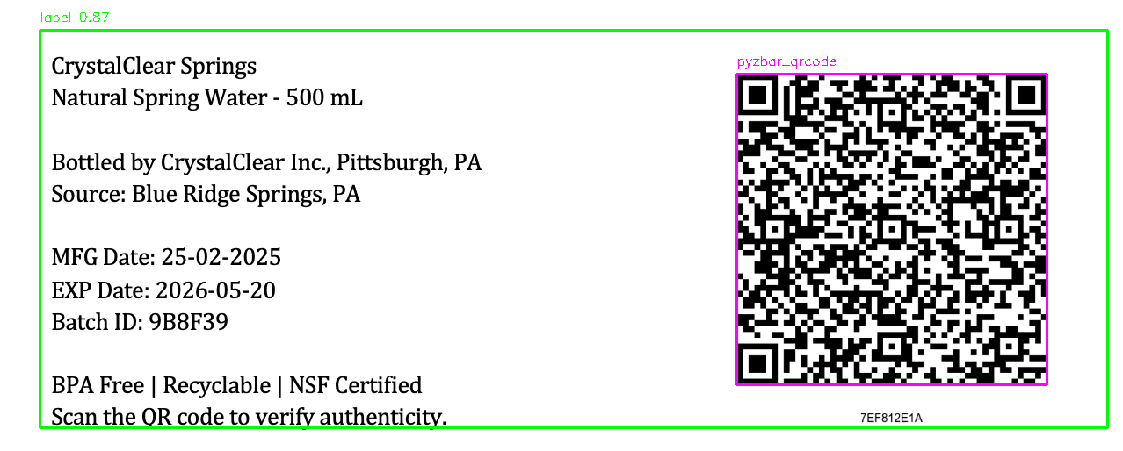
Solving the Problem
3. OCR & Metadata Extraction
The system combines the following to extract and verify metadata:
YOLOv5 to detect QR and text regions
EasyOCR or Tesseract to extract printed text
Pyzbar to decode QR codes
All extracted metadata is validated against the existing dataset.

Slide 10
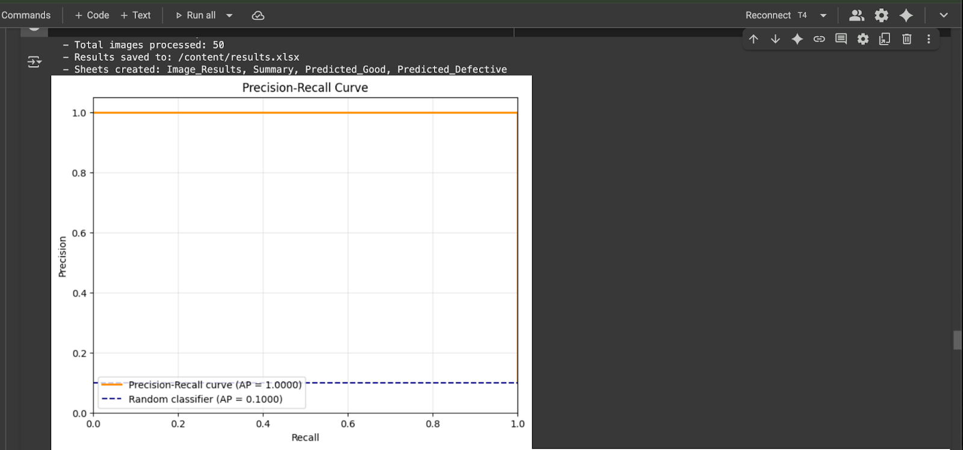
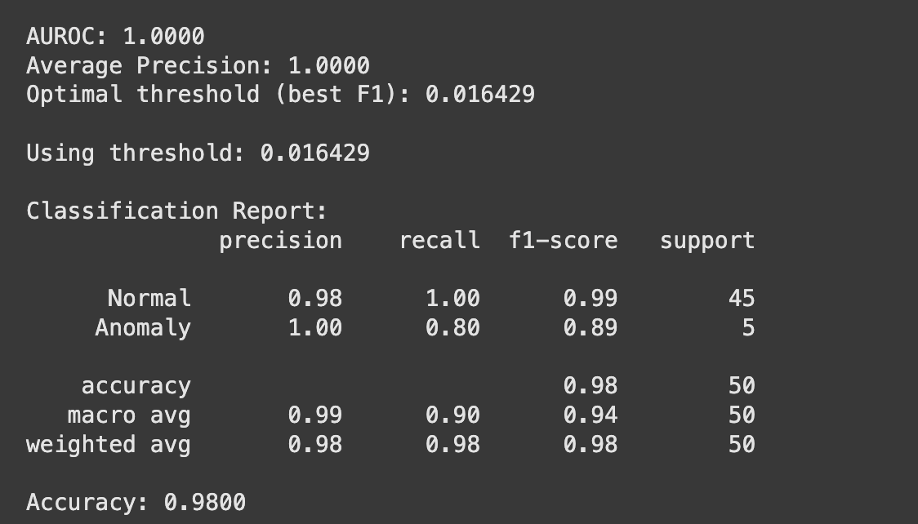
Solving the Problem
4. Defect Detection using CNN
A ResNet18 model is used to detect defects in bottle images from the MVTec dataset.
Anomaly detection techniques used:
PCA (Principal Component Analysis)
OCSVM (One-Class Support Vector Machine)
The model achieved 98% accuracy with AUROC score of 1.0 and no false positives.

Slide 11
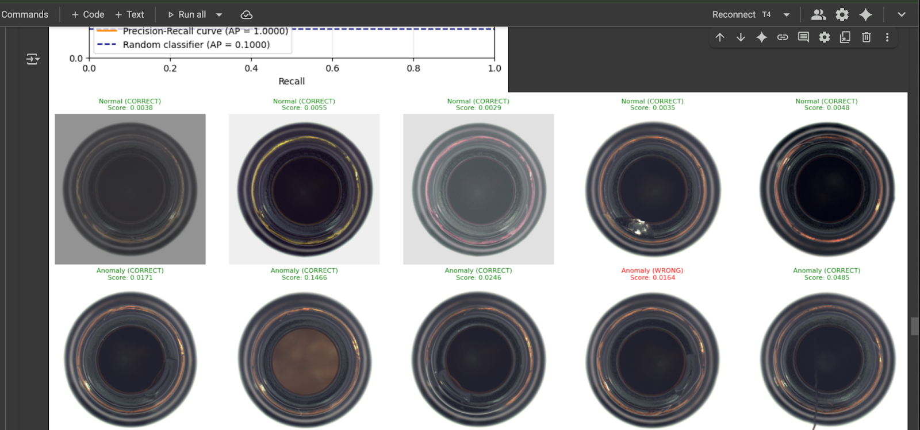
Results of Defect Detection using CNN:

Slide 12
Solving the Problem
5. Final Decision Logic
A multi-step logic is followed to determine product status:
If RoHS Compliance is 'no', the product is rejected.
If the OCR output shows a mismatch, the label is unreadable, or the extracted data does not align with the reference dataset, the item is marked as rejected.
If CNN model detects a defect, the product is rejected.
Only if all conditions are satisfied, the product is approved.

Slide 13
Solving the Problem
6. Logging & Traceability
All inspection results are logged in two formats:
CSV/Excel file with conditional formatting
SQLite database for structured storage and traceability
Each log entry contains: Device ID, Batch ID, Timestamp, Inspection Result, and Reason for Rejection (if any).
Output Type | File Name | Description
Excel | final_combined_result55.xlsx | Final results with color coding (green = approved, red = rejected)
Database | inspection_results.db (Table: FinalInspectionResults) | All inspection data stored in SQLite format for efficient querying

Slide 14
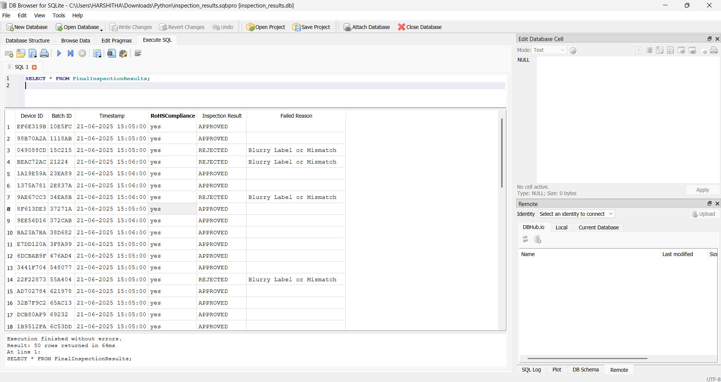
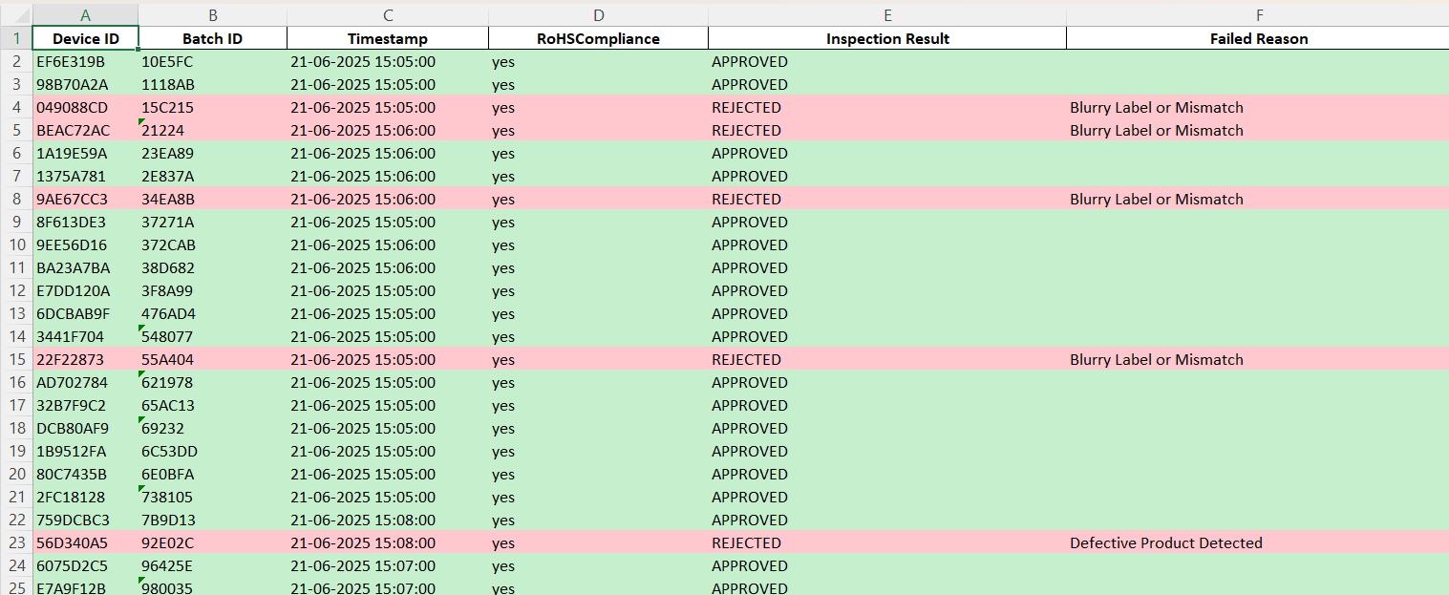
Final Logging & Traceability Results:
1. SQLite Database
2. Excel Sheet

Slide 15
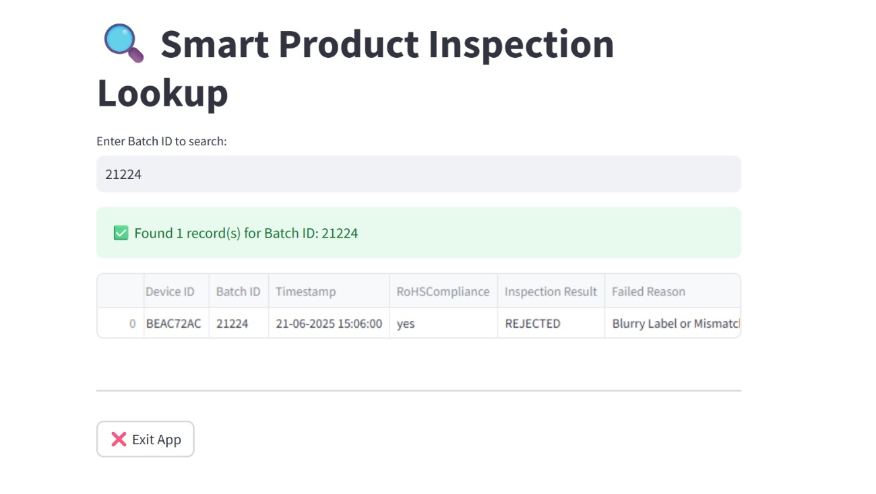
Solving the Problem
7. Interactive Result Viewer
A Streamlit-based user interface allows users to query product inspection records in real time using Batch ID.
Complete inspection details are displayed for audits and reviews.

Slide 16
Final Reports
1.Excel Report:
final_combined_result55.xlsx
Color-coded: Green = APPROVED, Red = REJECTED
2.SQLite Database:
Inspection_results.db → FinalInspectionResults table
Fields: Device ID, Batch ID, Timestamp, Result, Reason
3.Model Performance:
ResNet18 + PCA
Accuracy: 98%, AUROC: 1.0
Zero false positives

Slide 17
Final Reports
4.AI Modules Used:
YOLOv5 (Label Detection)
OCR (Tesseract / EasyOCR)
CNN (Defect Detection)
5.Traceability Support:
Logs stored in Excel and SQLite
Streamlit UI for Batch ID-based result viewer
6.Benefits:
Improved inspection accuracy and compliance
End-to-end automated traceability
Ready for audit, review, and reporting

Slide 18
Learning Outcomes of Internship
Gained experience in integrating computer vision, OCR, and barcode/QR decoding for automated label inspection.
Learned how to apply deep learning (ResNet) and anomaly detection (PCA, OCSVM) for defect identification.
Understood the design of automated traceability workflows using metadata validation and decision logic.
Developed skills in simulating end-to-end inspection systems using Python and real-world datasets.
Improved ability to analyze and visualize inspection data using Pandas, NumPy, and Matplotlib.
Built an interactive dashboard for traceability using Streamlit and SQLite.
Developed awareness of regulatory standards like RoHS and their importance in AI-based quality control.

