Slide 1
MusicOn

Slide 2
FrontEnd and BackEnd Team
Katakam Shreya-21BD1A1293
Konda Vani-21BD1A1298
Kondamadugu Akshitha-21BD1A1299
Kondamadugu Anvitha-21BD1A12A0

Slide 3

CONTRIBUTIONS..
Student Name | Contribution to application
K.Akshitha | Backend code of USER (Java) and Tables in mysql
2.K.Anvitha | Backend code of ADMIN (Java) and Services in Angular
3.K.Vani | Frontend using HTML (Angular) and JDBC
K.Shreya | Complete Frontend and Backend implementation

Slide 4
Overview of the Project
ProjectName : MusicOn
Description :
Our project is a music player web application built using Angular for the frontend and Java for the backend.
The application allows users to browse and play their favorite songs, create folders to organize songs, and add songs to their favorites list.
The project focuses on providing a user-friendly and interactive interface for music enthusiasts to enjoy their favorite tracks.

Slide 5
Key Features :
Song Library: The application provides a diverse collection of songs with details such as song name, singer, and movie name.
Music Player: Users can play, pause, and skip songs using the integrated music player.
Favorites List: Users can create their favorite songs list and add songs to it.
Folder Management: Users can create folders to categorize songs based on their preferences.
Password Protection: Folders can be protected with passwords to ensure privacy.
User Authentication: The application supports user registration and login to manage personalized folders and favorites.
Responsive Design: The user interface is designed to be responsive and compatible with various devices.

Slide 6

Technologies Used:
Frontend: Angular, HTML, CSS, TypeScript
Backend: Java, Spring Boot
Database: MySQL,MongoDB
Challenges:
Data Management: Handling and organizing song details, folders, and favorites.
Password Protection: Making sure folders are password-protected and accessible only to authorized users.
Testing and Bug Fixing: Identifying and fixing issues in the application.
Future Enhancements: Planning for future updates and improvements.

Slide 7
Future Enhancements:
In the future, we plan to implement features like song search, user playlists, and social sharing options. Additionally, aim to improve the overall performance and user experience of the application.
Conclusion:
Music player web application provides a seamless platform for music enthusiasts to discover, organize, and enjoy their favorite songs. The combination of Angular and Java technologies enables efficient data management and a smooth user experience. With future enhancements, application aims to cater to a broader audience and become a go-to destination for music lovers.

Slide 8
Front-End Structure Overview:
The front-end web application on music player is built using Angular, TypeScript, and CSS. It comprises several components that work together to provide a seamless user experience for managing songs, folders, and favorites. Here's an overview of the front-end architecture:
app.component: The main component that serves as the entry point of the application. It contains the root HTML template and acts as the container for other components.
login.component: The login component responsible for user authentication. It takes user credentials and verifies them against the backend to allow access to the app.
displaysounds.component: This component displays a list of songs available in your music library. Users can view song details and play songs using the music player.
opensong.component: The music player component that allows users to play, pause, forward, and backward through songs. It also displays the current song's details and duration.

Slide 9
add-to-favorites.component: This component provides the "Add to Favorites" functionality. Users can add selected songs to their favorite folders, protected by passwords.
folder.component: This component displays a list of existing folders created by the user. It also allows the user to create new folders with a name and password for protection.
password-protection.component: This component handles password verification for accessing protected folders. Users need to enter the correct password to view the songs in the folder.
app-routing.module: Angular's routing module that defines the routes and navigation between different components.
song-services.service: A service responsible for managing song-related data and providing functions to retrieve song information.
folder-management.service: A service for handling folder-related operations like creating folders, adding songs, and password verification.

Slide 10

FLOWCHART OF FROTEND ARCHITECTURE
+----------------------+
| app.component |
| |
+---+--------------+---+
| |
| |
| |
+--------------------+ | | +---------------------------------------+
| login.component | | | displaysounds.component |
| +------+ | | +----> |
+--------------------+ | | +----------------------------------------+
| |
| |
| | +-----------------------------------+
| +----> opensong.component |
| | | |
| | +-----------------------------------+
| |
| | +---------------------------------------+
| +----> add-to-favorites.component |
| | | |
| | +----------------------------------------+
| |
| | +---------------------------+
+--------------+ | folder.component |
| |
+-----------------------------+

Slide 11
The flowchart is a simplified representation of the front-end architecture.
The flowchart depicts the relationship between different components in the application. Users start by logging in using the login component. After successful authentication, they can access the displaysounds component, which lists all available songs.
Users can then use the opensong component to play songs or add them to their favorites using the add-to-favorites component. The folder component manages existing folders and allows the creation of new folders, protected by passwords with the help of the password-protection component.

Slide 12
Backend Structure Overview:
The backend web application on music player is developed using Java in IntelliJ IDEA. It follows a well-structured architecture that includes various packages and modules for different functionalities. Here's an overview of the backend structure:
User Authentication: Contains classes and logic related to user authentication and authorization. This package handles user login, registration, and token-based authentication.
Controller: Contains the controller classes that receive HTTP requests from the front-end and route them to the appropriate service methods.
Domain: Includes domain classes that represent the core entities of your application, such as User, Song, Folder, etc.

Slide 13
Exceptions: Deals with custom exception classes for handling specific error scenarios.
Proxy: This package handles the integration with external APIs or services, if any.
Repository: Contains classes responsible for interacting with the database. It includes methods for querying and manipulating data.
Service: Implements the business logic of your application. It contains service classes that encapsulate the core functionality of each feature.
Resources: Contains configuration files, such as application.properties, that store properties and settings for the application.
Test: Includes test classes for unit testing various components of the application.

Slide 14

BACKEND FLOWCHART
+--------------------------------------+
| User Authentication |
| |
| +----------------------------+ |
| | Controller | |
| | | |
| +------------+---------------+ |
| | |
| | |
| v |
| +----------------------------+ |
| | Service | |
| | | |
| +-------------+--------------+ |
| | |
| | |
| v |
| +----------------------------+ |
| | Repository | |
| | | |
| +----------------------------+ |
| |
+--------------------------------------+
The flowchart represents the flow of data and logic in the backend. HTTP requests from the front-end are received by the controller, which delegates the tasks to the service layer for business logic implementation. The service layer interacts with the repository to perform database operations.

Slide 15
Database Overview:
In music player web application we have utilized both MySQL and MongoDB databases to handle different types of data and requirements:
MySQL:
Used for User Authentication and related data.
Handles structured data with predefined schemas, such as user details like username, password, and other user-related information.
Ensures data integrity and consistency for user-related operations.
MongoDB:
Utilized for handling vehicle data and other dynamic data with changing requirements.
Stores vehicle information in JSON-like documents, allowing for flexibility in data structures and rapid schema changes.
Enables seamless scaling and handling of large volumes of vehicle-related data.

Slide 16
Flowchart for MySQL Usage in User Authentication:
+------------------------+
| |
| User Input |
| |
+---------+--------------+
|
v
+------------------------+
| |
| Backend Service |
| (Java - Intellij) |
| |
+---------+--------------+
|
v
+------------------------+
| |
| MySQL DB |
| |
+------------------------+
Both MySQL and MongoDB work in tandem to handle different types of data, allowing your application to leverage the strengths of each database technology based on the nature of the data and its requirements.
Flowchart for MongoDB Usage in Song Data:
+------------------------+
| |
| User Input |
| |
+---------+--------------+
|
v
+------------------------+
| |
| Backend Service |
| (Java - Intellij) |
| |
+---------+--------------+
|
v
+------------------------+
| |
| MongoDB DB |
| |
+------------------------+

Slide 17
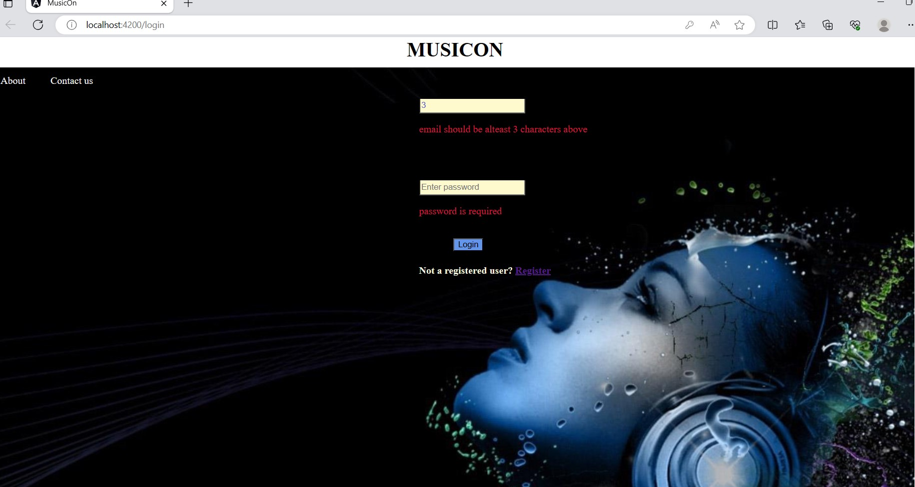
User Interface
The User Interface (UI) plays a crucial role in providing an intuitive and engaging experience for users to browse, search, and interact with songs. Here are some specific details related to the User Interface in your project:
Home Page:
The home page serves as the main
dashboard of the music player application.
It displays a list of songs, including their
titles, singers, movie names, and
album covers.
Users can scroll through the list to explore
different songs
Each song is accompanied by a "Play"
button that allows users to listen to
the song.

Slide 18
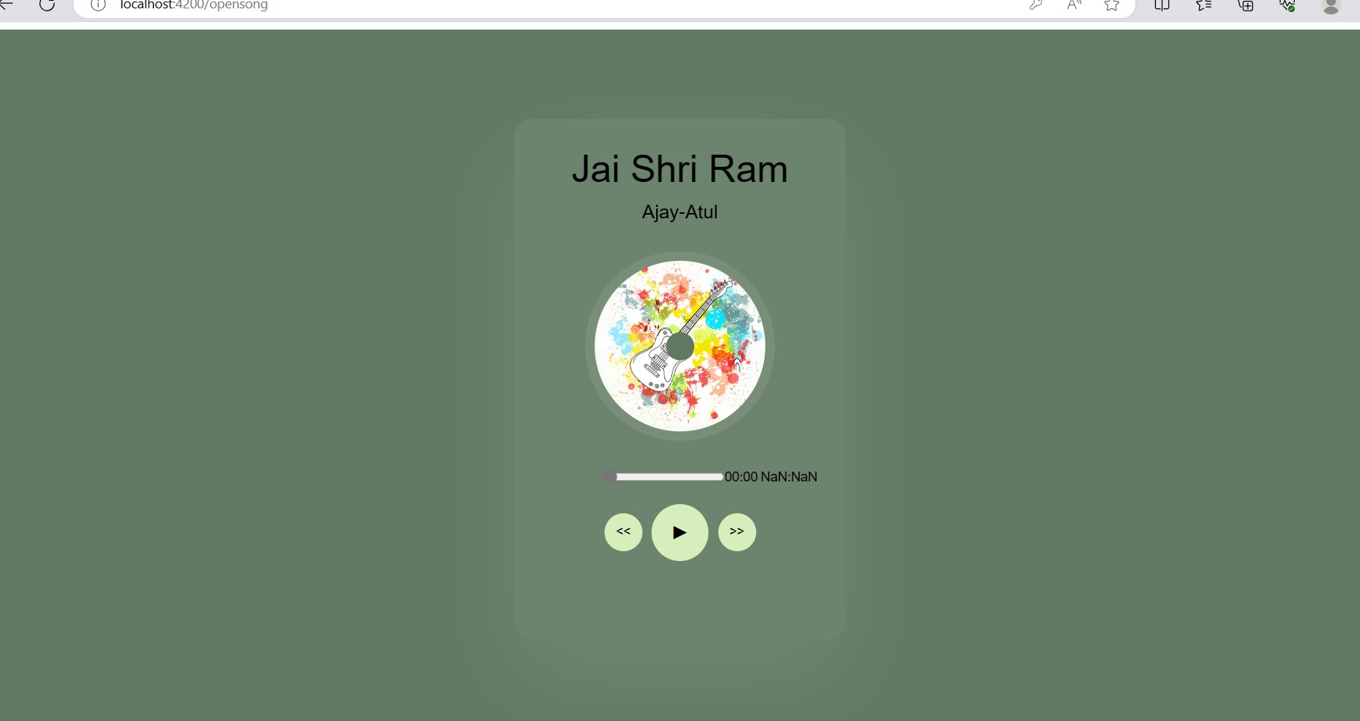
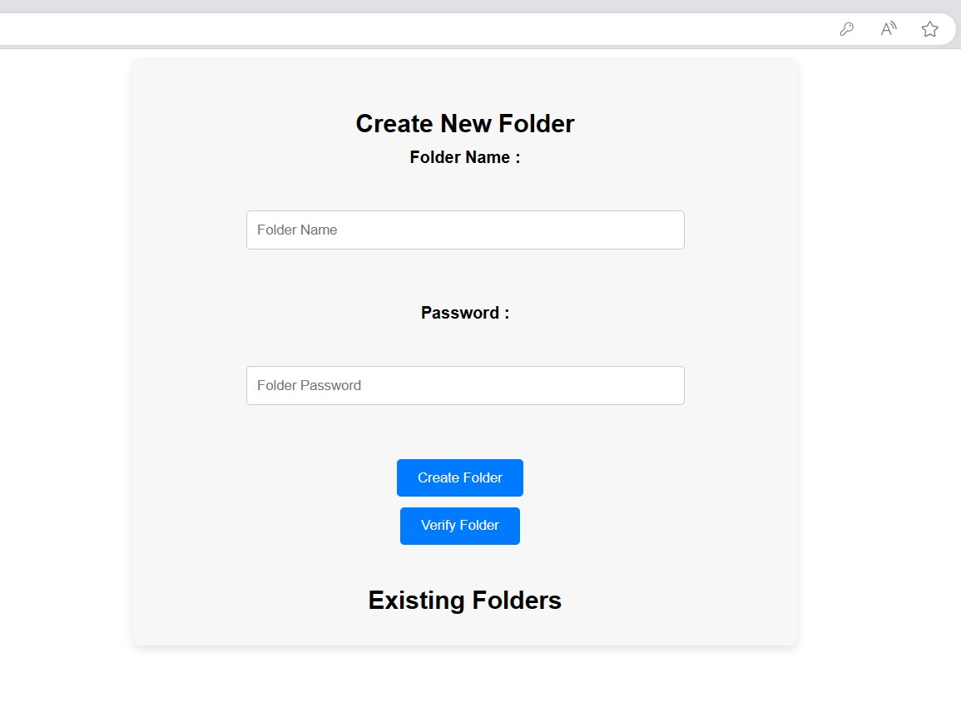
Add to Favorites:
The application allows users to add
their favorite songs to a personalized
favorites list or folder.
Users can create a new folder for
favorites and assign a password to protect it.
After creating a folder, users can
add songs to it by clicking the "Add to
Favorites" button on the song details page.
User Authentication:
The music player application implements
user authentication to ensure secure
access to personalized folders.
Users need to log in with their credentials
(e.g., username and password) to access
their favorite folders.

Slide 19
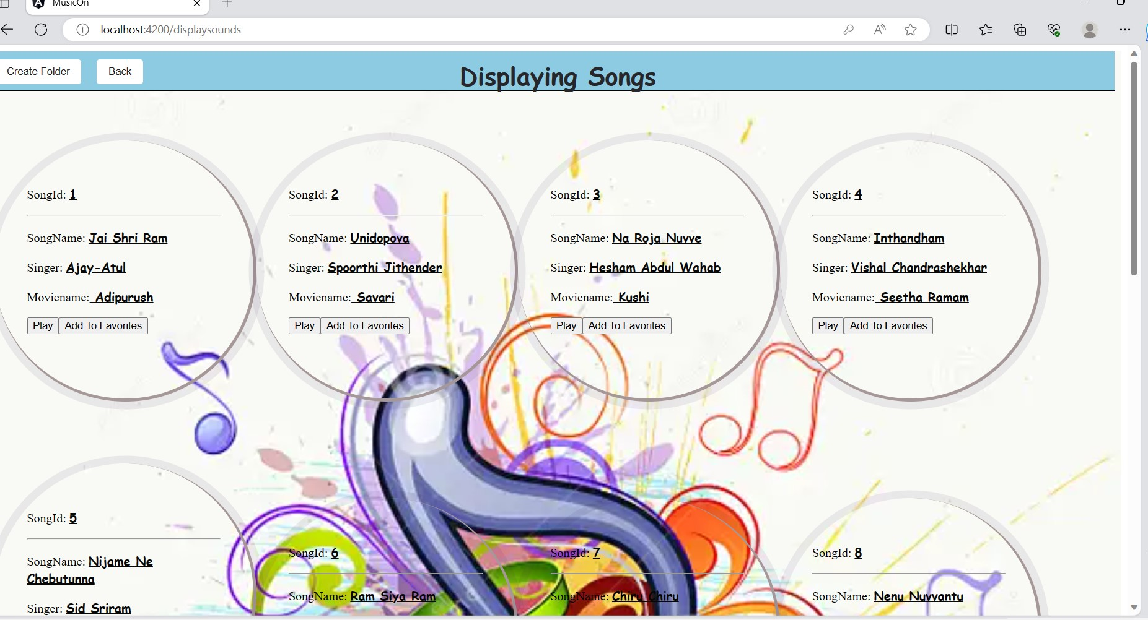
Song Details Page:
Clicking on a song's title or album
cover opens the song details page.
The song details page presents
additional information about the selected
song, such as the song's duration
and release date.
Users can see the song's album cover
and various playback controls, such as
play, pause, forward, and backward.
Folder Management:
Users can view and manage their folders containing favorite songs.
The "Existing Folders" section on the home page lists all the folders with their respective song counts.
Users can click on a folder to view its contents and see the songs they added.

Slide 20
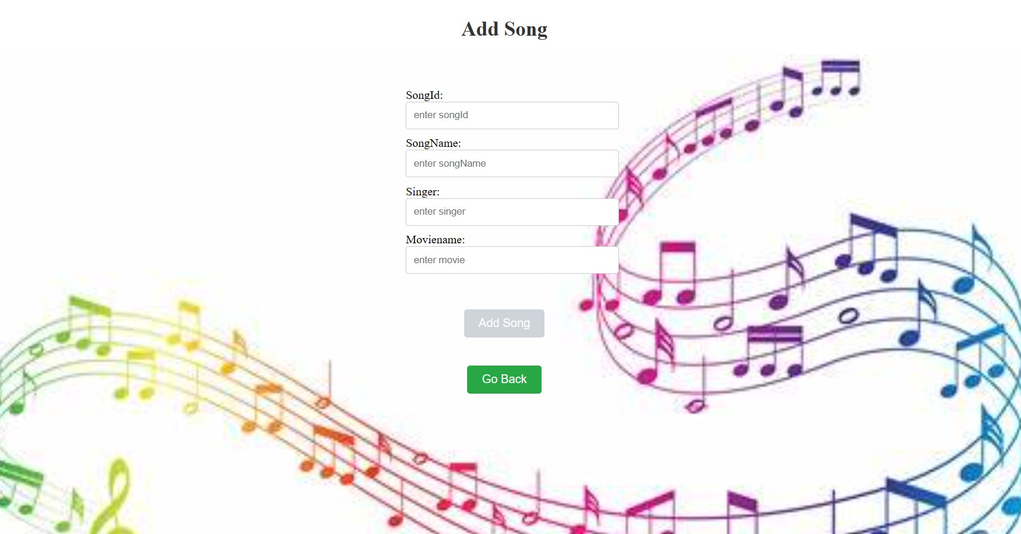
Aesthetic and Color Scheme:
The UI incorporates an aesthetically pleasing color scheme, aligning with the theme of the music player application.
The use of appropriate fonts, icons, and visual elements enhances the overall user experience.

Slide 21
Functionalities
The main functionalities of music player application can be summarized in simple words as follows:
Song Listing: Display a list of songs with details like title, singer, and movie name.
Song Playback: Allow users to play, pause, and control the playback of songs.
Add to Favorites: Let users create personalized folders and add their favorite songs to them.
Folder Management: Allow users to view and manage their favorite song folders.
User Authentication: Implement secure login to access personalized folders.
Responsive Design: Ensure the application works smoothly on different devices.
Database Integration: Integrate MySQL and MongoDB databases for data storage.
User Authorization: Control access to certain features based on user roles.
Password Protection: Provide password protection for individual folders.
These functionalities collectively create a user-friendly and engaging music player experience for the users.

Slide 22
Challenges and Solutions
Challenge: Implementing User Authentication Solution: Use a robust authentication mechanism like JWT (JSON Web Tokens) to securely manage user logins and access to personalized folders.
Challenge: Integrating MySQL and MongoDB Databases Solution: Utilize appropriate database connectors and ORM (Object-Relational Mapping) frameworks to seamlessly interact with both MySQL and MongoDB databases.
Challenge: Handling Concurrent Song Playback Solution: Implement audio control features using Angular's audio API and manage song playback states to ensure smooth handling of multiple concurrent song plays.
Challenge: Creating Responsive Design Solution: Use responsive design techniques with CSS and media queries to adapt the application layout and styles based on different screen sizes and devices.
Challenge: Folder Management and Organization Solution: Design an intuitive user interface for creating, renaming, and deleting folders, along with drag-and-drop functionality to easily manage songs within folders.

Slide 23
Challenge: Handling Errors and Exceptions Solution: Use error handling techniques in both the frontend and backend to gracefully handle unexpected errors and provide meaningful error messages to users.
Challenge: Testing and Quality Assurance Solution: Conduct comprehensive testing, including unit testing and end-to-end testing, to ensure the application functions as expected and meets quality standards.
Challenge: Performance Optimization Solution: Optimize database queries, reduce page load times, and cache frequently accessed data to enhance the overall performance of the application.
By addressing these challenges with well-thought-out solutions, the project can achieve its objectives and provide a seamless and enjoyable music player experience to its users.

Slide 24
Future Enhancements
User Profile and Settings: Implement a user profile section where users can update their personal information, change passwords, and manage account preferences.
Social Media Integration: Allow users to share their favorite songs or playlists on social media platforms, enhancing the app's social engagement.
Playlist Creation: Enable users to create and manage custom playlists with their favorite songs for easy access.
Song Recommendations: Implement a recommendation engine based on user preferences, listening history, and song metadata to suggest personalized song recommendations.
Offline Mode: Introduce an offline mode that allows users to download their favorite songs for offline playback, ensuring a seamless music experience even without an internet connection.
Lyrics Display: Integrate a feature to display song lyrics alongside the music player, enhancing the user's overall experience.
Song Tagging and Sorting: Allow users to tag songs with custom labels and sort them based on tags, genres, or moods.
Multi-Language Support: Provide support for multiple languages to cater to a diverse user base.

Slide 25
Conclusion
In conclusion, the music player application project has been successfully developed, providing users with a seamless and enjoyable music listening experience. The project's frontend, built using Angular, offers a user-friendly interface that allows users to explore, play, and manage their favorite songs effortlessly. The backend, developed in Java with MySQL and MongoDB databases, ensures secure user authentication and efficient data management.
Throughout the project, several key challenges were encountered, such as integrating two different databases (MySQL and MongoDB) for user authentication and song data storage. However, these challenges were overcome through careful planning, thorough testing, and effective utilization of libraries and frameworks.
The main functionalities of the application include user registration and login, browsing and searching for songs, playing music with a built-in player, and adding songs to personal folders. Additionally, users can create and manage custom playlists, view song details, and explore song recommendations based on their preferences.
Future enhancements for the project include implementing user profiles and settings, social media integration, playlist creation, offline mode, song recommendations, and more. These enhancements aim to further improve user engagement and satisfaction with the application.
In summary, the music player application project showcases the successful integration of frontend and backend technologies to create a robust and feature-rich application. With the potential for future improvements, the app can continue to evolve and provide a delightful music experience for users worldwide.

