Slide 1
Motifs
First Session- 05/17/2024

Slide 2
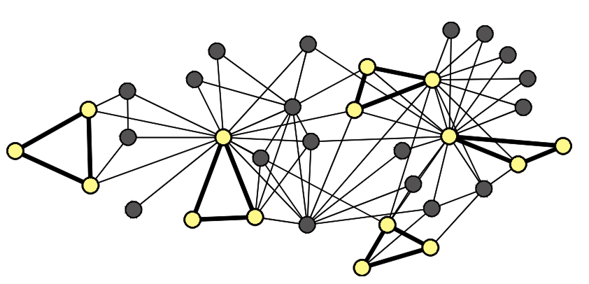
Introduction
Motif

Slide 3
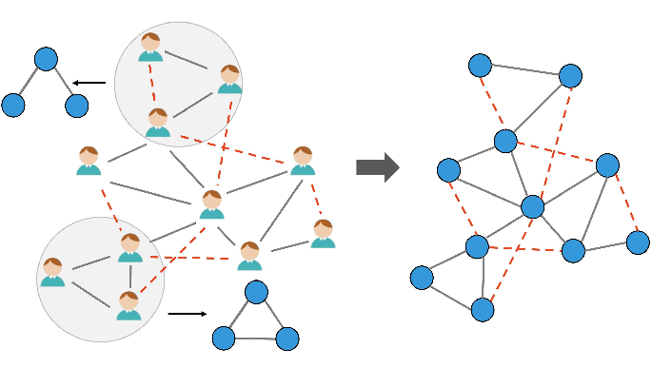
Example

Slide 4
Motif applications
Motif applications
Social network analysis
Graph data mining
Biology
Neuro science

Slide 5
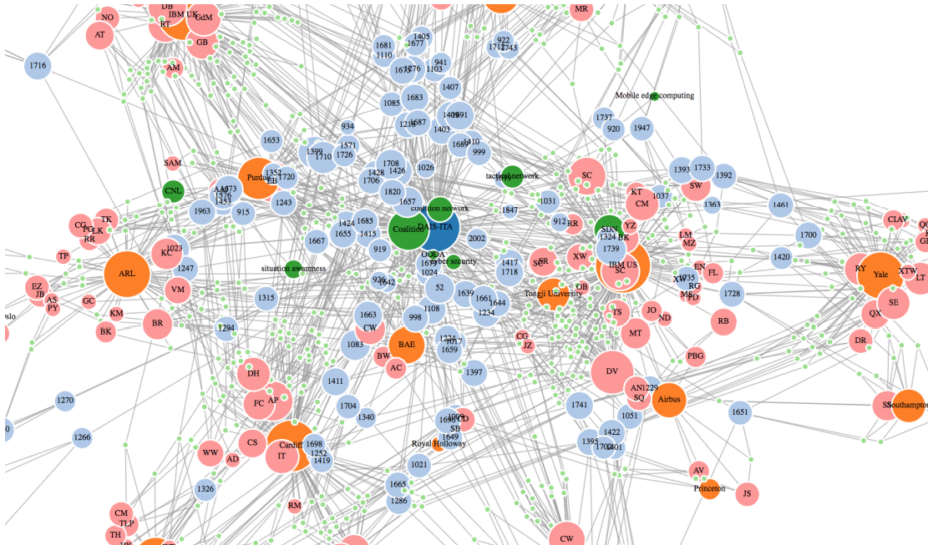
Challenges of counting motifs in large graphs
Combinatorial Complexity
Symmetry and Redundancy
Graph Isomorphism
Efficient Algorithms
Parallelization and Scalability

Slide 6
Algorithms for subgraph counting
Exact subgraph counting
Approximate subgraph counting
Parallel subgraph counting

Slide 7
Questions
Being familiar with the concepts and preliminaries
Finding and understanding exact algorithms for subgraph counting
What is their approach?
Are there any restrictions on the nodes? Does the method only work for the certain subgraph sizes?
Is the method applicable to directed or undirected graphs?
Is the code publicly available?

