Slide 1
Geoinformatics
Watershed Analysis Of Assi River
By : Shreyam Gupta &
Sourav

Slide 2
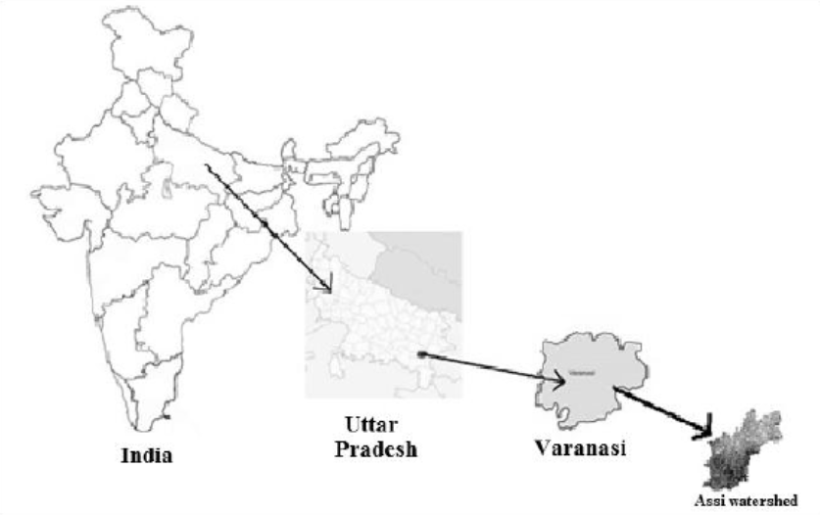
Problem definition :
To delineate the watershed and derive the river network of the Assi River using QGIS and identify the area of land that contributes runoff and sediment to a particular stream or river.
Study Area

Slide 3




GIS Criteria
Accuracy
The ASTER-DEM should have a high resolution to accurately represent the topography of the Assi River basin.
Consistency
The watershed map should be clear, concise, and easy to interpret.
Timeliness
The OSM data should be up-to-date to accurately represent the drainage network of the Assi River basin.
Completeness
The watershed delineation should be performed using a hydrological approach (i.e., the Strahler order approach) and should include:
- boundary
- drainage network
- elevation of Assi River basin

Slide 4
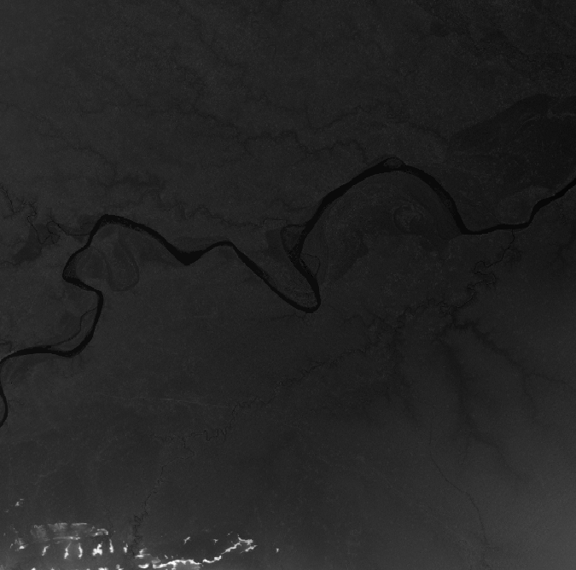
Methodology
Before we can delineate a watershed, we need to upload our data! We will extract a Digital Elevation Model (DEM) – a geospatial dataset storing elevation values – from a USGS database.
Re-projection: we must re-project our DEM to an appropriate coordinate system (this will vary in accordance to your region of study). To do this you can use the Warp (Reproject) tool:Raster → Projections → Warp (Reproject)

Slide 5
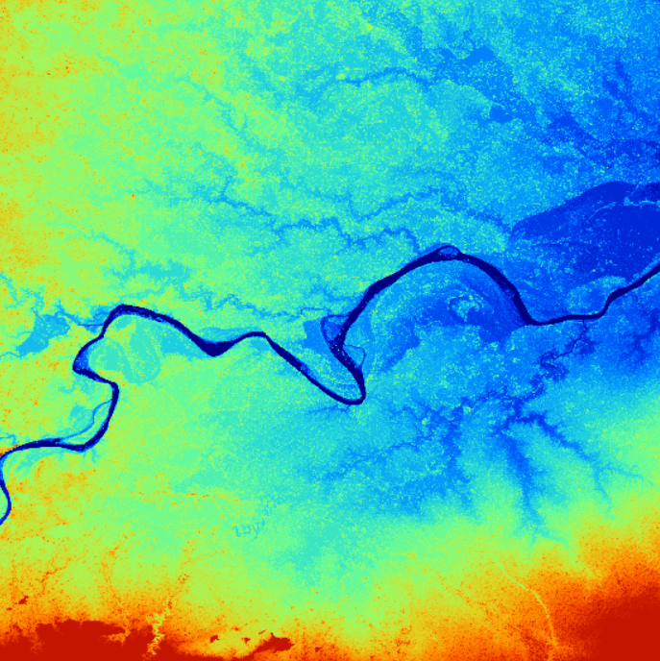
Fill Sinks: Next, we will fill in the sinks, using Fill sinks (wang & liu) tool:SAGA->Terrain analysis->preprocessing->fill sinks(wang liu)Be sure to select Filled DEM as your only Output File)

Slide 6
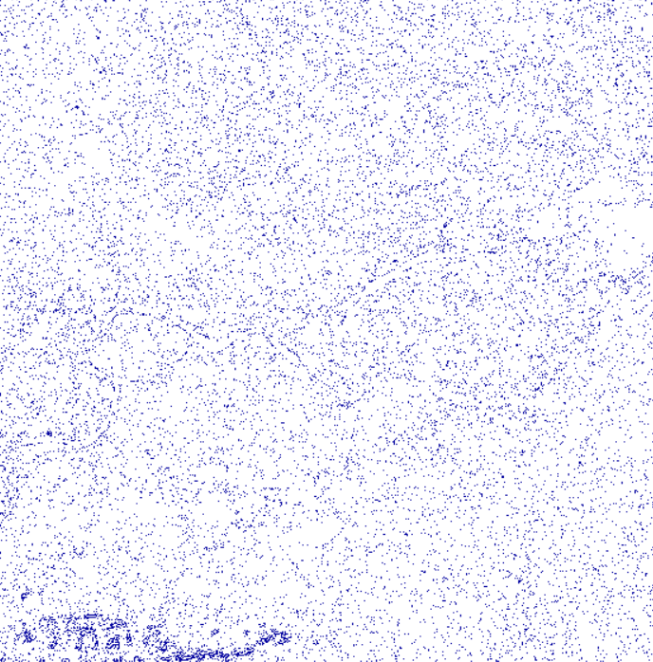

Strahler Order: Generate the Stream network (Strahler Order) Now that we have projected our DEM onto our project, we will generate a Strahler Order to outline our stream network. To generate our Strahler Order, we will use the Strahler Order tool: Processing Toolbox → SAGA → Terrain Analysis – Channels → Strahler Order Once you run the tool, a stream network should be generated as per the images below Image of our Strahler order file

Slide 7
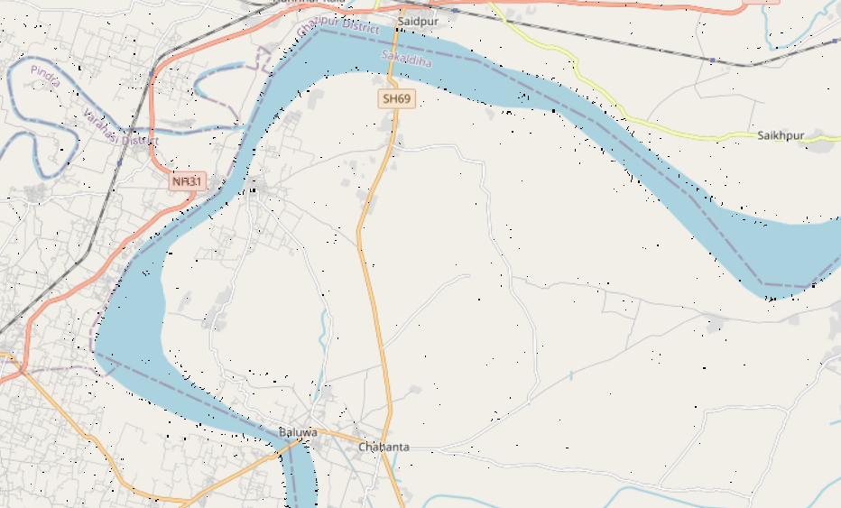

Conclusion
The watershed delineation analysis of the Assi River using QGIS was successful. A high-resolution watershed map was generated, which can be used to identify areas that are vulnerable to flooding, assess the impact of land use changes on water quality, and develop water conservation strategies.

Slide 8

SCOPE OF FURTHER STUDY
Morphometric analysis is a powerful tool for understanding and managing water resources. By continuing to develop and apply new morphometric methods, we can gain a better understanding of natural systems and develop more effective strategies for managing them
Integrating morphometric analysis with ecological models to study the impact of land use changes on river ecosystems.
Using morphometric analysis to identify areas that are vulnerable to flash floods.
Developing morphometric-based models for predicting flood flows and sediment transport.

Slide 9
Thank You

