Slide 1
Group Project
Group Members:
Sara Bali - sxb220128
Vishnuvardhan Yekabote - vxy230003
Ashish Reddy Resu – axr230070
Megha Sai Sree Pinnaka - mxp220072
Shreya Madan Mali - sxm220336
Vishnuvardhan Yanamandala- vxy220010

Slide 2
Objectives
Data Visualization with Tableau using trucking fleet data.
Identifying High-Risk Truck Drivers in California.
Enhancing Truck Safety Through Location and Event Evaluation.
Identifying Potentially Hazardous Truck Models.
Geographical Analysis of Truck Risks in California.

Slide 3


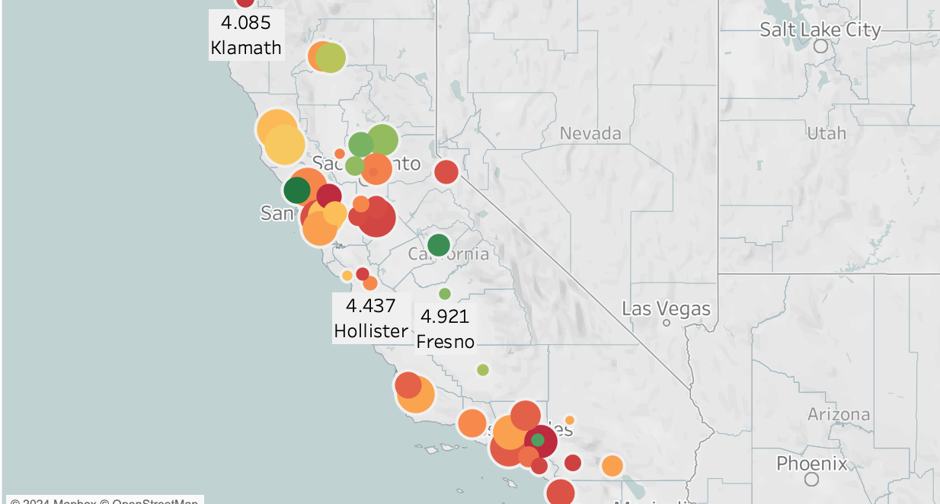


Workflow diagram
Transfer the files into HDFS
Data Preparation and Loading
Create tables and load the data into Hive/Impala
Identify Objectives of the Project
Use Tableau to analyze the data and create visualizations
Create the schema model in Tableau
Connect Tableau to Cloudera Hadoop
Run regression analysis in Tableau using R Server
Provide insights and interpretations of the visualizations

Slide 4
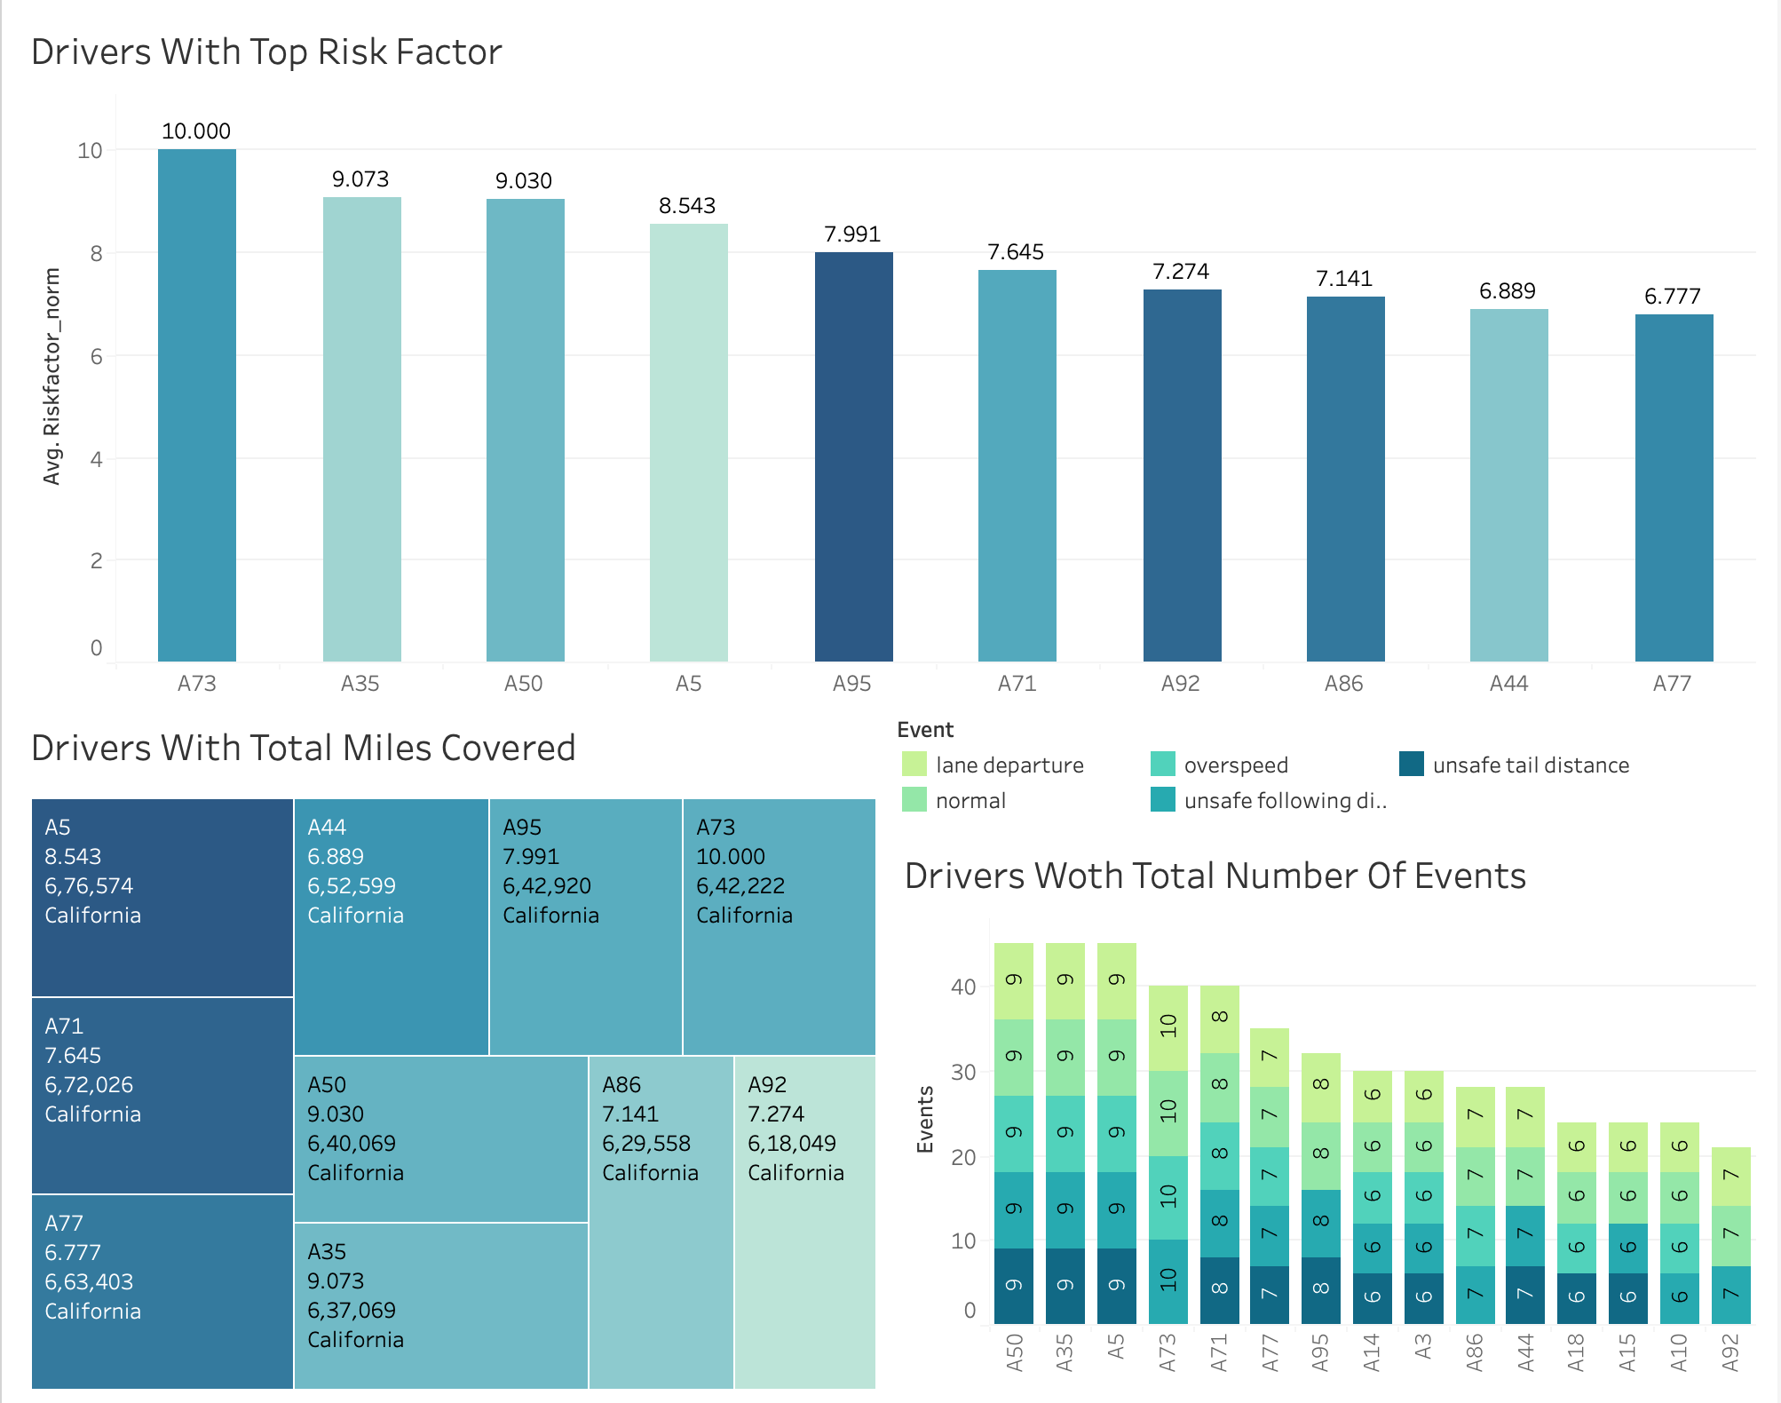
Drivers with top risk factors
The charts display the top 10 drivers who pose the highest risk based on normalized risk factors.
These drivers also tend to have more events associated with them. Notably, Driver ID A73 stands out as having the highest risk factor among them all.

Slide 5
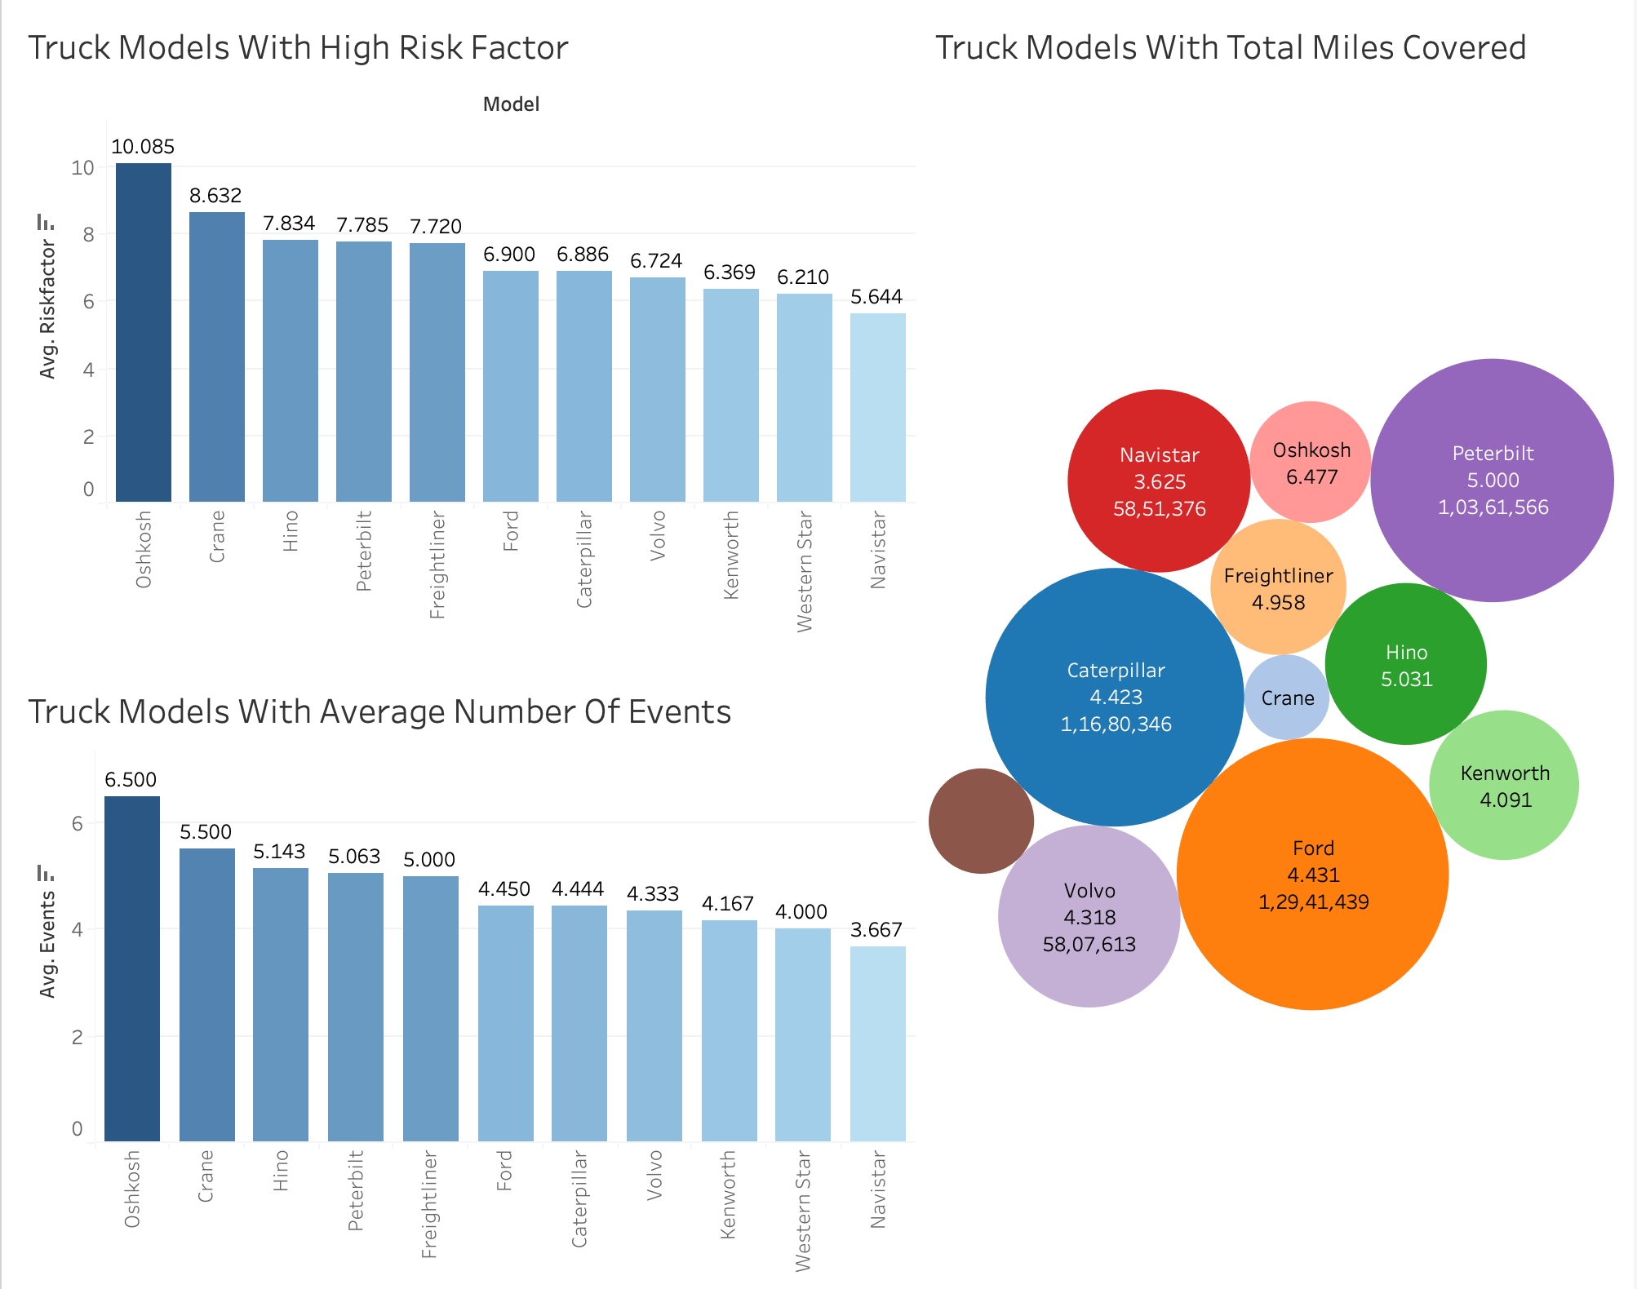
truck model with top risk factors
The plots illustrate truck models alongside their average risk factors.
Among them, the Oshkosh model exhibits the highest average risk factor, with Crane and Hino following closely behind.

Slide 6
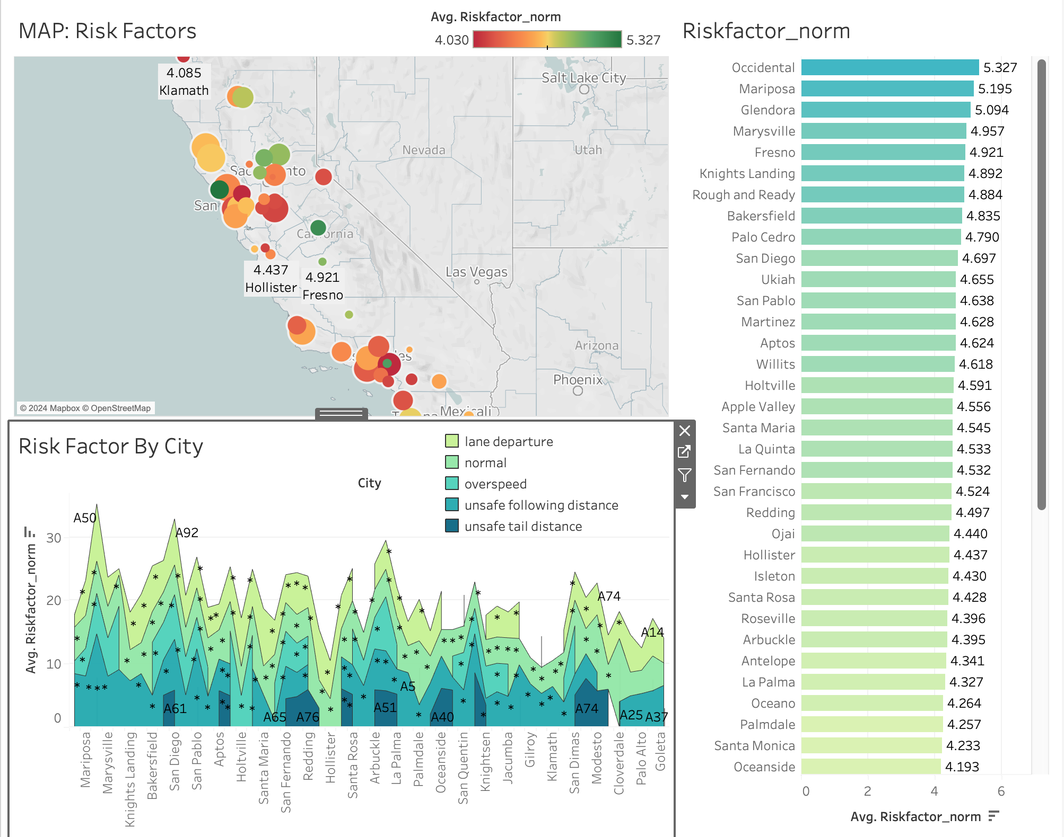
analyze geographical trends
The map showcases the average risk factors of California cities, with darker colors indicating higher risk levels.
Occidental stands out with the highest risk factor, closely followed by Mariposa and Glendora.

Slide 7
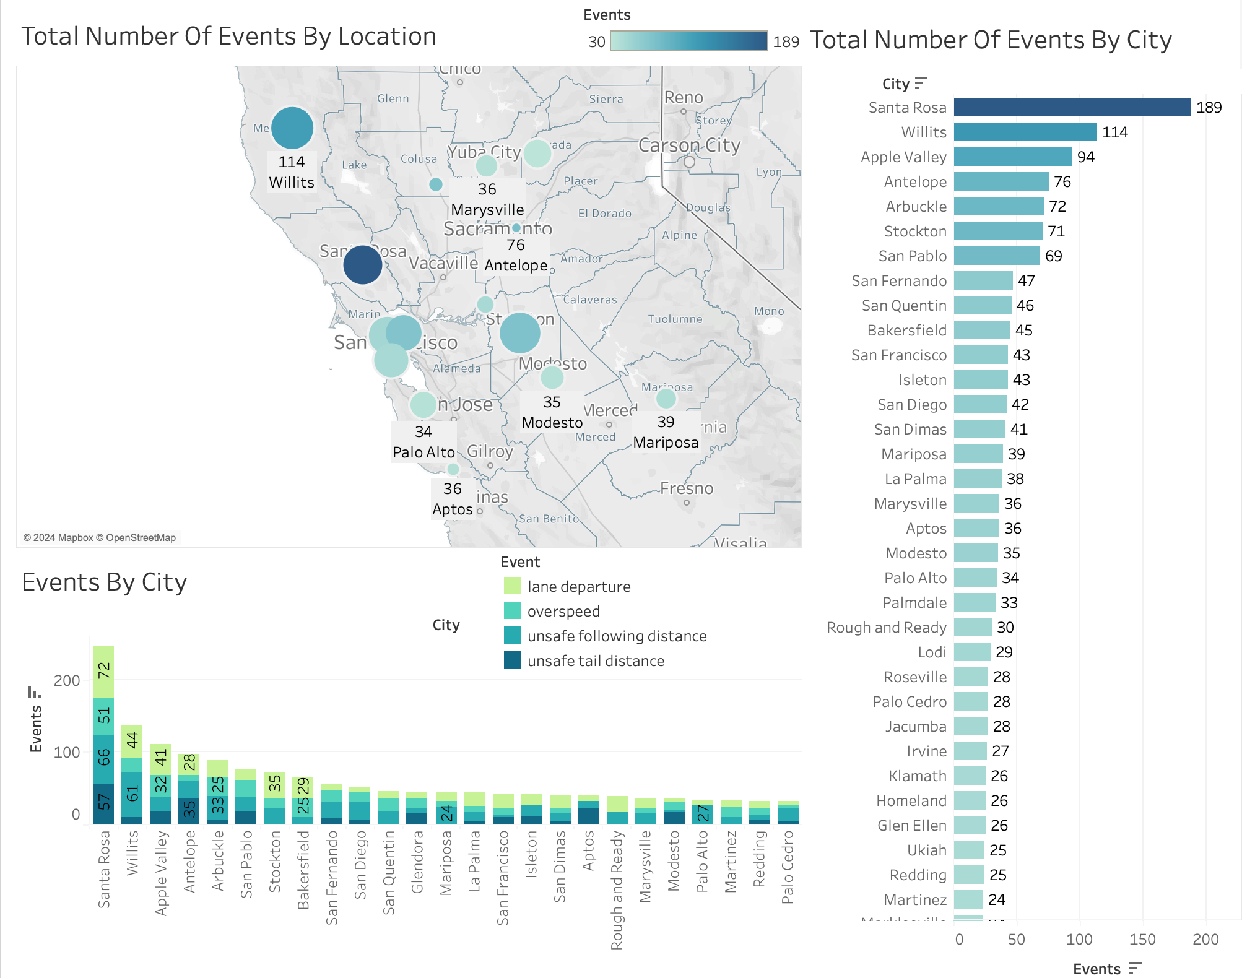
number of events by location
The map shows the total abnormal events in California cities, with darker reddish colors indicating a higher number of incidents.
Santa Rosa tops the list with the highest number of incidents, followed by Willits and Apple Valley.

Slide 8
R integration
The map shows the total abnormal events in California cities, with darker reddish colors indicating a higher number of incidents.
Santa Rosa tops the list with the highest number of incidents, followed by Willits and Apple Valley.

Slide 9
Conclusion
Different types of trucks can impact the likelihood of accidents, indicating that it's not solely dependent on the driver's behavior.
Despite logging fewer miles, certain truck models consistently show higher risks for accidents. This suggests that inherent design or mechanical issues may contribute to increased risk levels.
To address this, it's advisable to consider replacing these specific truck models with safer alternatives. By doing so, we can proactively reduce the probability of accidents occurring on the road.
When unusual things happen on the road, like bad weather or unexpected obstacles, accidents are more likely.
To make roads safer, we can train drivers who work in places where these unusual events happen a lot. This training will help them handle tough situations better and reduce the chances of accidents.

Slide 10
THANK YOU

