Slide 1

SYMBIOSIS DIGITAL ACADEMY
Presented by
Shreya Mahalle
Shubhangi Ragit
Krutika Bharekar
Mansi Arbune
Under the guidence
MRS. Kiran Tiwari

Slide 2
Topic Name: Employee Management System

Slide 3
CONTENTS
INTRODUCTION
ABSTRACT
OBJECTIVE
FRONTEND & BACKEND TECHNOLOGY
NUMBER OF MODULE
SOME SCREENSHOT OF MODULE
FUTURESCOPE
CONCLUSION
REFERENCES

Slide 4
INTRODUCTION
Employee Management System (EMS) provides a simple interface for maintenance of employee information. Employee management system deals with all kind of employee details like name , mail id , mobile number details too.
Time and Attendance Tracking: The system offers tools to track and manage employee attendance, including clock-in/out functionalities, leave requests, and scheduling. .

Slide 5
ABSTRACT
The Employee Management System is a comprehensive software solution designed to streamline and automate various aspects of employee administration within an organization. This project aims to improve efficiency, enhance productivity, and provide effective management of human resources.

Slide 6
OBJECTIVE
Enhance Efficiency and Productivity: The system should improve overall efficiency and productivity by reducing manual paperwork, eliminating redundant tasks, and minimizing errors
Employee Information.
Attendance Tracking: The system should automate the tracking of employee attendance.
It should provide a user-friendly interface for HR administrators and employees.

Slide 7
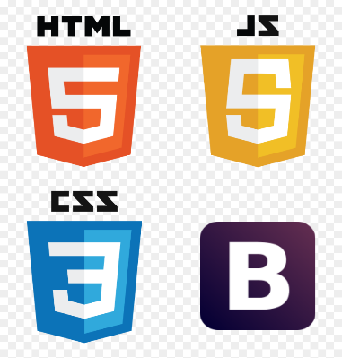

FRONTEND TECHNOLOGY
HTML
CSS
JAVASCRIPT
Angular
TypeScript
BOOTSTRAP

Slide 8


BACKEND TECHNOLOGY
JAVA
SpringBoot
MySQL

Slide 9
NUMBER OF MODULE
Employee List.
Add Employee.

Slide 10
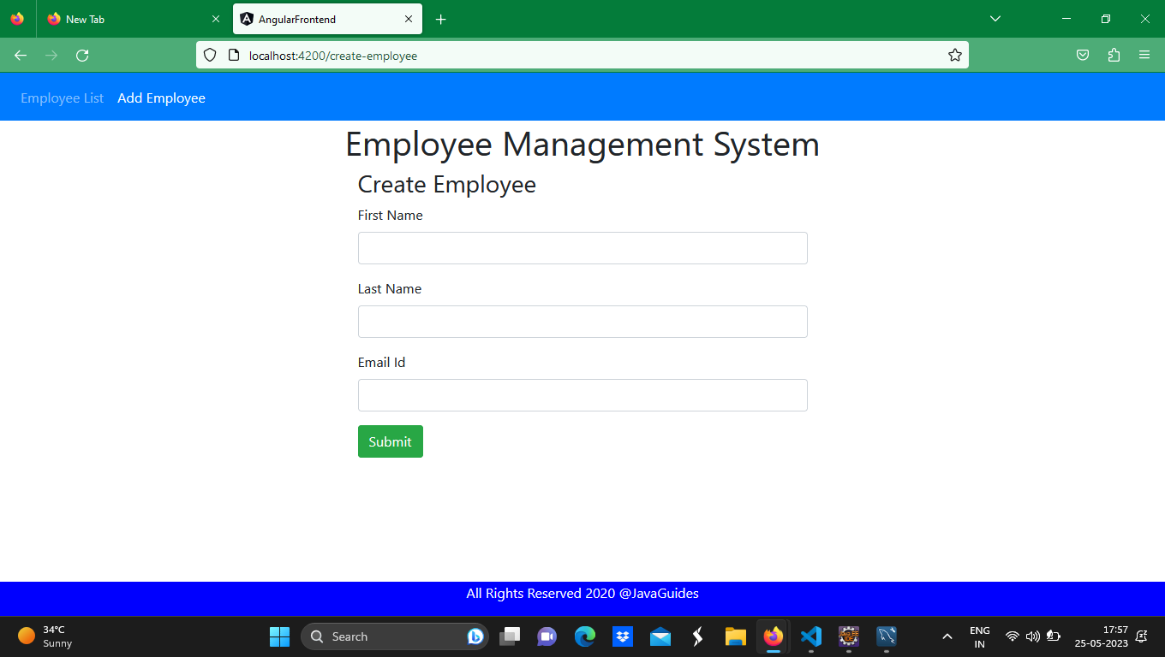
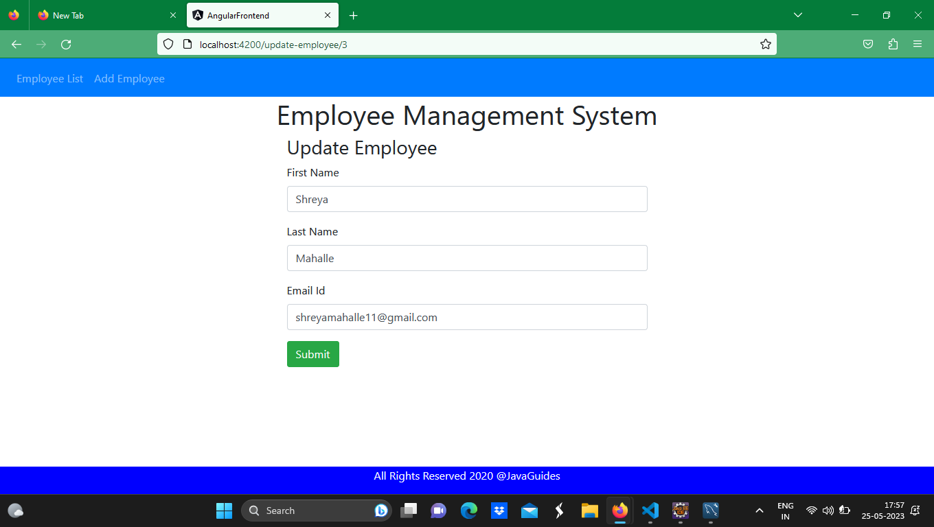
SOME SCREENSHOT OF MODULE

Slide 11
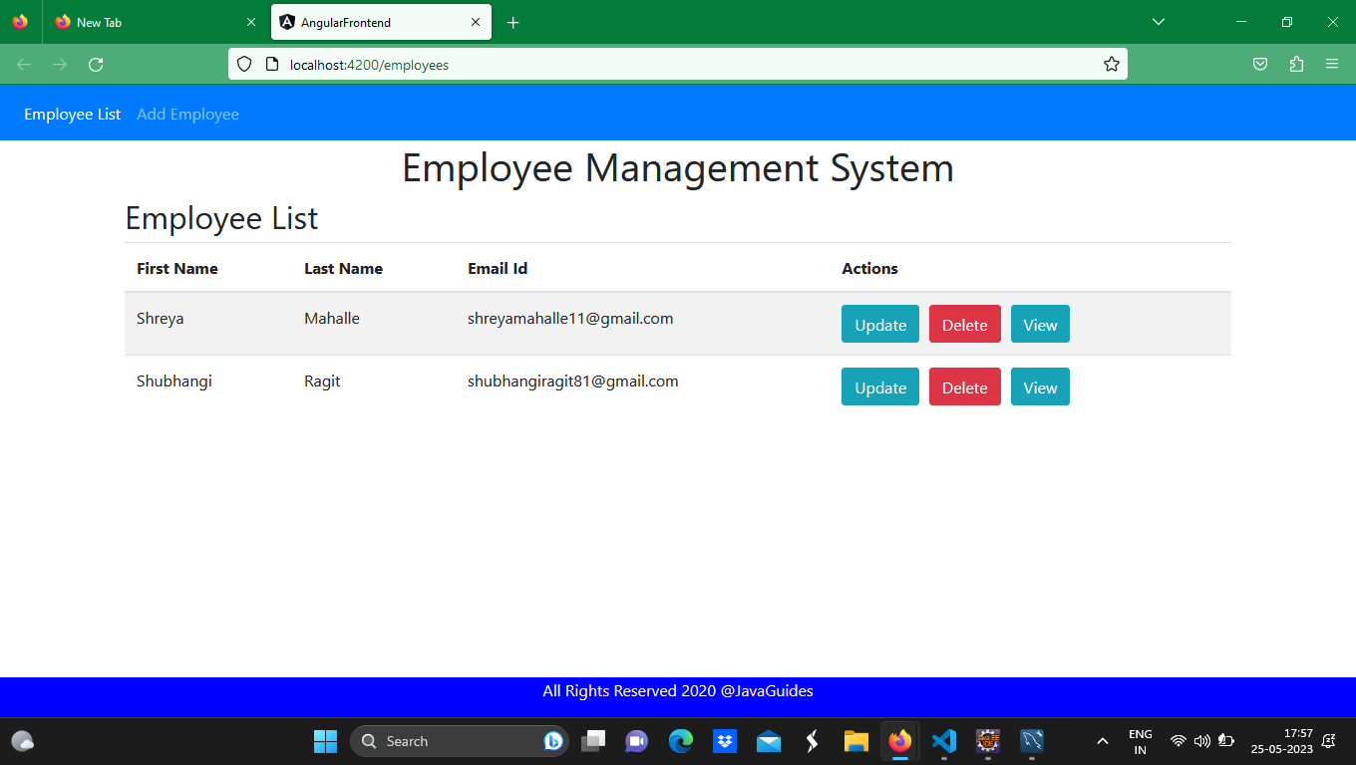
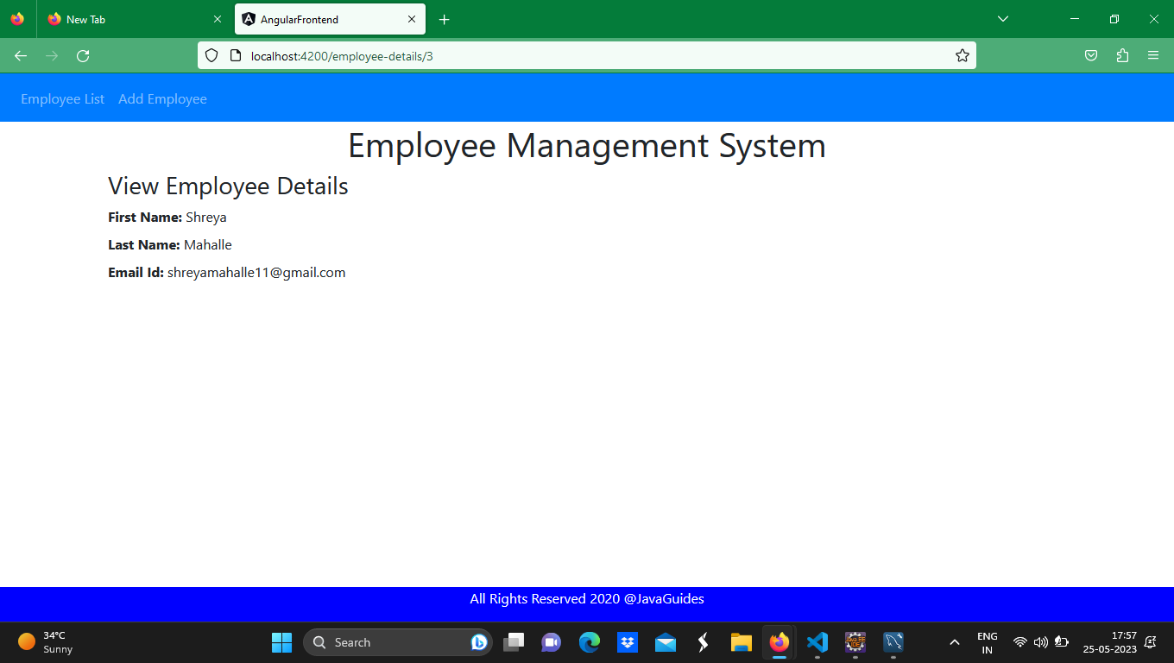
SOME SCREENSHOT OF MODULE

Slide 12
FUTURESCOPE
Mobile Application: Developing a mobile application for the Employee Management System.
Employee Self-Service Portals: update personal details, submit leave requests, access attendance records, and view pay stubs.
Managing employee information, tracking attendance, requesting leaves, and accessing payroll details.

Slide 13
CONCLUSION
Software for employee management systems helps your organization improve workforce productivity and boost overall well-being by tracking and monitoring the daily working activities of every employee.
By implementing the Employee Management System, organizations can experience numerous benefits.
The system reduces paperwork and manual errors, resulting in increased efficiency and productivity

Slide 14
REFERENCES
Adams, J., & Peterson, M. (2017). Human Resource Management: The Employee Life Cycle. Routledge.
Cascio, W. F. (2018). Managing Human Resources: Productivity, Quality of Work Life, Profits. McGraw-Hill Education.
Dessler, G. (2017). Human Resource Management. Pearson Education.
Milkovich, G. T., Newman, J. M., & Gerhart, B. (2020). Compensation. McGraw-Hill Education.
Noe, R. A., Hollenbeck, J. R., Gerhart, B., & Wright, P. M. (2020). Human Resource Management: Gaining a Competitive Advantage. McGraw-Hill Education.
Pynes, J. E. (2017). Human Resources Management for Public and Nonprofit Organizations: A Strategic Approach. John Wiley & Sons.

Slide 15
Thank You

