Slide 1
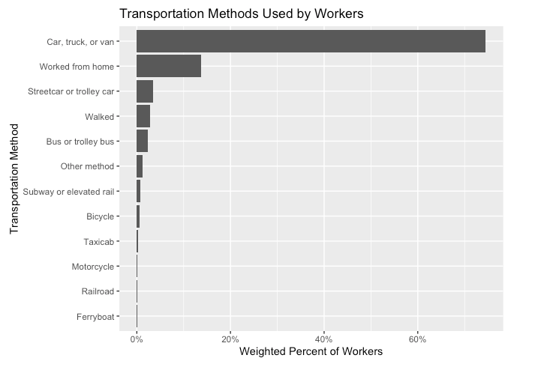
Transportation Methods
Used by Workers
Across U.S. States
DS 2020 Final Project
Shreya Nallapeta
A quick look at how commuting choices vary by state and demographic group.
DS 2020 Final Project
01
Notes:
Introduce the project topic. Say that the presentation explores how workers commute in five selected states using ACS PUMS data, with a focus on transportation method, state, age group, and sex.

Slide 2
Project Motivation
Why commuting method is a useful data question
Why this topic matters
Research goal
Commuting affects daily time, cost, access to work, and city planning.
Transportation choices can show differences across states and groups.
Work-from-home is now an important “commuting” category.
Compare how workers travel to work in Iowa, California, New York, Texas, and Illinois.
Use weighted ACS PUMS data to estimate worker-level patterns.
Look for differences by state, age group, and sex.
Research questions
What methods are most common overall?
How do selected transportation methods differ across states?
Which states stand out for public transit or work-from-home?
Do patterns vary by age group or sex?
DS 2020 Final Project
02
Notes:
Explain why transportation is not just a simple lifestyle choice. It connects to job access, state infrastructure, public transit availability, and remote work. Then state the main research questions.

Slide 3
Data Source & Variables
American Community Survey Public Use Microdata Sample
Dataset
Variables used
ACS 1-Year PUMS, 2023
Person-level worker records from the U.S. Census Bureau
Selected states: Iowa, California, New York, Texas, Illinois
Survey weights used for weighted worker percentages
JWTRNS — Transportation to work
AGEP — Age
SEX — Sex
PWGTP — Person weight
ESR — Employment status
State_abbr — State abbreviation added during loading
Why this dataset works
Large sample size and recent data.
Contains both categorical and numeric variables.
Government source; suitable for reproducible exploratory analysis.
DS 2020 Final Project
03
Notes:
Describe the ACS PUMS dataset, the five states, and the variables. Mention that PWGTP is important because it lets the analysis estimate worker percentages rather than just raw sample counts.

Slide 4
Data Cleaning & Analysis Approach
Turning raw survey codes into readable categories
1. Load
2. Filter
3. Recode
4. Group
5. Summarize
Download/read ACS PUMS records for five states.
Keep valid transportation values and workers age 16+.
Convert codes into readable labels for transportation, age, sex, and state.
Create broader categories: car-based, public transit, active transportation, WFH, other.
Use PWGTP weights to compute percentages and charts.
Output
Tables of weighted worker counts and percentages.
Charts comparing transportation patterns by state and demographic group.
A reproducible R Markdown report that can be knitted into README.md.
DS 2020 Final Project
04
Notes:
Walk through the data preparation process: load, filter, recode, group, and summarize. Explain that readable labels and grouped categories make the final charts easier to interpret.

Slide 5
Finding 1: Car-Based Commuting Dominates
Overall transportation methods used by workers
What the chart shows
Car, truck, or van is the largest category by a wide margin.
Working from home is the next major category in the selected states.
Most other transportation methods make up much smaller shares.
Interpretation
For these states, commuting is still mostly car-based.
Remote work is meaningful enough to appear as a visible second category.
DS 2020 Final Project
05
Notes:
Use this slide to present the broad story. Car-based transportation is the dominant commuting method. Worked from home is not the largest category, but it is significant compared with many other methods.

Slide 6
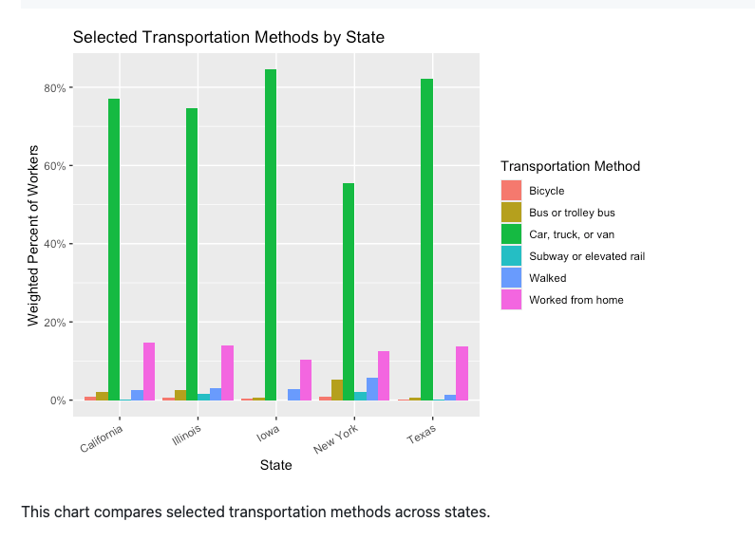
Finding 2: State Differences Are Clear
Selected transportation methods by state
State-level pattern
Iowa and Texas show very high car-based transportation shares.
New York has a noticeably lower car-based share than the other selected states.
Smaller categories become easier to compare when viewed by state.
Why it matters
State differences likely reflect urban density, transit availability, and job location patterns.
This supports looking beyond the overall average.
DS 2020 Final Project
06
Notes:
Explain that the same transportation methods do not have the same share in every state. New York stands out because car-based commuting is lower and public transportation is more visible.

Slide 7
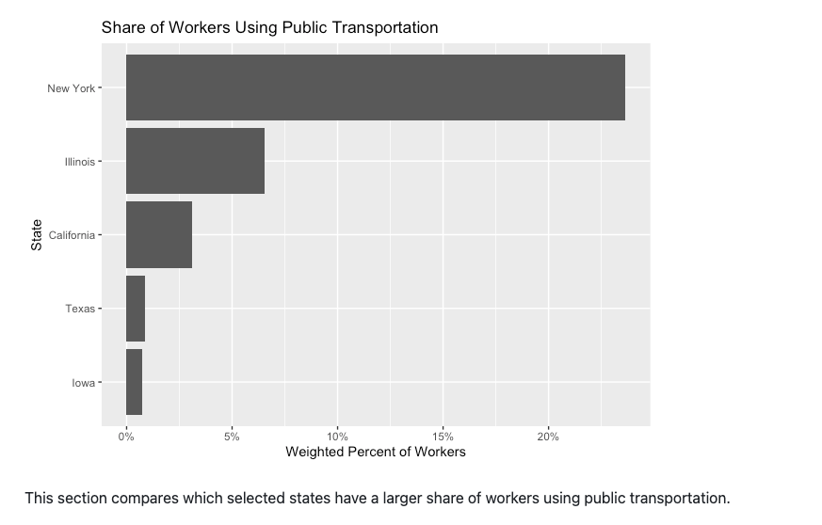
Finding 3: Public Transportation Is Concentrated
Public transit share among selected states
Main takeaway
New York has the highest public transportation share among the selected states.
Illinois and California also show visible public transit use, but much lower than New York.
Texas and Iowa have much smaller public transit shares.
Interpretation
Public transportation depends heavily on infrastructure and urban context.
This chart shows the strongest state-level contrast in the project.
DS 2020 Final Project
07
Notes:
This is one of the strongest findings. New York clearly has the largest public transportation share, while Iowa and Texas are much lower. Connect this to transit infrastructure and urban development.

Slide 8
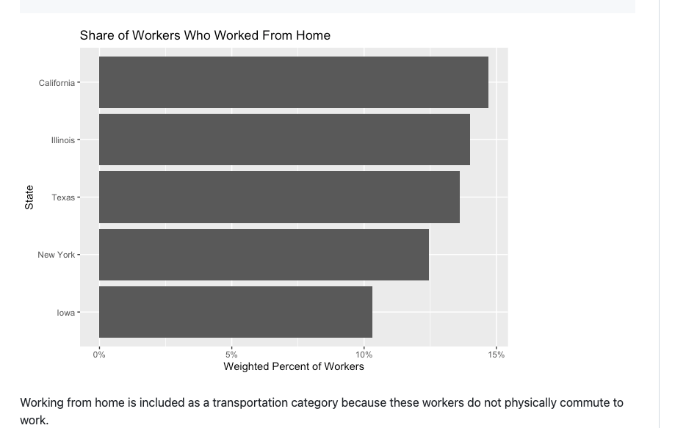
Finding 4: Work-From-Home Varies by State
Remote work as a transportation category
Main takeaway
Working from home appears in every selected state.
California and Illinois show higher shares than Iowa.
This category matters because these workers do not physically commute.
Why include it?
ACS treats work-from-home as a commuting category.
It helps show how work arrangement changes transportation demand.
DS 2020 Final Project
08
Notes:
Mention that working from home is an important transportation category because it reduces physical commuting. Highlight that California and Illinois are higher, while Iowa is lower in this selected-state comparison.

Slide 9
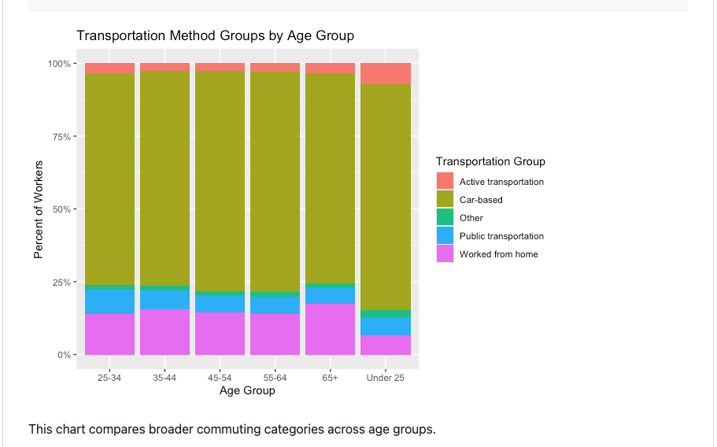
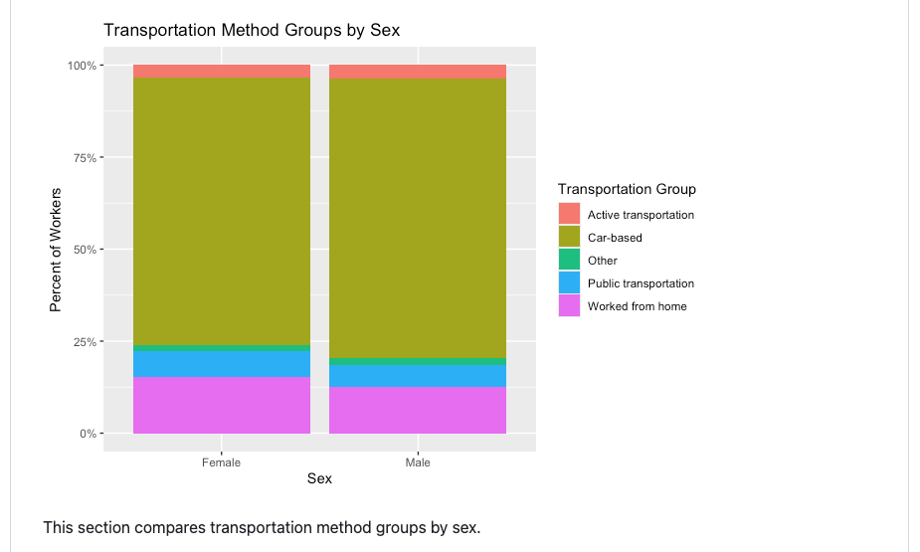
Finding 5: Demographic Patterns
Age-group and sex comparisons
Key interpretation
Car-based transportation dominates across age groups and both sex groups. Age and sex differences exist, but they are less dramatic than state-level public transit differences.
DS 2020 Final Project
09
Notes:
For demographic patterns, emphasize that car-based transportation dominates in all groups. The demographic differences are present but not as strong as the state differences, especially public transportation by state.

Slide 10
Limitations & Skepticism
How to interpret the results carefully
Limitations
What I would do next
Only five states are included, so results do not represent the entire U.S.
ACS data is survey-based; weighted values should be interpreted as estimates.
The transportation variable shows what people use, but not why they chose it.
The analysis is exploratory and does not prove causation.
Add more states or compare all 50 states.
Add income, occupation, metro area, or commute time variables.
Separate carpooling and driving alone if available in a future dataset/codebook expansion.
DS 2020 Final Project
10
Notes:
Use this slide to show skepticism. Explain that the project gives useful descriptive patterns, but not causal explanations. Mention that adding more states and more socioeconomic variables could strengthen the project.

Slide 11
Conclusion
Transportation behavior is not the same everywhere.
Car-based transportation is the dominant method among workers in the selected states.
New York stands out for public transportation use.
Working from home is a meaningful category across all selected states.
Age and sex patterns are present, but state differences are more visually clear.
ACS PUMS is useful for reproducible exploratory analysis of commuting behavior.
Thank you
Questions?
Notes:
End with the main conclusion: car-based commuting dominates, but there are important differences across states. New York is strongest for public transit, and work-from-home is a visible category across states.

