Slide 1
Data Generation in Network Anomaly Detection for Anomalous Class using GANs & Autoencoders
Group 7:
Anshul Jain (M42CSA002)
Avi Bhandari (M24CSA006)
Bilas Chandra Tarafdar (M24CSA008)
Om Patel (M24CSA019)
Rahul Maurya (M24CSA025)

Slide 2
Motivation
Anomalies are not as rare as commonly perceived and frequently occur in real-world scenarios like fraud detection, medical diagnostics, and network security.
Insufficient anomalous data leads to biased models that fail to generalize effectively.
Generating anomalous class data enables balanced training, improving model robustness and accuracy.
Addressing this challenge is crucial for building reliable and trustworthy machine learning systems.

Slide 3
Our Claim
We utilize CTGAN and TimeGAN to generate realistic anomalous class data, bridging the gap caused by data imbalance.
These generative models ensure the synthetic anomalies are representative of real-world irregularities, enriching the training dataset.
For detecting anomalies, we implement Autoencoders, which excel at identifying deviations from learned patterns.
This combined approach strengthens model robustness, improves detection accuracy, and enhances reliability in handling anomalous scenarios.

Slide 4
Methods
Dataset:
We utilized a publicly available network dataset sourced from Kaggle, chosen for its relevance to anomaly detection scenarios. The dataset includes timestamps, network activities, and other relevant features.

Slide 5
Methods
Preprocessing:
Removed missing or invalid entries (NaN values) to ensure data quality and consistency.
Converted timestamp columns from string format to datetime objects to facilitate time-series analysis and modeling.
Performed standard normalization and scaling to prepare the data for GAN-based modeling.

Slide 6
Methods
Data Generation:
CTGAN: The preprocessed data was input into a Conditional Tabular GAN (CTGAN) to generate synthetic tabular data for the anomalous class, capturing statistical and feature-level nuances.
TimeGAN: For time-series anomalies, the same preprocessed data was used to train a TimeGAN model, generating realistic synthetic sequences for the anomalous class.

Slide 7
Methods
Anomaly Detection:
An Autoencoder was trained on the original dataset to serve as an anomaly detector. It learned to reconstruct normal patterns in the data, and reconstruction errors were used to identify anomalies.
The synthetic anomalous data generated by CTGAN and TimeGAN was used to validate the effectiveness of the autoencoder in detecting anomalies, ensuring the generated data accurately represented anomalous behavior.

Slide 8
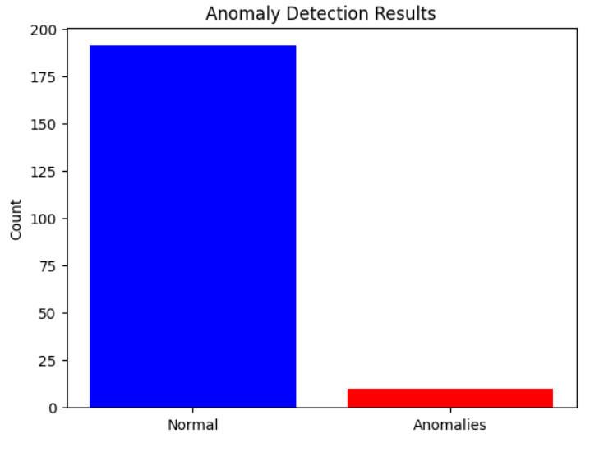
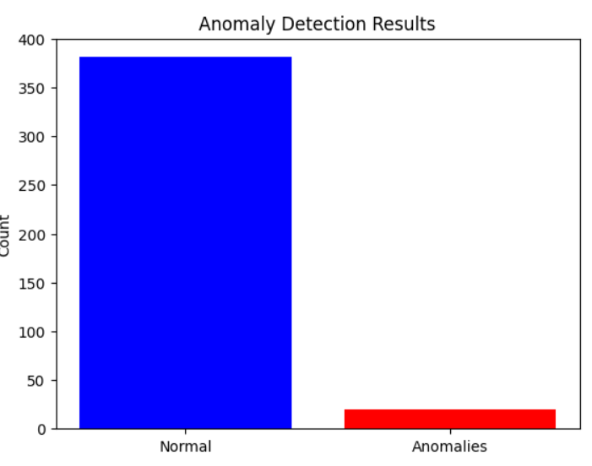
Results
Fig 1: Before Upscaling
Fig 2: After Upscaling

Slide 9
Results
The effectiveness of our approach to generating anomalous class data is demonstrated in the following visualizations:
Before Upscaling:
The first plot shows the class distribution before generating additional anomalous data.
The dataset is highly imbalanced, with anomalies being significantly underrepresented compared to normal data. This imbalance negatively impacts model performance, making it difficult to detect anomalies effectively.

Slide 10
Results
After Upscaling:
The second plot illustrates the class distribution after applying CTGAN and TimeGAN for anomalous data generation.
The increased representation of anomalies creates a more balanced dataset, enabling the autoencoder model to better learn and detect anomalous patterns.
These results highlight how generating synthetic data for the anomalous class improves class balance, enhancing the robustness and accuracy of anomaly detection systems.

