Slide 1
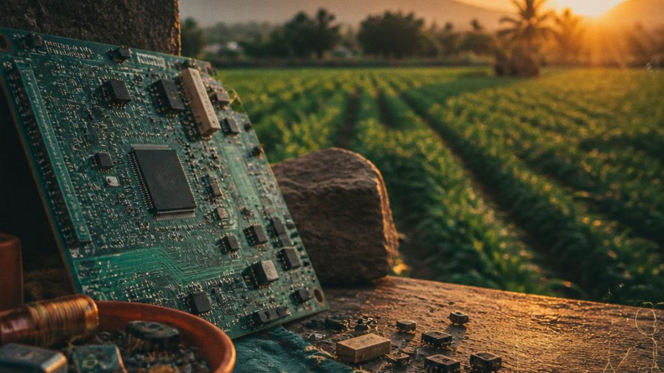

COLLEGE INNOVATION PROJECT / 2026
INDIA · CIRCULAR TECHNOLOGY
Novel E-Waste
Management
Ideas for India
From Electronic Waste to Regional Innovation
Name : Shreyank Parab
01 E-WASTE-TO-AGRITECH — MAHARASHTRA
02 E-WASTE-TO-COASTAL SAFETY — KERALA
Roll no: 24102B0044
TE CMPN B

Slide 2
02 / REGIONAL INNOVATION
NOVEL E-WASTE IDEAS
E-Waste-to-AgriTech
Converting Urban E-Waste into Low-Cost Smart
Farming Technology
Region: Maharashtra, India
DISCARDED DEVICES
→
RECOVERED PARTS
→
FARMER BENEFIT
“Giving discarded electronics a second life in agriculture.”

Slide 3


03 / REGIONAL INNOVATION
NOVEL E-WASTE IDEAS
The gap is both electronic and agricultural.
E-Waste Problem
Agriculture Problem
Discarded phones, computers, routers, chargers
and devices may still contain useful components.
Not every part needs to immediately become
material waste.
Small and marginal farmers may have limited
access to affordable smart farming technology.
Monitoring moisture, temperature and water levels
can be expensive.
KEY QUESTION
Can safe components recovered from e-waste become affordable technology for local
problems?

Slide 4
04 / REGIONAL INNOVATION
NOVEL E-WASTE IDEAS
Second-life technology pathway
OUR OBSERVATION
POTENTIALLY REUSABLE
“A discarded electronic
Displays · LEDs · Motors · Connectors
Wires · Communication modules
Power components · Selected sensors
Enclosures · Selected modules
device may be useless as
a complete product, but
some components may
still have a useful second
life.”
COLLECT
→
SORT
→
RECOVER
→
TEST
→
REUSE
→
MONITOR
→
RECYCLE

Slide 5

05 / REGIONAL INNOVATION
NOVEL E-WASTE IDEAS
Urban waste.
Rural need.
Maharashtra connects electronic-waste
generating centres with diverse
agricultural regions.
Mumbai
Nashik
Pune
MAHARASHTRA
Nagpur
Cotton · sugarcane · soybean · grapes · vegetables · fruits

Slide 6

06 / REGIONAL INNOVATION
NOVEL E-WASTE IDEAS
A small kit that makes the invisible measurable.
Soil moisture · temperature · humidity · water
level · light intensity · irrigation status
FARM NODE
62%
Soil moisture is low — irrigation
recommended.
Recovered parts can sit alongside new critical sensors and
controllers.
SENSORS → CONTROLLER → DISPLAY

Slide 7


07 / REGIONAL INNOVATION
NOVEL E-WASTE IDEAS
The second-life pathway
01
02
03
04
E-Waste Collection
Sorting
Component ID
Safety Testing
Gather devices through local
centres.
Separate by type and condition.
Identify recoverable modules.
Check function and isolation.
05
06
07
08
Refurbishment
Prototype Build
Farm Testing
Deployment
Repair, clean and adapt.
Assemble the field-ready system.
Observe performance in place.
Place with community partners.

Slide 8



08 / REGIONAL INNOVATION
NOVEL E-WASTE IDEAS
Designed for the people closest to the
problem.
PRIMARY AUDIENCE
ENVIRONMENTAL
AGRICULTURAL
ECONOMIC
Small and marginal farmers
Extends
component life
Reduces
avoidable
e-waste
Circular economy
Affordable
monitoring
Better local
decisions
Community
participation
Collection, repair,
testing and
assembly
opportunities
Partners: agricultural colleges · NGOs · rural
innovation centres · e-waste centres · engineering
colleges · environmental organizations · startups

Slide 9
09 / REGIONAL INNOVATION
NOVEL E-WASTE IDEAS
Local signals for
coastal communities.
Converting discarded electronics into low-cost
environmental monitoring systems.
Region: Kerala, India
Urban e-waste → recovery → monitoring node → coastal communities

Slide 10
10 / REGIONAL INNOVATION
NOVEL E-WASTE IDEAS
A coastline that needs more local visibility.
E-Waste Problem
Coastal Problem
Discarded phones, computers, routers, chargers
and devices may still contain useful components.
Not every part needs to immediately become
material waste.
Heavy rainfall, waterlogging, flooding and changing
local water levels can affect low-lying
communities.
KEY QUESTION
Can safe components recovered from e-waste become affordable technology for local
problems?

Slide 11
11 / REGIONAL INNOVATION
NOVEL E-WASTE IDEAS
Circular economy meets IoT
OUR OBSERVATION
POTENTIALLY REUSABLE
“Electronic waste can
Displays · LEDs · Motors · Connectors
Wires · Communication modules
Power components · Selected sensors
Enclosures · Selected modules
become a resource for
building low-cost
environmental
technology.”
COLLECT
→
SORT
→
RECOVER
→
TEST
→
REUSE
→
MONITOR
→
RECYCLE

Slide 12

12 / REGIONAL INNOVATION
NOVEL E-WASTE IDEAS
A weatherproof node for shared awareness.
Water level · rainfall · temperature · basic
environmental conditions · communication · local
display
COASTAL NODE
RISING
WATER LEVEL: RISING
Recovered parts can sit alongside new critical sensors and
controllers.
SENSORS → CONTROLLER → DISPLAY

Slide 13
13 / REGIONAL INNOVATION
NOVEL E-WASTE IDEAS
From discarded parts to a field signal
01
02
03
04
E-Waste Collection
Sorting
Component ID
Safety Testing
Gather devices through local
centres.
Separate by type and condition.
Identify recoverable modules.
Check function and isolation.
05
06
07
08
Refurbishment
Node Assembly
Field Calibration
Data Monitoring
Repair, clean and adapt.
Assemble the field-ready system.
Observe performance in place.
Place with community partners.

Slide 14



14 / REGIONAL INNOVATION
NOVEL E-WASTE IDEAS
Information becomes useful when a
community can act on it.
PRIMARY AUDIENCE
ENVIRONMENTAL
SOCIAL
ECONOMIC
Coastal communities · local
organizations · local authorities
Extends
component life
Reduces
avoidable
e-waste
Circular economy
Affordable
monitoring
Better local
decisions
Community
participation
Collection, repair,
testing and
assembly
opportunities
Partners: agricultural colleges · NGOs · rural
innovation centres · e-waste centres · engineering
colleges · environmental organizations · startups

Slide 15

15 / REGIONAL INNOVATION
NOVEL E-WASTE IDEAS
Two ideas. One circular principle.
Feature
Maharashtra
Kerala
Region
Maharashtra
Kerala
Main problem
Affordable agricultural technology
Local environmental monitoring
E-waste reuse
Smart farm components
Monitoring-node components
Main users
Small farmers
Coastal communities / local bodies
COLLECT
→
SORT
→
RECOVER
→
TEST
→
REUSE
→
MONITOR
→
RECYCLE

Slide 16
16 / REGIONAL INNOVATION
NOVEL E-WASTE IDEAS
E-waste should not always be viewed only as
waste.
Suitable components can become resources for solving
local problems.
SAFETY BOUNDARY
LONG-TERM VISION
Damaged batteries, hazardous components, burnt PCBs
and unsafe power supplies must go to authorized
e-waste recyclers.
AI-based systems · solar-powered IoT · LoRa
communication · mobile apps · cloud dashboards ·
predictive analytics
From Electronic Waste to Regional Innovation.

