Slide 1

College Feedback Intelligence System
NLP-Based Student Feedback Analysis
Shreyansh Sinha
23FE10CDS00513
B.Tech CSE – Data Science | Batch F

Slide 2




Problem Statement
Colleges receive a large amount of student feedback through surveys and forms.
Manually reading and analyzing large volumes of feedback is time-consuming.
Important concerns and positive trends can be difficult to identify quickly.
Automated NLP-based analysis can summarize feedback and highlight areas that need attention.

Slide 3





Project Objectives
Process student feedback using Natural Language Processing.
Classify feedback as Positive, Negative, or Neutral.
Identify major college-related aspects discussed in feedback.
Create visual dashboards for easier interpretation.
Generate useful feedback insights.
Provide an analyzed, downloadable feedback report.

Slide 4
Proposed Solution
CSV Upload
→
Text Preprocessing
→
TF-IDF
→
Logistic Regression
Sentiment Prediction
→
Aspect Detection
→
Visualizations
Key Insights
→
Downloadable Feedback Report
The system provides an end-to-end workflow from raw feedback to actionable analysis.

Slide 5







Technologies Used
Python
core development language
Pandas & NumPy
data handling and numerical operations
NLTK
tokenization and stopword removal
Scikit-learn
TF-IDF and Logistic Regression
Plotly
interactive visualizations
Streamlit
web application interface
Joblib
model and vectorizer persistence
GitHub + Streamlit Community Cloud
version control and deployment

Slide 6
System Workflow
1
2
3
4
Upload student feedback CSV
Detect the feedback column
Preprocess, tokenize, and remove stopwords
Convert text into TF-IDF features
5
6
7
8
Predict Positive / Negative / Neutral sentiment
Detect the college aspect using keywords
Generate charts and insights
Display and download the analyzed report

Slide 7
NLP Preprocessing
1
Convert feedback text to lowercase.
2
Remove unnecessary characters using regular expressions.
3
Tokenize the text into individual words.
4
Remove common English stopwords.
5
Join the remaining tokens to create cleaned feedback.
6
Use the cleaned text as input to the TF-IDF vectorizer.

Slide 8




Sentiment Classification
TF-IDF converts text into numerical features based on word importance.
Positive
Logistic Regression uses these features to classify feedback.
Negative
Three sentiment classes are used: Positive, Negative, and Neutral.
Neutral
The trained model and TF-IDF vectorizer are saved and loaded by the deployed application.

Slide 9


Aspect Detection
The system identifies the college area discussed in each feedback response.
Current aspect detection uses predefined keywords and rules.
Examples:
Faculty
Teaching
Laboratory
WiFi
Library
Hostel
Canteen
Placement
Infrastructure
Course
Examination
Aspect detection is rule-based, while sentiment classification is ML-based.

Slide 10




Application Dashboard
Upload a student feedback CSV.
Automatically detect the feedback column.
View summary metrics and interactive charts.
Inspect analyzed feedback and generated insights.
Download the analyzed feedback report.
Live application: college-feedback-intelligence.streamlit.app

Slide 11


Visual Analytics
Overall sentiment distribution shows the balance of Positive, Negative, and Neutral responses.
College aspect analysis shows which areas are discussed most frequently.
Sentiment-by-aspect charts compare feedback across different college areas.
Aspect vs Sentiment heatmap helps identify areas with higher positive or negative feedback.
Positive and negative feedback are summarized separately.

Slide 12
Model Performance
96.67%
0.97
0.97
Accuracy
Macro F1
Weighted F1
Class | Precision | Recall | F1
Negative | 1.00 | 0.89 | 0.94
Neutral | 1.00 | 1.00 | 1.00
Positive | 0.94 | 1.00 | 0.97
Test set size: 120 feedback responses

Slide 13
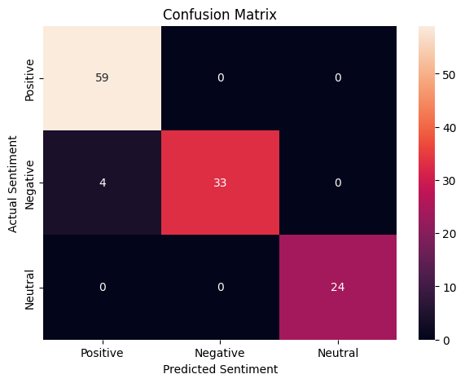

Confusion Matrix
The confusion matrix compares actual sentiment labels with predicted sentiment labels.
1
It helps identify which classes are classified correctly and where misclassification occurs.
2
Use the saved confusion_matrix.png screenshot in this slide.
The model shows strong overall classification performance on the test set.
3

Slide 14




Key Results & Insights
Most discussed aspect is identified automatically from uploaded feedback.
Most positively received and most negatively discussed aspects are highlighted.
Overall Positive, Negative, and Neutral counts are displayed.
Feedback is presented in an analyzed table with sentiment and aspect labels.
The analyzed dataset can be downloaded as a CSV report.

Slide 15

Deployment & Future Scope
Transformer-based sentiment models for improved classification.
1
Semantic similarity for improved aspect detection.
2
Deployment: Streamlit Community Cloud
Multilingual and Hinglish feedback support.
3
Live application:
college-feedback-intelligence.streamlit.app
Department/semester analysis and historical trend analysis.
4
Administrative dashboard for institutional decision-making.
5

Slide 16
Conclusion
The project automates student feedback analysis using NLP and machine learning.
1
It combines sentiment classification, college aspect analysis, visualization, and reporting.
2
Thank You
The deployed Streamlit application provides an easy interface for uploading and analyzing feedback.
3
The system can help colleges identify feedback patterns and areas that may require attention.
4

