Slide 1

CROP PREDICTOR Using Python and ML
Made By:-
Shreyansh Rai
00811124420
MCA- V Sem
Under the Guidance of:-
Mrs. Pooja Arora

Slide 2
Abstract
Farming is one of the major sectors that influences a country’s economic growth.
In country like India, majority of the population is dependent on agriculture for their livelihood. Many new technologies, such as Machine Learning and Deep Learning, are being implemented into agriculture so that it is easier for farmers to grow and maximize their yield.
In this project, I present a website in which the following applications are implemented:-
Crop recommendation
Fertilizer recommendation
Plant disease prediction

Slide 3
Contents
Introduction
Aim of the Project
Working of the Project
Flow Chart
Advantages
Future Scope
Conclusion
References

Slide 4
Introduction
Farm Expert is basically web based application developed using Python with Machine Learning Algorithms to predict the types of crops to be yield and types of fertilizers to be used.
Webpage is developed using HTML and CSS.

Slide 5
Aim of the Project
The aim of the project is mentioned below:-
In the crop recommendation application, the user can provide the soil data from their side and the application will predict which crop should the user grow.
For the fertilizer recommendation application, the user can input the soil data and the type of crop they are growing, and the application will predict what the soil lacks or has excess of and will recommend improvements.
For the last application, which is the plant disease prediction application, the user can input an image of a diseased plant leaf, and the application will predict what disease it is and will also give a little background about the disease and suggestions to cure it.

Slide 6
Working of the Project
Data Collection:-Data collection is the first step most, we have collected the data from different resources like government websites, kaggle, etc. To get an approximate dataset for the system. The dataset contains the following attributes:- i) Soil pH, ii)Rainfall, iii) Phosphorus, iv) Nitrogen.
Machine Learning Algorithm for Prediction:- Machine learning algorithms has highly optimized estimation has to be likely outcome based on trained data. Predictive analytics is the use of data, statistical algorithms and machine learning techniques. In this project we have used supervised machine learning that is Classification algorithm.
Crop & Fertilizer Prediction:- Crop & Fertilizer prediction process begin with loading the external crop datasets. After data preprocessing, train the models using decision tree classifier into training set.

Slide 7
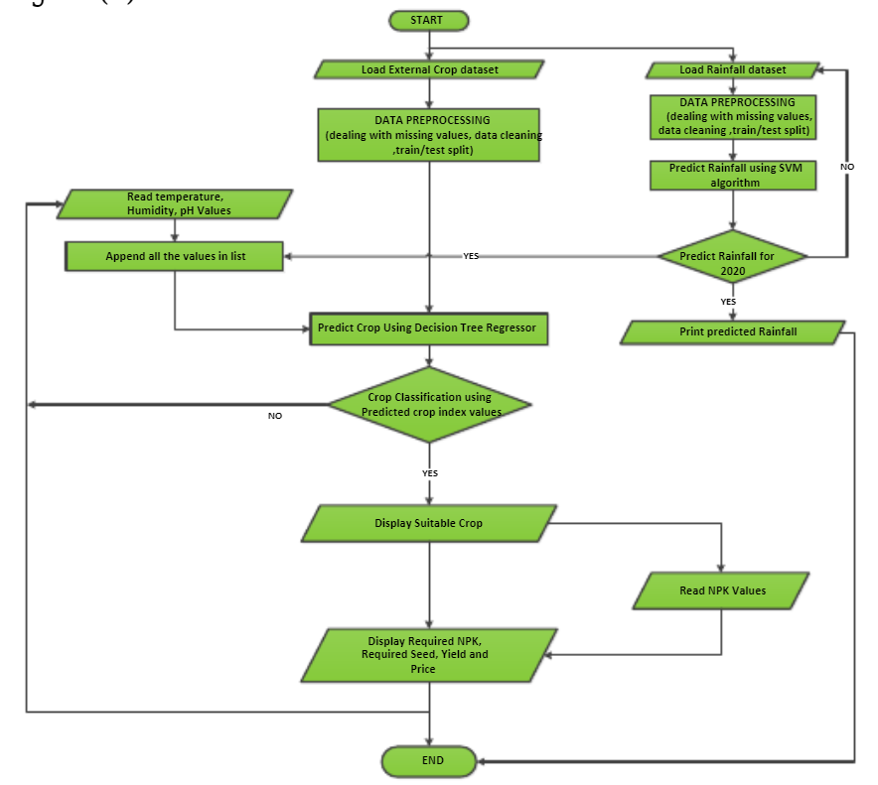

Slide 8
Advantages
Predicting productivity of crop in various climatic conditions can help farmer and other partners in essential basic leadership as far as agronomy and product decision.
This model can be used to select the most excellent crops for the region and also its yield thereby improving the values and gain of farming also.
The farmers get to know about the fertilizers for their farm to make them more fertile.
The system identifies the crop disease and gives solution to cure.

Slide 9
Future Scope
Building this website in multiple regional language so that it would be more comfortable for farmers to use.
Voice Assisting feature can be added so that farmers can access it using voice commands in their regional language.
A generalized prediction model can be developed for various crops by considering other parameters like humidity, sunlight, ets.

Slide 10
Conclusion
Crop yield prediction has been a challenging issue for farmers since many years.
Hence this project with more accurate data can be used globally so that farmers can yield most suitable crop.
After seeing the results, we can conclude that the perfect depiction at the various horticultural outputs will definitely be favorable to the people practicing this to improve this output beneficially.

Slide 11
References
https://www.kaggle.com/datasets
https://www.kaggle.com/plant-disease-classification-resnet-99-2
https://www.kaggle.com/plant-disease-classification-resnet-99-2
https://machinelearningmastery.com/random-forest-ensemble-in-python/

Slide 12
THANK YOU!

