Slide 1
Task-2
Name: Shreyansh Shital Patil

Slide 2
VULNERABILITY REPORT
Test Site: zero.webappsecurity.com
Vulnerability: Out-of-date version of Apache
Severity: Critical
Details: An outdated version of Apache is being used
Effects: Older versions of websites are more prone and easier for the hackers to attack and exploit
Solution: Upgrading Apache to the latest and stable version

Slide 3
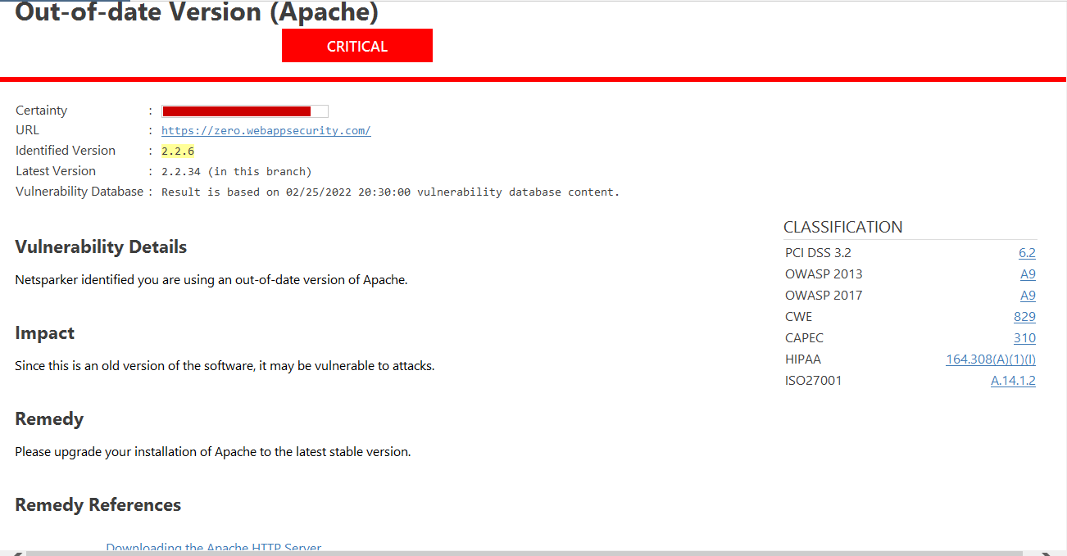
NETSPARKER REPORT

Slide 4
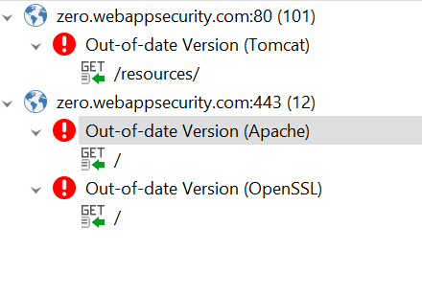
Critical Vulnerabilities

Slide 5
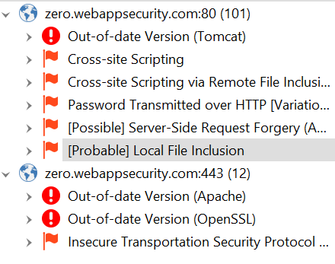
High Severity and above Vulnerabilities

Slide 6
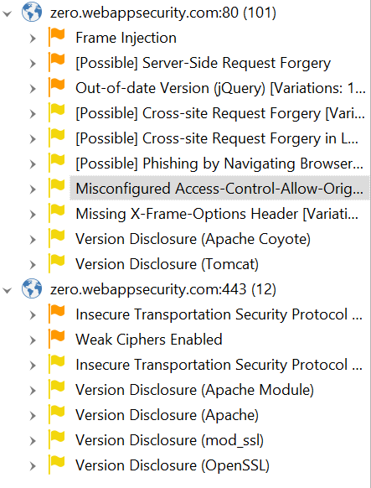
Medium And Low Vulnerabilites

