Slide 1
Outline of C++ code for FHR determination from audio recording

Slide 2
Processing steps
Frame of 1.5s, hop length of 0.2s
Envelope detection
A(n) = |IFT(FT(s(n))×2U(f))|
same as A(n) = √(s²(n)+s^² (n))
A(n) passed through 120th order FIR LPF
Downsampling from 44.1kHz to 4.41kHz
s(n)
Interval calculation
Find location and value of highest ACF peak in the range of lags corr to 60bpm to 300bpm
FHR (in bpm) = 60000/interval (in ms)
R(j)
ACF calculation
R(j) = ∑_{n}x(n)x(n+j)
R(j) <- R(j)/R(0)
x(n)
Notes:
Downsampling is enough as repetition freq of 3kHz means that data is limited to 1.5kHz
No zero padding when taking FT

Slide 3
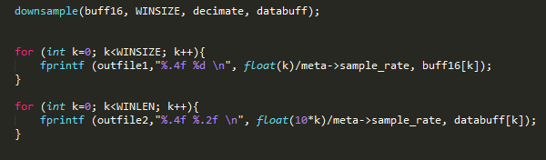
Downsampling
The downsample function decimates the input signal from the original sampling rate (Fs) to Fs/decimate
Here decimate = 10, Fs = 44.1kHz, so output sample rate is 4.41kHz

Slide 4
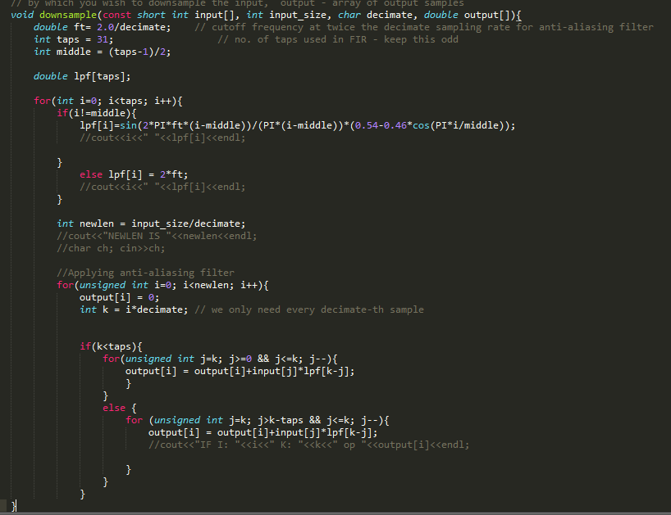
Downsampling
Filter coefficients – these have to be computed based on the formula used
Downsampling – errors likely to occur here

Slide 5
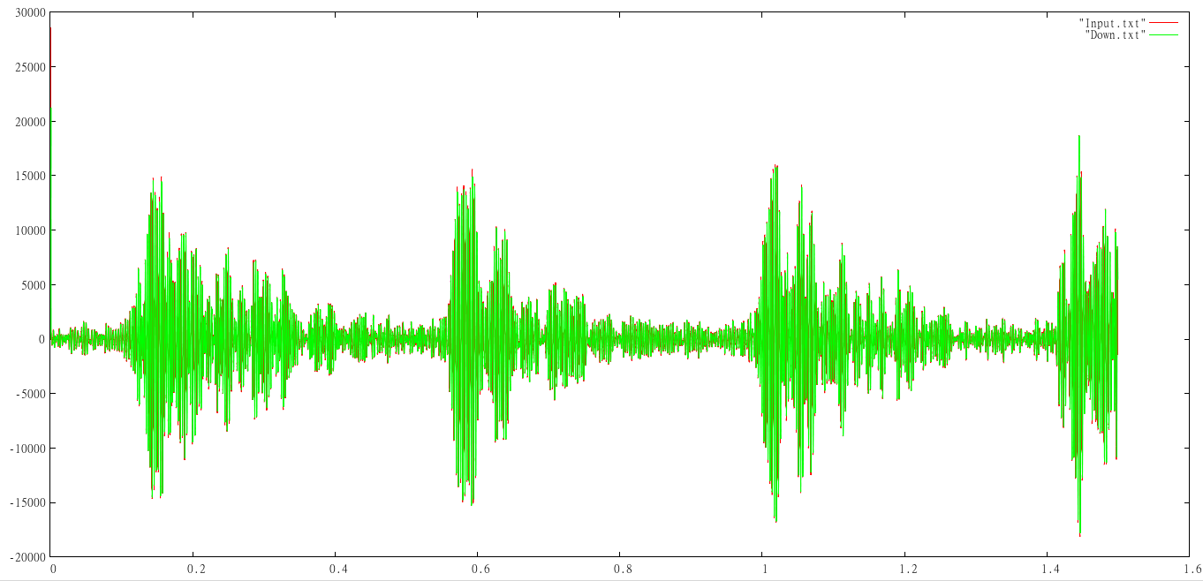
Downsampling - Example

Slide 6
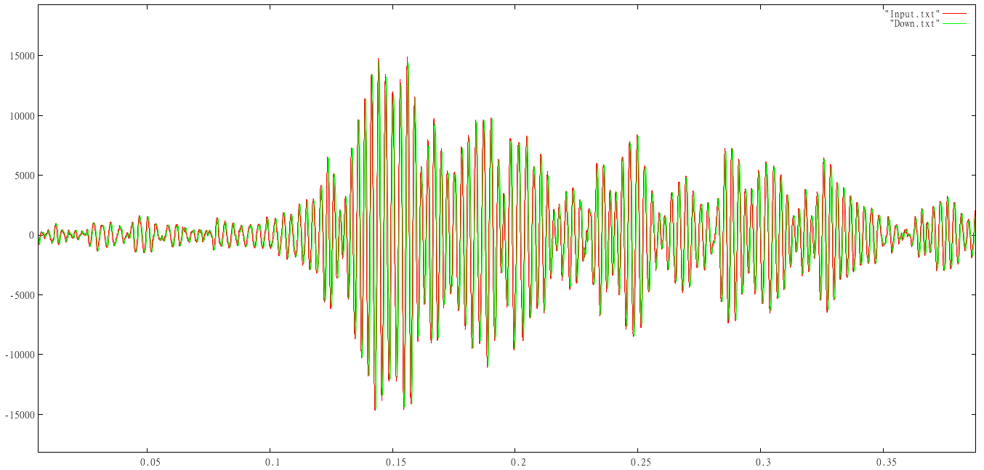
Downsampling – Example zoomed

Slide 7
Downsampling - Debugging
Outfile1 and outfile2 are files into which the data read and the downsampled output are printed
Plots of the data in these files should give results similar to those shown before if downsampling has been implemented correctly

Slide 8
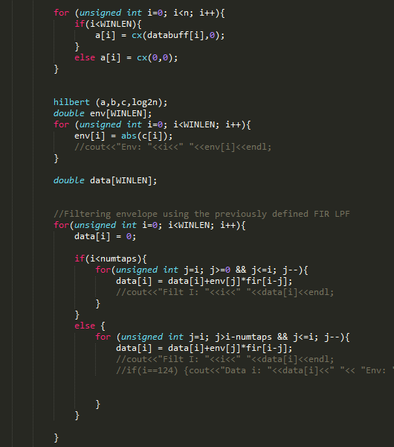
Envelope detection
Hilbert transform of downsampled signal found
Uses FFT which has been implemented in the code – library may be used instead
Envelope found by filtering

Slide 9
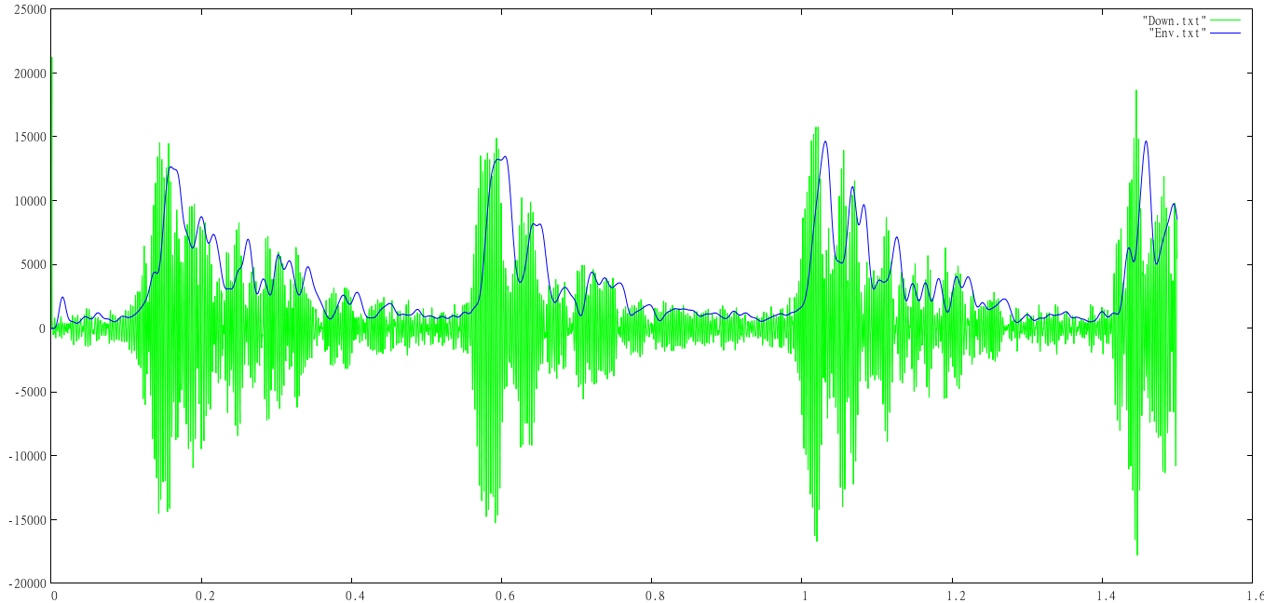
Envelope detection
Envelope is slightly shifted in time to the signal due to delay introduced by filtering. This delay is not an issue as the output is shifted by just 27ms (=121/4410 s).

Slide 10
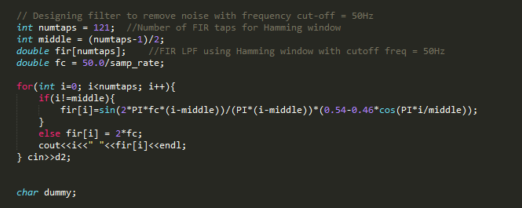
Envelope detection-debugging
Filtering
y(n) = ∑_{m}x(m)f(n-m)
The filter coefficients are currently printed on the console. These should not vary if the same formula is used. A constant scaling is acceptable.
The envelope data is printed in outfile3. The envelope should “trace” the major peaks and troughs in the signal.

Slide 11
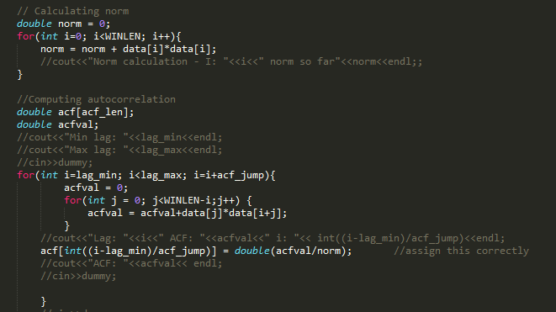
ACF calculation
R(j) = ∑_{n}x(n)x(n+j)
R(j) <- R(j)/R(0)
Norm = sum of square of all samples
ACF = sum of product of signal with a shifted version of itself
Normalization

Slide 12
ACF calculation
Lag_min and lag_max correspond to the minimum and maximum lag for which ACF has to be computed (defined at start of code).
Acf_jump is set to 10, i.e., ACF is calculated for lag_min, lag_min+10, lag_min + 20 and so on to save computation time

Slide 13
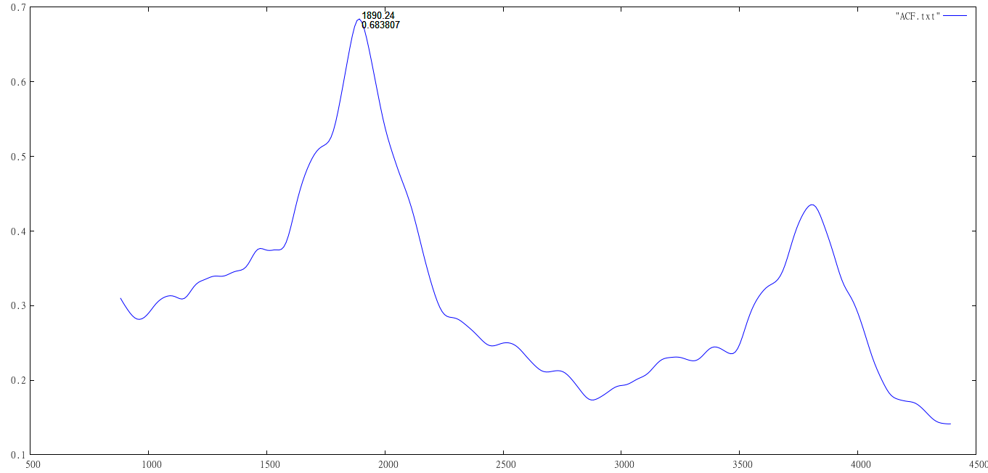
ACF calculation

Slide 14
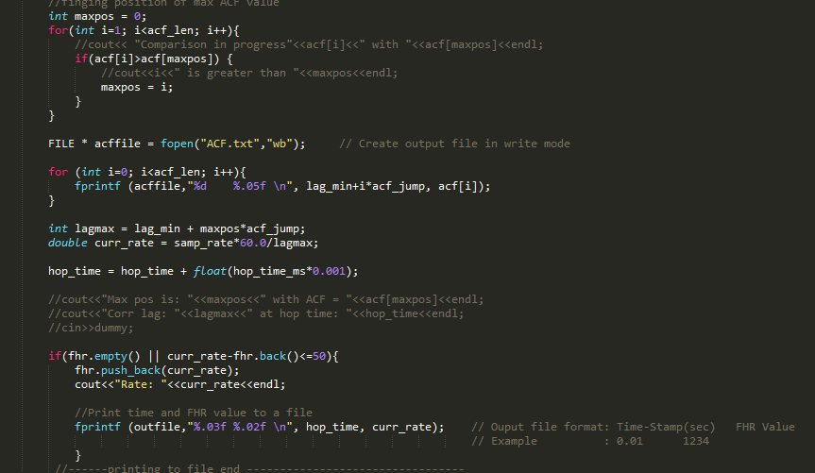
Interval determination

Slide 15
Interval determination
Lag at which peak ACF value occurs is found.
FHR (in bpm)= 60*samp_rate/lag – the sample rate here is 4.41kHz (due to downsampling)
FHR value is ignored if present value differs by more than 50bpm from the last determined FHR value

Slide 16
Interval determination
ACF peak occurs at a lag of around 1890 samples. This corresponds to an FHR of about 140 bpm.

Slide 17
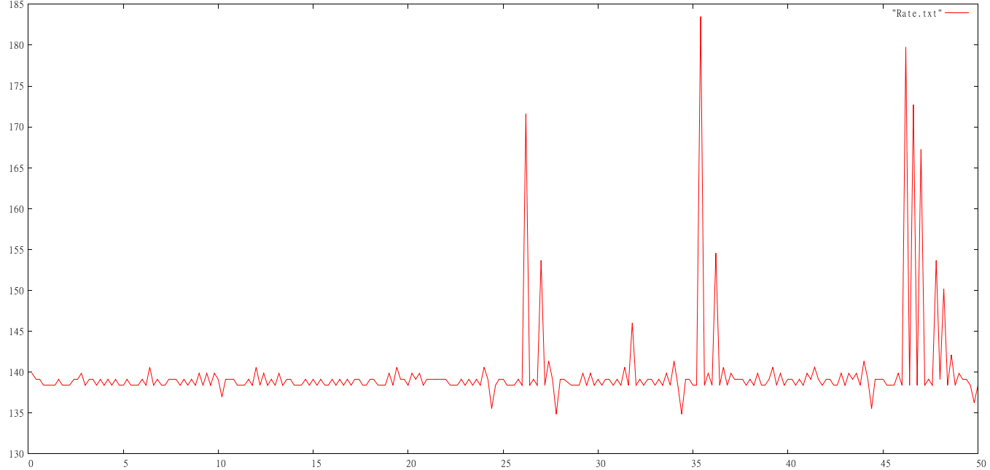
Interval determination
This trace does not match the wanted result exactly, especially the spikes towards the end.

Slide 18
Debugging
The ACF calculation should only occur between lag_min and lag_max – it is highly likely that there are bigger ACF peaks at smaller lags
The calculated FHR for NST_Normal.wav should mainly lie between 130bpm and 160bpm

Slide 19
Debugging
A simple check for whether the file/audio is being read correctly could be simply plot the data of all the frames and see if it matches how the waveform is supposed to look like (in any audio waveform visualizer, say Praat or Audacity)
The ACF can be checked at each hop to see if the peak is not occurring at either lag_min or lag_max – this is likely to be erronous for clear audio

Slide 20
Thank you!

