Slide 1

ALY 6015: Intermediate Analytics
Final Project Presentation
Attrition Problem of a Company
Team Members:
Shreyansh Bhalodiya (NUID:002664707)
Clyde Antonio Dias Do Rosario (NUID:002686677)
Raja Raghu Ram Pydi (NUID:002637033)
Surpreet Kaur Mann (NUID:002660066)

Slide 2
Business Objective
Factors Affecting Attrition
Machine Learning model to Predict Attrition Rate
ML model to Predict monthly income

Slide 3
Summary of Data
Dataset Structure: 1470 observations (rows), 20 features (variables)
Missing Data: Luckily for us, there is no missing data! this will make it easier to work with the dataset.
Data Type: We only have two data types in this dataset: factors and integers
Label/Output: Attrition is the label in our dataset and we would like to find out why employees are leaving the organization!
Imbalanced dataset: 1237 (84% of cases) employees did not leave the organization while 237 (16% of cases) did leave the organization making our dataset to be considered imbalanced since more people stay in the organization than they actually leave.
Variable:
Age, Business Travel, Department, Education field, Environment Satisfaction, Gender, Job involvement, Job level, Job satisfaction, Marital Status, Monthly Income, Over time, Total working Hours, Work life-balance, Years at company, Years in current role, Years since last promotion, Years with current manager, Distance from home.

Slide 4
Avg. Monthly Income
Years with company
Marital Status
Distance from Home
Years with current manager
Analysis Chart

Slide 5
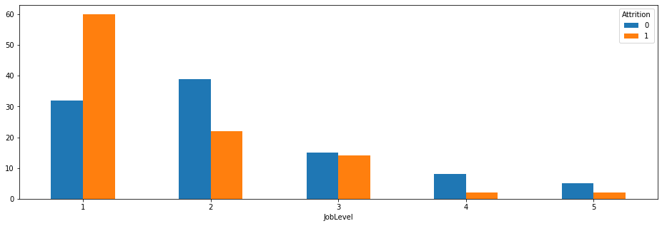
JOB LEVEL
Row Labels | Average of Years At Company | Average of Monthly | Average of Distance | Average of Years Since Last Promotion | Average of Total Working | Average of Years With Company | Average of Work Life
0 | 4.24 | 2854 | 8.33 | 1.21 | 6.26 | 2.69 | 2.73
1 | 3.08 | 2598 | 9.48 | 1.15 | 4.85 | 1.89 | 2.67

Slide 6
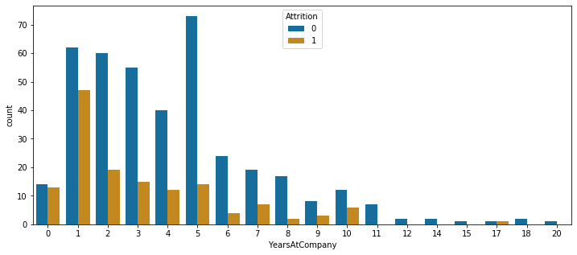
JOB LEVEL 1 AND YEARS WITH COMPANY

Slide 7
Marital Status and Job Level of past employees
majority of single left company more than anyone else
majority of single were working at level 1
75% of singles were below 35 years and their total working years avg. is 6 so may be for better opportunity they left company.
75% of singles monthly income is below 5331 so we can say that majority of singles may left company because of monthly income and also their total working years avg. is 6 so for better income or opportunity they may have left

Slide 8
Years Working with Manager
30% Attrition in Dept > Job level 1> less than 2 year with manager
Out of 237 employees who left the company 133 were from R& D department and 92 from sales department
Out of 133 from R&D, 101 left at the initial Job level 1.
Out of 101, 70 has left in first 2 years of working under manager.
Department|JobLevel|YatCM | Average of YearsWithCurrManager
 | Attrition 0 | Attrition 1
Human Resources|1|0-2 | 1.36 | 0.6
Research & Development|1|0-2 | 1.23 | 0.7
Sales|1|0-2 | 1.25 | 0.8

Slide 9
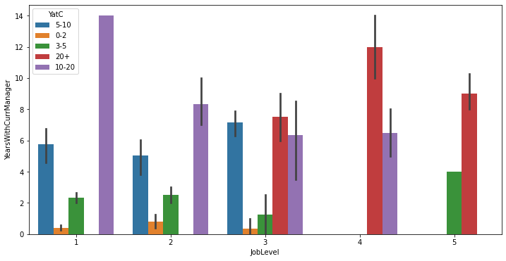
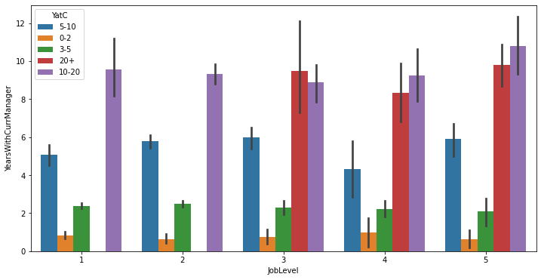
Job Level , Year with Manager and Years at Company
Employee with Attrition 1
Employee with Attrition 0

Slide 10
Analysis Flow Chart
Age Group
Male
Female
Single
Married
Divorce
Single
Married
Divorce
Monthly Income
Monthly Income
Monthly Income
Monthly Income
Monthly Income
Monthly Income
Distance From Home
Distance From Home
Distance From Home
Distance From Home
Distance From Home
Distance From Home

Slide 11
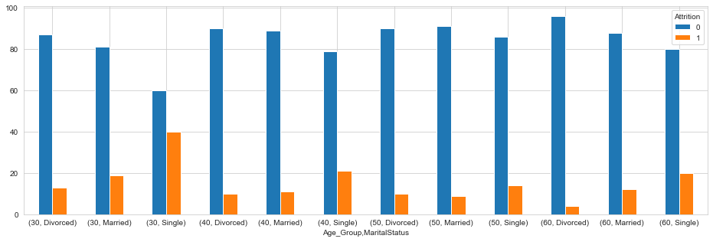
Age Vs Gender Vs Marital Status
Analysis of Attrition on Age group and gender:
Attrition is evenly spread between Gender without in major difference.
But Monthly Salary is one of the major factors affecting attrition in The Age Group below 30 and 30 to 40.
In age group below 30, there is around 26% of salary gap between the employee who has left the company and who still in company.
Since Attrition is evenly distributed, we cannot inferred attrition on the basis of Gender, we need further dive in the data.
Attrition analysis on the basis of Marital Status in different age group in Male and Female: From the above table we can clearly see the Attrition is High for Singles in Age group below 30 (40%) and 30 to 40(21%). Singles are likely to leave company in their early level of Job.

Slide 12
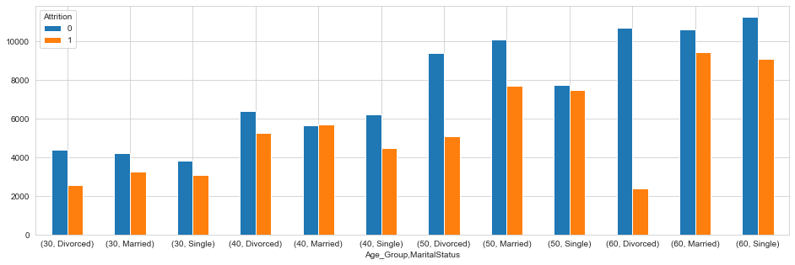
Monthly Income
Conclusion: From the above table we can say that Monthly Income is likely to be the reason for the high attrition in the Age group below 30 and 30 to 40 for singles.

Slide 13
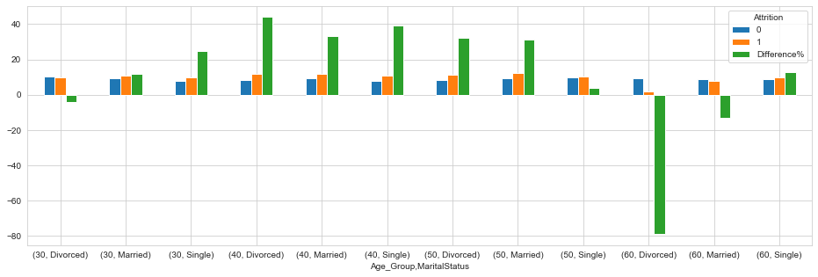
Distance From Home
Conclusion: From the above table and graph we can se that Distance from home is affecting the attrition in all the age group, majorly in below 30 and 30 to 40 Single Male.

Slide 14
JOB LEVEL 1
Year Under Current Manager/ Years at Company
VARIABLES AFFECTING ATTRITION
Maritial Status
MONTHLY INCOME
Environment Satisfaction

Slide 15
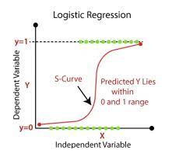
Logistic Regression
Data Split 70% train & 30% test.
Target : Attrition
Predictors : Major Variables affecting Attrition
model_1 <- glm(Attrition~., data=data, family = binomial(link = 'logit'))

Slide 16

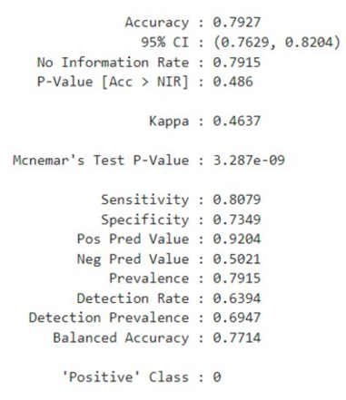
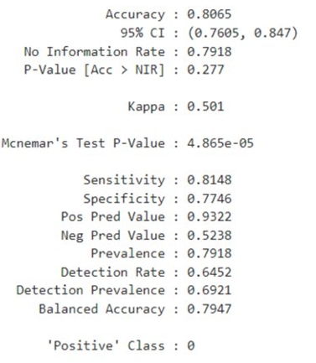
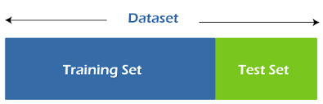
RESULTS
TEST
TRAIN
Prediction / Actual → | 0 | 1
0 | 509 | 44
1 | 121 | 122
Prediction / Actual → | 0 | 1
0 | 220 | 16
1 | 50 | 55

Slide 17
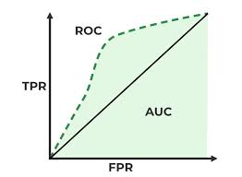
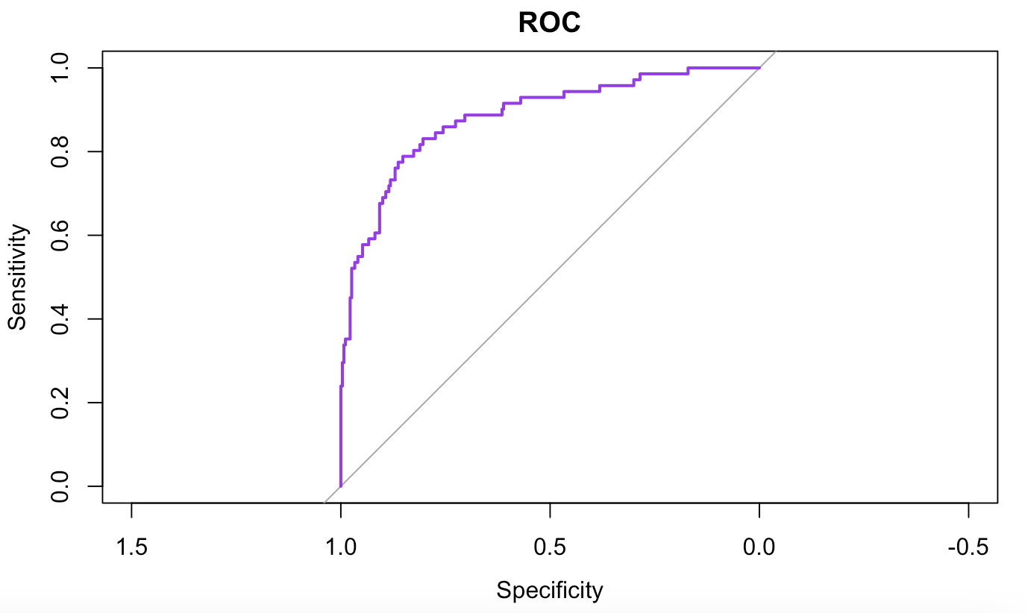
ROC and AUC:
ROC= 0.86 which indicates the performance of a binary classification model in discriminating between the two classes.
The ROC curve depicts model's performance.
It is created by plotting the true positive rate (TPR) against the false positive rate (FPR) at various classification thresholds.
The AUC = Area under the ROC curve. Scalar value that summarizes the model's performance.
The AUC ranges from 0 to 1, where a value= 0.5 suggests the model performs no better than random guessing, and a value = 1 indicates a perfect classifier.

Slide 18
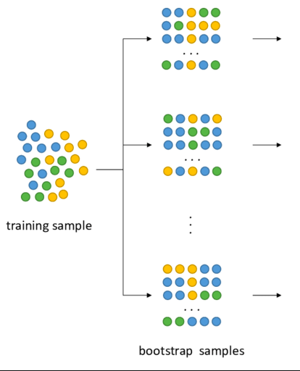
XG Boost Model Thresholding and Accuracy
Introduction:
XG Boost model achieved 71% accuracy on the testing set.
Thresholding was applied to the model's output probabilities.
Threshold value initially set at 0.5 for classification.
Setting a higher threshold yielded better accuracy but increased false positives.
Trade-off: Accuracy vs. False Positives:
Higher Threshold (0.5 or more):
Results in better accuracy.
However, increases the number of false positives.
False positives are incorrect positive predictions, which may lead to misclassifications.

Slide 19
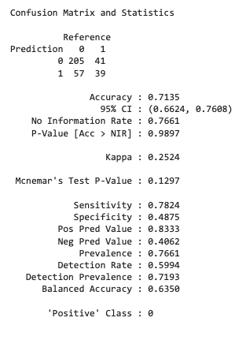
XG Boost Model Finding the Optimal Threshold
Motivation for Decreasing the Threshold:
High false positives were undesirable in the model's context.
Focus on increasing true positives (correct positive predictions).
Impact on Accuracy:
Decreasing the threshold to 0.3:
Increased the number of true positives.
Improved detection of positive instances.
Led to a decrease in accuracy due to more false negatives (incorrect negative predictions).
Conclusion and Next Steps:
A lower threshold improves true positive rates but may increase false negatives and reduce overall accuracy.
Future work may involve finding an optimal threshold that balances the trade-off between accuracy and minimizing false positives/negatives.

Slide 20
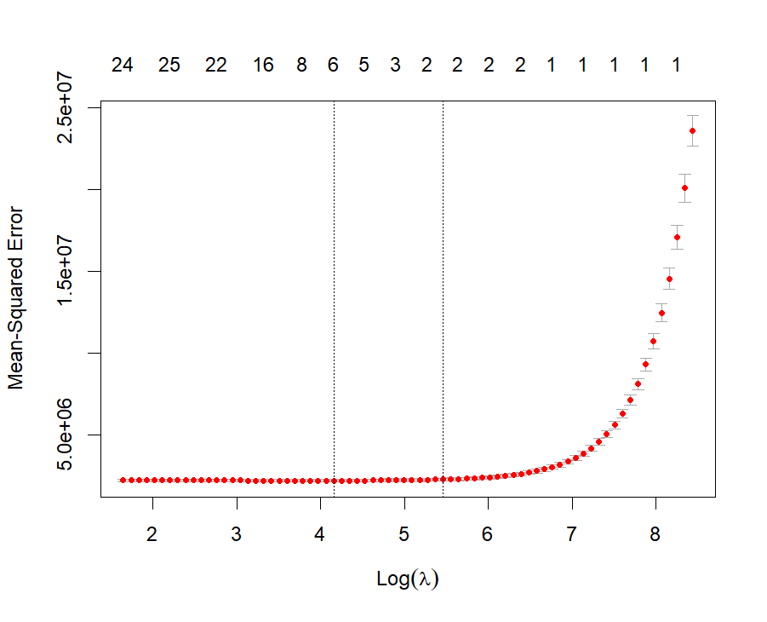
Cross-Validation For Lambda Values
LASSO Regression Model To Predict Monthly Income
Log(Lambda Min) 4.159
Lambda Min 64.037
Log(Lambda 1se) 5.461
Lambda 1se 235.554

Slide 21
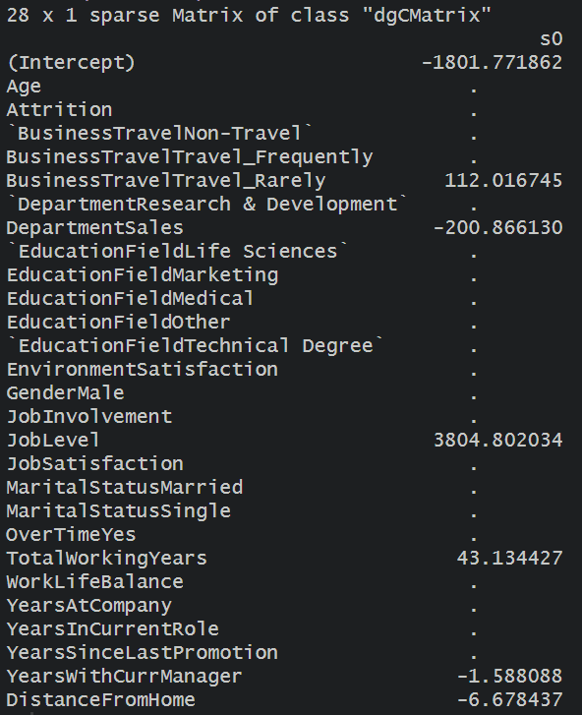
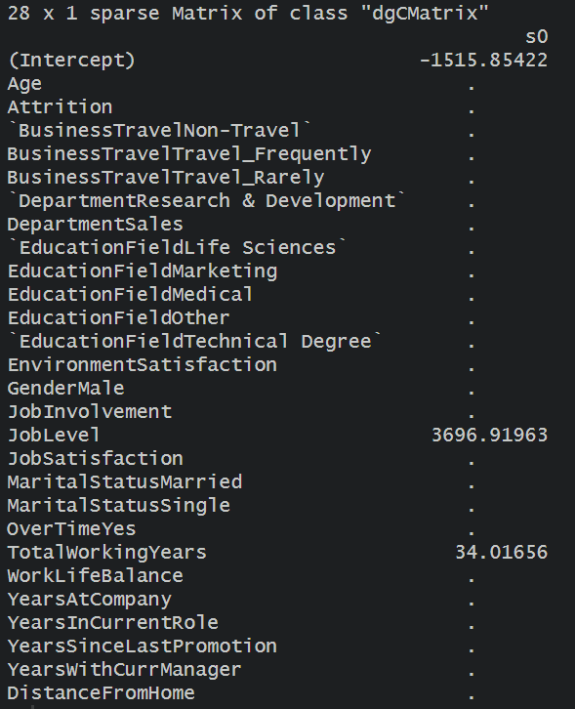
Coefficients For Lambda min and 1se
Model 1
Model 2
Minimum lambda value eliminated 18 variables
1se lambda value further simplified the model by eliminating a total of 22 variables
Job level and Total Working Years

Slide 22


Model Performance
Train Set
Test RMSE < Train RMSE
Model does not overfit the train data
Model generalizes well to unseen data
High R square values for both train and test set
Test Set

Slide 23

Thank You

