Slide 1


RESTAURANTS INSPECTION SCORE ANCHORAGE ALASKA
ALY6010
CAPSTONE FINAL PROJECT REPORT
Name: Shreyansh Bhalodiya
NUID : 002664707
Instructor name: Mohsen Soltanifar, PhD, AStat Faculty Lecturer

Slide 2


Slide 3
DATASET
Restaurants Inspection
Anchorage, Alaska
Data shape 27178 X 6
Main columns Business name, inspection score , year, locations
Dataset has the following columns and subjects of the column and its datatype.
● X - Index (Integer)
● Business name - Name of restaurant or name of chain (Character)
● inspection score - Score at the time of inspection (Integer)
● Year - Year of inspections (Integer)
● Number of locations - number of restaurants for each chain. (Integer)
● Weekends - inspected on weekends or weekdays. False - Weekdays
True - Weekend (Logical)
Source of dataset.
https://vincentarelbundock.github.io/Rdatasets/articles/data.html
https://www.kaggle.com/datasets/loulouashley/inspection-score-restaurant-inspection?select=restaurant-and-food-inspections-1.csv
Data Dictionary:
https://vincentarelbundock.github.io/Rdatasets/doc/causaldata/restaurant_inspections.html

Slide 4
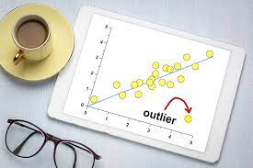

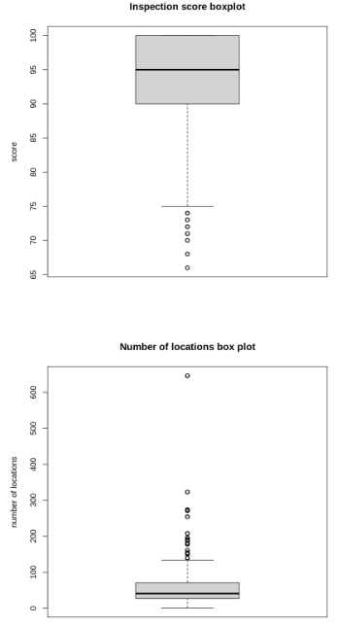
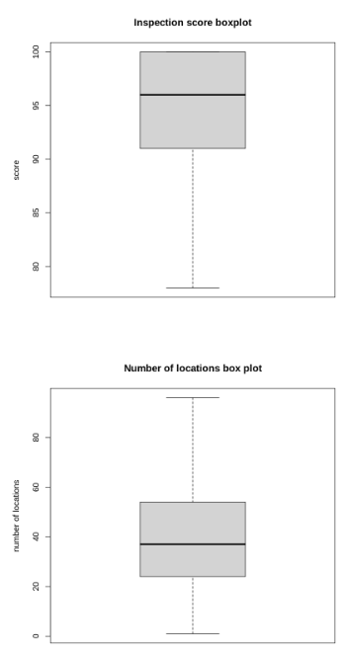

DATA CLEANING / OUTLIER ANALYSIS
BEFORE OUTLIERS
CLEANED DATA FROM OUTLIER
Null value analysis - Data has zero null values hence we can move to the next step for data cleaning
Outlier Analysis- Here we have two main columns which are integer hence let’s check the outlier analysis for those columns using box plot and then using R code let’s drop outlier if any and then again plot the box plot. Left Box Plot before dropping outlier and Right after dropping outlier. we have cleaned our data please check R file for coding part of outlier analysis.

Slide 5
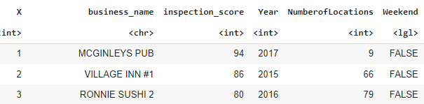
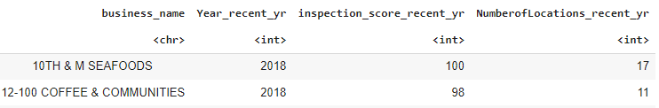

Questions & Answers For EDA
I would like to see the number of locations for each restaurant over 20 years.
I will find difference between inspection score at the start of each restaurants and recent years how the trend has changed.
I will also find the age of each restaurant in the span of 20 years.
Step1: Main Data frame
Step2: Sorting data points for the most recents year for each of the restaurants using library(dplyr)
Step3 :Similarly Sorting data points for the starting year for each of the restaurants

Slide 6


EDA OUTPUT
No New Location
Inspection score max difference is 23
Inspection score average is < 1
Inspection scores have been maintained
Age of restaurants.

Slide 7
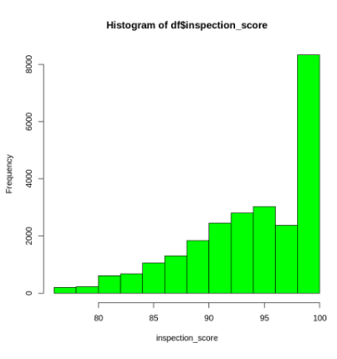
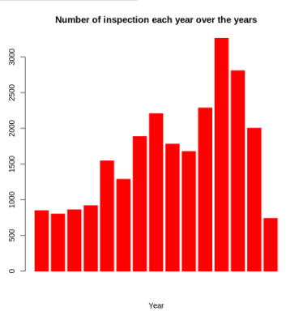
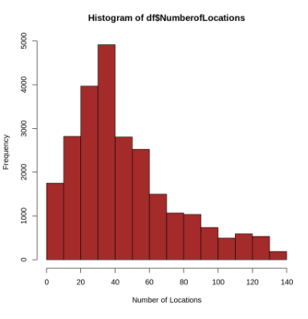
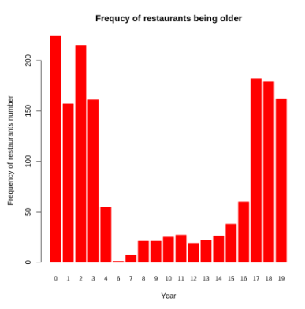
Data Visualization

Slide 8

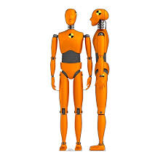
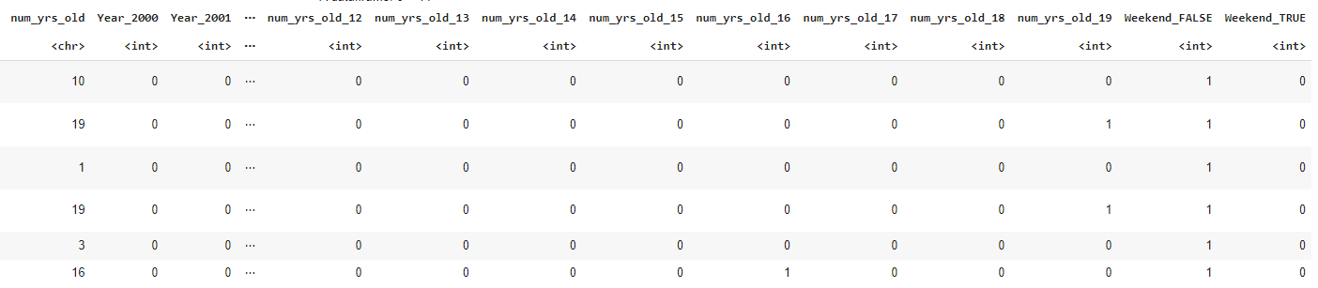
Creating Dummies for Regression lines.
install.packages("fastDummies")
library('fastDummies')
https://www.marsja.se/create-dummy-variables-in-r/

Slide 9
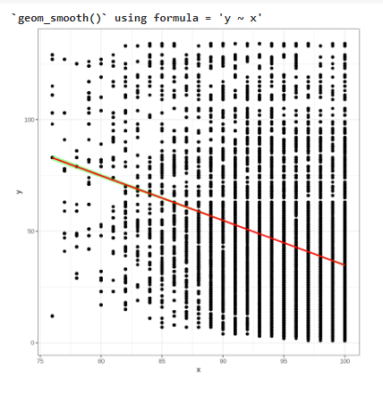
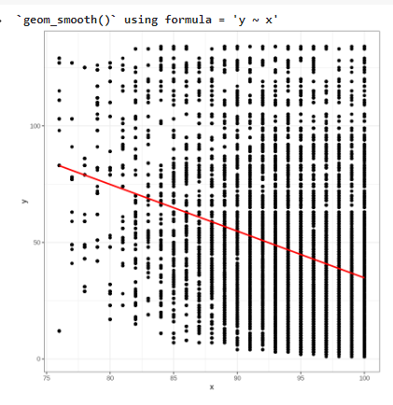
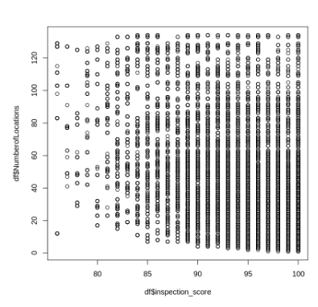
Plt ➔ plt2 ➔ plt3➔

Slide 10
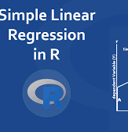
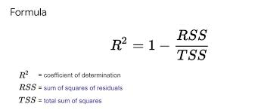
Linear Regression Modelling-Model 1 & Model 2
Overall, we tried two linear regression models with two different sets of variables. In model 1 even after using all the major variables r value is just 0.27 which is a low score. Similarly for model 2 we tried to predict inspection score using two variables. We don’t find any major trends in data as major variables which are used in calculating the inspection score are missing. Also, data is narrow for fitting any model as it is limited to few variables.
Particular | Model 1 | Model 2
R- Square | 0.2768 | 0.2409
Adjusted R-square | 0.2758 | 0.2409

Slide 11

Thanks you
References
Available datasets. (n.d.). https://vincentarelbundock.github.io/Rdatasets/articles/data.html
R: Data on Restaurant Inspections. (n.d.). https://vincentarelbundock.github.io/Rdatasets/doc/causaldata/restaurant_inspections.html
Johnson, D. (2023, March 25). T-Test in R Programming: One Sample & Paired T-Test [Example]. Guru99. https://www.guru99.com/r-t-test-one-sample.html
Unpaired Two-Samples T-test in R - Easy Guides - Wiki - STHDA. (n.d.). http://www.sthda.com/english/wiki/unpaired-two-samples-t-test-in-r
Marsja, E. (2021, April 15). How to Create Dummy Variables in R (with Examples). Erik Marsja. https://www.marsja.se/create-dummy-variables-in-r/

